Slide 1
Thapar Research & Mentorship Portal
Bridging the Gap Between Faculty & Students
Empowering Innovation through Seamless Collaboration

Slide 2
Introduction: The Need for Innovation
Thapar Institute thrives on cutting-edge research.
However, connecting the right students with the right faculty can be challenging.
We need a system that matches academic rigor with technological efficiency.
The Research Portal is designed to be that bridge.

Slide 3
The Current Problem: Fragmented Systems
Faculty receive hundreds of unorganized emails.
Students struggle to find relevant active projects.
No centralized repository of ongoing research.
Time wasted on logistics instead of actual research.

Slide 4
The Proposed Solution: A Centralized Hub
A single unified platform for all research activities.
Streamlined discovery of projects and mentorships.
Automated tracking of applications and statuses.
Designed specifically for Thapar's ecosystem.

Slide 5
Key Objectives of the Portal
Increase student participation in high-impact research.
Reduce administrative overhead for faculty and PIs.
Provide transparent metrics on research engagement.
Foster a culture of interdisciplinary collaboration.

Slide 6
Novelty 1: Unified Ecosystem
No more scattered Google Forms or Excel sheets.
Everything from project ideation to final selection happens in one place.
A clean, modern interface that users actually want to use.

Slide 7
Novelty 2: Automated Mentorship Alignment
The system doesn't just list projects; it aligns them.
Faculty can set strict prerequisite skills for projects.
Only eligible students can apply, ensuring high-quality candidates.

Slide 8
Novelty 3: Data-Driven Matching
Leveraging student profiles (CGPA, Tech Stack, Previous Projects).
Providing faculty with instant analytics on an applicant's suitability.
Smart tagging system for rapid sorting and filtering.

Slide 9
Methodology: Phase 1 - Data Aggregation
Consolidate existing faculty profiles and research domains.
Migrate legacy project data into a modern, structured format.
Ensure data integrity and consistency across departments.

Slide 10
Methodology: Phase 2 - Secure Access
Implement robust authentication for both students and faculty.
Role-based access control (RBAC) to protect sensitive data.
Seamless integration with institutional credentials.

Slide 11
Methodology: Phase 3 - Application Workflow
1. Faculty posts a project with required skills.
2. Students browse, filter, and apply.
3. Faculty reviews applications via a specialized dashboard.
4. One-click accept/reject with automated notifications.

Slide 12
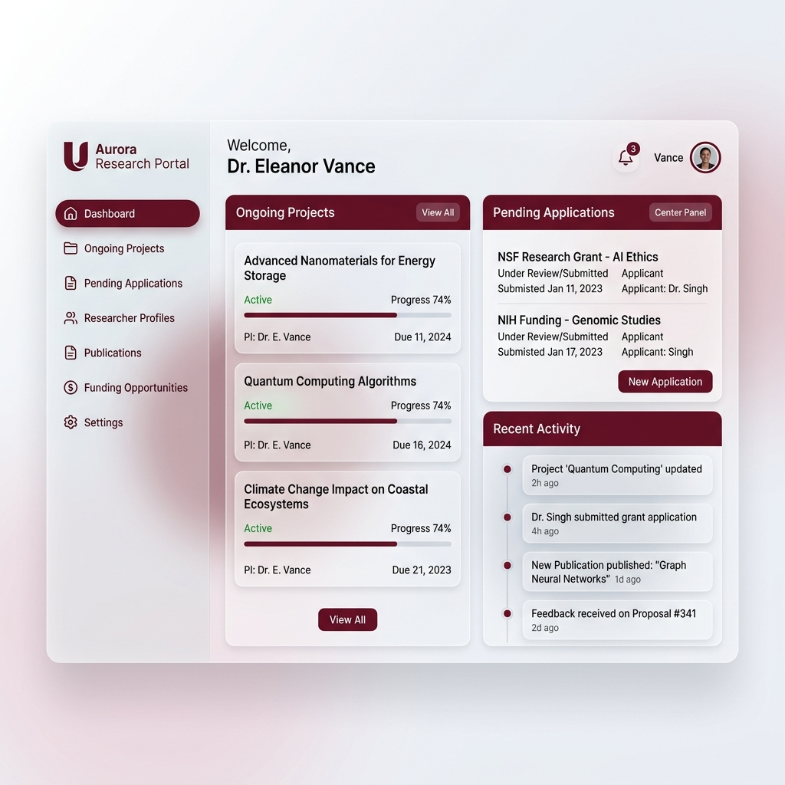
Portal Solution: Faculty Dashboard
A clean, centralized view of ongoing projects, pending applications, and recent activity.

Slide 13
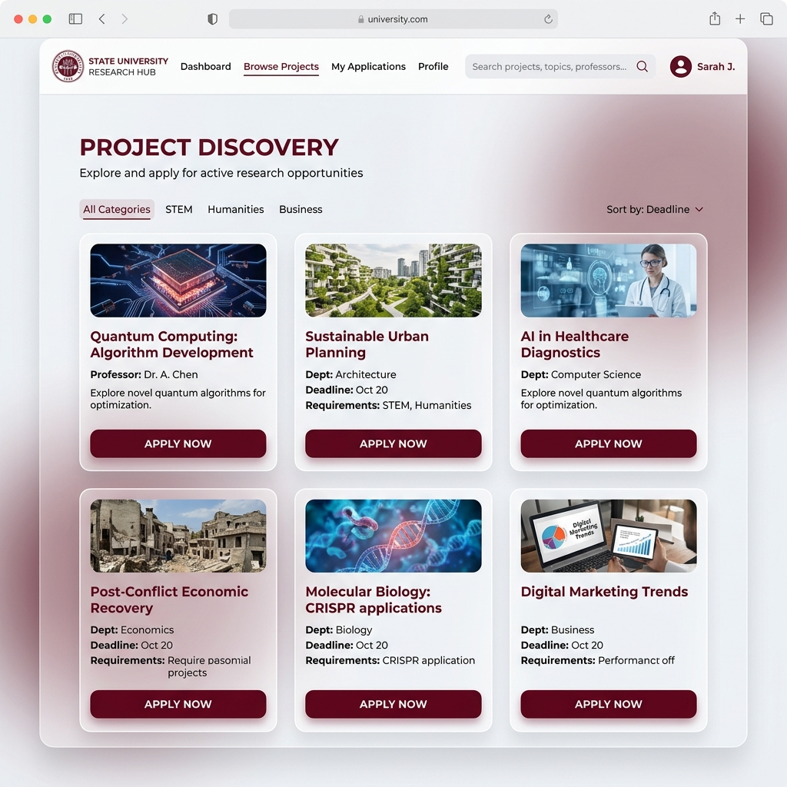
Portal Solution: Project Discovery
Students can easily browse, filter, and apply to research projects matching their interests.

Slide 14
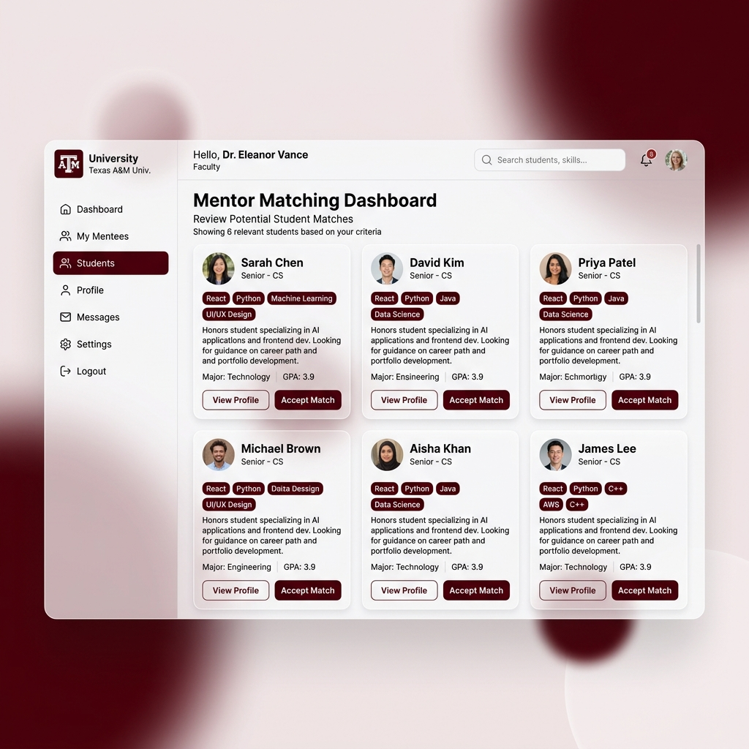
Portal Solution: Mentor Matching
Faculty can review student profiles, complete with skill tags and GPAs, for rapid decision-making.

Slide 15
Tech Stack: Overview
Built for speed, scale, and maintainability.
Frontend: Next.js (React) & Tailwind CSS.
Backend: Cloudflare Workers (Edge Computing).
Database: Cloudflare D1 (Serverless SQL).
Language: TypeScript.

Slide 16
Tech Stack: Deep Dive
Next.js provides server-side rendering for instant load times.
Tailwind CSS ensures a responsive, Thapar-branded aesthetic.
Cloudflare D1 provides a globally distributed, low-latency database.
TypeScript prevents runtime errors, ensuring a stable platform.

Slide 17
Easing Faculty Stress
No More Inbox Clutter: Move away from hundreds of emails.
Pre-Screened Candidates: Only qualified students get through.
Automated Responses: Bulk accept/reject with one click.
Focus on Research, Not Admin: Let the platform handle logistics.

Slide 18
Future Steps: Advanced Student Filter
Allow faculty to set complex boolean filters (e.g., Python AND Machine Learning).
Automated ranking of students based on project relevance.
Integration with past academic performance metrics.

Slide 19
Future Steps: Dedicated Mentor Service
Expand beyond project-based matching.
Allow students to request 1-on-1 career or academic mentorship.
Bring alumni onboard as external mentors.
Algorithmic matchmaking based on long-term career goals.

Slide 20
Thank You
Empowering Thapar's Research Community
Ready for Questions

