Slide 1

RAMP: Research And Mentorship Portal
A College Project
Bridging the Gap Between Faculty & Students
Empowering Innovation through Seamless Collaboration

Slide 2
Agenda & Index
1. Introduction: The Need for Innovation
2. The Current Problem: Fragmented Systems
3. The Proposed Solution: A Centralized Hub
4. Key Objectives & Target Outcomes
5. Novelty: Unified Ecosystem & Automated Alignment
6. Methodology: Phased Implementation Strategy
7. Real Portal Showcases (Dashboard, Discovery, Matching)
8. Tech Stack Architecture (Diagram & Details)
9. Value Proposition: Easing Faculty Stress
10. Future Horizons: Advanced Filtering & Mentor Services
11. Conclusion & Open Q&A

Slide 3
Introduction: The Need for Innovation
Context: Thapar Institute of Engineering & Technology has a vibrant research culture.
Challenge: Despite high enthusiasm, connecting the right students with the right faculty can be daunting.
Goal: We require a system that matches academic rigor with technological efficiency to streamline workflows.
Vision: RAMP (Research And Mentorship Portal) is designed to act as a definitive bridge, turning potential collaboration into tangible outputs.

Slide 4
The Current Problem: Fragmented Systems
Information Silos: Faculty are forced to rely on hundreds of unorganized, scattered emails for applications.
Visibility Issues: Students struggle to discover relevant, active projects because they aren't listed centrally.
Inefficient Processes: Time is heavily wasted on logistics—coordinating meetings, tracking status, filtering resumes.
Lack of Analytics: No centralized repository exists to track ongoing research metrics and student involvement across departments.

Slide 5
The Proposed Solution: A Centralized Hub
Unified Ecosystem: A single, integrated web platform covering all research activities at the institute.
End-to-End Tracking: From initial project ideation to final student selection, every step is automated and tracked.
Customized Workflows: Designed specifically for Thapar's unique academic environment, respecting existing hierarchies and procedures.
Data Accessibility: Provides intuitive dashboards tailored separately for faculty, students, and administrators.

Slide 6
Key Objectives of the Portal
Maximize Engagement: Increase overall student participation in high-impact, meaningful research.
Minimize Administrative Overhead: Drastically reduce the time faculty and PIs spend on managing applications.
Enhance Transparency: Provide clear, real-time metrics on research engagement and application statuses.
Promote Interdisciplinary Work: Foster a campus culture where cross-departmental collaboration is visible and accessible.

Slide 7
Novelty: Unified & Automated Ecosystem
Elimination of Legacy Tools: Replaces scattered Google Forms, WhatsApp messages, and Excel sheets with a cohesive UI.
Automated Mentorship Alignment: The system actively prevents 'spray-and-pray' applications.
Prerequisite Enforcement: Faculty can set strict, verifiable skills for projects (e.g., must know React and Next.js).
Quality Assurance: Only students who meet the rigorous criteria are allowed to submit a formal application.

Slide 8
Novelty: Data-Driven Matching
Comprehensive Profiles: Leverages detailed student profiles including CGPA, specific Tech Stacks, and Portfolio links.
Instant Analytics: Provides faculty with immediate, visual analytics indicating an applicant's exact suitability score.
Smart Tagging: Utilizes a robust tagging architecture for rapid sorting, categorization, and retrieval of research domains.

Slide 9
Methodology: Phase 1 - Data Aggregation
Consolidation: Gather and consolidate existing faculty profiles, research papers, and domains into a unified database.
Data Migration: Safely migrate any legacy project data into our modern, structured, schema-validated formats.
Normalization: Ensure strict data integrity, consistency, and typing across all departments using TypeScript and Zod.
Indexing: Prepare the database for high-speed searches and complex queries for the frontend.

Slide 10
Methodology: Phase 2 - Secure Access & Profiles
Robust Authentication: Implement enterprise-grade, secure authentication flows for both students and faculty.
RBAC Implementation: Strict Role-Based Access Control to ensure sensitive data (like proposals) is protected.
Profile Customization: Enable dynamic user profiles where users can showcase their achievements securely.
Edge Delivery: Utilize Cloudflare's edge network to serve authenticated sessions with ultra-low latency.

Slide 11
Methodology: Phase 3 - Application Workflow
1. Project Posting: Faculty post a detailed project description along with mandatory skill requirements.
2. Discovery & Filtering: Students browse the central repository, filter by their tech stack, and apply.
3. Centralized Review: Faculty receive applications directly in their specialized dashboard, circumventing email.
4. Resolution: Faculty perform a one-click accept/reject action, triggering automated, polite notification emails.

Slide 12
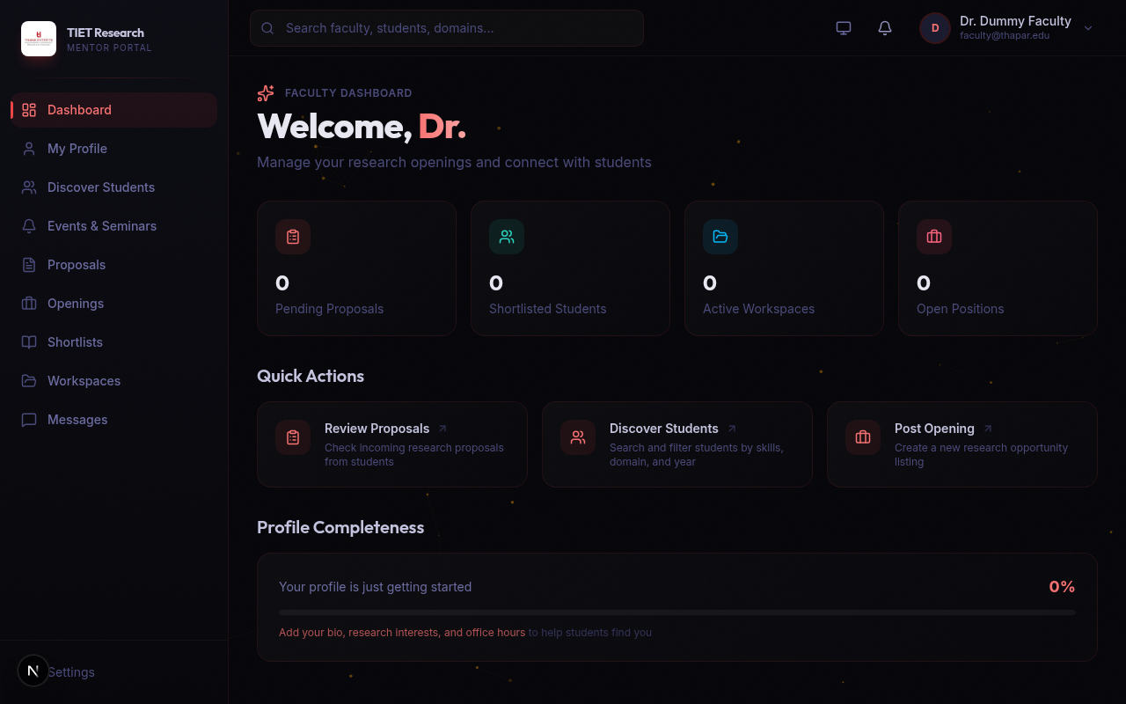
Portal Showcase: Faculty Dashboard
Real Portal Screenshot: A clean, centralized view demonstrating ongoing projects and pending applications for faculty.

Slide 13

Portal Showcase: Project Discovery (Student View)
Real Portal Screenshot: The student interface allowing intuitive browsing and instant applications to relevant opportunities.

Slide 14
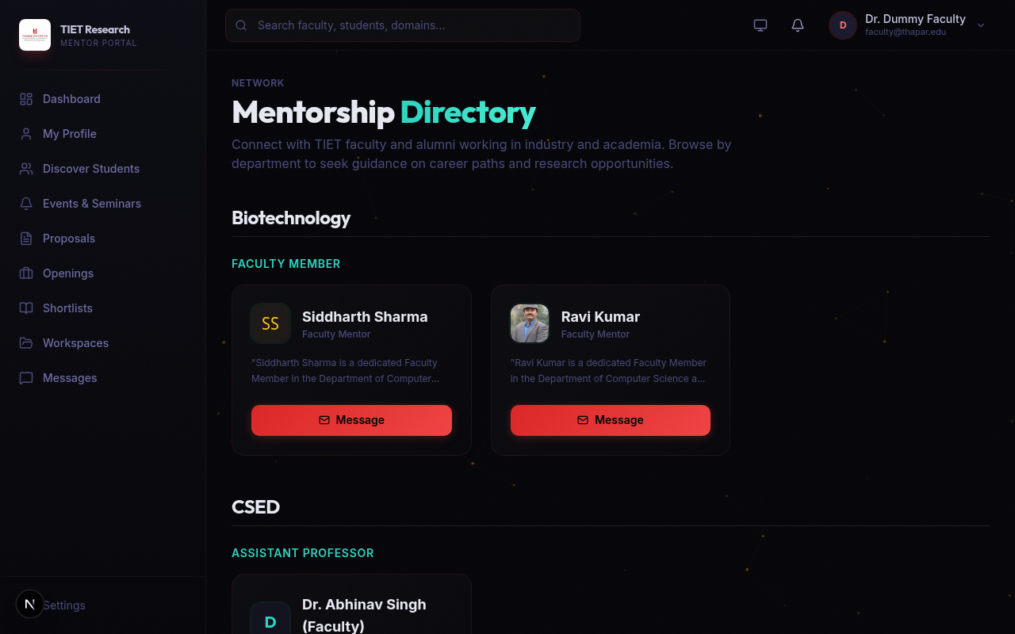
Portal Showcase: Mentor Matching
Real Portal Screenshot: The faculty interface for reviewing applicants, displaying profiles, and making matching decisions.

Slide 15
Tech Stack Architecture: System Flow Diagram
Next.js
API Routes
Next.js Frontend
(Students & Faculty)
Turso DB
(LibSQL Database)
System Architecture: Secure, Global Edge Delivery with Serverless SQL.

Slide 16
Tech Stack Architecture: Core Technologies
Philosophy: Built entirely for blistering speed, massive scale, and long-term maintainability.
Frontend Framework: Next.js (React) utilizing the App Router for optimal Server-Side Rendering (SSR).
Styling Engine: Tailwind CSS, providing a responsive, cohesive, and Thapar-branded visual aesthetic.
Backend & API: Next.js API Routes, providing robust backend integration natively.
Database: Turso DB (LibSQL), offering an edge-ready, ultra-fast SQLite distributed database.
Language: Strict TypeScript, ensuring end-to-end type safety and drastically fewer runtime errors.

Slide 17
Easing Faculty Stress: Automating the Mundane
No More Inbox Clutter: Fully transition away from hundreds of disorganized emails to a structured dashboard.
Pre-Screened Quality: The system physically blocks unqualified candidates from applying, saving immense review time.
Automated Responses: With bulk accept/reject capabilities, faculty no longer need to draft individual rejection emails.
Focus on Core Work: By letting the platform handle the logistical heavy lifting, faculty can dedicate their time to actual research.

Slide 18
Future Steps: Advanced Student Filtering
Complex Logic: Allow faculty to set complex boolean filters (e.g., must know 'Python' AND 'Machine Learning', but NOT 'Java').
Automated Ranking: The portal will automatically rank incoming students based on how closely their profiles match the project.
Academic Integration: Direct integration with institutional records to automatically verify CGPAs and course completions.
Portfolio Parsing: AI-driven analysis of a student's GitHub or past projects to determine authentic competency.

Slide 19
Future Steps: Dedicated Mentor Service
Beyond Projects: Expand the portal's scope beyond strict project-based matching to general mentorship.
1-on-1 Guidance: Allow students to formally request 1-on-1 career, academic, or domain-specific mentorship from faculty.
Alumni Network: Bring esteemed alumni onboard as external mentors to guide current students entering the industry.
Algorithmic Pairing: Implement machine-learning matchmaking to pair students with mentors based on long-term career goals.

Slide 20
Thank You
Empowering Thapar's Research Community
Ready for Questions and Feedback

