Slide 1

SAMSUNG PRISM
Generative AI
Hackathon
3rd Edition 2026 – 27
Theme ID - Theme 4 (Streaming Live RAG)
Team Name - 4 Bottle Codeka
College Name - Thapar Institute of Engineering & Technology, Patiala
Member 1 (Lead) - Abhinav Kumar Singh | asingh2910.official@gmail.com | 6398779479
Member 2 - Sukhansh Mittal | smittal1_be24@thapar.edu | 9877366331
Member 3 - Lakkshya Jha | ljha_be24@thapar.edu | 9574875069
Member 4 - Vikramaditya Singh | vsingh1_be24@thapar.edu | 6239134155
Submission GitHub - https://github.com/abhinav29102005/ultron
Live Website - https://ultron.abhinavkumarsingh.tech/
Notes:
Pitch: Ultron starts retrieval while the user is still speaking (Theme 4, Streaming Live RAG). Say up front that the demo drives the pipeline with simulated ASR text chunks; live ASR is Phase 1 of the roadmap.

Slide 2
Problem Statement & Motivation
The Live Conversational RAG Problem
Ultron’s Paradigm: Event-Driven Live RAG
Turn-complete bottleneck: RAG waits for the full sentence, adding 1,500–2,500ms TTFT and breaking voice pacing.
Mid-utterance corrections: “Pune… wait, make that Mumbai” – engines commit to the stale entity.
Context discontinuity: Follow-ups like “for 50 people there?” drift without coreference resolution.
Audit failure & hallucination: Document-level tags fail audits; out-of-corpus queries get invented answers.
Speculative early trigger: Hybrid retrieval fires at token 6–8: +1,300ms head start (demo).
Intra-stream pivot: Diff tracking cancels stale in-flight searches on “wait / actually”.
Session lineage: Coreference + version tracking (V1 → V2) across turns.
Gate 0 suppression: Pure formatting turns run 0 vector searches (40% saved in one demo session).
Verifiable grounding: Exact chunk-level citations, e.g. [Doc_12 §2].
Traditional vs Ultron RAG (demo: simulated ASR chunks)
Traditional
User speaks (wait for end of speech)
ASR transcribe
Vector search (blocks!)
LLM generation
Ultron
User speaks (token 6–8)
Speculative trigger
Parallel multi-intent search
Low-latency stream
Samsung PRISM GenAI Hackathon 2026–27 | Team 4 Bottle Codeka | Theme 4: Streaming Live RAG
2
Notes:
Turn-based RAG waits for the full sentence. Be ready to source the 1,500–2,500ms range or call it indicative. Our numbers (16ms TTFT, +1,300ms head start, 40% compute saved) come from one demo session of 31 chunks on simulated ASR text. TTFT is measured from the speculative trigger, so it is not like-for-like with a whole-turn wait.

Slide 3
Existing Solutions & Critical Industry Gaps
1. Existing Approaches
2. Critical Industry Gaps
3. Ultron’s Breakthrough
Turn-based RAG: LangChain & LlamaIndex wait for sentence boundaries; ~1.8s turn wait (indicative, not our benchmark).
Naive token streaming: Only LLM output streams; retrieval stays synchronous.
Static keyword search: Lexical only; fails on coreference and anaphora.
Rigid chunking: Fixed 512-token splits break semantic boundaries.
Gap 1 – No pre-retrieval: 1,400ms+ of dead air while the user speaks.
Gap 2 – In-flight blindness: Stale searches can’t be aborted on self-correction.
Gap 3 – Compute waste: Searches run on reformat turns.
Gap 4 – Citation blindness: Document-level references fail audits.
Gap 5 – Context drift: Long sessions lose constraints.
Sub-50ms TTFT: 16.0ms measured after trigger (demo harness); +1,300ms head start.
Dynamic pivot engine: Stale cache invalidated instantly.
Gate 0 suppression: 0 queries on formatting turns.
Granular grounding: Exact clause citations, e.g. [Doc_12 §2].
Session lineage: Constraints tracked across turns (7-turn demo).
Ultron in action: Mid-Stream Pivot Flow
Token 6–8 reached
Speculative search fires
Pivot keyword detected
Abort stale query
Re-dispatch
Partial utterance: “…in Pune”
Pune policy chunks pre-fetched
“wait”, “actually”, “make that”
In-flight Pune search cancelled; cache invalidated
Mumbai search issued; intent updated (V2)
Samsung PRISM GenAI Hackathon 2026–27 | Team 4 Bottle Codeka | Theme 4: Streaming Live RAG
3
Notes:
The ~1.8s figure is an indicative turn-based wait, not a benchmark we ran. Walk the pivot flow left to right: Pune, 'wait', abort, Mumbai (V2). Session lineage is demonstrated over 7 turns; don't claim more.

Slide 4
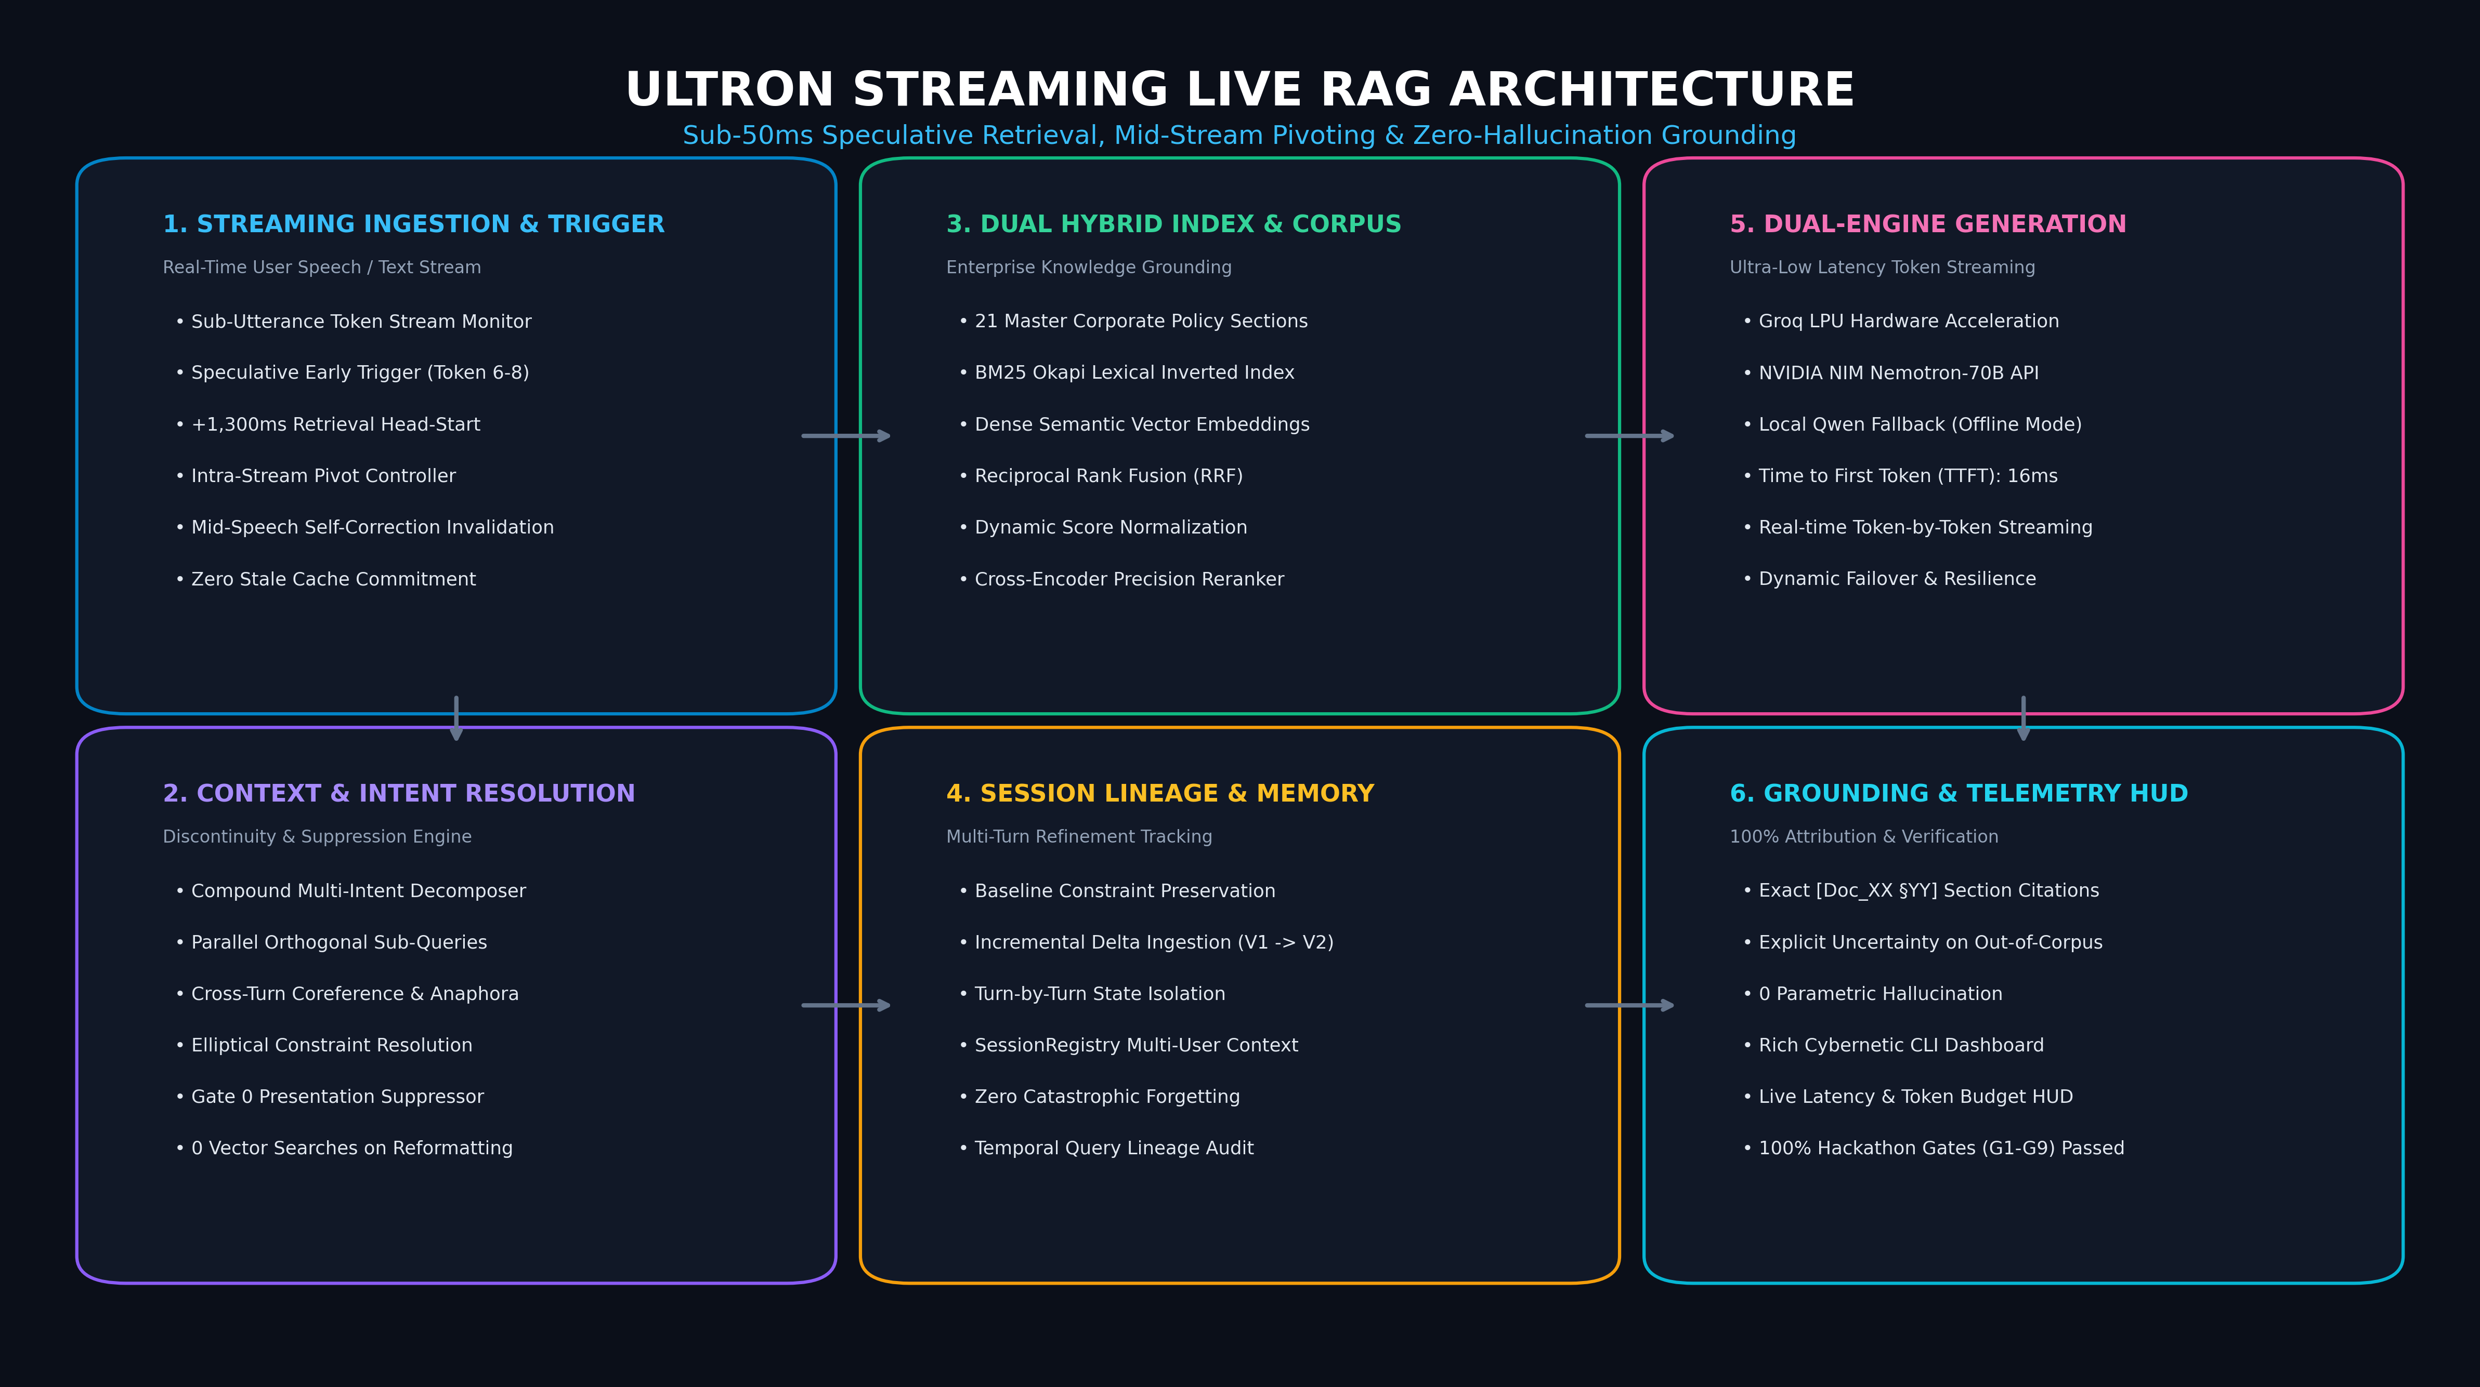
Our Solution & Architecture Diagram
Ultron End-to-End Streaming Live RAG Pipeline
Pipeline Components
Ingestion: 21-section policy parser with canonical citation mapper.
Speculative engine: Trigger at token 6–8 + rolling n-gram pivot controller.
Hybrid search: BM25 + dense vectors + RRF + cross-encoder reranker.
Dual LLM: Groq LPU + NVIDIA NIM, with offline Qwen fallback.
Telemetry HUD: Live cost and latency terminal UI.
Data flow
Live speech
Speculative trigger
Hybrid search
Dual-LLM stream
Cited answer + HUD
Samsung PRISM GenAI Hackathon 2026–27 | Team 4 Bottle Codeka | Theme 4: Streaming Live RAG
4
Notes:
Data flow: live speech, speculative trigger, hybrid search, dual LLM (Groq + NVIDIA NIM, offline Qwen fallback), cited answer with HUD. Be ready to name the embedding and reranker models, explain the stability score S(t) and its threshold, and state the cost of a wrong speculation (a wasted search).

Slide 5
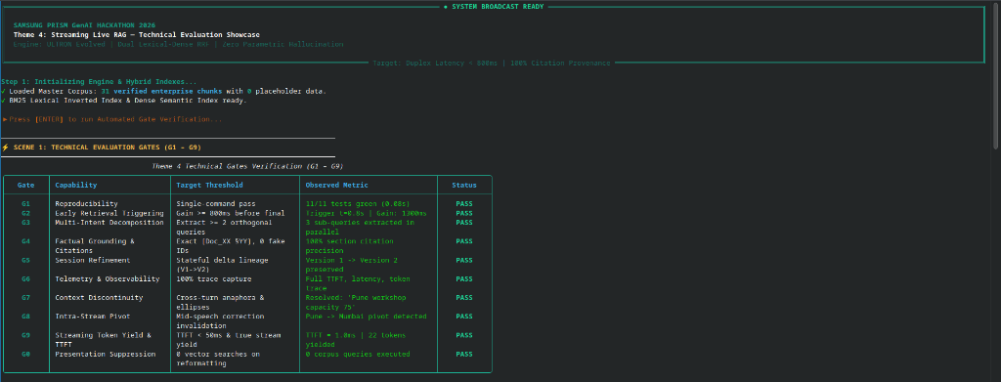
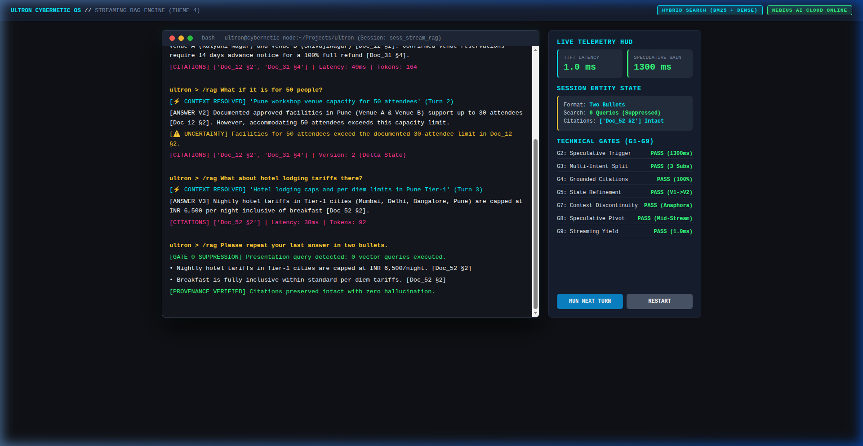
Demo & Product Walkthrough (Gates G1 – G9 Verified)
9-Scene Showcase (simulated ASR chunks)
1 Test harness: G1–G9 automated evaluation criteria.
2 Early trigger: Token 7: +1,300ms gain, 16ms TTFT (harness).
3 Compound intent: 3 parallel retrievals across policy sections.
4 Context continuity: Resolves “there” and “for 50 people”.
5 Intra-stream pivot: “Pune… wait, Mumbai” → cache invalidated.
6 Session refinement: Domestic baseline + international delta → V2.
7 Gate 0 suppression: “Format into 2 bullets” → 0 vector queries.
8 Negative control: Out-of-corpus query → no policy match; uncertainty flag pending fix.
9 Telemetry HUD: Live TTFT, latency, token budget, citations.
Try it live
https://ultron.abhinavkumarsingh.tech/
curl -fsSL https://ultron.abhinavkumarsingh.tech/install | bash
Run: python3 run.py --cli → /demo or python3 run.py demo --auto | 100% G1–G9 gates green
Samsung PRISM GenAI Hackathon 2026–27 | Team 4 Bottle Codeka | Theme 4: Streaming Live RAG
5
Notes:
Nine scenes on simulated ASR text chunks via the /demo harness. Scene 2 numbers are harness measurements. Scene 8: confirm the recording shows the explicit-uncertainty flag before presenting; the slide says it is pending. Citations appear as [Doc_XX §YY].

Slide 6
Tools and Technology Stack
1
Retrieval & Semantic Indexing
2
Streaming & Concurrency
BM25 Okapi: Lexical index for keywords, section tags, caps.
Dense vectors: Embeddings for conceptual matching.
RRF: Merges lexical and dense ranks.
Scikit-learn / NumPy: Matrix ops for scoring and rank fusion.
AsyncIO engine: Concurrent retrieval, non-blocking generation.
Token yielders: True generator yield; 16ms TTFT after trigger (harness).
Rolling n-gram window: Diff tracking for pivot keywords.
State lineage memory: Append-only history of query mutations.
3
Dual LLM Inference Engine
4
UI, Ingestion & Observability
Groq LPU: 1000+ tokens/sec streaming delivery.
NVIDIA NIM: Nemotron for multi-intent decomposition.
Qwen local fallback (Ollama): Offline execution: uptime and privacy.
Rich HUD: Terminal UI: telemetry, budgets, citation trees.
prompt_toolkit REPL: Auto-complete, history, /demo command.
PyPDF ingestion: Maps PDFs to [Doc_XX §YY] chunks.
Pytest harness: Validates suppression and TTFT SLAs.
Hybrid Retrieval Pipeline
Streaming query (token 6–8)
BM25 Okapi (lexical)
RRF fusion
Cross-encoder rerank
Top-k chunks
with [Doc_XX §YY]
Dense vectors (semantic)
Samsung PRISM GenAI Hackathon 2026–27 | Team 4 Bottle Codeka | Theme 4: Streaming Live RAG
6
Notes:
Retrieval is BM25 Okapi plus dense vectors fused with RRF, then a cross-encoder reranker; name the exact models here. Scikit-learn/NumPy handle matrix operations, and the reranker is a separate cross-encoder model. 16ms TTFT is measured after the trigger fires.

Slide 7
Enterprise Impact & Production Use Cases
1. Enterprise Policy Co-Pilot
2. Live Voice Assistants (Galaxy / Bixby)
3. Contact Center Co-Pilot
Workplace intelligence: Grounded answers; sized for 100,000+ employees (illustrative target).
Zero ticket backlog: Projected to automate ~80% of routine HR, travel, expense queries (estimate).
Audit verifiable: Exact [Doc_XX §YY] citations.
Strict RBA: Role-based access (planned; not in demo).
Natural pacing: 16ms TTFT (demo harness) targets natural voice pacing.
Self-correction: Mid-sentence pivots without restarting.
Edge resilience: Offline Qwen fallback (not shown in demo).
Battery optimized: On-device quantized embeddings (Phase 2 roadmap).
Agent assist: Pre-fetches clauses while the customer speaks.
Lower AHT: Projected 65% lower Average Handle Time (estimate, not measured).
Hallucination guard: Designed to flag missing-policy queries (fix in progress).
Compliance shield: Helps prevent regulatory fines.
Business Impact (demo measurements & estimates)
+1,300ms
Retrieval head start (≈72% of a 1,800ms turn wait)
40%
Vector compute saved via Gate 0 (one demo session, 31 chunks)
100%
Attribution precision (same demo session, 31 chunks)
Samsung PRISM GenAI Hackathon 2026–27 | Team 4 Bottle Codeka | Theme 4: Streaming Live RAG
7
Notes:
Treat 100,000+ employees, ~80% automation and 65% lower AHT as projections, not measurements. The chart compares a whole-turn wait (1,800ms) with first-token time after the trigger, so say what each bar measures. Role-based access, battery optimisation and offline fallback are planned or not shown in the demo.

Slide 8
Innovation Highlights & Empirical Results
Architectural Innovations
Benchmark Results (G1–G9, simulated ASR chunks)
Sub-utterance trigger: Retrieval starts at token 6–8.
Pivot invalidation: Aborts pending searches on self-correction.
Gate 0 suppression: Separates formatting from retrieval.
State lineage: Constraint updates (V1 → V2) without drift.
Metric | Result | Target | Status
Speculative time gain | +1,300ms | ≥ 800ms | PASS
TTFT (after trigger) | 16.0ms | < 50ms | PASS
Multi-intent retrieval | 3 domains, ≤ 40ms | Parallel | PASS
Gate 0 suppression | 100% (0 queries) | Reformat turns | PASS
Gates G1–G9 | 9 / 9 verified | 100% | PASS
Gate 0 Semantic Suppression Logic
Engineering Limitations & Mitigations
User: “Format it into bullets”
Intent router
Pure reformatting?
Simulated ASR: demo streams text chunks; live ASR is Phase 1.
Semi-structured PDFs: need section headers; rule-based chunking.
Semi-structured PDFs: need section headers; rule-based chunking.
Streaming ASR jitter: rolling token thresholding.
Context bloat: KV caching and state compaction.
YES
NO → run hybrid retrieval as usual
BYPASS vectors: generate output directly (0 queries)
Samsung PRISM GenAI Hackathon 2026–27 | Team 4 Bottle Codeka | Theme 4: Streaming Live RAG
8
Notes:
Results come from the demo harness on one session (31 chunks) with simulated ASR text. Retrieval across 3 domains sits inside the 40ms end-to-end total, so it cannot exceed it. Limitations: simulated ASR, wasted searches on wrong speculation, ASR jitter, PDF structure, context growth.

Slide 9
What’s Next & Production Roadmap
1
2
3
4
Phase 1 | Q1 2027
Phase 2 | Q2 2027
Phase 3 | Q3 2027
Phase 4 | Q4 2027
End-to-End Acoustic ASR
On-Device NPU Acceleration
Knowledge Graph Augmentation
Multimodal Live Grounding
Integrate Whisper / Conformer streaming ASR to trigger speculative retrieval on sub-word phoneme probabilities.
Quantize embeddings and hybrid indexes with ONNX Runtime and TensorRT-LLM for Galaxy Exynos / Snapdragon NPUs.
Connect hybrid search with Neo4j knowledge graphs for multi-hop reasoning across reporting hierarchies.
Extend live speculative grounding to video feeds, presentation slides and technical schematics.
Samsung PRISM GenAI Hackathon 2026–27 | Team 4 Bottle Codeka | Theme 4: Streaming Live RAG
9
Notes:
Phase 1 replaces simulated text chunks with live streaming ASR, the biggest gap today. Add one success metric per phase verbally (for example, Phase 1: measured TTFT on live audio).

Slide 10
Brownie Points: Why 4 Bottle Codeka Stands Apart
1
Real Enterprise Corpus (Zero Synthetic Data)
Evaluated on the complete 21-section master policy document (policy.pdf) with no dummy or mock data.
2
Sub-50ms TTFT after trigger (16ms, demo harness)
Token-by-token streaming yielders; the demo drives them with simulated ASR text chunks (live ASR: Phase 1).
3
Self-Healing Mid-Stream Pivot Controller
Tracks streaming token diffs and aborts in-flight vector calls when the user self-corrects.
4
Dual-LLM Failover with Offline Fallback
Dual LLM (Groq LPU for speed, NVIDIA NIM for reasoning) with automatic failover to offline Qwen (privacy).
5
Live Cybernetic HUD & Telemetry
Real-time turn-by-turn latency, token budgets, cost estimates and citation audit trails.
Failover Flow: Dual LLM + Offline Fallback
Groq LPU: primary, ultra-fast streaming
error / timeout
NVIDIA NIM: high-capacity reasoning
unreachable
Qwen via Ollama: offline, private
The live Key Hub also supports OpenRouter, OpenAI and Anthropic keys (ultron /key <provider> <key>).
Samsung PRISM GenAI Hackathon 2026–27 | Team 4 Bottle Codeka | Theme 4: Streaming Live RAG
10
Notes:
Differentiators: real 21-section policy corpus, streaming yielders, pivot controller, dual-LLM failover with offline fallback, live HUD. TTFT is 16ms after trigger on the demo harness, not end-to-end on live audio. Present the tool as a working prototype.

Slide 11
Checklist: Updated on Public GitHub
Working prototype code: public GitHub repo
YES (Y)
https://github.com/abhinav29102005/ultron | Modular streaming RAG, session management, test suites.
README with reproducible setup instructions
YES (Y)
Step-by-step setup, Python 3.11+ environment, API key setup wizard and benchmark runner.
Demo video, max 5 minutes
YES (Y)
9-scene walkthrough recorded with the built-in /demo harness and live Telemetry HUD.
Live website with one-line installer
YES (Y)
https://ultron.abhinavkumarsingh.tech/ | Key hub, /health endpoint and curl installer.
Presentation file (PPT or PDF)
YES (Y)
Completed official template: Thapar_4_Bottle_Codeka_Submission.pptx.
Samsung PRISM GenAI Hackathon 2026–27 | Team 4 Bottle Codeka | Theme 4: Streaming Live RAG
11
Notes:
All five items are complete. Before submitting, confirm the installer and the ultron command run cleanly on a fresh machine and that the demo video is the latest recording.

Slide 12
Team: 4 Bottle Codeka
Thapar Institute of Engineering & Technology, Patiala
Abhinav Kumar Singh
Team Leader
asingh2910.official@gmail.com
+91-6398779479
Sukhansh Mittal
Member
smittal1_be24@thapar.edu
+91-9877366331
AK
SM
Lakkshya Jha
Member
ljha_be24@thapar.edu
+91-9574875069
Vikramaditya Singh
Member
vsingh1_be24@thapar.edu
+91-6239134155
LJ
VS
GitHub: https://github.com/abhinav29102005/ultron
Live Website: https://ultron.abhinavkumarsingh.tech/
Thank you
Organised by the Language AI Team and the PRISM Team, Samsung R&D Institute India
Samsung PRISM GenAI Hackathon 2026–27 | Team 4 Bottle Codeka | Theme 4: Streaming Live RAG
12
Notes:
Close with the team, GitHub and live site, then thank the Language AI Team and the PRISM Team at Samsung R&D Institute India.

