Slide 1
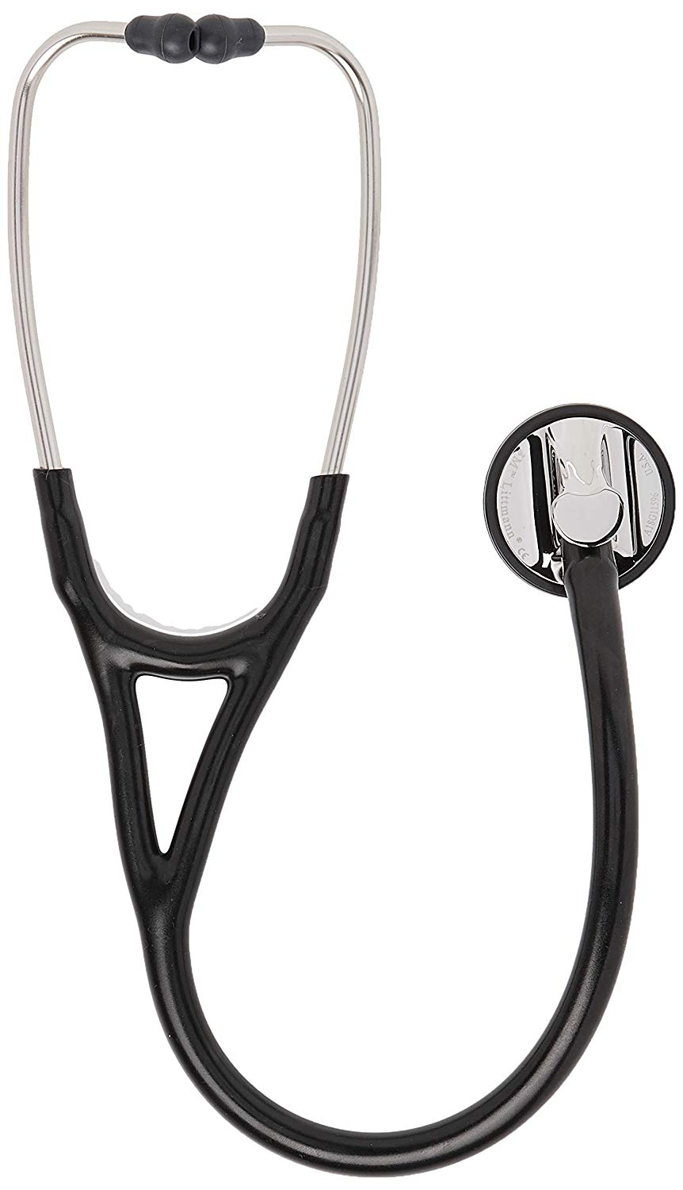
HEALTH RADAR
RESHAPING YOUR LIFE....

Slide 2
Who am I ??
I'm basically a health assistant in form of an mobile application with whom you can take suggestion reguarding your day to day health issues and who can keep a track on you to make you stay healthy .
MOTTO OF THIS APPLICATION
Our major long termmotto is to be a go-to assistant which a layman user can use for any health related query,which can also store the recent health report of the person and also can communicate with the doctors if necessary.

Slide 3
Technologies Used
Flutter
DialogFlow

Slide 4
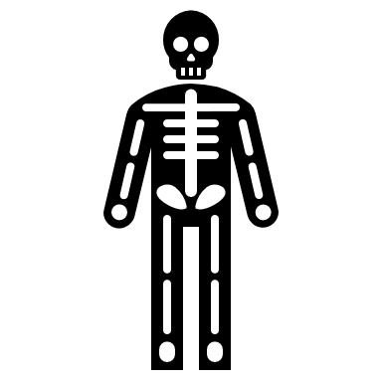
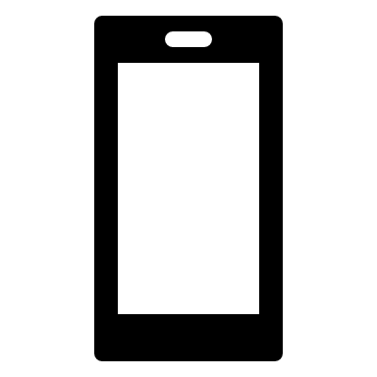



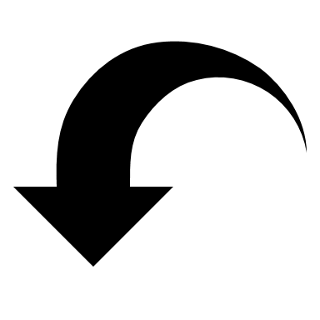
USE CASE AND METHEDOLOGY
HEALTH RADAR
USER
CHECKS THE DATA FOR APPROPRIATE OUTPUT
PROVIDES OUTPUT
AS FOR INSTANCE, IF THE USER SAYS "I'VE MILD FEVER", THE ASSISTANT FINDS THE MOST APPROPRIATE OUTPUT AND SAYS,"YOU MAY TAKE PARACETAMOL OR ASPIRIN".

Slide 5

MERITS OF THE APPLICATION
SINCE WE HAVE USED FLUTTER,THEREFORE THIS APPLICATION CAN BE USED ACROSS ALL THE PLATFORMS i.e MORE CUSTOMER REACHABLE.
IT WILL BE ABLE TO SOLVE BASIC DAY TO DAY HEALTH RELATED PROBLEMS AND IT WILL SUGGEST CERTAIN PRECAUTIONS AND TIPS TO BE FOLLOWED, ACCORDINGLY.
THE EMBEDDED MACHINE LEARNING MODELS PROVES TO BE ONE OF THE MOST HELPFUL FEATURE OF THIS APP THAT CAN ACCURATELY PROVIDE RESULTS OF AN X-RAY SCAN, BP DATAS (PROVIDED USING HARDWARES etc. AND ALL THAT IN A MATTER OF SECOND.

Slide 6
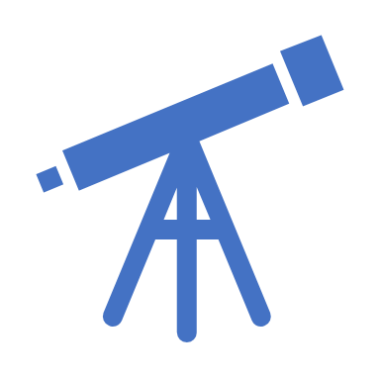
FUTURE PERSPECTIVE
AS EVERY PRODUCT OR APPLICATION HAS A FUTURE PERSPECTIVE AND THEIR LIES CERTAIN AREA OF IMPROVEMENT, SO DOES OUR HEALTH RADAR.
FUTURE PERSPECTIVE OF HEALTH RADAR IS THAT IT CAN BE TURNED INTO A COMMERCIAL FINISHED PRODUCT WHICH WILL BE A DEDICATED HEALTH ASSISTANT TO A LEYMAN.
THE PRODUCT WILL NOT ONLY BE ABLE TO GIVE SUGGESTIONS BUT WILL ALSO BE ABLE TO TRACK THE PATIENT'S HEALTH, SUPPLY NECESSARY REPORT TO DOCTOR AND MONITOR DIFFERENT HEALTH PARAMETERS USING DIFFERENT SENSORS, AND PERFORMS ALL OF THESE EFFICIENTLY AND EFFECTIVELY WITHIN A COMPACT DEVICE.

Slide 7
THANK YOU

