Slide 1









Presents
2 days hands-on workshop on Internet of Things
At
Sikkim Manipal University of Technology
(25th-26th January, 2020)

Slide 2

Agenda – Day 1
What is Internet of Things?
Designing IoT systems
Edge systems
NodeMCU
Arduino framework
Cloud layer
Local communication
Global communication
MQTT
Implementation

Slide 3
Agenda – Day 2
More implementation on MQTT
A demo on smart speakers and how it works using Alexa
Some more demos . . .

Slide 4
What is IoT?
Device
Device
Device
Device
Device
Cloud layer

Slide 5

What is a device (Edge)?
Anything connected to network and transferring any data
Smart watch
Cell phone
Smart bulbs
Smart vehicles

Slide 6
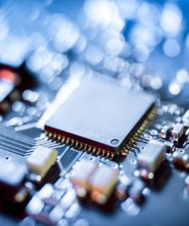
What does it consists of?
Microcontroller unit (MCU)
Sensors
Actuators

Slide 7

What happens in cloud?
Rule engine
Data analytics
Data visualization
Action(s)

Slide 8

Designing IoT systems
Understand the problem statement
What edge part is required
MCU
Sensors
Actuators
Network connectivity
Choice of cloud layer or IoT platform
How to send data to cloud
Build an app to control and monitor everything

Slide 9

Design a smart gardening system

Slide 10

Open any editor or simply a notebook and draw what components are required and where each components fits in . . .

