Slide 1
H
HostelHub
All-in-One Digital Hostel Management Platform
Streamlining Complaints, Daily Attendance, Mess Regulations & Real-Time Communication
Developed by Abhinav Kumar (Lead Full-Stack Developer) | August 2026

Slide 2
H
HOSTELHUB PLATFORM
Problem Statement & Digital Vision
⚠️ Traditional Hostel Challenges
• Manual Paper Register Attendance leads to proxy errors and lost records.
• Unorganized Maintenance Complaints cause long delays in repair dispatch.
• Food Waste in Mess due to lack of real-time meal skip tracking.
• Fragmented Student Communication via unverified chat groups.
• No accountability or photo proof of work completion by service staff.
🎯 The HostelHub Solution
✔ 100% Digital Workflow connecting Students, Wardens, Staff & Admins.
✔ Automated Ticket Dispatching with category-based routing to staff.
✔ Mandatory Image Proof Upload by staff before marking jobs resolved.
✔ Real-Time Roll Call Attendance with instant hostel-wise statistics.
✔ Evening Snacks & Meal Skip System to optimize mess preparation.

Slide 3
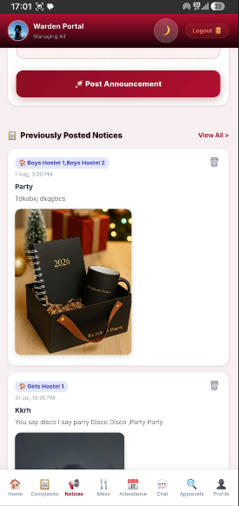
H
HOSTELHUB PLATFORM
Core Platform Architecture & Modules
🚀 Key System Modules
🔧 Ticket Maintenance Engine
Instant photo complaints, category routing & rating feedback.
📅 Daily Roll Call Roster
Binary Present/Absent marking with hostel block filtering.
☕ Mess Regulations & Snacks
Weekly meal schedules, evening snacks & skip meal tracking.
💬 Real-Time Group Chat
Block & Batch chats powered by Socket.io WebSockets.
🔒 Profile Security Guard
Warden re-approval required for Gender or Batch modifications.

Slide 4
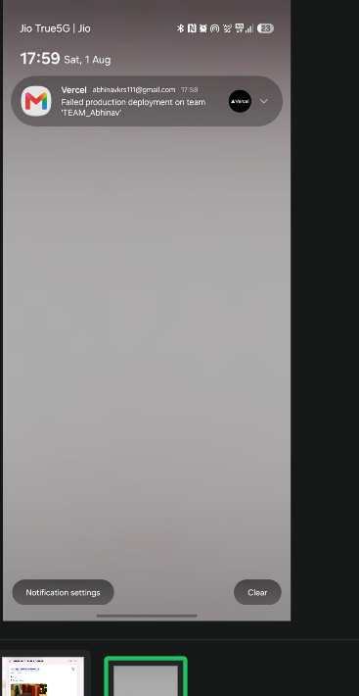
H
HOSTELHUB PLATFORM
Student Portal - Instant Issue Raising
📝 Frictionless Complaint Dispatch
• Categorized Issue Selection: Electrical, Plumbing, Carpentry, Cleaning, Other.
• Priority Assignment: Low, Medium, High, Urgent level tags.
• Native Photo Capture: Direct camera attachment for physical damage proof.
• Real-Time Progress Tracking: 4-stage visual timeline (Ticket Raised -> Staff Assignment -> Work Progress -> Resolution).
• Warden Contact Cards: One-tap call/email buttons to reach assigned block wardens instantly.

Slide 5
H
HOSTELHUB PLATFORM
End-to-End Ticket Lifecycle & Proof Verification
1. Raise Ticket
Student logs issue with title, category, priority & issue photo.
2. Assign Staff
Warden views workload & assigns specialized electrician/plumber.
3. Work Progress
Staff marks job 'In Progress' & visits student room.
4. Proof & Feedback
Staff uploads resolution photo proof. Student rates job 1-5 stars.

Slide 6
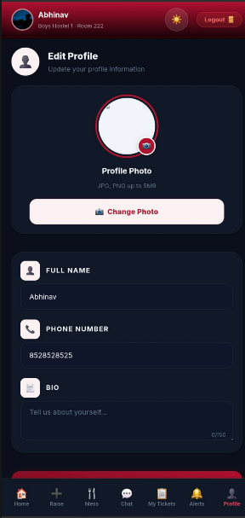
H
HOSTELHUB PLATFORM
Warden Portal - Daily Roll Call Attendance
📅 Streamlined Roll Call Roster
✔ Binary Status Model: Strictly tracks Present & Absent (Outing clutter eliminated).
✔ Hostel Block Filtering: Filter by All Hostels, Boys Hostel 1/2, Girls Hostel 1/2.
✔ Live Summary Metrics Bar: Displays Total Students, Present Count, and Absent Count in real-time.
✔ Bulk Action Controls: One-tap 'Mark All Present' with optional student remark entries.
✔ Student Attendance Metrics: Students view overall attendance % & history.

Slide 7
H
HOSTELHUB PLATFORM
Mess Regulations, Evening Snacks & Meal Skipping
☕ 4-Meal Daily Schedule
• Breakfast: Morning healthy options & tea/coffee.
• Lunch: Full nutritional meal schedule.
• Evening Snacks (☕ Added): Tea, snacks & evening refreshment item.
• Dinner: Evening meal schedule with special weekend menus.
• Warden Menu Control: Wardens update weekly meal items in real-time.
♻️ Meal Skip & Waste Reduction
✔ One-Tap Skip Toggle: Students mark meals they will skip ahead of time.
✔ Mess Staff Analytics: Live count of meals to prepare, cutting food waste by up to 30%.
✔ Mess Feedback Rating: Students rate food quality, hygiene & quantity.
✔ Warden Feedback Overview: Wardens monitor mess ratings & student comments.

Slide 8
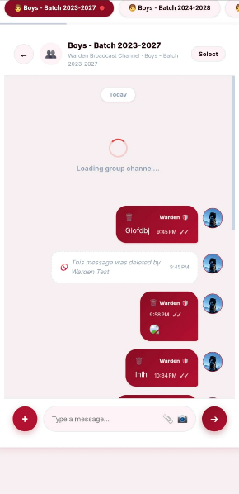
H
HOSTELHUB PLATFORM
Real-Time Communication & Group Chat
💬 Powered by Socket.io WebSockets
• Automatic Group Membership: Joined into Block Group Chat & Academic Batch Chat on signup.
• Warden Group Hub: Wardens broadcast notices to all or specific hostel blocks.
• Photo Sharing & Attachment Preview: Share room issues & study notices.
• Single-Screen Immersive UI: Bottom navigation stays pinned during scrolling.
• Developer Team Cards: Integrated GitHub, LinkedIn, Twitter, Email & 📸 Instagram buttons.

Slide 9
H
HOSTELHUB PLATFORM
Architecture & Critical Security Guards
⚙️ Full Stack Architecture
▪ Frontend: Angular Standalone Components, Vanilla CSS Tokens, RxJS.
▪ Mobile APK: Capacitor Native Android Bridge & Back-Button Guard.
▪ Backend: Node.js, Express.js REST API layer.
▪ Database: PostgreSQL Database with Sequelize ORM & indexing.
▪ Cloud Storage: Supabase Image Storage with Base64 fallback.
🔒 Security Enforcements
🛡️ Profile Re-Approval Rule: Standard profile updates save instantly. Editing Gender or Batch triggers critical warning & requires Warden Re-approval.
🛡️ Dual-Press Back Button Exit Guard: Back button navigates to Home tab first; second press opens sleek Exit Confirmation Modal.
🛡️ Role-Based JWT Authorization: Strictly enforces route access for Students, Wardens, Staff & Admins.

Slide 10
Transforming Hostel Operations with HostelHub
✓ Zero Paperwork | ✓ 100% Ticket Accountability | ✓ Reduced Mess Waste | ✓ Instant Emergency Alerting
Thank You!
For inquiries, app deployment, or feedback, connect with the HostelHub Engineering Team.

