Slide 1
Department of Computer Science & Engineering
UE17CS355 – Web Tech II Laboratory
Project Evaluation
Project Title : APTITUDE TEST
Project Team : PES1201701500 – ABHINAV VIGNESHWAR B M
PES1201701897 – S.NISHITH VIHAR
PES1201701649 – AJAY CHAVAN

Slide 2
Project Description
Aptitude Test Website
Free practice Aptitude Tests giving you the best preparation for your employment aptitude test.
To use the websites full potential,you can login or signup with us and save the progress for stepwise improvement in your test.
Finally the page will show analysis based on your performance in the test

Slide 3
Technologies Used
Flask:
We have used Bcrypt,JWT manager and Sqlalcemy as a ORM
React:
React. js is an open-source JavaScript library that is used for building user interfaces specifically for single-page applications.
Node-sass for styling,material design icons,react-helmet and react-router-dom and axios for rest api calls.
Chart.js for data analysis
Sqlite:
Lite database used along with flask for persistence.

Slide 4
Techniques Implemented
Ajax patterns used:
Periodic refresh:
We have used this ajax pattern in setting the timer which is refreshing every 1 second asynchronously.This pattern is also used for reducing the hints asynchronously
RESTful apis:
3 RESTful are used in flask,the 3 apis are:
Registration api for user registration.
Login api for storing login details into sqlite database.
Storing the analysis data for the user test into the sqlite database.

Slide 5
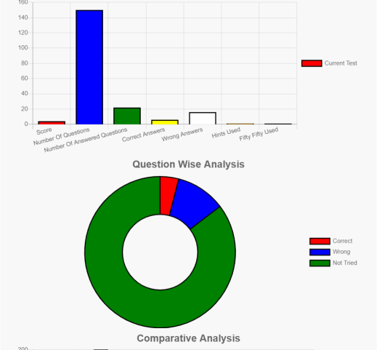
Intelligent Functionality
Graphical representation of data analysis:
The given piechart is based on the users performance

Slide 6
Thank You

