Slide 1

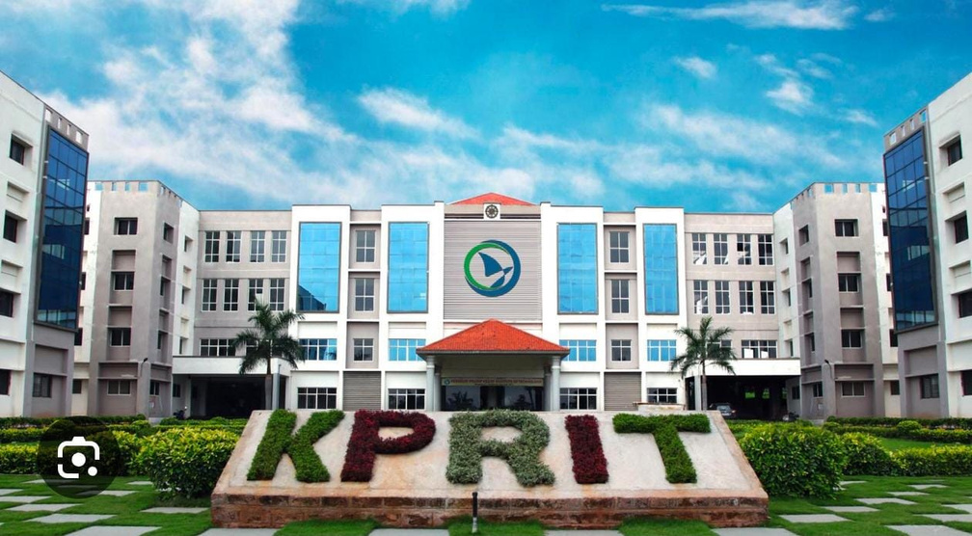
KOMMURI PRATAP REDDY
INSTITUTE OF TECHNOLOGY
Department of Computer Science & Engineering
MAJOR PROJECT REVIEW
IV B.Tech - CSE | A.Y. 2026 - 2027
PROJECT TITLE
Med Connect - Online Appointment Booking System for Streamlined Healthcare
GUIDE
SECTION
TEAM
Mrs. C. Vinitha Reddy
IV-I CSE - A
4 Members
REVIEW
16 / 09 / 2026

Slide 2

Team Details
Team
S. No.
Name
Roll No.
Role / Responsibility
1
J. Lirisha
23RA1A0565
Team Lead / Front-End Design
2
T. Bhanu Vara Prasad
23RA1A0525
Back-End Development
3
M. Abhinav
23RA1A0503
Database Design
4
J. Chandra Shekar Reddy
23RA1A0532
Testing & Documentation
PROJECT GUIDE
SECTION
Mrs. C. Vinitha Reddy | Assistant Professor
CSE - A
Department of Computer Science & Engineering | KPRIT | A.Y. 2026–2027

Slide 3
1. Project Title
1
MED CONNECT - ONLINE APPOINTMENT BOOKING SYSTEM FOR STREAMLINED HEALTHCARE
A web based system that lets patients book doctor appointments online
DOMAIN
Web Development / Healthcare Management System
Department of Computer Science & Engineering | KPRIT | A.Y. 2026–2027

Slide 4
2. Abstract
2
Med Connect is a simple online system for booking doctor appointments.
ABSTRACT
Med Connect is a web based system that makes doctor appointment booking simple. Today most patients book by visiting the hospital or calling the front desk, which wastes time and often ends in long queues. This project brings the whole process to one website with three logins - patient, doctor and admin. A patient can see the doctor list, check the free slots and book an appointment in a few clicks.
• Main features: doctor list, free slots, booking, cancel and visit history.
• Expected result: less waiting time, no double booking and clear records.
It replaces the manual booking method with a single digital platform.
Department of Computer Science & Engineering | KPRIT | A.Y. 2026–2027

Slide 5
3. Problem Statement
3
Booking a doctor appointment is still slow and manual. Patients must reach the hospital or keep calling the desk just to know when a doctor is free.
PROBLEM
STATEMENT
• Problem: Patients still book by visiting the hospital or calling the front desk.
• Reason: Bookings are kept in registers, so free slots are not visible online.
• Affected: Patients, doctors and desk staff all lose time every single day.
• Gap: Phone lines stay busy, double booking happens and paper records get lost.
• No proof: There is no instant confirmation, so many patients travel in vain.
Need: one simple online system that shows free slots and confirms the booking at once.
Department of Computer Science & Engineering | KPRIT | A.Y. 2026–2027

Slide 6
4. Objectives
4
OBJECTIVE 01
OBJECTIVE 02
Create a secure sign up and login for patients, doctors and admin
Allow patients to view doctors and book a free slot online
OBJECTIVE 03
OBJECTIVE 04
Allow doctors to update availability and view their appointments
Allow admin to manage doctors, patients and booking records
Department of Computer Science & Engineering | KPRIT | A.Y. 2026–2027

Slide 7
5. Scope
5
✓ IN SCOPE
✕ OUT OF SCOPE / FUTURE WORK
• Secure login for patient, doctor, admin
• Doctor list with timings and free slots
• Online booking, cancel and rebooking
• Patient dashboard with visit history
• Doctor page to update free time
• Admin panel to manage users and slots
• Instant booking confirmation on screen
• Online payment and billing
• Video consultation with doctors
• Android / iOS mobile app
• Prescription and report storage
• Lab test and pharmacy linking
• Insurance and claim handling
• SMS or WhatsApp alerts (future work)
In short: the project covers the full booking journey - login, doctor search, slot booking, confirmation and records.
Department of Computer Science & Engineering | KPRIT | A.Y. 2026–2027

Slide 8
6. Literature Survey
6
Paper / Year
Approach / Key Finding
Limitation / Gap
Online Doctor Appointment System (2020)
Web page where patients can request an appointment
Doctor availability is not updated live
Hospital Management System (2021)
Stores patient, doctor and visit records
Booking is done by staff, not by the patient
Smart Healthcare Booking App (2022)
Mobile app for picking appointment slots
No separate admin control panel
Cloud Based Clinic Scheduling (2023)
Appointment data is stored on the cloud
Setup is complex and costly for small clinics
Med Connect combines patient booking, live doctor availability and admin control in one system.
Department of Computer Science & Engineering | KPRIT | A.Y. 2026–2027

Slide 9
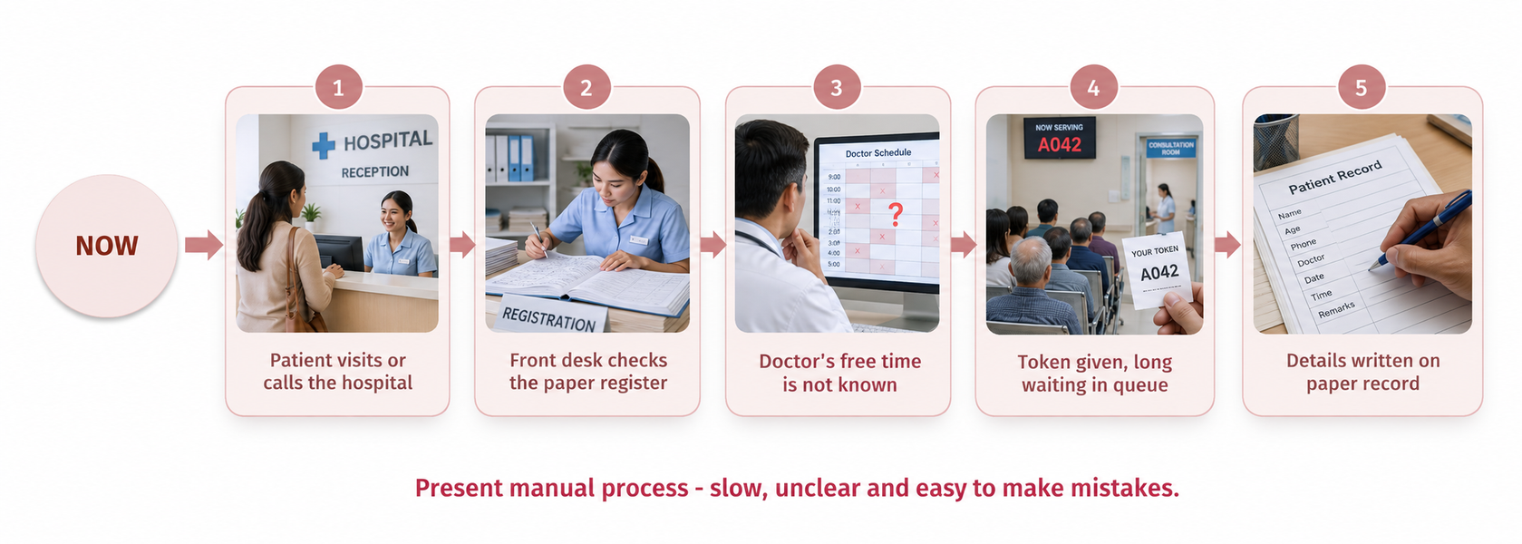
7. Existing System
7
At present the whole booking work is done by hand at the hospital counter.
• Patients book by visiting the hospital or calling the desk
• Appointments are written in registers or simple sheets
• Doctor free time is not known before the patient arrives
• Double booking, long queues and lost records are common
NOW
Present manual process - slow, unclear and easy to make mistakes.
Department of Computer Science & Engineering | KPRIT | A.Y. 2026–2027

Slide 10
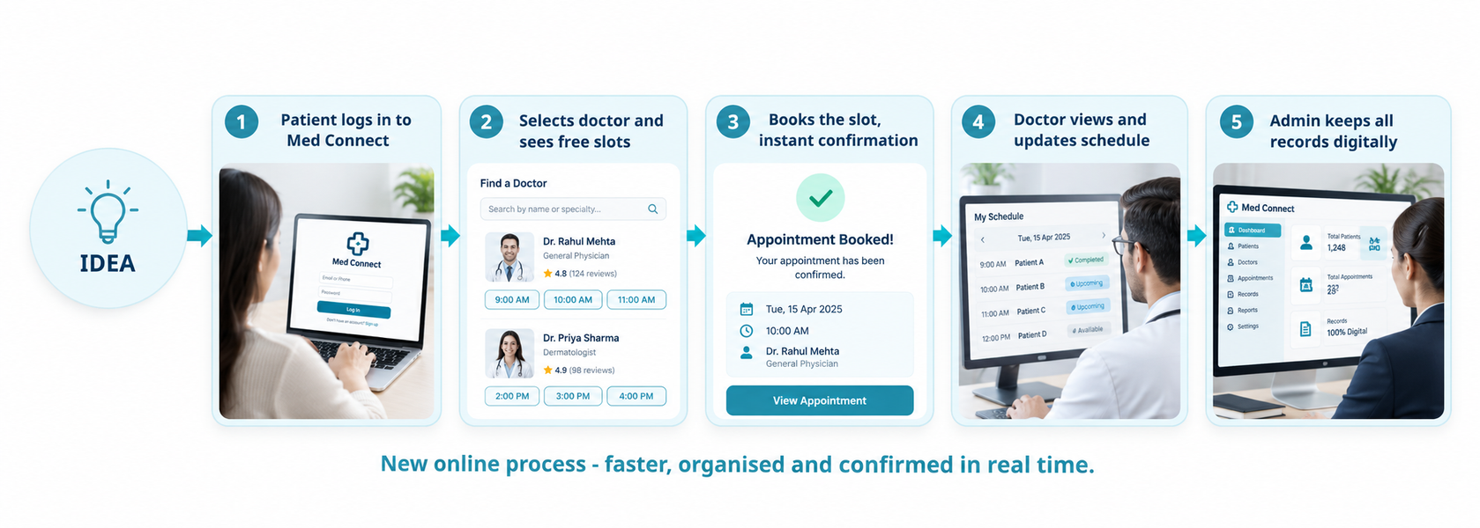
8. Proposed System
8
Med Connect moves the same work online, so booking is done in a few clicks.
• One website with separate logins for patient, doctor and admin
• Patient picks a doctor, sees free slots and books at once
• Doctor updates availability and views the day schedule
• Admin manages doctors, patients and all booking records
IDEA
New online process - faster, organised and confirmed in real time.
Department of Computer Science & Engineering | KPRIT | A.Y. 2026–2027

Slide 11

KOMMURI PRATAP REDDY
INSTITUTE OF TECHNOLOGY
DEPARTMENT OF COMPUTER SCIENCE & ENGINEERING
J. LIRISHA
Thank You
T. BHANU VARA PRASAD
For Your Valuable Attention
M. ABHINAV
Guide: Mrs. C. Vinitha Reddy, Assistant Professor Section: CSE – A
IV B.Tech CSE | A.Y. 2026-2027 | Review-I | 16 / 09 / 2026
J. CHANDRA SHEKAR REDDY

