Slide 1



JOB-A-THON - May 2021
Approach Document
Submitted By: Abhinava Kumar Saha
: abhinava.saha@outlook.com
: 8600068548
Date: 30th May 2021

Slide 2
Project analysis slide 11
Problem Statement
Problem Statement: Credit Cart Lead Prediction.
Happy Customer Bank wants to cross sell credit cards to its existing customers, for this bank has identified a set of customers that are eligible for taking credit cards.
We need to build a prediction model to help Bank identify the customers who are more promising Leads to opt for credit card.
Through this Bank will be able to spend judiciously its Promotion and marketing budget on promising leads, which are more likely to get the credit cards.
This will also help bank marketing team focus their effort on promising leads than spending on leads which are less likely to convert.

Slide 3
Project analysis slide 11
Solution Design
As a data scientist we will use the below approach to analyse the data and come up with the best prediction model.
  Perform basic Data checks and analysis using Python.
  Perform Exploratory Analysis of the given data (Univariate, Bivariate and multivariate analysis) and come up with useful insights.
  Split the Training data into Train and validation set.
  Fit the Training data through pipeline on various models and use cross validation to check the model performance (Use ROC AUC score i.e. area under the ROC curve).
  Take the best performing model and fit on Training data and check performance on Validation set, perform hyper parameter tuning to improve to get the right fit model.
  Use this above model to predict on the Test Data and create the submission file containing predicted probability of class 1 (i.e. positive leads). Submit this file in solution checker and check the score.
  Analyse the model performance on Test data and work on Further improvement on Feature engineering and Feature selection to further improve the model performance.

Slide 4
Project analysis slide 11
Data Dictionary
Data Dictionary.
Variable | Definition
ID | Unique Identifier for a row
Gender | Gender of the Customer
Age | Age of the Customer (in Years)
Region_Code | Code of the Region for the customers
Occupation | Occupation Type for the customer
Channel_Code | Acquisition Channel Code for the Customer (Encoded)
Vintage | Vintage for the Customer (In Months)
Credit_Product | If the Customer has any active credit product (Home loan, Personal loan, Credit Card etc.)
Avg_Account_Balance | Average Account Balance for the Customer in last 12 Months
Is_Active | If the Customer is Active in last 3 Months
Is_Lead(Target) | If the Customer is interested for the Credit Card 0 : Customer is not interested 1 : Customer is interested
ID column is unique identifier of customer record.
Avg_Account_Balance is the only continuous feature, rest all are categorical in variables.
Credit Product variable has got null values in both Train and Test data. The null values will have to be imputed.
Is Lead is the Target variable, which we need to predict for Test data, showing the probability of Customer showing interest in the credit card.

Slide 5
Project analysis slide 11
Approach Brief
A brief on the approach.
Analyse the data quality and get the data ready for modelling.
  The data given was of good quality except for null values in Credit Product feature. Which will have to be imputed. (This turned out the key feature, will discuss in subsequent slide)
Build base model and analyse performance.
Create new features and check the performance.
Change the imputation strategy for Credit Product after analyzing the distribution of Target variable for various value of Credit Product (Yes, No, Null).
Rebuild model after above changes and retest performance. Optimize the hyper parameters to further improve.

Slide 6
Project analysis slide 11
Data-preprocessing
A brief on Data-preprocessing steps.
Change all object/Text data features to numerical data by using label encoding.
Avg_Account_Balance data was heavily right skewed, hence used log transformation to normalize data.
Used below strategies for imputing the null value in Credit Product, which was of binary nature(Yes/No).
  Impute Credit Product null value using mode value which was ‘No’.
    Using this strategy was able to get the roc auc score of first base model at around 0.78, tried various other things like feature engineering (as discussed on next slide) but the score didn’t improve much.
    As the data was heavily skewed towards ‘No’ and correlation heatmap showed positive correlation with Target column, hence decided to Impute the null values as ‘Yes’
  Impute Credit Product null value as ‘Yes’.
    This improved the performance drastically from 0.78 to 0.85. was delighted to see this improvement, but couldn’t get to improve further, while on leader board people had got upto 0.87. So I analysed the percentage of Target(Is_Lead) distribution for Credit Product = (No, Yes and Null), found that these were different for all 3 categories, hence decided to create a new category for Nulls.
  Create a separate category for the null values, which makes 3 levels of credit_product.
    Creating a separate category for null values, along with other feature engineering brought up the roc auc score in the range of 0.87.

Slide 7
Project analysis slide 11
Feature Engineering
A brief on Feature Engineering.
Most of the features were categorical in nature with Avg_Account_Balance being the continuous feature. The correlation heatmap did not show much correlation for avg account balance with Target column, hence algorithm was not able to learn much out of it. While other features like age, vintage, region code were better correlated with target.
In order to extract variance out of the avg account balance, decided to generate new features of mean/max/min of avg account balance(after log transformation) for various categories of other features(both individual and in combination).
Some of these new features turned out to be of more important for the algorithm than others like mean, max, some were of not much importance which were later removed, like mean of avg balance for occupation, gender, region code.
Since there were very few features PCA was not required, rather to extract cluster of similar customers who would be interested in credit card, I used Kmeans clustering to created different number of clusters and also create mean avg account balance feature for these clusters.

Slide 8
Project analysis slide 11
Modelling Approach
Base Model:
First model was build on the raw data after imputing null with mode and encoding the text features to numerical features.
Various models like(logistic regression, LDA, Naïve Bayes, Random Forest, Light GBM, XGBoost) were run through the base data using cross validation to check the performance of these models.
Light GBM gave the best performance on the base model using cross validation. The roc auc score came around 0.78 for this model.
Model with new Features and credit product nulls imputed as ‘Yes’:
To improve performance new feature as mentioned in previous slide were created and cluster feature was also added. The imputation strategy was changed to ‘Yes’. This helped in bring up the roc auc value close to 0.85, but others had got to 0.87, hence need further improvement, but how?
Model with new Features and credit product nulls as separate category:
As discussed earlier, by looking at distribution of target class distribution for credit product = (Yes, No and Null) decided to try out creating a separate class of credit product for Null values, it turned out to be key and helped in improving the roc auc value to 0.87.

Slide 9
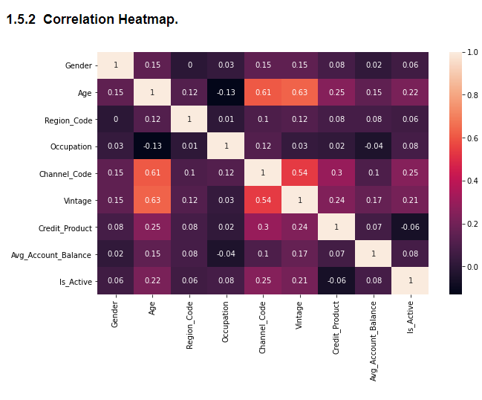
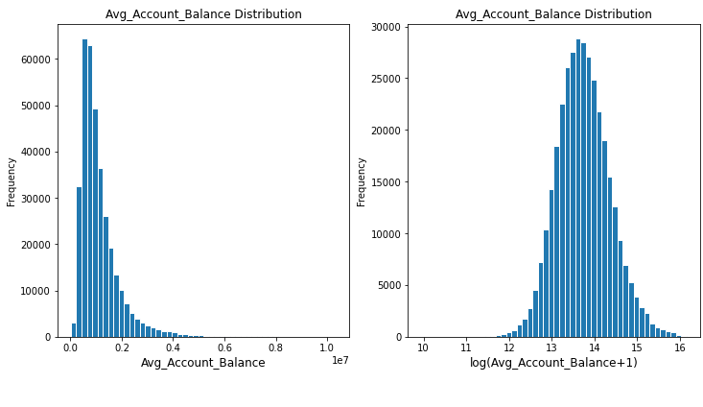
Project analysis slide 11
Visualization/Charts
Log Transformation of Avg Account Balance

Slide 10
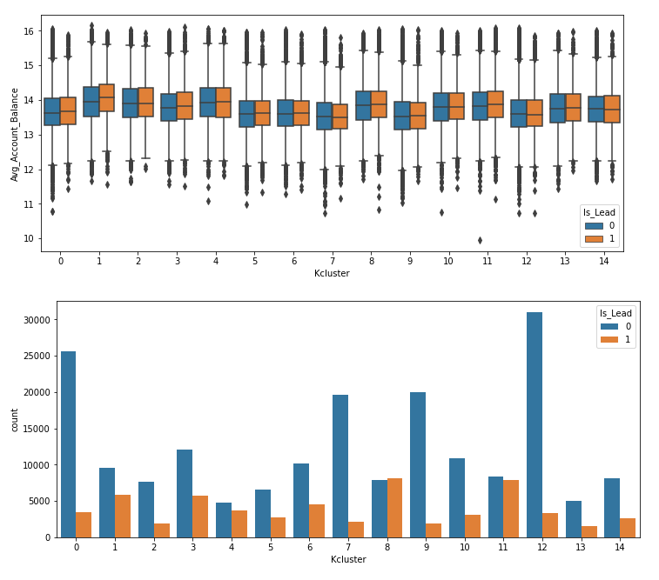
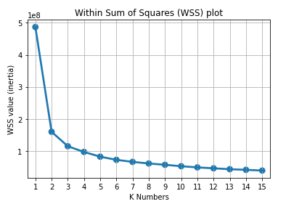
Project analysis slide 11
Visualization/Charts
Kmeans Clustering- WSS plot

Slide 11
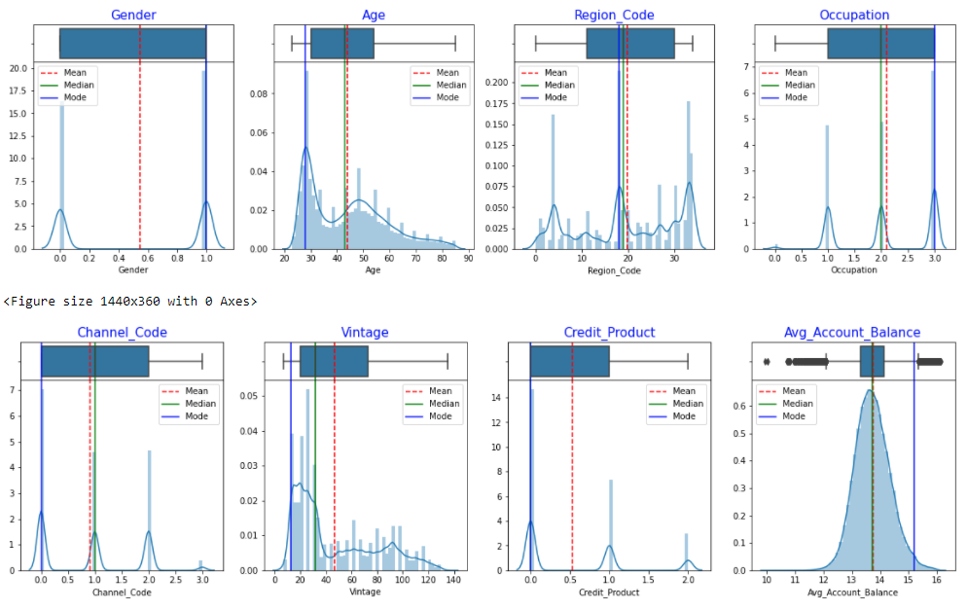
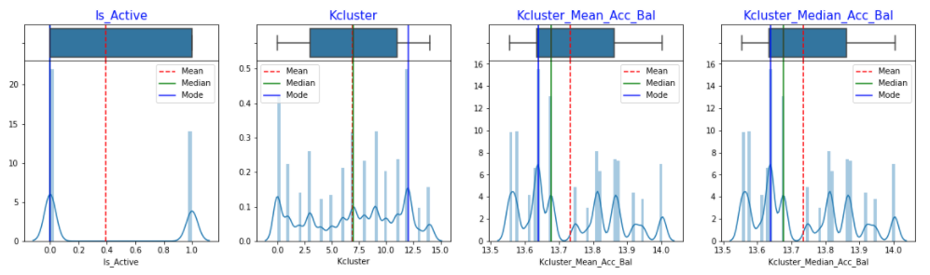
Project analysis slide 11
Visualization/Charts

Slide 12
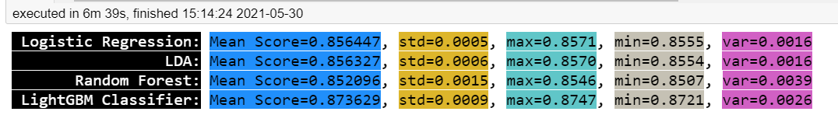
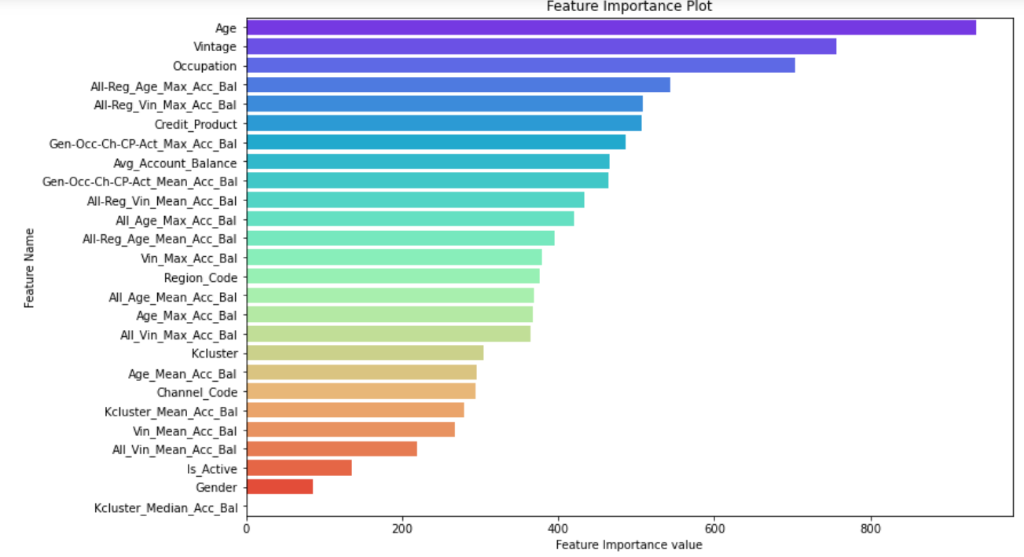
Project analysis slide 11
Visualization/Charts

Slide 13

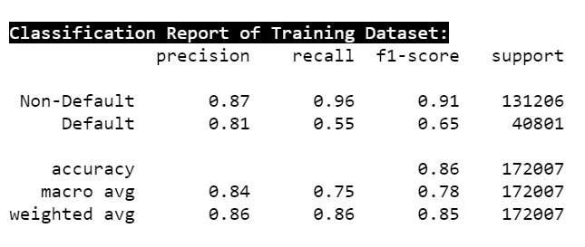
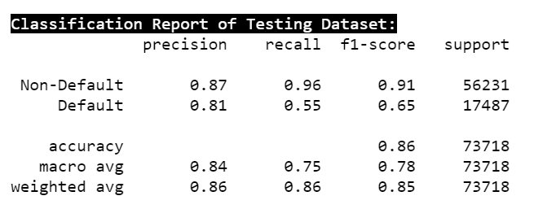
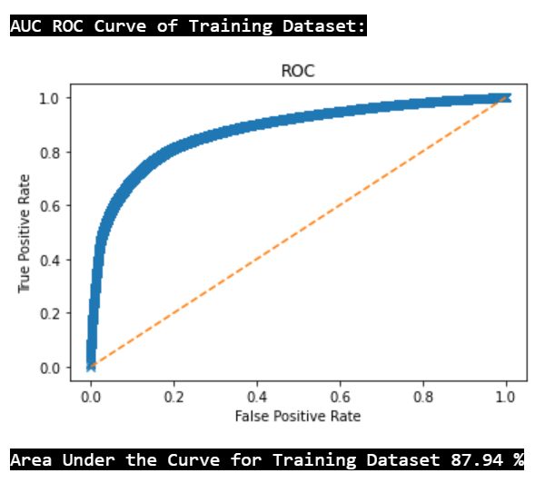
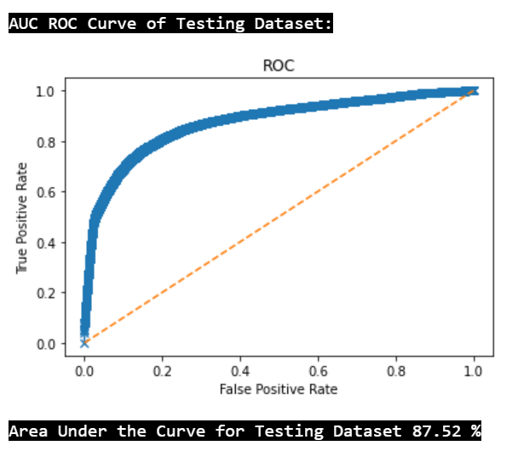
Project analysis slide 11
Final model performance on 70:30 Train-Test split.

Slide 14
Project analysis slide 11
Conclusion
Conclusion/Next step for the Bank.
The performance of final model with roc auc score of 87% means this model is able to 87% of True positive and True Negatives. This is very good compared to gut feeling or guess of Bank’s marketing team.
Bank can use this model to focus on positive leads which can be further optimized by threshold tuning to get a better f1 and recall score for class 1(positive leads).
This may increase the False positives slightly but bank can decide on how much False positive will be acceptable to get more of class 1s correct.
False positive means money being spent on not so promising leads, but slight increase in false positive will not hurt, as more earning from True leads will cover for slight increase in cost.
Banks need to run targeted marketing and promotional campaign on these Promising leads to convert them into future customers.

Slide 15
Thank You
Marketing and Retail Analytics Project Report
Submitted By: Abhinava Kumar Saha
Batch: PGP-DSBA Jun 20-B
Date: 25th April 2021

