Slide 1

Late Delivery Prediction
for e-commerce Supply Chain
Author: Abhinav Ahluwalia
Date: July 15, 2021

Slide 2

Outline
Introduction & Problem Statement
Dataset & Wrangling
EDA and findings
Machine Learning
Conclusions

Slide 3
Introduction and Problem Statement
Customer:
Goal:
Requirement:
Our target business is an e-commerce supply chain business. The business has two major concerns in its business operations:
It is facing high customer churn of unsatisfied customers due to late deliveries
It is facing losses due to fraudulent transactions
The goal is to identify patterns in the sale data to come up with insights regarding customer churn with emphasis on late deliveries since it is a key driver for customer satisfaction.
The business has decided to consult a data analytics firm (us) and wants to figure out:
Any insights they can find on their business in terms of their product catalog and customer base.
Which customers can they target immediately to reduce churn and boost sales.
Do any patterns emerge from their customer base and transactional data that can point to patterns in late deliveries and fraudulent transactions.
A prediction model that can predict late deliveries using the order/sale data before they occur.

Slide 4
The Dataset
The data used is the transactions of all sales by product from January 2015 to January 2018 for a reputed ecommerce business. The data is published by DataCo and can be downloaded from : https://data.mendeley.com/datasets/8gx2fvg2k6/5
It contains metadata of 44 features for every sale/transaction by product.
The dataset is relatively clean with just 3 features containing null-values.

Slide 5
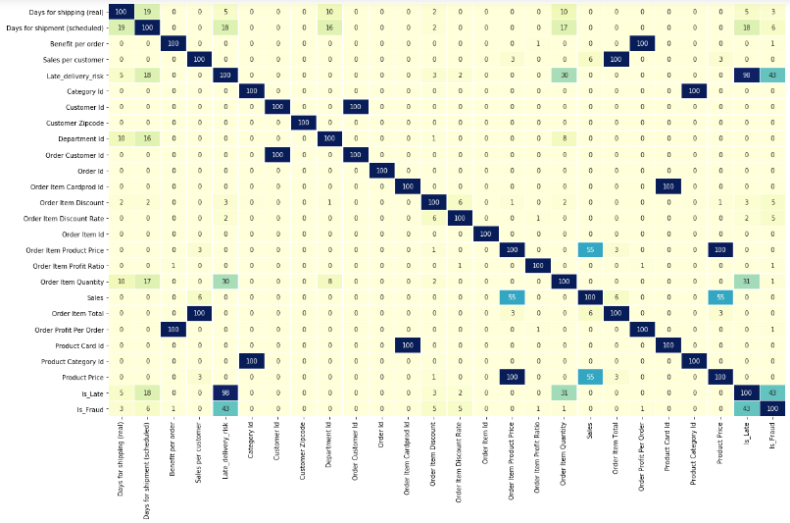
Data Wrangling
The data set was relatively clean with only 4 out of 45 columns having any null values.
The following steps were performed to prepare the dataset for use:
Columns with large missing values were dropped - Order Zipcode & Product Description
Unnecessary columns with useless information were dropped such as Customer Password, Customer Street, Product Image etc.
First Name and Last Name were combined to remove repetitiveness.
It was suspected that there are multiple features with duplicate values. To confirm and address this, a heat map was made of comparison of all columns. 100% matching columns were removed to deal with duplicates (shown to the right).
Two new columns - Is_Late & Is_Fraud were created as target variables for the machine learning algorithms
Standardization of the data set was also performed before implementing machine learning algorithms.

Slide 6
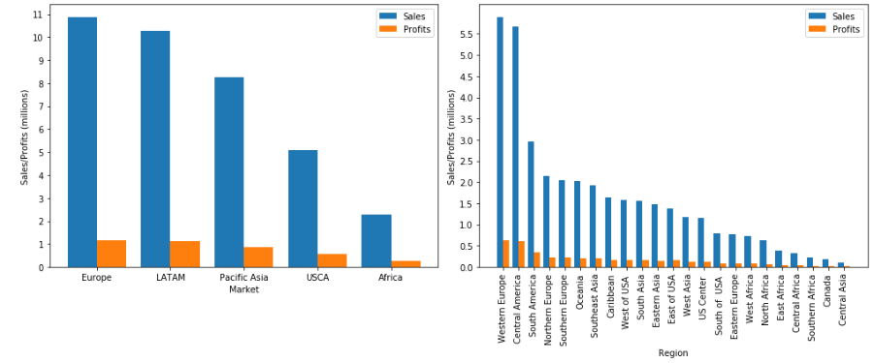
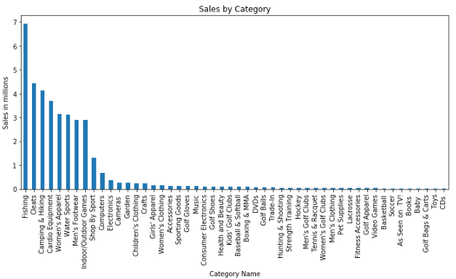
EDA and research
Sales data by Region
Shows that Western Europe and Central America are the geographies with the highest sales and hence the largest consumer base.
Sales data by Product Category
Shows that the top 8 categories carry most of the sales volume. Fishing product category leads in sales followed by Cleats.

Slide 7
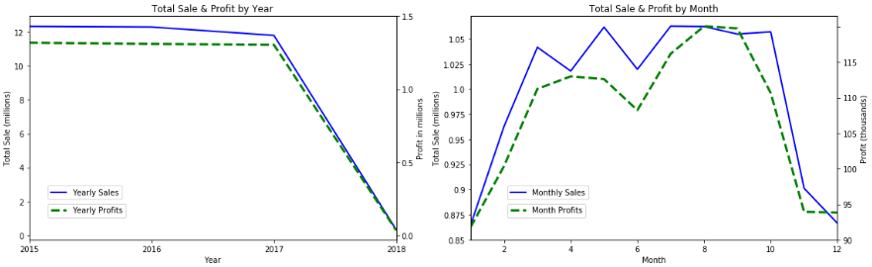
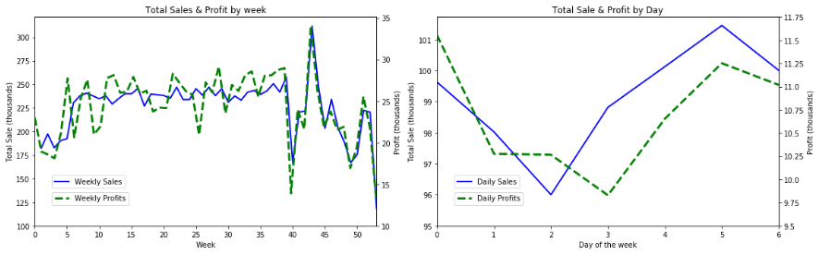
Time series based Sales and Profit Analysis
Key Takeaways:
Dip in sales post 2017 Q3
Dip in sales in Jan and Dec
Friday, weekends are the busiest.

Slide 8
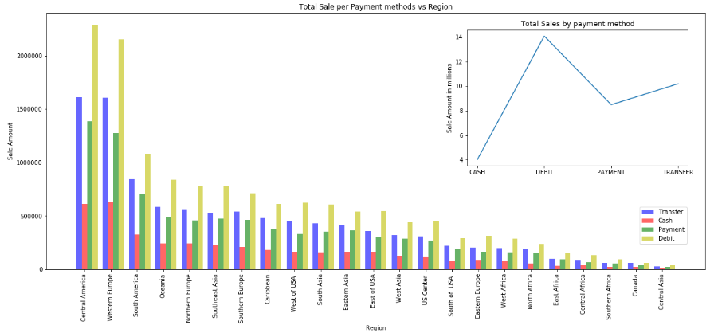
Analysis of Payment Methods
Key Takeaways:
Debit is the most preferred type of transaction throughout regions.
Cash is preferred the least

Slide 9
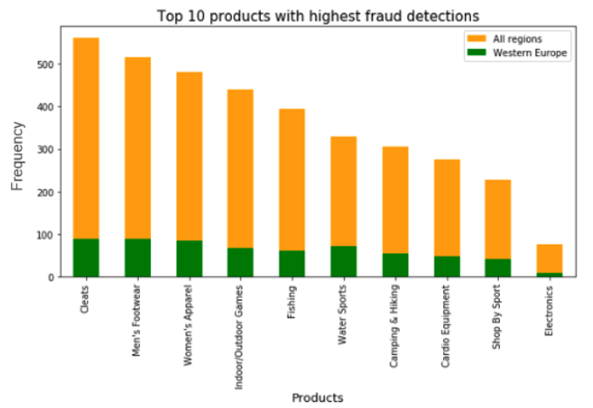
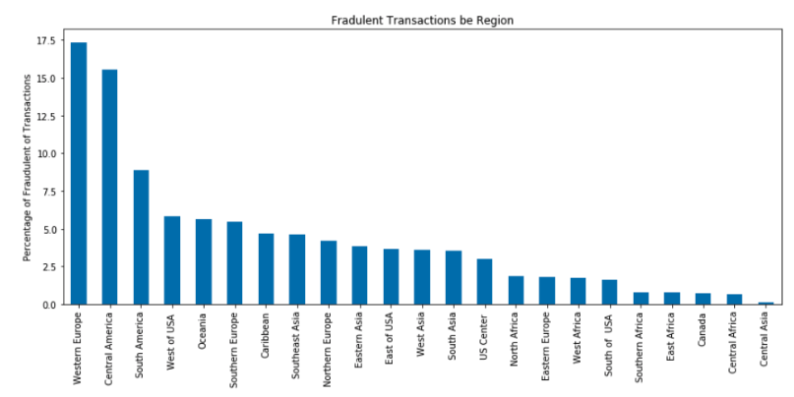
Analysis of Fraudulent Transactions
Key Takeaways:
Maximum fraudulent transactions in Western Europe & Central America
Products with maximum fraudulent transactions – Cleats & Men’s Footwear.

Slide 10
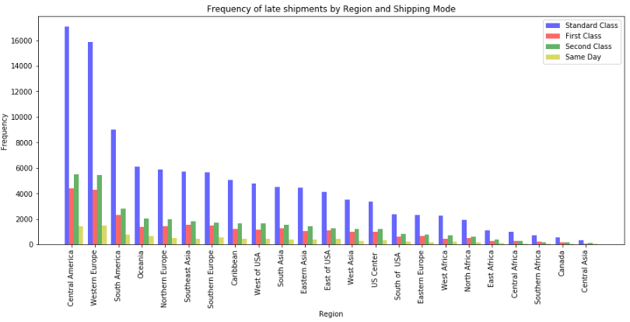
Analysis of Logistics Efficacy
Key Takeaways:
The effect Shipping Mode is evident from the graph with Standard Class performing the most poorly.
Late deliveries seem to be proportional to sales by region.

Slide 11
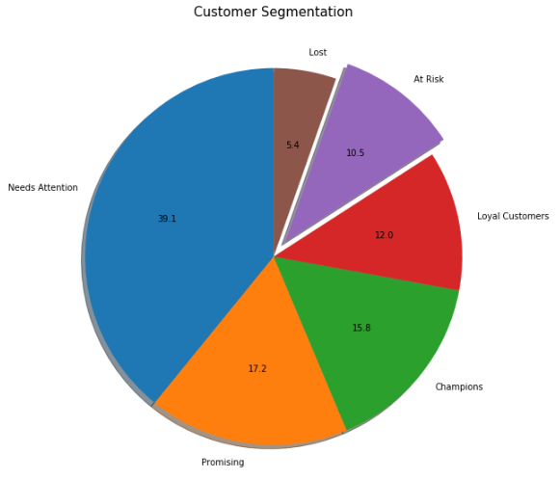
Customer Segmentation and Strategies to lower churn
Key Takeaways:
RFM (Recency, Frequency, Monetary) segmentation technique applied to categorize customers and assign a score
Handy tool for targeted promotions to boost sales and customer loyalty
10.5% customers are at risk of attrition and nearly 40% need attention!

Slide 12
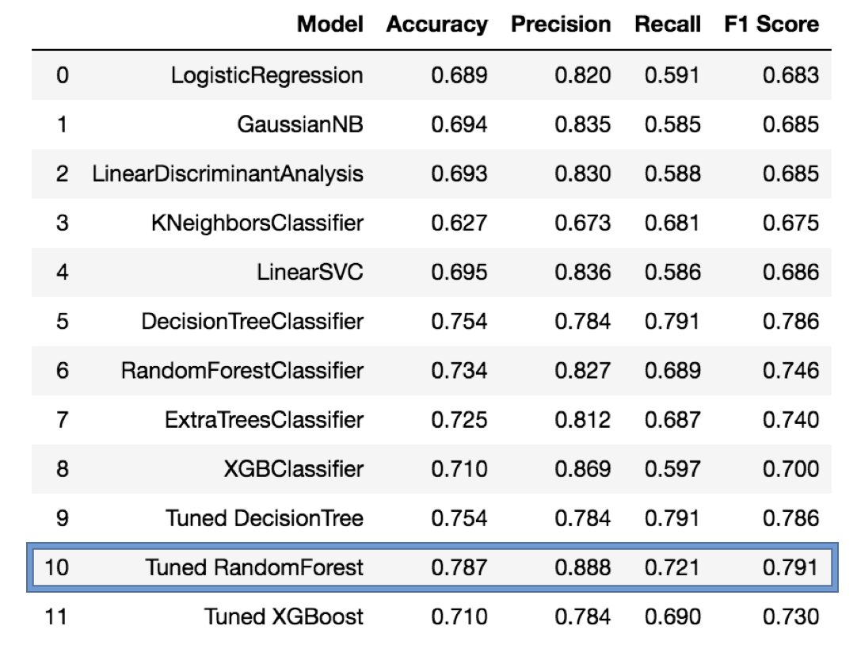
Machine Learning
The prediction task of predicting whether a sale would be delivered late or not is that of binary classification.
To this effect, we use industry standard classification algorithms and compare their performance using cross validation techniques.
The most efficient algorithms are considered for tuning of hyper parameters in order to use the best performing model for production.
Random forest turned out to be the best model for late delivery prediction
Below is a summary table of classifier performance:

Slide 13
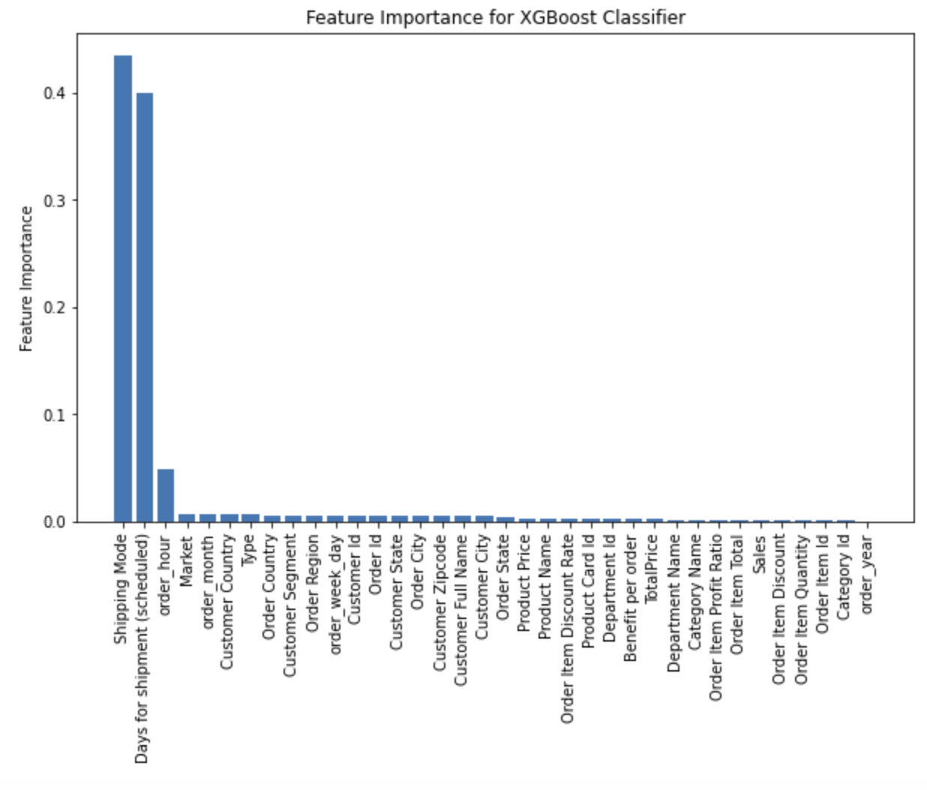
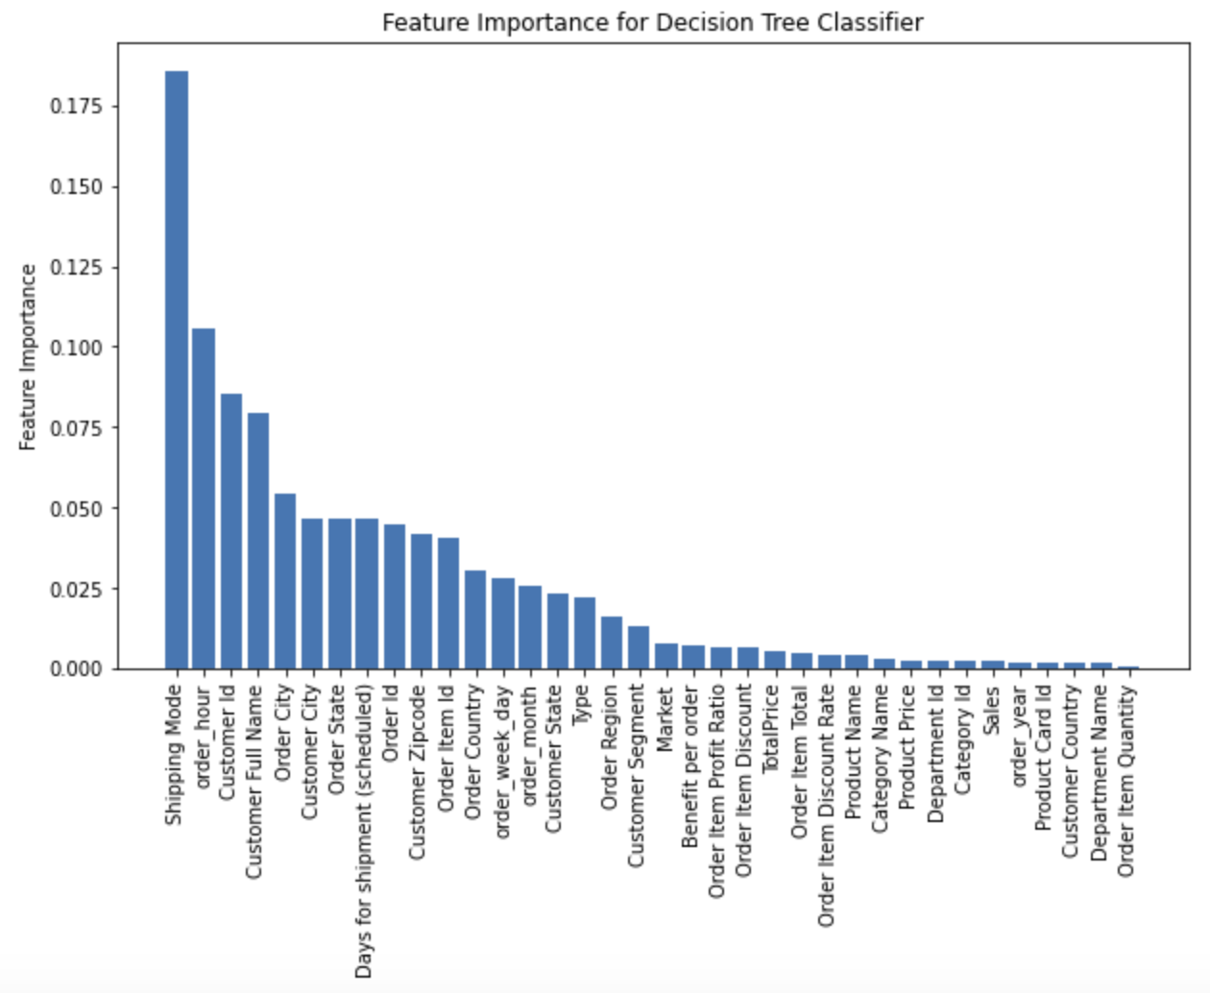
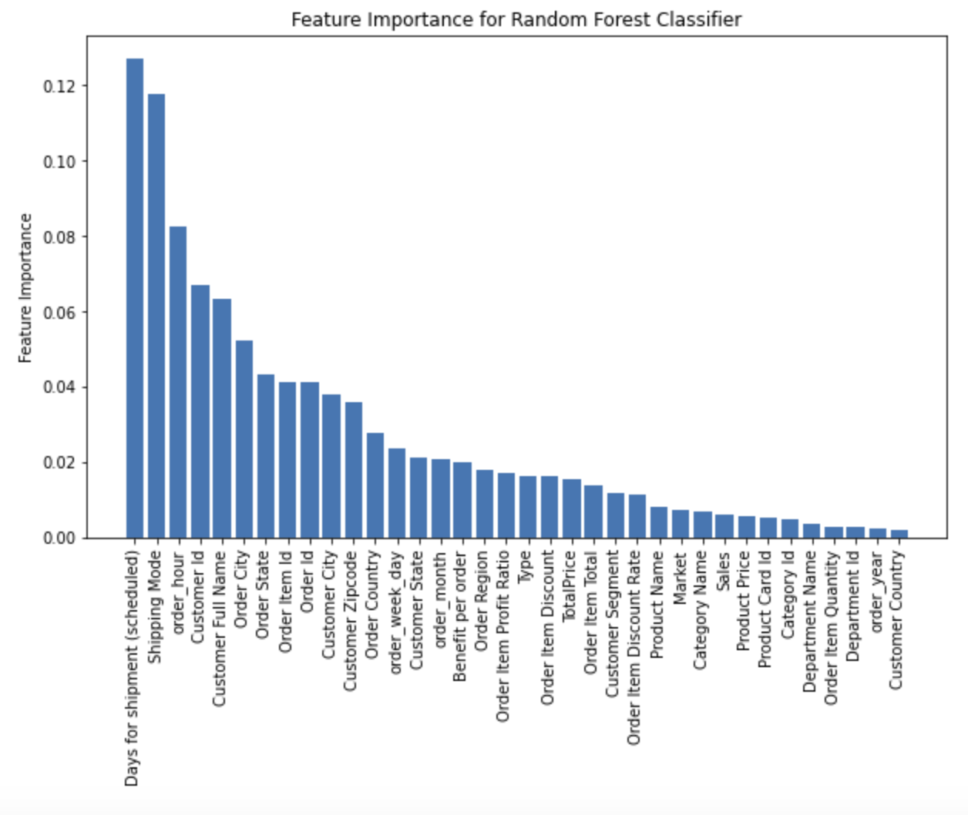
Feature Importance
We look at the feature importance assigned by the tree based models.
Shipping mode, Scheduled shipment days and order hour have the maximum weightage in all three models

Slide 14
Conclusions:
Sales and Geographies:
Highest sales from Western Europe and Central America. Good to improve services in these regions. Also responsible to highest fraudulent transactions.
Important to look into the sales dip in Q1 2018.
Wire transactions highest contributor to fraudulent transactions. Better checks and balances required in place.
Customer Segmentation:
The RFM technqiue deployed clearly shows a lack of customer retention techniques with almost 50% of the consumers falling under the 'At Risk' and 'Needs Attention' categories. This segmentation can help guide a comprehensive customer loyalty program which can help reduce the consumer churn significantly.
Logistics Efficacy:
Supply chains of ‘Cleats’, ‘Men’s Footwear’ and ‘Women’s Apparel’ to be better optimized to reduce late deliveries.
The prediction model developed can predict with nearly 80% accuracy when deliveries will be late. The model can be deployed and put to immediate use to improve logistics performance and in turn customer satisfaction
'Shipping Mode', 'Days for shipment (scheduled)' and 'order_hour' have the maximum impact on prediction of late deliveries. In order to improve the logistics efficacy the company can:
Improve or switch the logistics for increased reliable performance on lower priced shipping modes.
Incorporate the order traffic and same day dispatch feasibility (these parameters could be indicative of 'order_hour') into the shipping estimates when orders are placed by customers.

