Slide 1
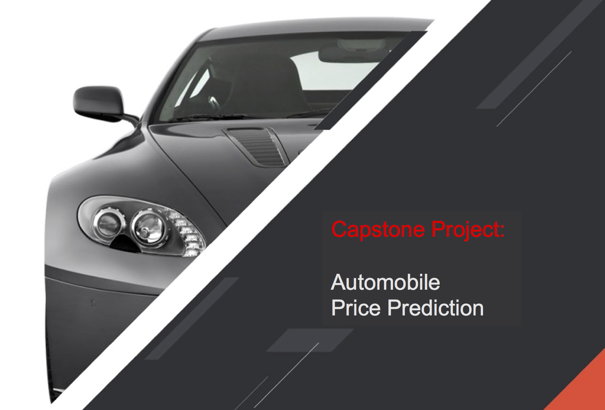
Author: Abhinav Ahluwalia
Date: June 4, 2021

Slide 2
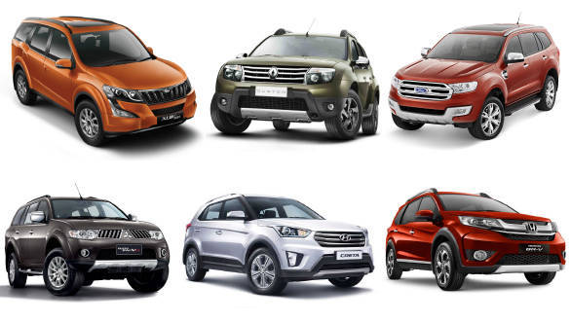
Outline
Introduction & Problem Statement
Dataset & Wrangling
EDA and findings
Statistical Inference
Machine Learning
Conclusions

Slide 3
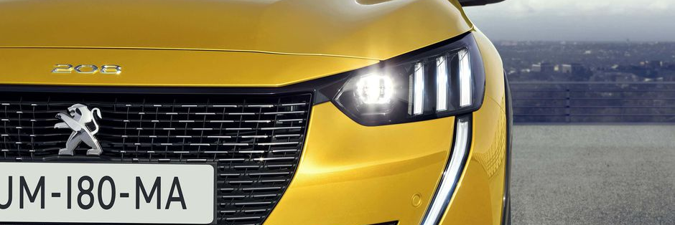
Introduction and Problem Statement
Customer: Our (imaginary) customer is a French car manufacturer Peugeot Automobiles.
Goal: Peugeot aims to enter the Indian Market by setting up a manufacturing unit in India. They wish to compete in the Indian market against their European counterparts.
Requirement: 1. Understand which factors influence the car pricing in the Indian Market.
2. Develop a pricing model for estimating the price of their new car to be launched in the Indian Market

Slide 4
The Dataset
The dataset chosen is the Indian Cars Dataset from Kaggle
https://www.kaggle.com/medhekarabhinav5/indian-cars-dataset
It contains a variety of features such as Model price, Engine related features, Body and comfort related features etc (Over 140). This makes it the optimal dataset for making a pricing model.
The dataset has reliable data though some amount of wrangling will be required due to the shape of the data and the missing entries.

Slide 5
Data Wrangling
The following steps were taken to wrangle the data and make it ready for ML :
Common sense shortlisting of features
The 140 available features were reduced to 24 by looking at practicality of the feature as well as the amount of missing information.
Cleaning, extracting and address missing values
Numerical Variables (Present along with units as strings in the database)
String consistency checks and extraction using Regex.
Filling in missing values using grouping and imputation over other logical variables.
Standardize the numerical variables after feature selection.
Categorical Variables
Reduction in categories by removing duplicate categories.
Filling missing values using grouping and imputation over other logical variables
Get dummies for categorical variables after feature selection.
Removing Outliers
Limiting the dataset to cars within the Rs. 2 Cr range.
Removing outlier entries identified by z-test over normally distributed numerical variables.
Removing outliers during linear modelling using studentized residuals, leverage and dffits.
Transformation of target variable
During the initial modelling stage, to obtain linearity in the model, we perform a log-transform on the target variable.

Slide 6
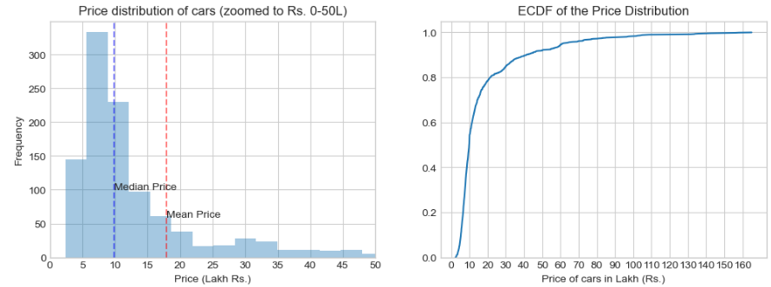
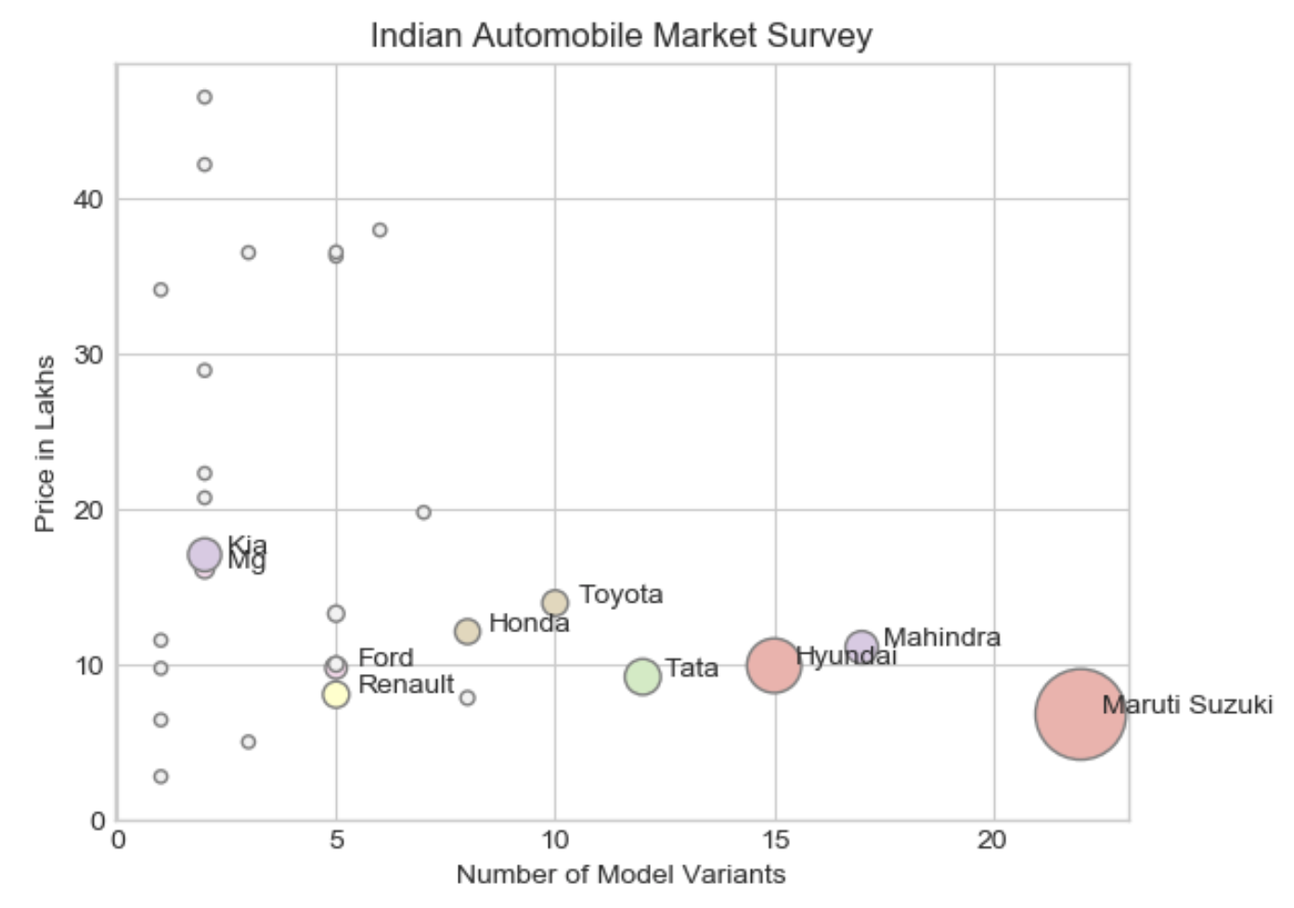
EDA and research
Price distribution characteristics:
50 percentile = Rs. 10 Lakhs
80 percentile = Rs. 25 Lakhs
Right-Skewed distribution
Competition Analysis:
A clear trend in strategy is observed when we plot the Variety vs Average Pricing and contrast it with the market size:
Indian automobile buyers gravitate towards low prices and high variety. Maruti Leads the space with 50% market share

Slide 7
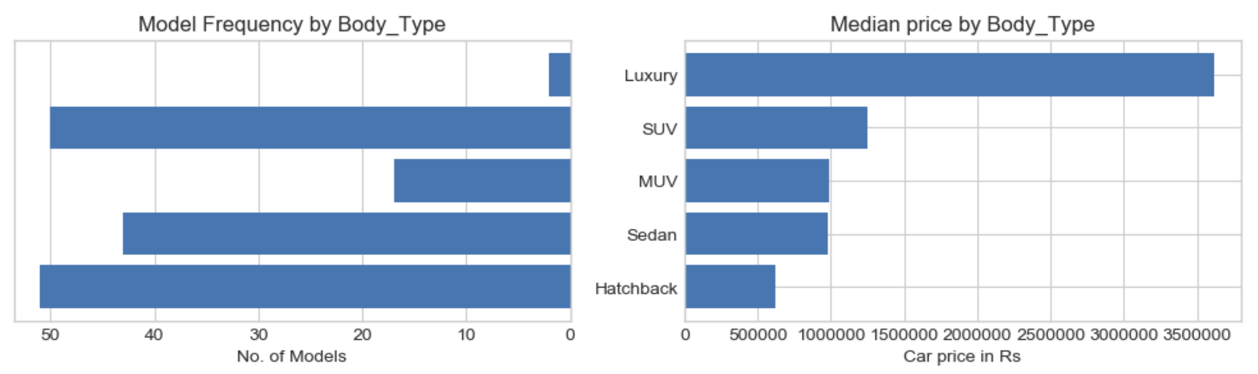
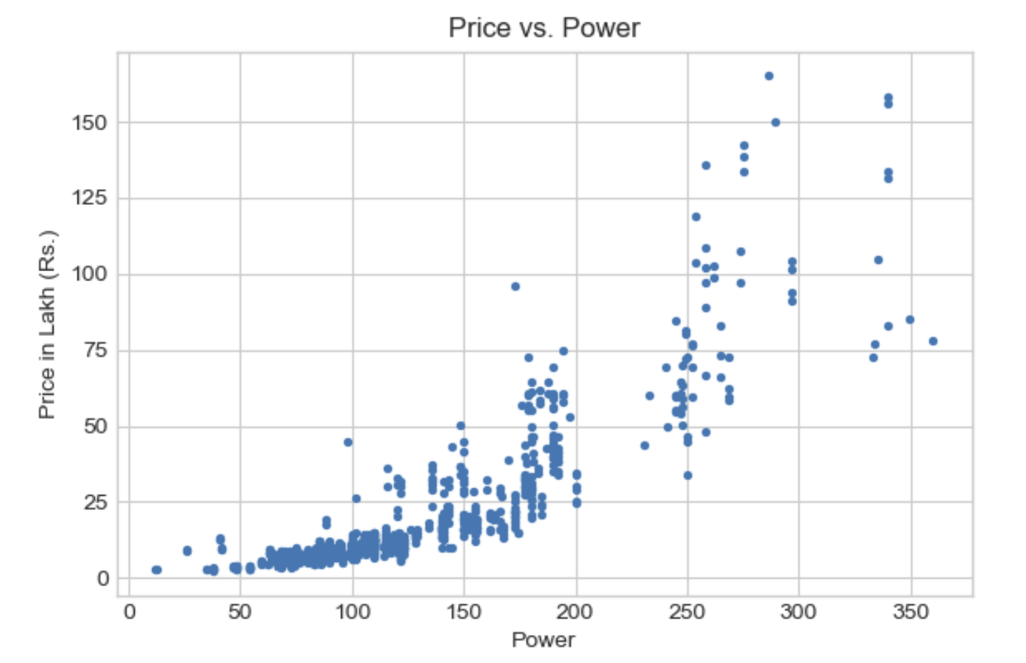
Two of the important features plotted against price:
Body Type vs Price:
The type of body of the car has a significant impact on the Price
Engine Power vs Price:
The horse power output of the engine has the strongest correlation with Price and turns out to be the most influential feature.

Slide 8
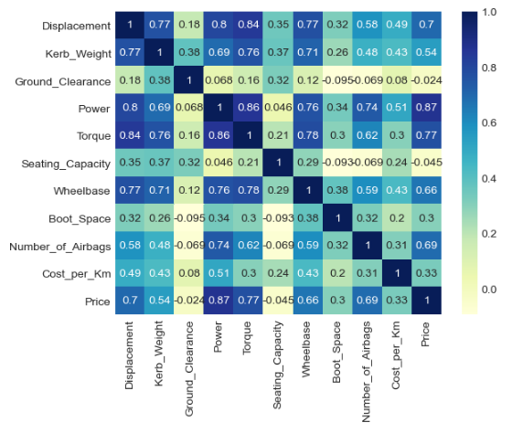
Statistical Inference & Feature Selection
The following Statistical Techniques employed for feature selection:
1. Persons Correlation:
Correlation assessment between numerical predictors and the response variable
Multicollinearity assessment amongst numerical predictors

Slide 9
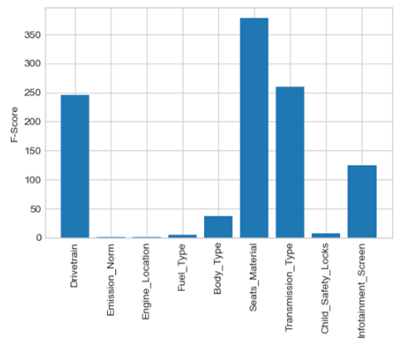
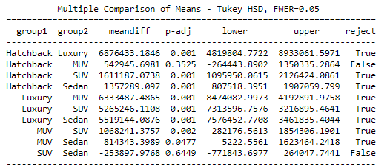
2. ANOVA
The null hypothesis : There is no difference between the means (obtained from the numerical variable) of the categories of the categorical variable.
The alternate hypothesis : The mean of at least one category is significantly different.
Used to shortlist categorical features of significant importance to the target variable
3. Tukey HSD test
Used to identify the significant categories for the variable Body Type.
ANOVA results
Tukey HSD results

Slide 10
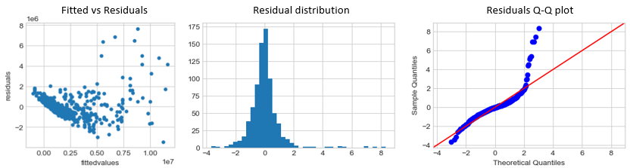
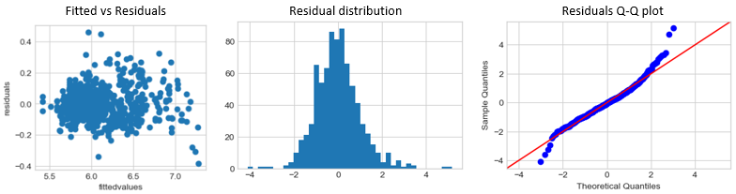
Machine Learning
Linear Regression
To model the data accurately though Linear Regression, the following techniques were employed:
1. Try the linear regression with raw data
(Problems with linearity and homoscedasticity observed)
2. Log transform the target variable
(Problems with outliers detected)

Slide 11
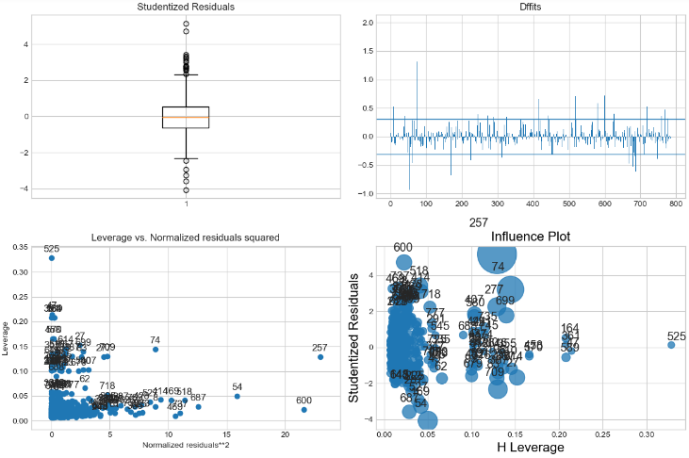
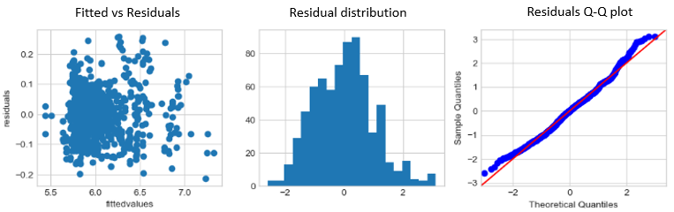
3. Remove the outliers and re-assess the model.
We are ready to try different linear regression models.

Slide 12
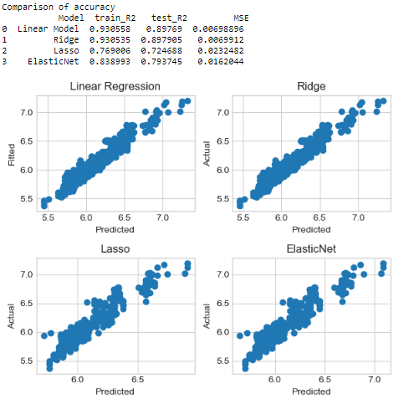
4. Try different types of linear regression models with tuned hyper-parameters.
Ridge regression proves to be the best model!

Slide 13
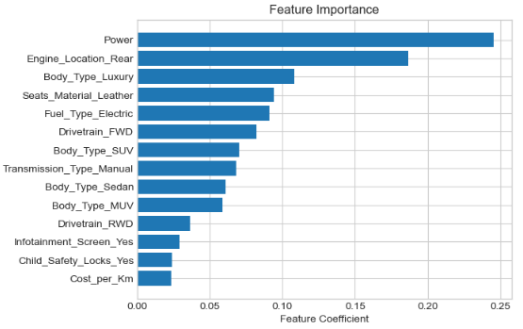
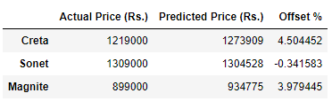
Feature importance and check on unseen data
Feature Importance
Unseen Data Performance:
We check the following 3 cars to assess the performance of our linear regression model against unseen data.
Hyundai Creta S - Ex-showroom Price: 12.19 Lakhs
Kia Sonet GTX Plus Turbo DCT DT - Ex-Showroom Price: 13.09 Lakhs
Nissan Magnite Turbo CVT XV - Ex-showroom Price: 8.99 Lakhs

Slide 14
Conclusions:
Power is the most significant factor in determining the Price of an automobile in the Indian Industry. Followed by engine location and body type.
The developed linear regression model has a test set prediction accuracy of 89% hence can be used by the customer to ballpark the entry price point of their new launch
Suggested Improvements:
Use ML classification techniques to define the price points along with direct identification of competition. Use a combination of body type grouping and price binning to identify classes of interest.
Improvement of the dataset by acquiring data for car models throughout the last 10 years.

