Slide 1

STOCK ANALYSIS
PREDICTIONS
D-CODERS

Slide 2

CONTENTS
Introduction
Block Diagram
Use Case
Technology
Showstoppers

Slide 3

Stock Analysis & Predictions
Web application for analysing and predicting prices of stocks of NIFTY 50 companies.
Analysis of stock prices of a company and graphs for visual representation.
On the basis of past data the model predicts future prices.

Slide 4

Functional Block Diagram
Streamlit
yfinance
Load Data
Raw Data
Prophet
Display
Forecast
Data
Graphs

Slide 5
Use Case Diagram
The "Load Data" use case involves loading stock data from a file or an external API.
The "Analyse Data" use case involves analysing the loaded data and computing various statistics, such as the mean, median, and standard deviation of the stock prices.
The "Visualize Data" use case involves visualizing the analysed data, such as by plotting a graph of the stock prices over time.
Stock Analyst
Load Data
Visualize Data
Analyse Data
Stock Stats
Forecast
Graphs

Slide 6
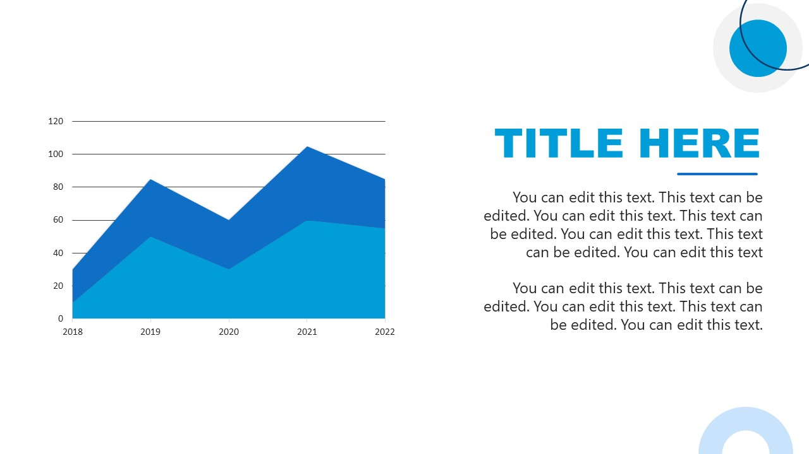
Technology Stacks
Python: Programming language used to write the code
Streamlit : Python library used to build the web application
Prophet: Python library used to perform time series forecasting
yfinance : Python library used to fetch stock data from Yahoo Finance
plotly : Python library used for interactive visualization

Slide 7
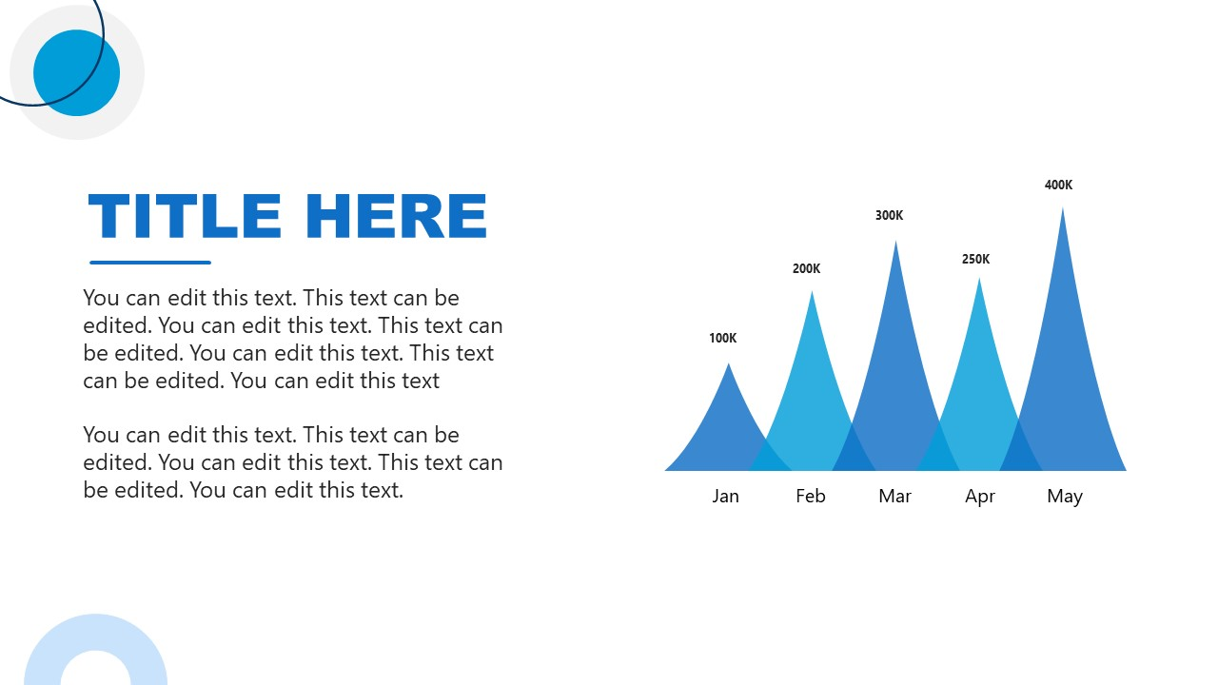
Show Stoppers
The code relies on external libraries such as Prophet and yfinance. If these libraries change or become unavailable, the code may break.
Market events such as pandemics, economic recessions, or natural disasters can significantly impact stock prices, and historical data might not be representative of future market behaviour.
Prophet is a forecasting tool and not a crystal ball; hence, it cannot predict future market behaviour with complete accuracy.

Slide 8


