Slide 1
S-BINS AUTOMATION FOR GREATER GOOD
TEAM NO-7
K.ABHINAVA KARTHIKEYA
SAI ABHINOV CHOWDARY
SWETHA
NISHITHA
HRISHIKESH
D.SAILAJA

Slide 2
CONTENTS
S.no | Title | Pg no.
1 | INTRODUCTION | 3 to 4
2 | COMPONENTS USED | 5 to 19
3 | PROJECT DESCRIPTION | 20 to 30
4 | SOCIAL APPLICATION | 31
5 | CONCLUSION | 32
6 | ACKNOWLEDGEMENT | 33
7 | REFERENCES | 34

Slide 3
INTRODUCTION
“SMART CITIES” ,this is the word we often hear these days. Smart cities are cities with smart solutions for different problems. Managing our household waste is a small problem for us. But when it comes to factories ,movie theatres ..,etc a large scale of waste is collected. It is not an easy task to separate those waste . For this problem we have a smart solution known as “SMART BINS”.

Slide 4
The E-Smart Bins project deals with the construction and design of an automated bin that is user friendly and reduces the effort of segregation by pointing the appropriate bin for each waste with the help of it’s perceptions (sensors) ,electronic system and some mechanical establishments(servo motors).
It also provides the Status of Bins to the users i.e., whether the bin is half filled or completely filled which is necessary for maintainance of the Bins via Display board and Internet

Slide 5
COMPONENTS USED:
Arduino UNO -2
Node MCU -1
Ultrasonic sensor -4
Servo motor -3
LCD display -1
Gas sensor -1
Moisture sensor -1

Slide 6
Arduino UNO
Arduino is an open-source electronics platform based on easy-to-use hardware and software. Arduino boards are able to read inputs-lights on a sensor, a finger on the button, or a twitter message- and turn into an output-activating a motor, turning on an LED, publishing something online
The chip on the board plugs straight into your USB port and supports on your computer as a virtual serial port. The benefit of this setup is that serial communication is an extremely easy protocol which is time-tested and USB makes connection with modern computers and makes it comfortable.

Slide 7
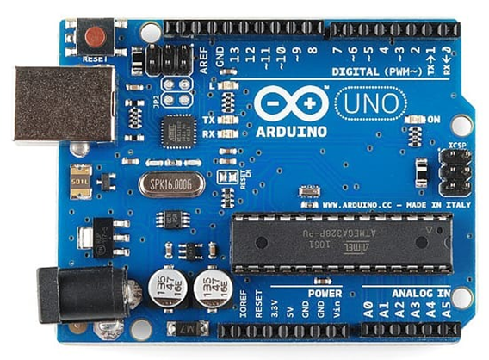

Slide 8
NodeMCU
NodeMCU is an open source firmware for which open source prototyping board designs are available. It is basically an SoC
A system on a chip is an integrated circuit that integrates all components of a computer or other electronic systems
The ESP8266 Integrates 802.11b/g/n HT40 Wi-Fi transceiver, so it can not only connect to a WiFi network and interact with the Internet, but it can also set up a network of its own, allowing other devices to connect directly to it. This makes the ESP8266 NodeMCU even more versatile.

Slide 9
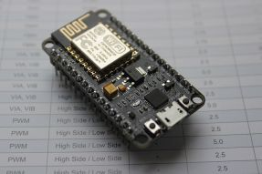
NodeMCU

Slide 10
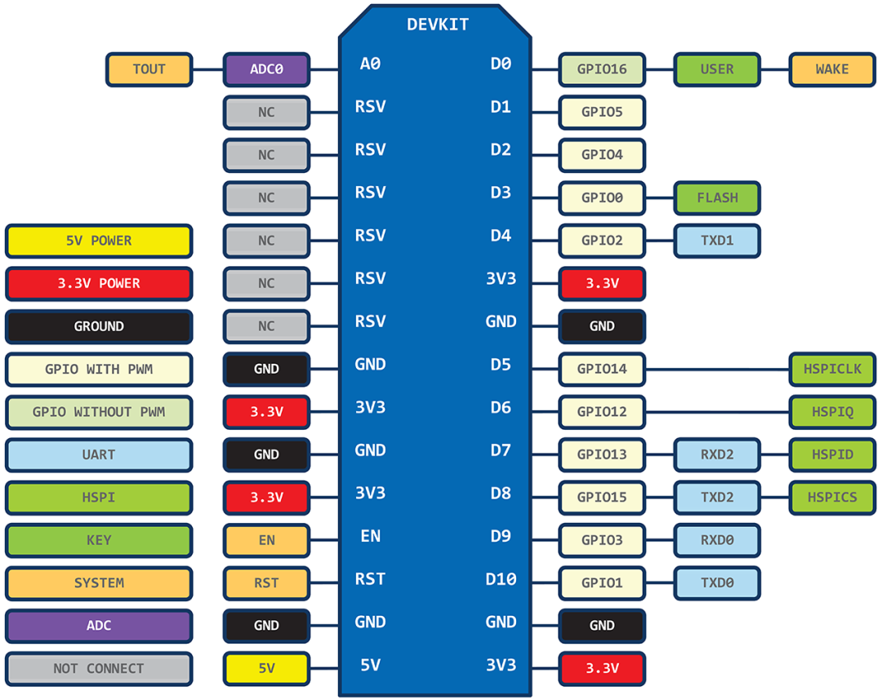

Slide 11
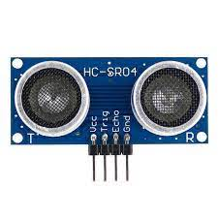
Ultrasonic sensor
An ultrasonic sensor is an instrument that measures the distance to an object using ultrasonic sound waves. An ultrasonic sensor uses a transducer to send and receive ultrasonic pulses that relay back information about an object's proximity.
Ultrasonic waves travels faster than the speed of audible sound.

Slide 12
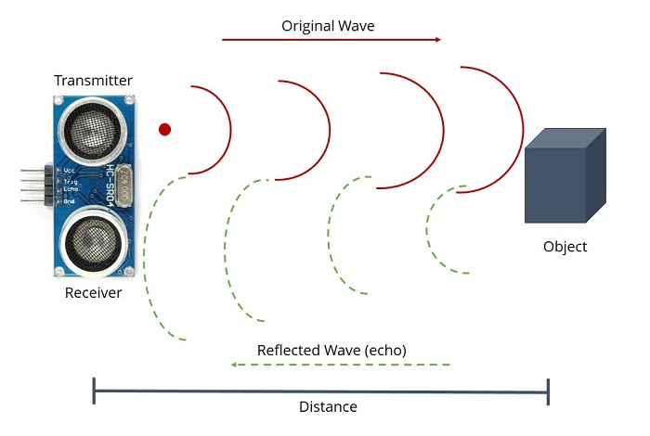

Slide 13
Servo motor
A servomotor is a rotary actuator or linear actuator that allows for precise control of angular or linear position, velocity and acceleration. It consists of a suitable motor coupled to a sensor for position feedback. ... Servomotors are used in applications such as robotics, CNC machinery or automated manufacturing.
Principle of working :
Servo motor works on the PWM ( Pulse Width Modulation ) principle, which means its angle of rotation is controlled by the duration of pulse applied to its control PIN. Basically servo motor is made up of DC motor which is controlled by a variable resistor (potentiometer) and some gears.

Slide 14
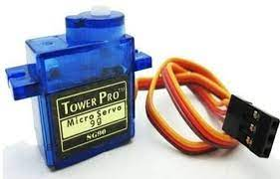
Servo motor

Slide 15
LCD Display
A 16x2 LCD display is very basic module and is very commonly used in various devices and circuits. A 16x2 LCD means it can display 16 characters per line and there are 2 such lines. In this LCD each character is displayed in 5x7 pixel matrix. ... Command register stores various commands given to the display.
They work by using liquid crystals to produce an image. The liquid crystals are embedded into the display screen, and there's some form of backlight used to illuminate them. The actual liquid crystal display is made of several layers, including a polarized filter and electrodes.
It displays the percentage of waste that is filled inside the bins.

Slide 16
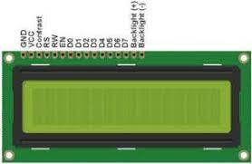
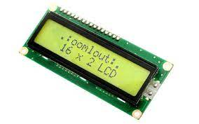
LCD Display

Slide 17
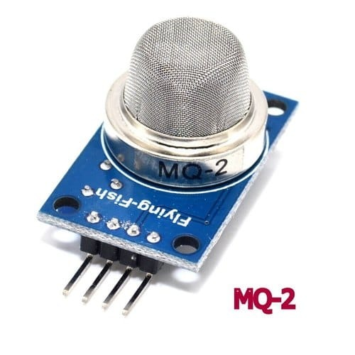
Gas sensor
MQ2 gas sensor is an electronic sensor used for sensing the concentration of gases in the air such as LPG, propane, methane, hydrogen, alcohol, smoke and carbon monoxide.
MQ2 gas sensor is also known as chemiresistor. It contains a sensing material whose resistance changes when it comes in contact with the gas. This change in the value of resistance is used for the detection of gas.
When this sensor detects any harmful gases in the waste ,then it throws them into the medical waste bin.

Slide 18
Moisture sensor
Moisture sensors measure the volumetric water content in the given component. The moisture sensor consists of two probes that are used to measure the volumetric content of water. The two probes allow the current to pass through the component, which gives the resistance value to measure the moisture value .
They are used to estimate the amount of stored water in the waste.
The Moisture Sensor uses capacitance to measure dielectric permittivity of the surrounding medium.
If the moisture content is more than 15%,then it is treated as a wet waste and is thrown into wet waste bin.

Slide 19
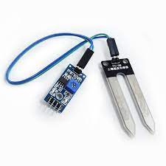
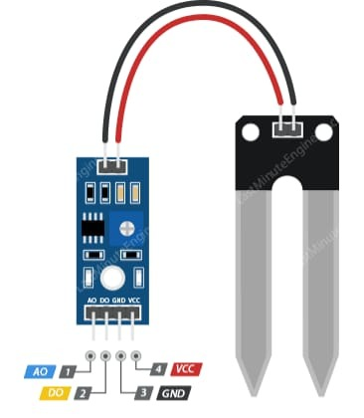
Moisture sensor

Slide 20
Project description
The basic idea of this project is to easily segregate different varieties of waste. For this purpose we are using 4 separate bins. The first bin " Use me " bin , is used as an input bin. In which the people are going to throw different kinds of waste. Different sensors are used to detect what kind of waste is it.
A Moisture sensor is used to measure the moisture content the wet waste. If a moisture sensor receives a positive input i.e., the unknown waste is turned out to be a wet waste ,then the bin 2 is opened .let's call bin 2 as a Wet waste bin. Hence that waste is transferred to wet waste bin.
A Gas sensor is used to measure the concentrations of wastes which contain harmful gases such as LPG, propane,methane,hydrogen ,alcohol or any other medical waste . If any harmful gases are detected then bin 3 let's call it as gaseous waste bin is opened and this waste is transferred into that bin.

Slide 21
If any of the waste is neither a wet waste nor a waste containing any harmful gases , then those kinds of wastes are transferred to bin 4 .let's call this bin as unsegregated waste bin. Those kinds of wastes are transferred into this bin.
There are 4 ultrasonic sensors. It measures the distance to an object using ultrasonic sound waves. With this we are finding the percentage of waste occupied in the bin.
We are using cloud platforms like "Thingspeak" and "IFTTT". The "Thingspeak" is an IOT analytic service that alloys you to aggregation, visualize and analyze live data streams in the cloud. We can send data to thingspeak from our devices ,create instantaneous visualization of the live data and send alerts.

Slide 22
Here , we are using 3 servo motors. These servo motors are used for the rotation of the top lid and bottom lid of the bin and to rotate the respective bins accordingly. Whenever they get different data about different kinds of waste, they open the lids accordingly.
In this project, we are using thingspeak. It will store the status of the bin. Whenever we want to see the amount of waste filled in each bin ,we can use Thingspeak.

Slide 23
IFTTT is a software that connects apps, devices and services from different developers in order to trigger one or more automations involving those apps, devices and services. This software send us a message whenever the bins are full. They will alert us to change the bins. In this way where ever we are, we can know about the current status of bins

Slide 24
Middle arduino (sends information to nodemcu about waste detected)
Moisture sensor (senses water content)
Gas sensor (senses any gases )
Undetected waste
Servo motor (rotates the top lid and bottom of the bin)
Ultrasonic sensor (senses how far hand is from bin and other details)
NodeMCU (checks about bin vacancy)

Slide 25
USE ME BIN
WET WASTE BIN
GASEOUS WASTE BIN
UNSEGREGATED WASTE BIN

Slide 26
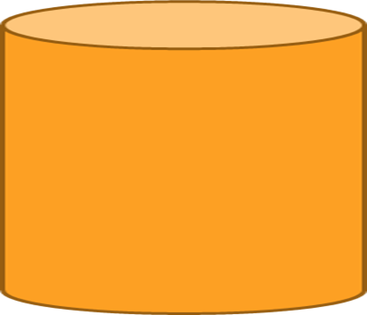



Use me
Wet
waste
Unsegregated
waste
Gaseous
waste

Slide 27
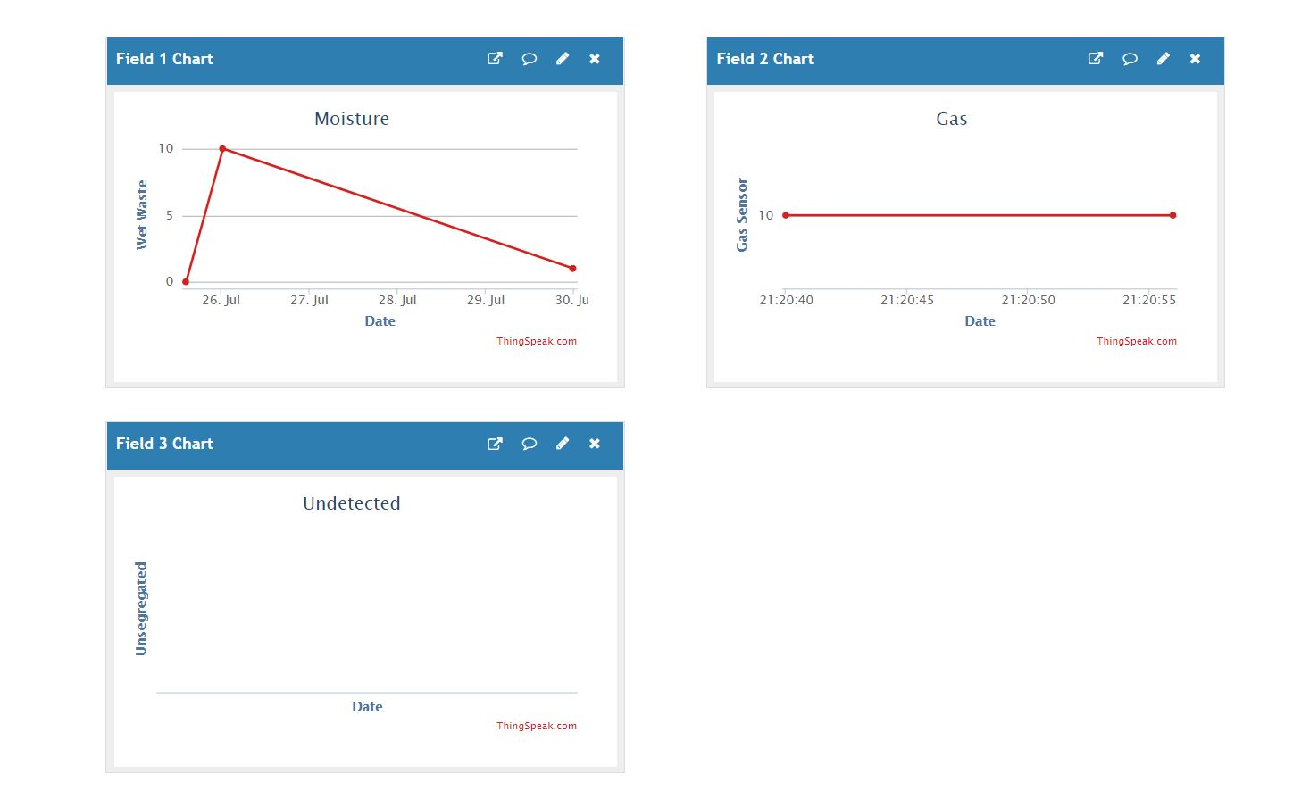
ThingSpeak Channel With Fields

Slide 28
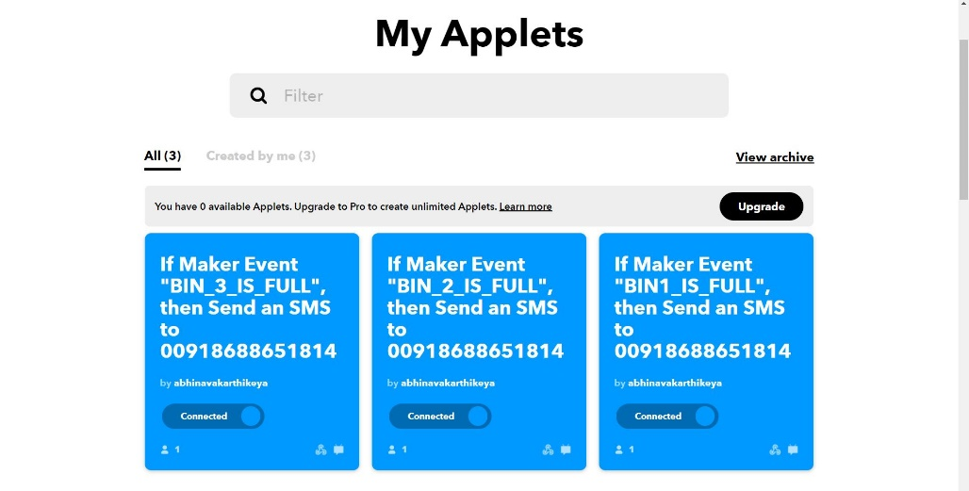
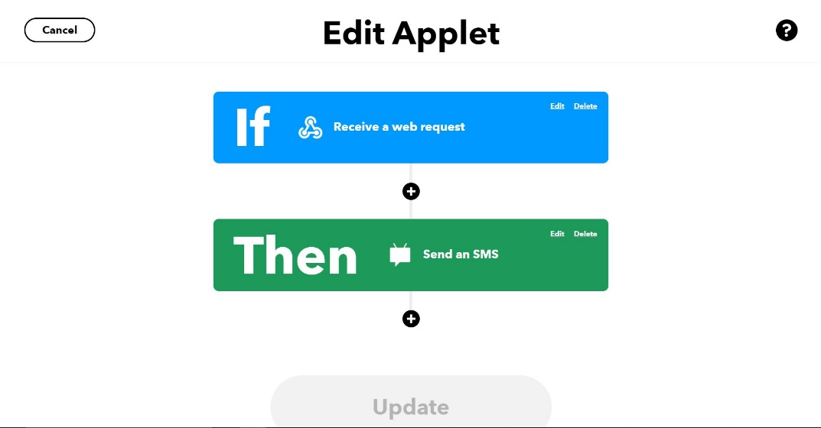
IFTTT(If this then that)

Slide 29
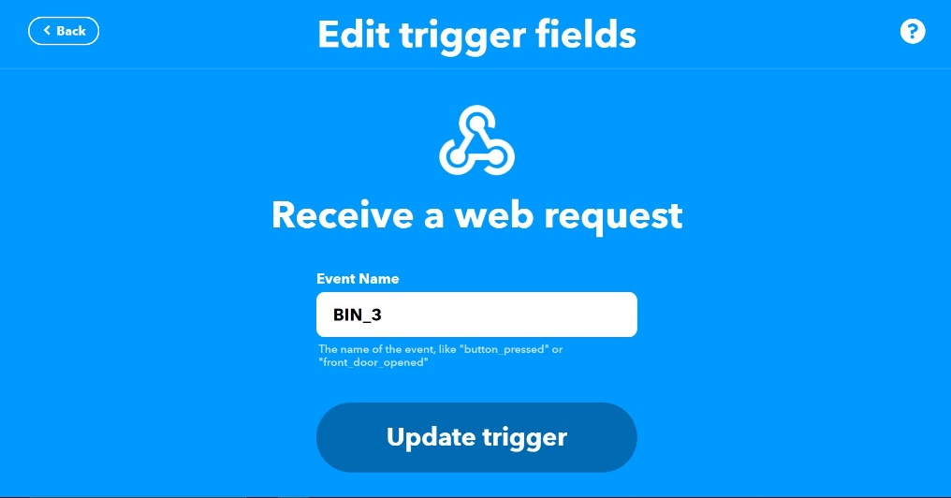
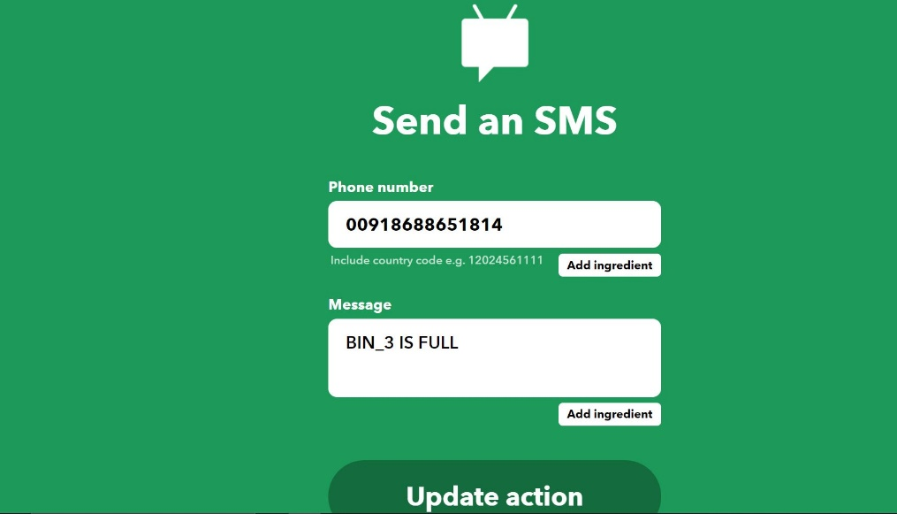
When it receives a Webrequest from Nodemcu(If statement)
It sends a message to the given mobile number.

Slide 30
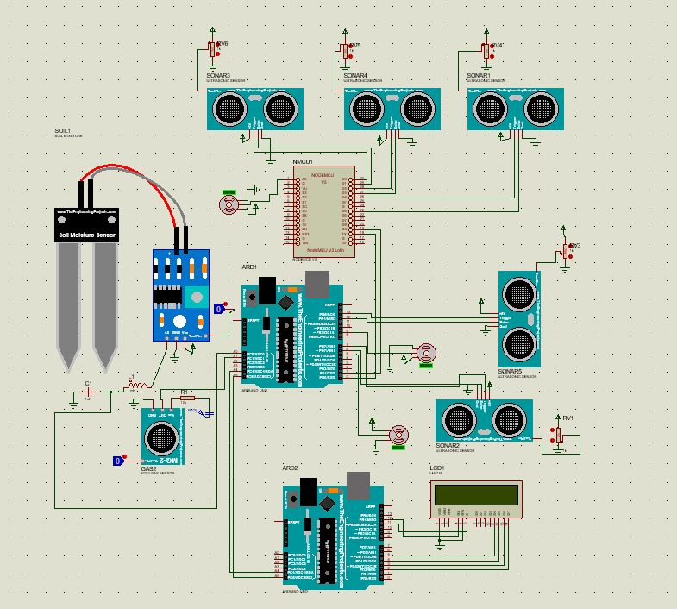

Slide 31
Social application
Waste Segregation is the first step in a compliant waste management plan that will help the environment and save the business money. ... It really does matter which bin you put the garbage into and also helps keep the cost of green waste disposal down for all businesses
It can be used at public and private places like cinema halls, parks, shopping malls and few other places where segregation of waste is neglected
It increases the quality and management of waste.
Thus it can be processed and reused most efficiently.
With slight modifications in design we can also use it for household works

Slide 32
Conclusion
The E-Smart Bins project deals with the construction and design of an automated bin that is user friendly and reduces the effort of segregation by pointing the appropriate bin for each waste with the help of it’s perceptions (sensors) ,electronic system and some mechanical establishments(servo motors).
Even today there are many literates who are very lazy to differentiate and put the wastes in appropriate bin.
Segregation of waste is a very important aspect of waste management which when done at the zero level would increase the quality of waste and thus efficiency of processing it.
Thus, we have come up with this S-bin to achieve our aim and have also included some smart features like level display and communication with bin via IOT, which makes it more user-friendly and attractive.

Slide 33
Acknowledgement
We would like to express our special thanks to IEEE robotics club for giving us this oppurtunity to do this wonderful project on the topic “SMART BINS”.
We are really thankful to our seniors in the club for giving us knowledge on various topics in robotics.
This project would not have been possible without the support of our team members.

Slide 34
References
Youtube references:
https://youtu.be/gCxovyVo-GU
https://youtu.be/F6XndxlJr9A
https://youtu.be/LJYWRTRJThY

