Slide 1
BCSE406L · NOSQL DATABASES · REVIEW 3 (DA 3)
Fleet Finance
Management System
Flask
Application layer
MongoDB
A hybrid MongoDB + Redis web app for tracking intercity bus revenue, mileage and fuel cost
Durable source of truth
Redis
Abhinavanagarajan A · 23BCE1123 · Redis
Rakshana V · 23BCE1620 · MongoDB
Vishnu Swaroop G · 23BCE1129 · Integration
In-memory live layer
D2+TD2 · Fall 26-27 · Dr Geetha S

Slide 2
The problem and the solution
The problem
MongoDB
Durable source of truth: one document per bus per day
1
Trips, odometer and diesel sit in paper ledgers
Redis
Live fleet totals, rolling averages, revenue leaderboard
2
No real-time view: weak routes and buses found late
3
Flat averages flag a normal Sunday spike or weekday dip as an anomaly
Application layer connecting the two stores
Flask

Slide 3
Five objectives, five implementations
Digital intake of singles, odometer and fuel
Submit Shift form, any number of singles per day
1
Rolling averages with above/below flags
bus:rolling:{bus_id} refreshed on every write; status stored in the document
2
Mileage (km/L) vs. the bus's baseline
total_km ÷ litres, scored GOOD / AVERAGE / LOW
3
Day-type patterns (Sunday, holiday, weekday)
Per-bus day_type_factors; Sundays judged against a Sunday baseline
4
Fast fleet ranking, expense and route-margin queries
Redis sorted-set leaderboard; MongoDB aggregation pipelines
5

Slide 4
Why NoSQL for a bus-day?
Relational: joins every refresh
Document: one atomic bus-day
DailyEntries
Singles
FuelLogs
singles[3–5]
odometer
JOIN × JOIN
fuel_fill
computed_summary
Variable singles per day means extra tables and migrations
One read returns the whole day. Redis then serves the hot read paths from memory.

Slide 5
MongoDB data model
daily_bus_logs
Embedded
{ "_id": "LOG_TN09BC1001_20260824",
"bus_id": "BUS_101",
"route_id": "RT_CHN_VLR",
"date": "2026-08-24",
"day_type": "WEEKDAY",
"odometer": { start_km, end_km,
total_km: 361 },
"singles": [ 4 x { trip_code,
departure_time, collection_inr,
passenger_count } ],
"fuel_fill": { litres, rate, bunk },
"computed_summary": {
gross_collection_inr: 20520.0,
net_margin_inr: 13039.05,
mileage_kmpl: 4.54 },
"performance_evaluation": {
collection_status: "ABOVE_AVERAGE",
mileage_status: "AVERAGE" } }
Singles, odometer, fuel fill and summary. Bounded (3–5 singles) and always read with the day.
Referenced: buses_master
5 documents linked by bus_id. Chassis, permit, baselines and day_type_factors are shared by 150+ logs, so one edit updates all.

Slide 6
Redis structures: the hot read paths
fleet:summary:{date}
bus:rolling:{bus_id}
fleet:rankings:{date}
HASH
HASH
SORTED SET
Gross collection, net margin, buses reported
7-day, 30-day, Sunday, weekday averages; 30-day mileage
Member = bus, score = gross collection
HINCRBYFLOAT · HINCRBY · HGETALL
HSET · HGETALL
ZADD · ZREVRANGE
MongoDB is the source of truth; Redis is a derived cache. Every write is a delta (new − old), so edits never double-count. rebuild_all() and audit() keep the two in sync.

Slide 7
Architecture and modules
Browser
db.py
Connections, 5 indexes, health probes
logic.py
Day type, mileage, margin, baseline rules
Flask app
app.py
generate_data.py
Seeded data: 5 buses, 150 logs
service.py
One write path: MongoDB, then Redis
Redis
summary · rolling · rankings
Service layer
service.py
redis_layer.py
Structures, deltas, rebuild, audit
queries_demo.py
The 12 queries as data specs
indexing_demo.py
explain(), timing, scale benchmark
MongoDB
daily_bus_logs · buses_master
app.py, run_all.py
Flask UI; end-to-end PASS/FAIL run

Slide 8
Shift submission flow and CRUD
1
2
3
4
5
Validate
build_log
MongoDB
Redis
UI trace
Dates, odometer, fuel, ≥ 1 single
Gross, expense, net, mileage, status
replace_one upsert
MULTI/EXEC deltas, rolling refresh
Every command shown
Operation | MongoDB | Redis effect
Create | replace_one(…, upsert=True) | Summary, leaderboard, rolling stats created
Read | find_one by _id; Sundays of BUS_101 | n/a
Update | update_one: $push late single + $set totals (gross 12,350 → 16,250) | HINCRBYFLOAT +3900, ZADD, rolling refresh
Delete | delete_one → deleted_count 1 | HINCRBYFLOAT −gross, ZREM

Slide 9
Reliability features
1
Graceful degradation
2
Self-healing cache
If Redis is down, the dashboard falls back to MongoDB queries and says so on screen.
One click rebuilds Redis from MongoDB; audit() verifies the stores agree.
3
Optimistic concurrency
4
12 automated tests
Updates apply only if gross is unchanged since read, with up to 3 retries.
Pages, all 12 queries, idempotent upsert, update, delete, validation, Redis-down fallback, rebuild.

Slide 10
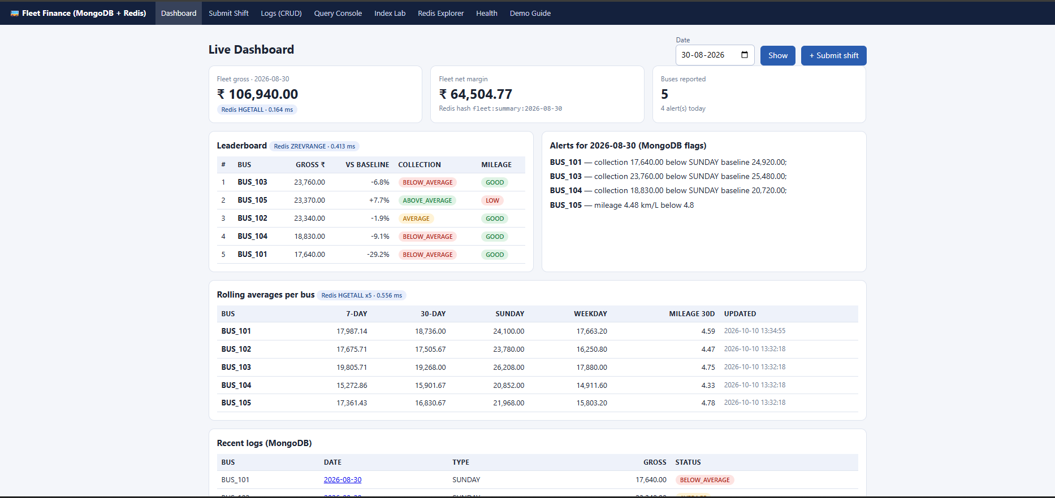
Live dashboard
Totals, leaderboard and rolling averages come from Redis; alert flags come from MongoDB.

Slide 11
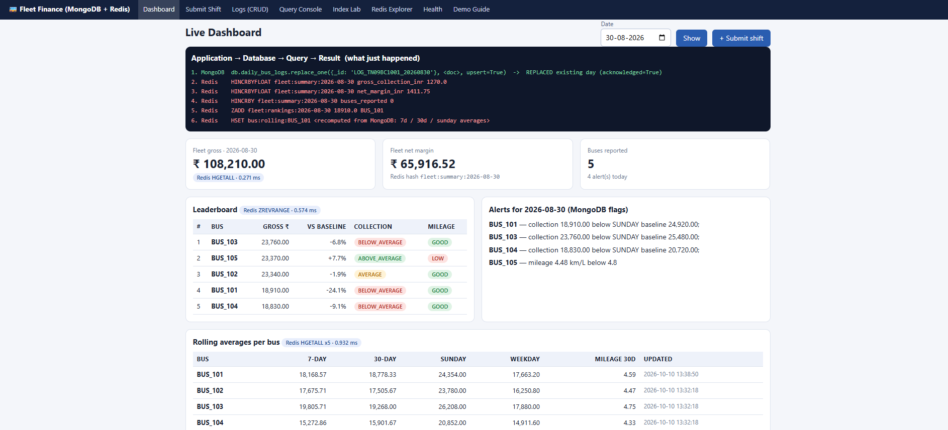
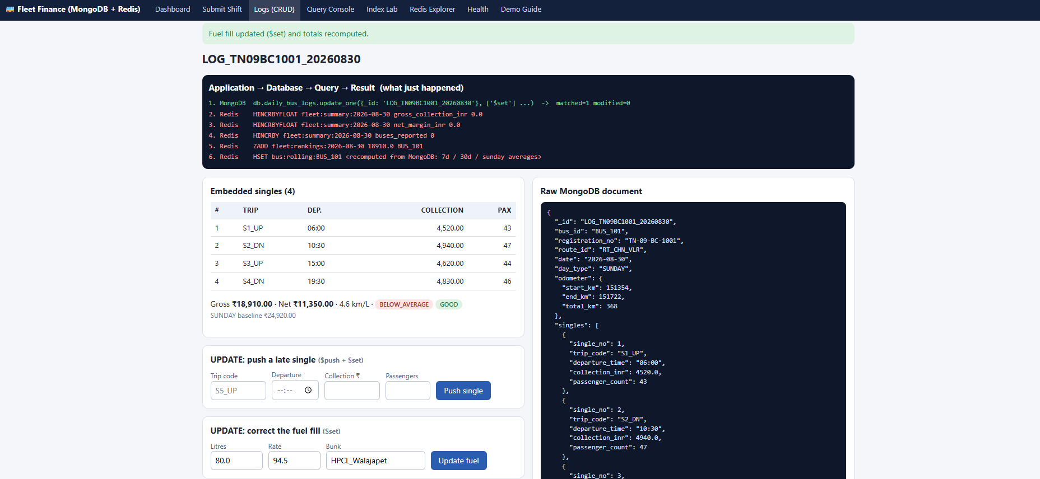
Every write is traceable
Submit Shift
Logs (CRUD)
The UI lists the MongoDB replace_one, then the Redis HINCRBYFLOAT, ZADD and HSET commands that followed.
Push a late single or correct the fuel fill. Totals are recomputed and Redis moves by the delta.

Slide 12
Important queries
Q1 · Point lookup (ix_bus_date)
Q2 · Anomaly detection (range + nested)
db.daily_bus_logs.findOne({
bus_id: "BUS_101", date: "2026-08-24" })
db.daily_bus_logs.find({ bus_id: "BUS_104",
date: {$gte: "2026-08-01", $lte: "2026-08-31"},
"performance_evaluation.collection_status":
"BELOW_AVERAGE" }).sort({ date: 1 })
Q4 · Day-type aggregation
Q7 · Route margin intelligence
db.daily_bus_logs.aggregate([
{$group: {_id: {bus_id, day_type},
avg_gross: {$avg: "$computed_summary
.gross_collection_inr"}}},
{$sort: {"_id.bus_id": 1}} ])
db.daily_bus_logs.aggregate([
{$group: {_id: "$route_id",
total_net_margin: {$sum: "$computed_summary
.net_margin_inr"}, trip_days: {$sum: 1}}},
{$sort: {total_net_margin: -1}} ])
Q9/Q10: ZREVRANGE fleet:rankings:2026-08-24 0 4 WITHSCORES · HGETALL bus:rolling:BUS_101

Slide 13
All 12 queries
# | Purpose | Feature
Q1 | Point lookup by bus and date | Compound index
Q2 | Underperforming days in a range | Nested index, sort
Q3 | Fleet-wide low-mileage flags | Nested filter, limit
Q4 | Sunday vs. weekday averages | $group, $avg
Q5 | Peak-revenue single per route | $unwind, $group
Q6 | Top-3 most profitable bus-days | Sort on nested key
# | Purpose | Feature
Q7 | Route margin ranking | $group, $sum
Q8 | Log → master reference lookup | Referencing
Q9 | Live leaderboard | Redis sorted set
Q10 | Rolling stats, fleet summary | Redis hashes
Q11 | Day's logs joined with master | $lookup, $project
Q12 | Revenue and fuel cost per km | $group, $divide
Q1–Q8, Q11, Q12 run on MongoDB; Q9 and Q10 run on Redis.

Slide 14
Indexing and explain() evidence
Index | Key | Used by
ix_bus_date | {bus_id:1, date:-1} | Q1, rolling refresh, history
ix_route | {route_id:1} | Q5, Q7
ix_daytype | {day_type:1} | Q4, Sunday average
ix_perf_status | {performance_evaluation .collection_status:1} | Q2, anomaly alerts
ix_bus_master_pk | {bus_id:1} unique | Q8, one master per bus
IXSCAN
Planner's choice: docs examined equals docs returned
COLLSCAN
Forced scan (hint $natural): all 150 documents examined
COLLSCAN
Non-indexed fuel_fill.bunk_name falls back to a full scan
explain("executionStats") run per query, planner's choice vs. forced collection scan.

Slide 15
NoSQL features used
1
2
3
4
Flexible schema
Embed + reference
Aggregation
Atomic upsert
3–5 singles per day, no migration
Singles embedded; master referenced; $lookup (Q11)
$group, $unwind, $lookup, $project, $sort, $limit
replace_one upsert; $push with $set
5
6
7
8
Atomic counters
Sorted set
Hybrid design
Rebuildable cache
HINCRBYFLOAT inside MULTI/EXEC
Auto-ordered leaderboard
MongoDB durability and analytics, Redis speed
Redis recreated from MongoDB at any time

Slide 16
Findings from the data
Sunday runs about 1.4–1.5× weekday, so judging it against its own baseline avoids false alerts. About 31% of bus-days (46 of 150) are flagged for review.

Slide 17
More results
RT_CHN_VLR
S1_UP
₹54.97/km
18%
Most profitable route (Q7)
Highest-earning slot: early up-trips (Q5)
BUS_103 earnings; fuel ₹19.87/km (Q12)
LOW mileage: 27 of 150 bus-days, 80 GOOD
✓
Correctness
✓
Idempotence
✓
Resilience
run_all.py: every check PASS (counts, 5 indexes, Redis consistent after seeding and CRUD, all 12 queries). 12 tests pass.
Re-submitting a bus and date leaves exactly one document and correct Redis totals.
With Redis stopped the dashboard still works from MongoDB; Rebuild Redis restores the cache.

Slide 18
Limitations and future scope
Limitations
Future scope
Single node: no replica set or sharding
No authentication or role-based access
Money stored as float; tiny rounding drift
Dates are ISO strings, not BSON Date
Rolling averages use last N logs, not calendar windows
Redis is eventually consistent with MongoDB
Seeded, simulated data, not a live operator
Replica set with change streams feeding Redis
Time-series collections and BSON dates
Decimal128 or integer paise for money
Driver and conductor analytics, SMS or WhatsApp alerts, mobile entry app
Authentication and role-based access
Predictive layer: expected collection by route, day, season

Slide 19
Individual contributions
A
R
V
Abhinavanagarajan A
Rakshana V
Vishnu Swaroop G
23BCE1123 · Redis
23BCE1620 · MongoDB
23BCE1129 · Integration
redis_layer.py, service.py, db.py, logic.py
generate_data.py, queries_demo.py, indexing_demo.py
app.py, crud_demo.py, run_all.py, tests
Three Redis structures, atomic live totals, ZADD/ZREVRANGE leaderboard, delta updates, rolling refresh, rebuild and audit, Redis Explorer.
Document model, seeded dataset, 12 queries and 5 pipelines, 5 indexes with explain() and benchmarks, baseline and day-type rules.
Flask app, single Mongo-then-Redis write path, CRUD with optimistic concurrency, degradation handling, Query Console, Health page, test suite.

Slide 20
Thank you
MongoDB for durability and analytics. Redis for speed. Rebuildable at any time.
github.com/abhinavanagarajan/fleet-tracker
Live demonstration: completed 21-10-2026 · Individual viva: completed 21-10-2026

