Slide 1
Deepsign: Deep on-line signature verification
CSE666 - Project Presentation by
Sai Abhinav Reddy Badinehal - 50461810
Sai Sandeep Lankisetty - 50469202

Slide 2
AUTHORS:
Ruben Tolosana , Ruben Vera-Rodriguez , Julian Fierrez , Member, IEEE,
and Javier Ortega-Garcia, Fellow, IEEE
PUBLISHED:
IEEE TRANSACTIONS ON BIOMETRICS, BEHAVIOR, AND IDENTITY SCIENCE, VOL. 3, NO. 2, APRIL 2021

Slide 3
Problem Being Solved
Verifying On-line handwritten signatures using Deep Learning methods is challenging task because of scarcity of publicly available data.
Though Traditional Machine learning methods exist we know what deep learning methods can do and how advanced they are in other biometrics such as Face, Finger etc.,
So, here we want to use Deep learning methods to verify the online signatures.

Slide 4
Related Research Work
R. Tolosana, R. Vera-Rodriguez, J. Fierrez, and J. Ortega-Garcia, “Exploring recurrent neural networks for on-line handwritten signature biometrics,” IEEE Access, vol. 6, pp. 5128–5138, 2018.
This paper discusses the Siamese architecture for verification of online-handwritten signatures using BGRU which is base for our paper.
S. Lai and L. Jin, “Recurrent adaptation networks for online signature verification,” IEEE Trans. Inf. Forensics Security, vol. 14, pp. 1624–1637, 2019.
This paper presents a novel approach for online signature verification using Recurrent Adaptation Networks (RANs) on MOBISIG dataset. The method aims to improve the performance and robustness of signature verification systems by addressing challenges like forgery, intra-class variations, and limited enrolment data.

Slide 5
A. Hefny and M. Moustafa, “Online signature verification using deep learning and feature representation using legendre polynomial coefficients,” in Proc. Int. Conf. Adv. Mach. Learn. Technol. Appl., 2019, pp. 689–697.
This paper proposes a new approach for online signature verification using a combination of deep learning techniques and Legendre Polynomial Coefficients (LPC) for feature representation. The primary objective is to enhance the performance of signature verification systems by effectively handling forgery attempts and intra-class variations.
C. Li et al., “A stroke-based RNN for writer-independent online sig-nature verification,” in Proc. Int. Conf. Doc. Anal. Recognit. (ICDAR),2019, pp. 526–532.
This paper makes use of stroke-level data to accurately and reliably capture the temporal and spatial properties of signatures.

Slide 6
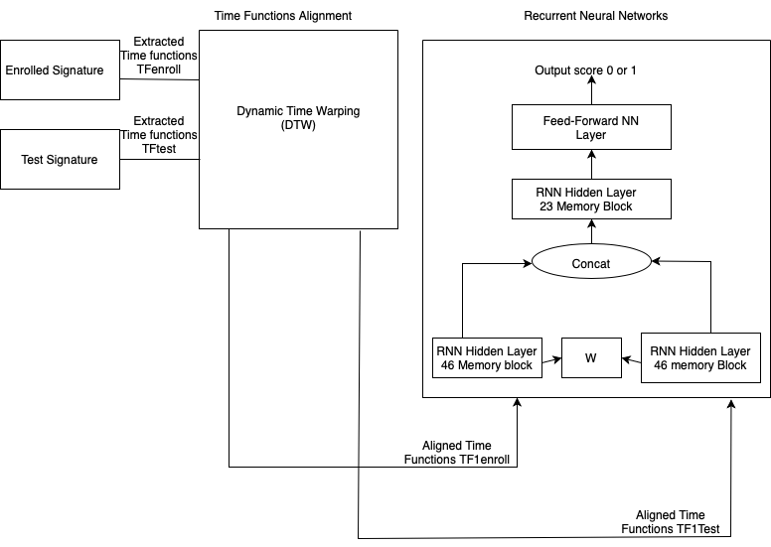
Our Approach – (TA-RNN)
Time-Functions Alignment
Recurrent Neural Networks

Slide 7
MOBISIG Database Description
The data obtained here is inputted using Finger.
There are 83 users present here
It contains 45 genuine and 20 forgeries samples per user.
Here all the signatures are recorded in 3 sessions. In each session 15 genuine signatures were recorded and in last two sessions 10 each forgery signatures were recorded.
Each file in dataset contains discrete values of x,y,t,pressure,f,vx,vy,ax,ay,az, gx,gy,gz.
Each data points are collected using Nexus 9 tablet.

Slide 8
Experiment Protocol
We have divided the mobisig dataset of 83 users into development and evaluation data. So that development data consists of 70 users and evaluation data consists of 13 users.
We have followed some key aspects such as we trained the model with four number of training samples where it contains equal number of genuine as well as equal number of forgeries by considering skilled forgery impostor scenarios.
Trained the model with genuine-genuine comparisons as well as genuine-forgery comparisons to make the model robust against the skilled forgeries.
Finally, the model was tested on those unseen 13 users to check the performance.

Slide 9
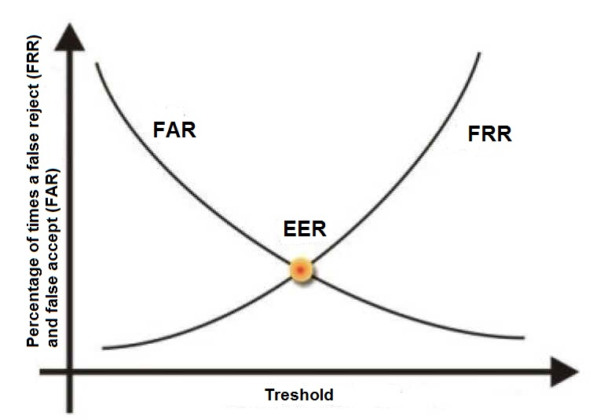
Evaluation Metric - EER
Equal Error Rate (EER): It is a point where the False Acceptance Rate (FAR) and False Rejection Rate (FRR) are equal.
Lower the EER, better the performance of the model.
This metric is commonly used in biometric and pattern recognition systems.

Slide 10
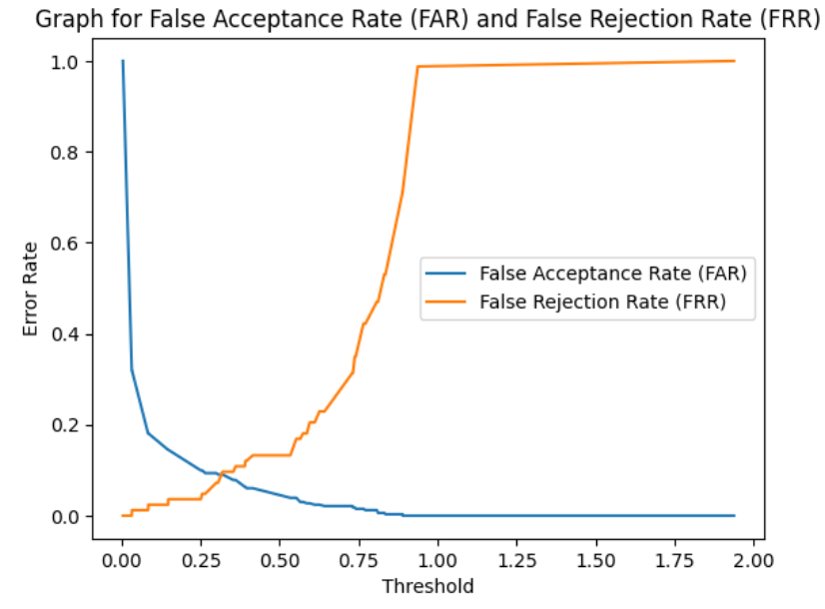
Experiment Results
Study | Classifiers | Database |  | Experimental Protocol |  |  | Performance in EER
 |  | Name | #Users | #Train Users | Input | #Train Sig.
Lai and Jin (2018) | GARU + DTW | Mobisig | 83 | 70 | Finger | 5 | Skilled = 10.9%
Li et al. (2019) | LSTM | Mobisig | 83 | 70 | Finger | 1 | Skilled = 16.1%
R. Tolsana(2021) | TA-RNN’s | DeepSignDB | 1526 | 1084 | Finger | 1 | Skilled = 13.8%
 |  |  |  |  |  | 4 | Skilled = 11.3%
Our Work | TA-RNN’s | Mobisig | 83 | 70 | Finger | 4 | Skilled= 9.03%

Slide 11
Conclusion and Future Scope
We were able to achieve the EER value less than 10 with fewer training samples when compared with previous state of art methods.
For future we would like to use this model and perform the transfer learning approach on DeepSignDb and improve its results against the finger scenarios.

Slide 12
References
R. Tolosana, R. Vera-Rodriguez, J. Fierrez, and J. Ortega-Garcia,“Exploring recurrent neural networks for on-line handwritten signature biometrics,” IEEE Access, vol. 6, pp. 5128–5138, 2018.
S. Lai and L. Jin, “Recurrent adaptation networks for online signature verification,” IEEE Trans. Inf. Forensics Security, vol. 14, pp.1624–1637, 2019.
A. Hefny and M. Moustafa, “Online signature verification using deep learning and feature representation using legendre polynomial coefficients,” in Proc. Int. Conf. Adv. Mach. Learn. Technol. Appl., 2019,pp.689697.
C. Li et al., “A stroke-based RNN for writer-independent online signature verification,” in Proc. Int. Conf. Doc. Anal. Recognit. (ICDAR),2019, pp. 526–532.
R. Tolosana, R. Vera-Rodriguez, J. Fierrez, A. Morales, and J. Ortega Garcia, “Do you need more data? the DeepSignDB on-line handwritten signature biometric database,” in Proc. Int. Conf. Doc. Anal. Recognit. (ICDAR), 2019, pp. 1143–1148.

