Slide 1


SMART INDIA HACKATHON 2026
TITLE PAGE
• Problem Statement ID – SIH26188
• Problem Statement Title- AI-Based Fake Identity & Document Screening System
• Theme- Blockchain & Cybersecurity
• PS Category- Software/Hardware Software
• Team ID- SIH-S-B1-148
• Team Name (Registered on portal) Asterix
Project Name: DocuShield AI
AI-Based Fake Identity & Multimodal Document Forensic Screening System

Slide 2
Team
Asterix
SIH-S-B1-148
IDEA TITLE: DOCUSHIELD AI
• Proposed Solution (Describe your Idea/Solution/Prototype)
• Detailed explanation of the proposed solution:
– DocuShield AI is an automated, multimodal forensic screening platform built to verify document authenticity across 5 core identity categories: Passports, Visas, National ID (Aadhaar/PAN), Driving Licences, and Permits.
– Operates a synchronized Dual-Engine Architecture: Engine A validates text, dates, and mathematical checksums (ICAO Doc 9303 MRZ, Verhoeff D5 algorithm), while Engine B performs digital image forensics (JPEG Error Level Analysis, Copy-Move cloning detection, Typography sharpness, and EXIF software signatures).
• How it addresses the problem:
– The Core Vulnerability: Forgers easily produce cards with plausible text and valid formats, but edit photos, dates, or stamps using digital manipulation software.
– Traditional Blindspot: Basic OCR and rule validators only read text strings; they are blind to pixel cut seams, cloned seals, or recompression discrepancies.
– The DocuShield Solution: Fuses optical text semantics with pixel-level physics. If an ID number looks plausible but the photo boundary shows cut seams or ELA anomalies, the document is flagged.
• Innovation and uniqueness of the solution:
✔ Multi-Family Evidence Fusion: Hierarchically corroborates 3 independent evidence families (Compression, Structural/Visual, Content/Identity) into a calibrated risk score [0–100%].
✔ “Why This Verdict?” Explainability: Generates human-readable evidence items (positive checks, cautions, critical indicators) to empower human border/KYC officers rather than opaque black-box AI.
✔ Deterministic & Privacy-Preserving: Strictly local execution without requiring citizen PII storage or external government database simulation, operating securely offline or on-premise.
Calibrated Forensic Verdicts: AUTHENTIC (≥80% | Risk ≤20%) • SUSPICIOUS (50–79% | Review) • FLAGGED (<50% | Tampered)
Dedicated Image Forensics Suite: ELA (90% JPEG) | Copy-Move (ORB+RANSAC) | Typography Stroke Variance | EXIF Software Markers
@SIH Idea submission- Template
2

Slide 3
Team
Asterix
SIH-S-B1-148
TECHNICAL APPROACH
• Technologies to be used (programming languages, frameworks, hardware):
✔ Core Language & Backend: Python 3.11+, FastAPI (REST API), Uvicorn ASGI server
✔ OCR & Text Parsing: EasyOCR (Neural Network Text Recognizer), PyTorch, Tesseract fallback
✔ Computer Vision & Forensics: OpenCV (cv2), NumPy, Pillow (PIL), SciPy for Laplacian/ORB/ELA
✔ Frontend & UI Dashboard: React 18, Vite, Canvas SVG Inspector, Lucide Icons
✔ Hardware & Deployment: Lightweight CPU (2 cores, 2GB RAM; optional GPU for high batch throughput)
• Methodology and process for implementation (Flow Charts / Images / working prototype):
1. DOCUMENT UPLOAD
Supports Passport, Visa, Aadhaar, DL, Permit
2. SECURITY & INGESTION
Magic-byte check, size limit, traversal guard
3. CLASSIFICATION
Automatic MRZ/keyword detection or override
4. DUAL-ENGINE FORENSICS
Synchronized text + pixel-level inspection
5. EVIDENCE FUSION
Hierarchical corroboration & risk calibration
ENGINE A: READ & VALIDATE (NLP & Checksum Logic)
• EasyOCR Engine: Extracts raw text, word confidences, normalized bounding boxes
• Document Field Schemas: Dedicated JSON schemas for all 5 document categories
• Date Chronology Engine: Ensures DOB < Issue Date < Expiry Date and plausible age ranges
• Deterministic Checksums: Verhoeff D5 dihedral group algorithm for 12-digit Indian UID
• ICAO Doc 9303 MRZ Parser: Weighted 7-3-1 modulus-10 check digits for Passport & Visa
ENGINE B: CHECK IMAGE (Digital Forensic Detectors)
• Error Level Analysis (ELA): 90% JPEG recompression reveals localized cut seams & photo swaps
• Copy-Move Forgery Detection: ORB feature descriptors + RANSAC homography for cloned stamps/seals
• Typography & Sharpness: Laplacian stroke variance detects spliced text and font inconsistencies
• Metadata & EXIF Forensics: Detects manipulation software traces (Photoshop, Canva, GIMP)
• Document Condition Analyzer: Calculates blur variance, resolution adequacy, and JPEG quality
@SIH Idea submission- Template
3

Slide 4
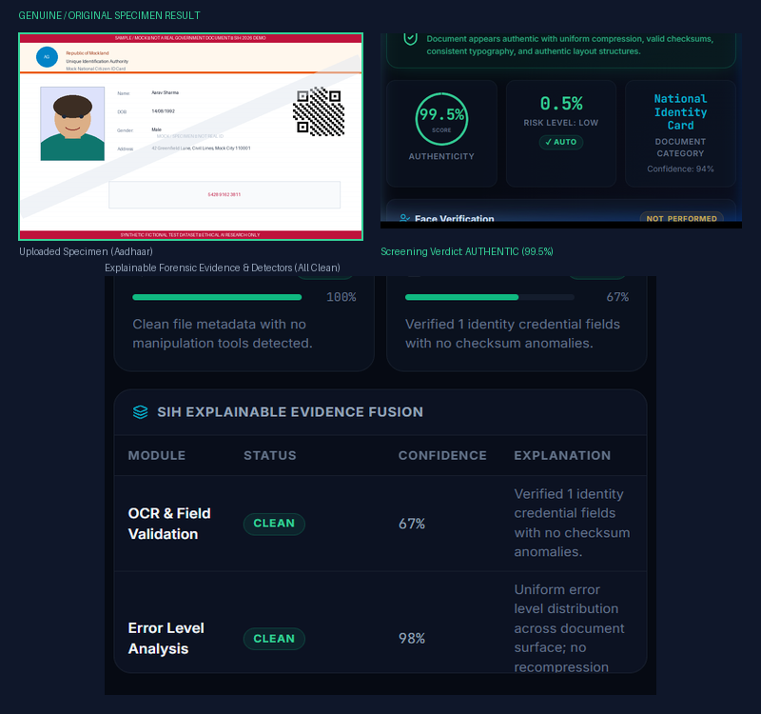
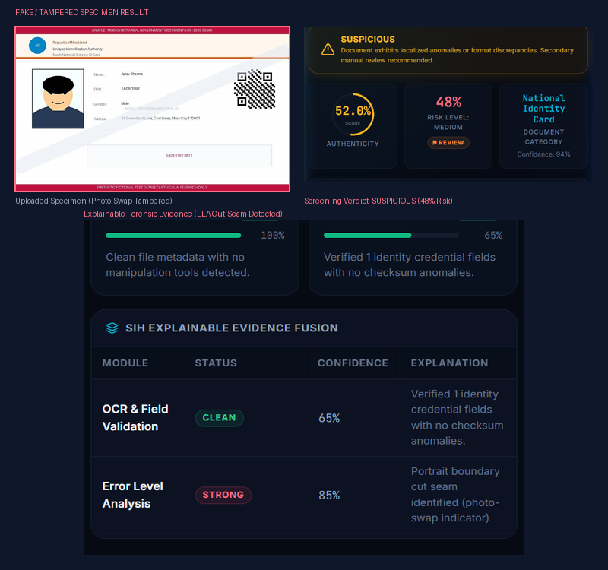
Team
Asterix
SIH-S-B1-148
FEASIBILITY AND VIABILITY
• Analysis of the feasibility of the idea (Validated via Live Working Prototype):
Genuine Specimen: AUTHENTIC (Score: 99.5% | Risk: 0.5% | Clean ELA & Verhoeff Valid)
Tampered Specimen: SUSPICIOUS (Score: 52.0% | Risk: 48.0% | ELA Strong 85% Cut-Seam Flagged)
• Potential challenges and risks:
– Physical Print-and-Scan Replays: High-resolution printed & rescanned cards can mask JPEG compression discrepancies.
– Camera Glare & Shadows: Extreme reflections on laminated plastic cards degrade OCR token clarity.
– Absence of Government DB: Fabricated identities with completely plausible details cannot be validated without central registry access.
• Strategies for overcoming these challenges:
✔ Multi-Metric Forensics: Laplacian stroke variance & edge density inspect physical printing sharpness alongside compression ELA.
✔ Optical Disambiguation: Heuristic OCR substitution rules (8↔6, O↔0) maintain mathematical checksum accuracy under glare.
✔ Human-in-the-Loop Review: System flags ambiguous inputs as SUSPICIOUS with clear diagnostic evidence for human officer decision-making.
Validated on 20-Document Controlled Testbed (10 Genuine + 10 Fake) | 98/98 Automated Tests Passed | Zero False Positives on Authentic Cards.
@SIH Idea submission- Template
4

Slide 5
Team
Asterix
SIH-S-B1-148
IMPACT AND BENEFITS
• Potential impact on the target audience:
– Banks & NBFCs → High-throughput automated customer KYC; eliminates loan fraud from forged salary slips, fake PAN, and fabricated Aadhaar cards.
– Telecom Sector → Real-time subscriber identity verification at point-of-sale for SIM allocation, shutting down synthetic identity rings.
– Gig Platforms & Fleet Operators → Instant, reliable driving licence and national ID verification for driver-partner and delivery agent onboarding.
– Government Agencies & Welfare → Fast citizen verification for direct benefit transfers, welfare distribution, and immigration transit checkpoints.
– FinTech & Digital Onboarding → Frictionless, privacy-preserving document fraud screening operating with sub-1.5s latency per document.
• Benefits of the solution (social, economic, environmental, etc.):
✔ Economic Benefits: Cuts manual screening overhead by >80%; prevents multi-crore fraud losses across financial institutions; sub-1.5s processing eliminates server scaling costs.
✔ Social & Ethical Benefits: Protects legitimate citizens against identity cloning; completely explainable verdict avoids algorithmic bias; strictly adheres to data privacy by retaining zero citizen PII.
✔ Operational Efficiency: Automated hierarchical evidence fusion reduces human reviewer fatigue by automatically verifying clean documents and highlighting exact tampering hotspots on suspicious cards.
✔ Environmental & Resource Sustainability: Lightweight, edge-deployable architecture requires minimal power and standard CPU hardware, avoiding carbon-heavy multi-billion parameter AI infrastructure.
@SIH Idea submission- Template
5

Slide 6
Team
Asterix
SIH-S-B1-148
RESEARCH AND REFERENCES
• Details / Links of the reference and research work:
1. Verhoeff, J. (1969). Error Detecting Decimal Codes. Mathematical Centre Tracts 29.
– Foundational mathematical proof of the D5 dihedral group checksum algorithm used for Indian 12-digit Aadhaar UID verification with optical confusion tolerance.
2. Fischler, M. A., & Bolles, R. C. (1981). Random Sample Consensus: A paradigm for model fitting. Communications of the ACM, 24(6), 381–395.
– Core algorithm utilized in DocuShield's copy-move forgery detector to estimate geometric homography and eliminate false-positive keypoint clusters. DOI: 10.1145/358669.358692
3. Zhu, Y., Shen, C., & Zhao, H. (2015). Copy-move forgery detection based on scaled ORB. Multimedia Tools and Applications.
– Technique adapted for scale-invariant ORB keypoint extraction and spatial displacement clustering for digital document seal and signature verification. DOI: 10.1007/s11042-014-2431-2
4. Warif, N. B. A., Wahab, A. W. A., et al. (2015). An evaluation of Error Level Analysis in image forensics. IEEE International Conference on Systems, Engineering & Technology.
– Theoretical and empirical validation of 90% JPEG recompression error grids for identifying cut-and-paste tampering seams and font splicing. DOI: 10.1109/ICSEngT.2015.7412439
5. Sudiatmika, I. B. K., Rahman, M. A., et al. (2019). Image forgery detection using error level analysis and deep learning. TELKOMNIKA, 17(2), 653–659.
– Demonstrates the efficacy of localized ELA feature maps for document tampering detection and edge discrepancy classification. DOI: 10.12928/TELKOMNIKA.v17i2.8976
6. Vaidya, A., & Awasthi, A. (2025). Zero-to-One IDV: A Conceptual Model for AI-Powered Identity Verification. arXiv:2503.08734 [cs.CV].
– Architectural reference for modern confidence-aware identity document screening and multi-family forensic corroboration pipelines.
@SIH Idea submission- Template
6

