Slide 1

VoiceFlow AI
Problem Statement: Missed customer calls and manual WhatsApp replies
Domain: AI / Voice Technology / Small Business Automation
Team Voice Flow
Abhinav Cheepa (Team Leader) · Raghav Goyal
abhinavcheepa7@gmail.com · +91 70007 59702
Event: HackMatrix 2026 — Round 2
GitHub: github.com/abhinavcheepa/voiceflow-hackmatrix
Demo video: [add link] · Live deploy: runs locally, self-hosted by design
HACK
MATRIX

Slide 2

The Problem
Calls go unanswered
After hours, during a rush, or when staff are busy. The customer simply dials a competitor next.
Hiring does not scale
A clinic or shop cannot staff 24/7 support, however many leads it loses by not doing so.
WhatsApp is still manual
The channel Indian customers prefer, yet every reply is typed by hand. A slow reply is a lost customer.
Who is affected?
Small business owners (clinics, salons, shops, coaching centres) → their staff, who answer the same questions all day → customers who give up and go elsewhere.
India has over 63 million MSMEs. Most run on a single phone number and one WhatsApp account.
Every missed call is revenue that walked away.

Slide 3
WHY THIS PROBLEM EXISTS
One number,
one pair of hands
Voice AI is
English-first
Per-minute
billing in USD
->
CORE PROBLEM
There is nobody to answer when the owner is busy, and no affordable tool that speaks the customer's language.
USER CONSEQUENCE
The customer waits, repeats themselves, or hangs up. The owner finds out hours later, if at all.
REAL IMPACT
Lost bookings, lost trust, and a business that cannot grow past the owner's own working hours.
->
->
Current approach:
Miss the call → hope for a callback → reply on WhatsApp hours later → the customer has already booked elsewhere.
Existing tools (Vapi, Bland, Retell) have weak Hindi support, bill per minute in USD, and move customer data out of the country.

Slide 4
OUR SOLUTION
INTRODUCING VOICEFLOW AI
VoiceFlow AI lets a small business answer every call and WhatsApp message 24/7, in the customer's own language, using a self-hosted agent that costs nothing per minute.
CUSTOMER
↓ calls, or messages on WhatsApp
SPEECH → TEXT
↓ Groq Whisper, language auto-detected
AGENT
↓ your business facts, your tone
TEXT → SPEECH
↓ natural Indian voice
ANSWERED
↓ logged to the dashboard
OWNER SEES EVERYTHING
Core capabilities
01 Answers in the customer's language
Hindi, Hinglish, English, Marathi, Tamil — detected automatically, answered in the same language.
02 Same agent on voice and WhatsApp
A voice note gets a voice note back. Text gets text, in the owner's writing style.
03 Self-hosted, no per-minute billing
Runs on the business's own machine. Customer data never leaves it.
Measured on a real run: 4.2 seconds from the customer finishing a sentence to hearing the reply.

Slide 5
PROTOTYPE / PRODUCT EXPERIENCE
Dashboard — calls, WhatsApp, contacts in one place
User journey
01 — INPUT
Customer calls or messages.
↓
02 — UNDERSTAND
Speech to text, language detected.
↓
03 — ANSWER
Agent replies using your facts.
↓
04 — SPEAK
Spoken back, or a voice note.
↓
05 — LOG
Lands in the dashboard.
Web call — talking to the agent live in the browser
What is running today, not a mockup
Web call and WhatsApp both run the full pipeline end to end. The screenshots above are the live product, with real conversations.
Every number in this deck was measured on an actual run — nothing is estimated.

Slide 6
WHAT MAKES US DIFFERENT?
WHY THIS APPROACH?
Existing tools VoiceFlow AI
Hindi / Indian accent Weak Built for it
Billing Per minute, USD ₹0 per minute
Where customer data sits Vendor's cloud Your own machine
WhatsApp voice notes Not supported Replies with a voice note
Business facts Generic prompt Your prices and timings
Setup for a small shop Sales call, KYC Runs on a laptop today
Our differentiator is not that we use AI. Everyone uses AI.
It is that the whole thing is self-hosted, speaks Indian languages properly, and costs a small business nothing per call.
The agent is also told what it does not know, so it says "I will confirm and call back" instead of inventing a price or a free slot.

Slide 7
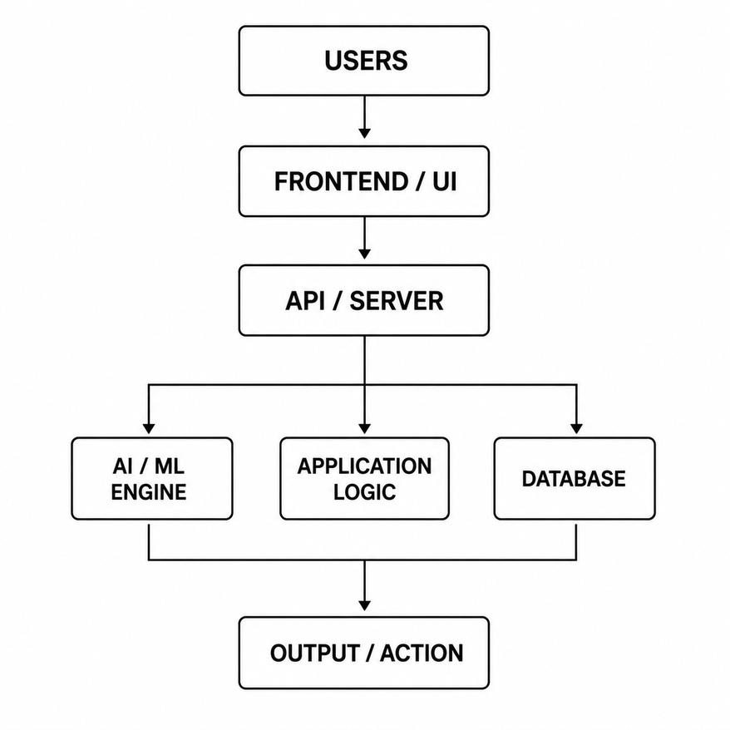
TECHNICAL ARCHITECTURE
Customer → Channel → Backend → AI → Reply → Dashboard
Tech stack
Frontend
React 19, Vite, Tailwind CSS v4
Backend
FastAPI (Python), WebSockets for live calls
Database
SQLite — self-contained, no server to run
Speech to text
Groq Whisper large-v3-turbo (1.3s), local faster-whisper as fallback
Language model
Groq Llama 3.3 70B — replies in about 1 second
Text to speech
Cartesia Sonic — 55 voices, 6 Hindi, 5 Tamil, 3 Telugu
WhatsApp
Local bridge (WhatsApp Web) or Meta Cloud API — one setting switches them
Telephony
Asterisk PBX, self-hosted; your own SIM over a Bluetooth GSM gateway
Every external service is owned by exactly one file,
so swapping a provider is one file's worth of work — not a rewrite.

Slide 8
FEASIBILITY + IMPACT
FEASIBILITY
IMPACT
Technical — already working
Browser calls, WhatsApp auto-reply, multi-agent personas, CRM, analytics
4.2s per conversational turn, measured end to end
Automated tests covering language detection and speech filtering
Operational
Runs on one ordinary laptop. No cloud bill.
Free tiers cover the AI; incoming calls are free in India.
Hackathon MVP — what we will demonstrate live
A real conversation in Hindi through the browser, and a WhatsApp message answered automatically, both on stage.
Who benefits?
Clinics, salons, shops and coaching centres — anyone losing calls while working.
What improves?
Every call is answered instead of missed. WhatsApp replies land in seconds, not hours.
Why does it matter?
A missed call is a customer who has already dialled somebody else. This gives a one-person business the reach of a staffed front desk.
Prototype → MVP → Pilot → Scale

Slide 9
IMPLEMENTATION ROADMAP
WHAT HAPPENS NEXT?
NOW — built and working
Browser voice calls
WhatsApp auto-reply, text and voice
Multiple agent personas
Contacts, campaigns, analytics
NEXT — in progress
Live audio on phone calls
(Asterisk answers and logs today)
Barge-in: interrupt the agent
Voice cloning — the owner's own voice
LATER
Pilot with real shops in Indore
Appointment calendar integration
Dashboard login and roles
Hosted option for non-technical owners
SCALE
More Indian languages
Multiple businesses per install
Payments and order taking
Reseller model for local IT shops
Already built vs planned
We are deliberately explicit about this. Everything under NOW runs today and can be demonstrated.
Phone-call audio is honestly marked as in progress — Asterisk answers and logs the call, but streaming the audio through the AI is not finished.

Slide 10
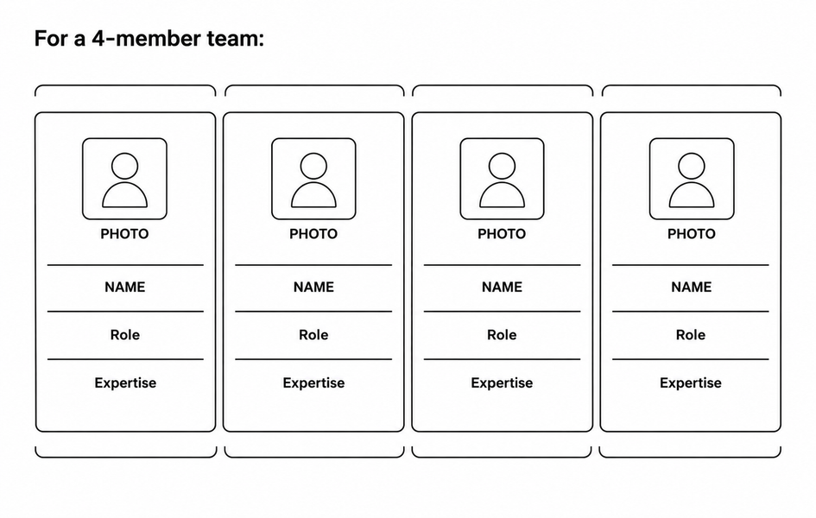
TEAM + EXECUTION
Team Voice Flow
Abhinav Cheepa — Team Leader
Backend, AI pipeline, telephony integration
abhinavcheepa7@gmail.com · +91 70007 59702
Raghav Goyal
Frontend, dashboard, testing and QA
Why this team can execute
We have already built and measured the hard part — a working speech-to-reply loop in Indian languages — instead of describing one. What remains is telephony plumbing, and the plan for it is written, costed and in the repo.

