Slide 1
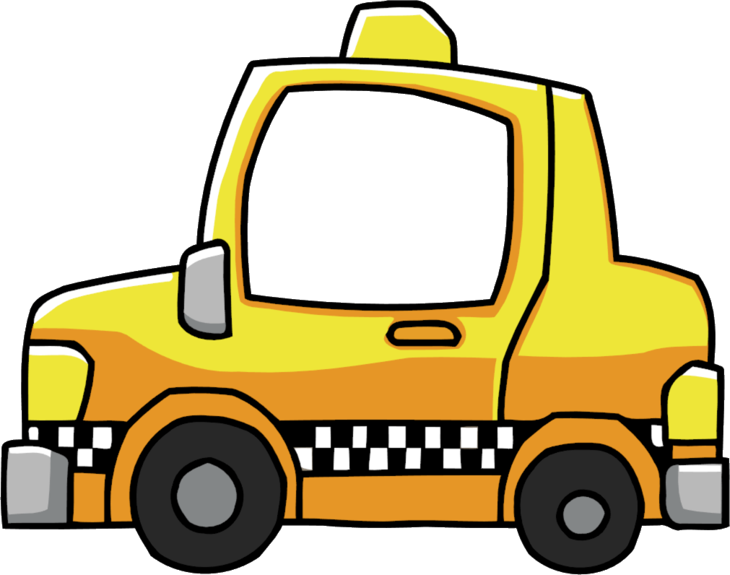
ALGORITHM DESIGN AND ANALYSIS PROJECT
CAB BOOKING SYSTEM
BY:-
ABHINAV GUPTA (2K19\IT\002)
ANSH KAKUSTH (2K19\IT\024)

Slide 2
CAB BOOKING SYSTEM
This program will help users to book a cab of their own convenience.

Slide 3
Implementation of program
In this program the user will first sign up and will give
his/her details (Name ,mobile number, mail etc).Then
user will be asked to enter location and his/her desired
destination.
Program will provide users with a number of cabs based
on their distance and type and will also display their cost.
Program will also show minimum path or distance from
user’s location to desired destination.
In end mode of payment and reviews\ratings will be asked
from the user.

Slide 4
ABOUT CAB BOOKING ONLINE
India- A country known for lowest car ownership across all emerging countries found a new answer to its mobility needs in 2013, when Taxi for sure launched its app based on-demand taxi program. The very same year, when Uber entered India and launched its services in Bangalore.
Till 2014, there were very few takers for on-demand taxis but a lot changed in 2015 when Ola rolled out a much improved and accurate app with broader coverage. Till 2014 and even early 2015, Ola`s ~20% bookings were made through laptops and desktops. India`s weak internet infrastructure and comparatively lower smartphone penetration was prime reason behind this.
The smartphone penetration was 6% in India in 2013 and, reached 28% by May 2019. In metro cities, the penetration reached 60%-65% by Q1-2015 and that is when and where the revolution of on-demand taxis began in India.

Slide 5
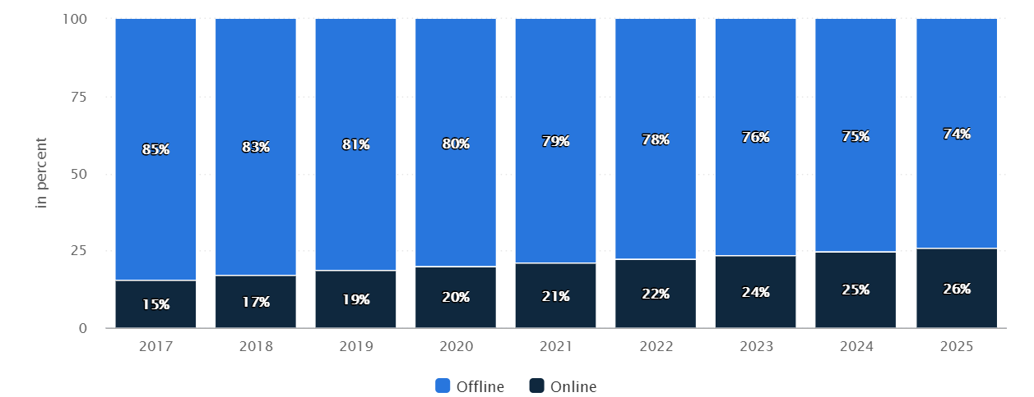
GROWTH OF ONLINE CABS IN INDIA

Slide 6
ALGORITHM
Firstly project layout.
Then we display sign up or login.
If signup then program get details of user.
Asking user whether user wanted to book a cab , if yes then we welcome him or else print thanks and exit.
Then we ask person location and its destination .
Then we print the best route .
Then we display cab charges according to cab details which are some distance away from user .
Then we ask the whether user want to book a cab or not ,if yes then further else exit.
later we ask for payment mode whether he wants to pay cash or online payment .
At the end we display thanks and ask review out of 5 stars.

Slide 7
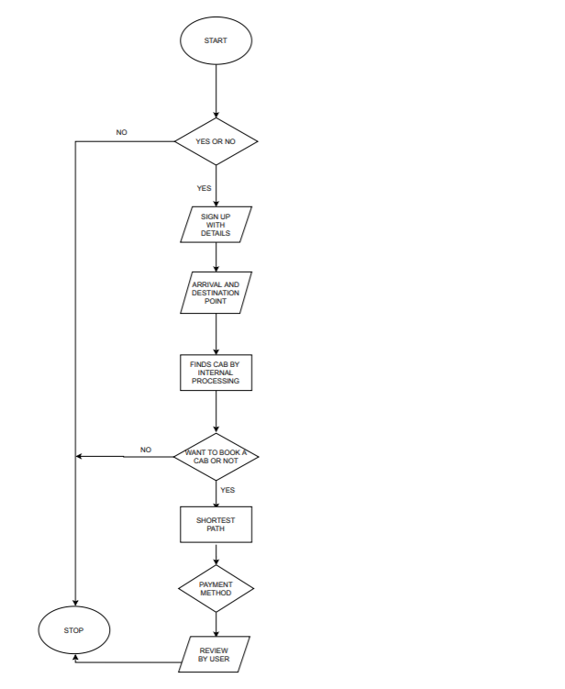

Slide 8
DIJKSTRA ALGORITHM
We used Dijkstra algorithm in our project for finding shortest path between two points
Of the graph and print its path.
The algorithm uses a greedy approach in the sense that we find the next best solution hoping that the end result is the best solution for the whole problem.

Slide 9
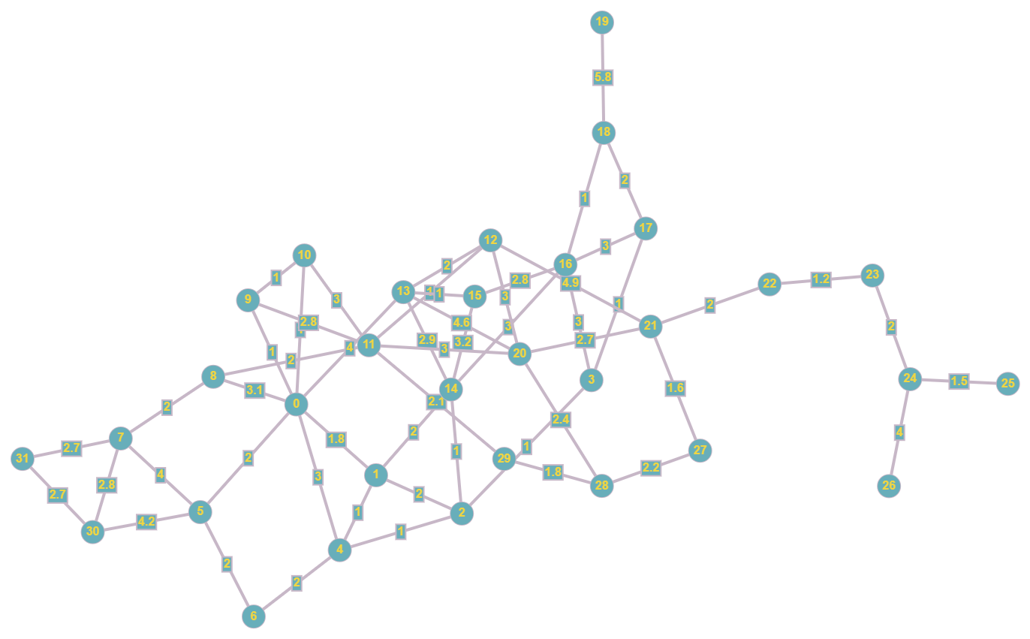
Our map

Slide 10
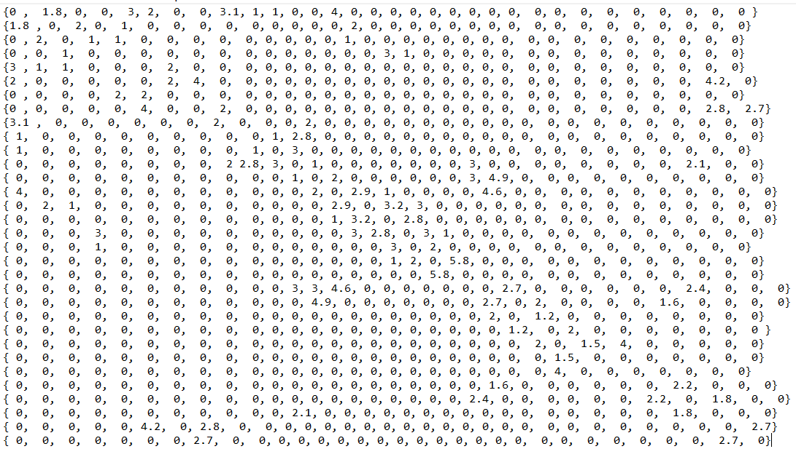
Map adjacency matrix

Slide 11
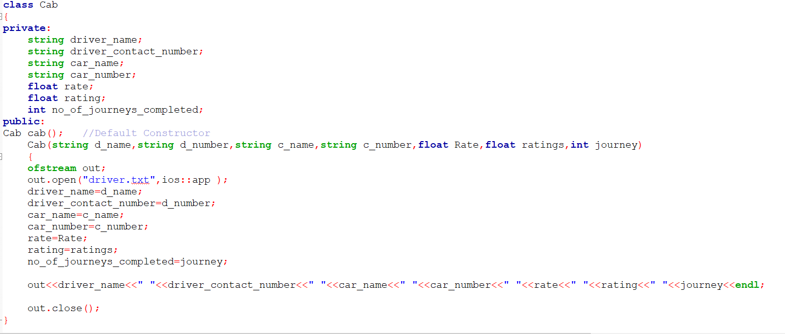

Slide 12
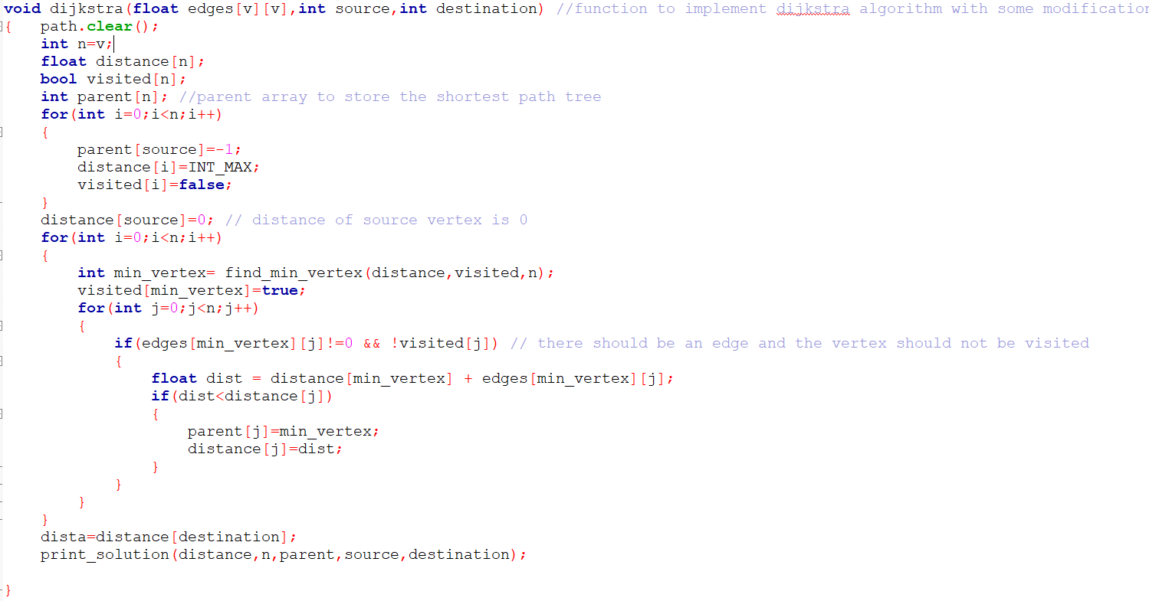

Slide 13
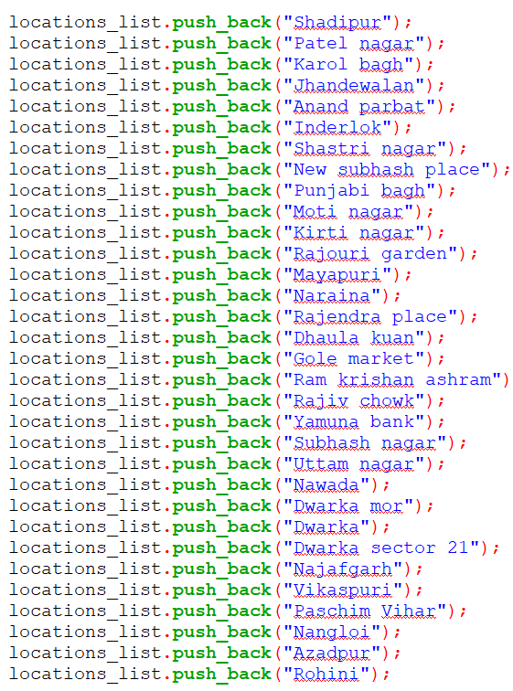

Slide 14
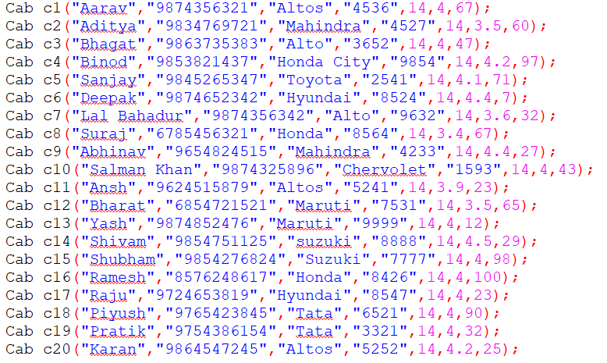

Slide 15
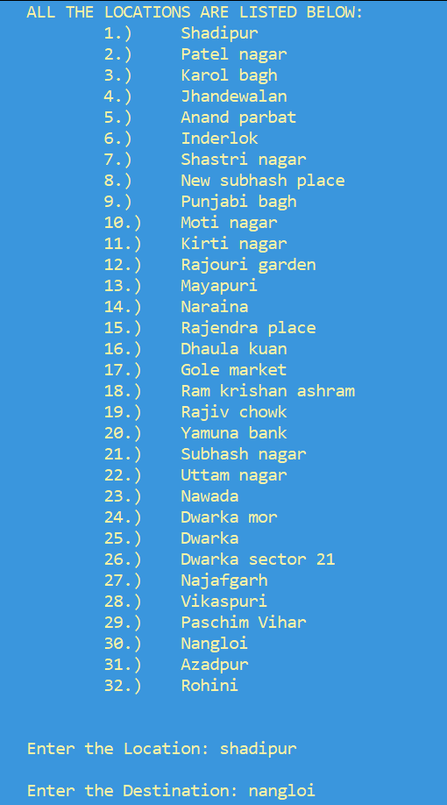

Slide 16
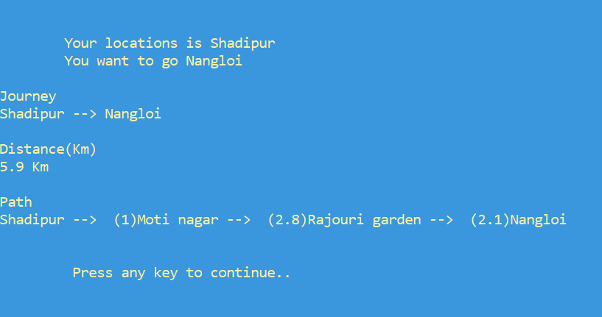

Slide 17
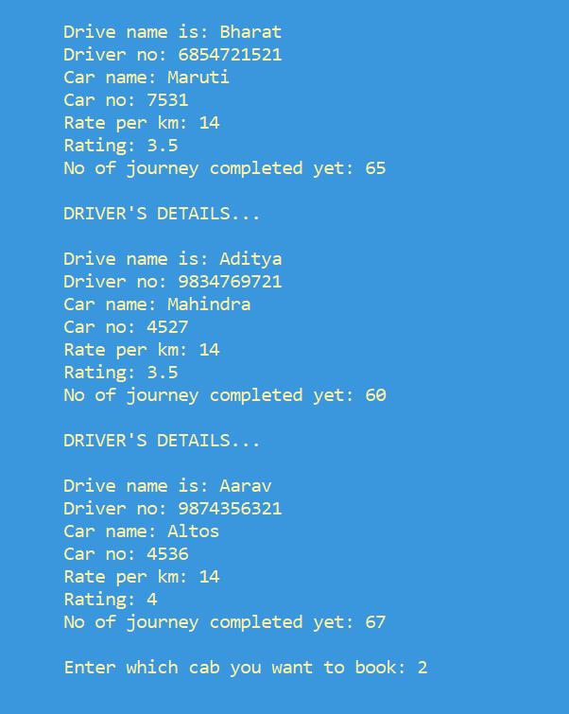

Slide 18
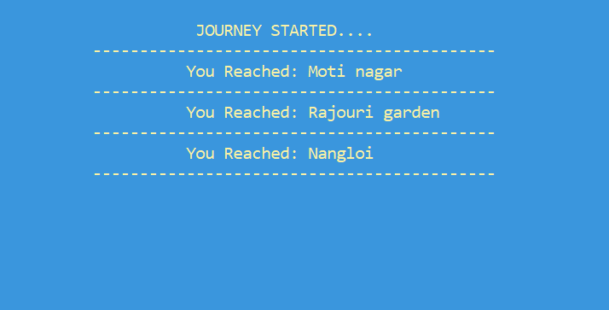

Slide 19
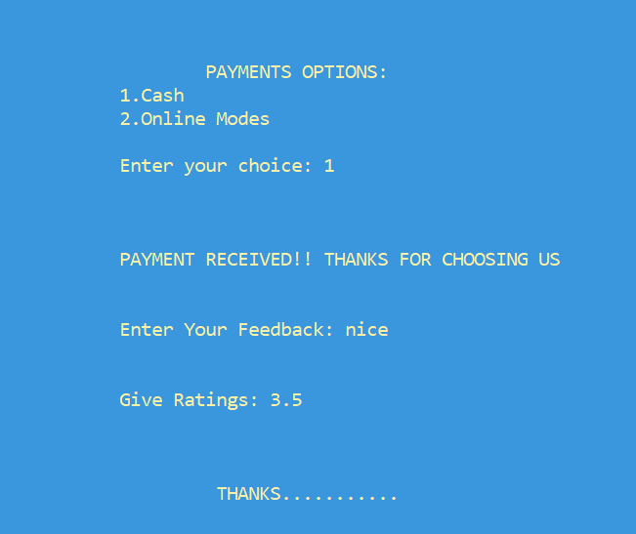

Slide 20
THANKS

