Slide 1


RxReader
Empowering patients with clear and accurate prescription (rx) information.

Slide 2
Service will help patients to understand their prescription better. By helping them with : 1. Give details about their ailments 2. Listing their medications 3. Listing precautions to take with those medicines 4. Recommending places to buy medicine online from trusted places

Slide 3
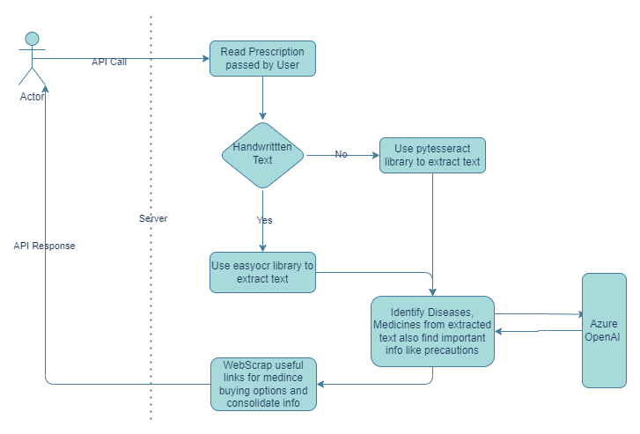
Flow Diagram

Slide 4
DEMO

Slide 5
Imp Links:
1. HackBox - RxReader (microsoft.com)
2. Code https://github.com/abhinavguptams/PrescriptionBuddy/tree/main
3. API endpoint to try the feature: http://172.178.105.199:5000/prescriptiondetails

Slide 6
Thanks!

