Slide 1
Turbo-charge Your Skuid Page With Apex
Ralph Callaway SR
rwc@callawaycloudconsulting.com
Charlie Jonas
charlie@callawaycloudconsulting.com

Slide 2
Safe Harbor
Safe harbor statement under the Private Securities Litigation Reform Act of 1995:
This presentation may contain forward-looking statements that involve risks, uncertainties, and assumptions. If any such uncertainties materialize or if any of the assumptions proves incorrect, the results of salesforce.com, inc. could differ materially from the results expressed or implied by the forward-looking statements we make. All statements other than statements of historical fact could be deemed forward-looking, including any projections of product or service availability, subscriber growth, earnings, revenues, or other financial items and any statements regarding strategies or plans of management for future operations, statements of belief, any statements concerning new, planned, or upgraded services or technology developments and customer contracts or use of our services.
The risks and uncertainties referred to above include – but are not limited to – risks associated with developing and delivering new functionality for our service, new products and services, our new business model, our past operating losses, possible fluctuations in our operating results and rate of growth, interruptions or delays in our Web hosting, breach of our security measures, the outcome of any litigation, risks associated with completed and any possible mergers and acquisitions, the immature market in which we operate, our relatively limited operating history, our ability to expand, retain, and motivate our employees and manage our growth, new releases of our service and successful customer deployment, our limited history reselling non-salesforce.com products, and utilization and selling to larger enterprise customers. Further information on potential factors that could affect the financial results of salesforce.com, inc. is included in our annual report on Form 10-K for the most recent fiscal year and in our quarterly report on Form 10-Q for the most recent fiscal quarter. These documents and others containing important disclosures are available on the SEC Filings section of the Investor Information section of our Web site.
Any unreleased services or features referenced in this or other presentations, press releases or public statements are not currently available and may not be delivered on time or at all. Customers who purchase our services should make the purchase decisions based upon features that are currently available. Salesforce.com, inc. assumes no obligation and does not intend to update these forward-looking statements.
Notes:
SR: Safe Harbor

Slide 3

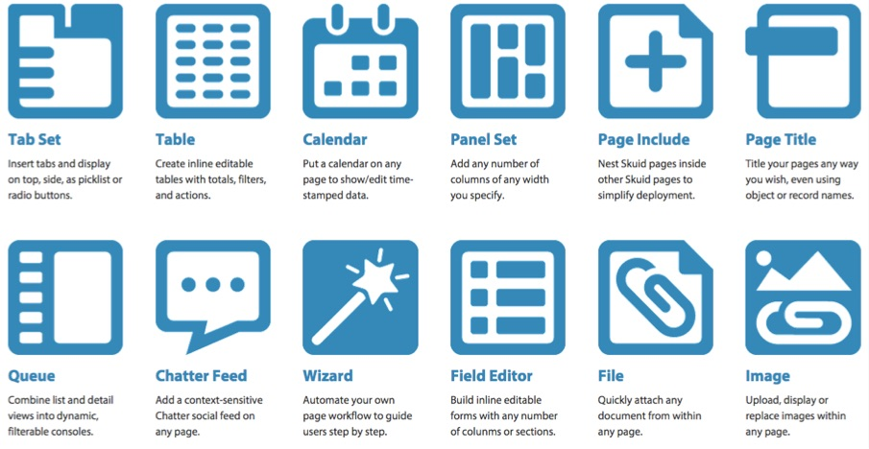
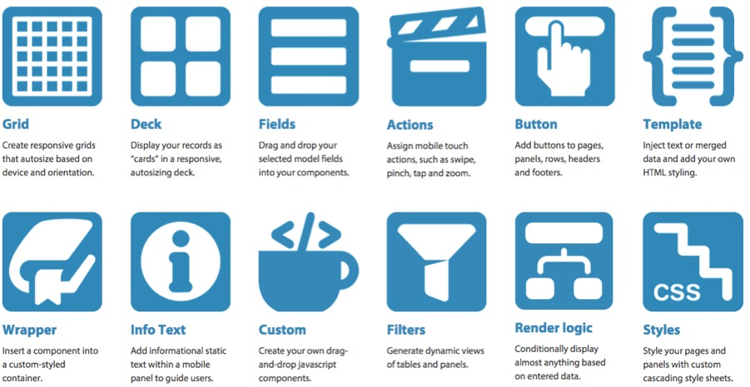
Notes:
SR

Slide 4
Why Skuid?
Connect Code Free to your data with drag and drop UI components
Visualize data to engage and motivate
Simplify and tailor the UI to reduce errors
Slash development and maintenance costs
Individualize the big picture with dynamic graphics

Slide 5
Why do I need Apex using Skuid?
Calling a remote service
Complex Business logic
Sending Email messages

Slide 6
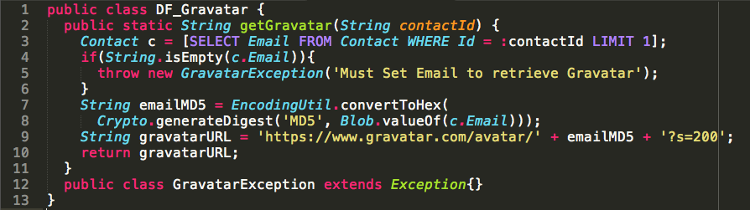
Contact Gravatar integration
The sales team would like to be able to import a persons “Gravatar” photo onto their contact record.
Gravatar API: http://www.gravatar.com/avatar/EMAIL_HASH

Slide 7
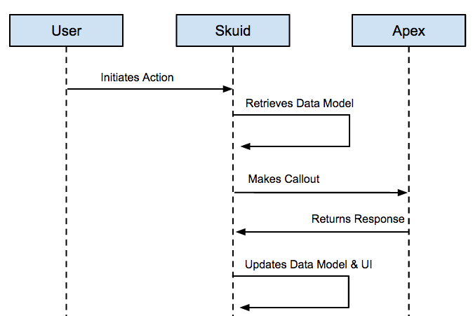
Flow

Slide 8

Retrieving Skuid Data Model - Contact

Slide 9
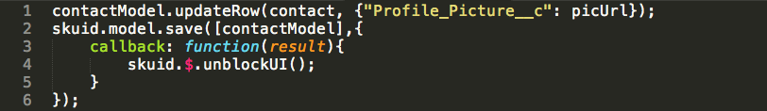
Updating Data Model
Updating
Re-querying

Slide 10
Ways to call Apex
Method | Requires Ajax Toolkit | Requires VF Page | Other Considerations
WebService | X* |  | Synchronous*
@RestResource | X |  | Must call through “Proxy”
@Invocable Method |  |  | No official Documentation**
Javascript Remoting |  | X
*when using sforce.apex.execute()
**for calling API from outside of Salesforce

Slide 11
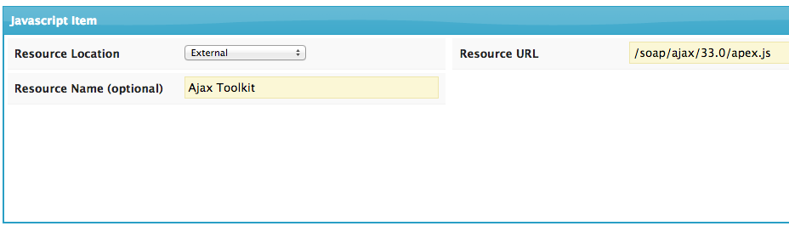
SOAP
Use when you have existing “Webservice” code
Can use Ajax Toolkit, but “sforce.apex.execute()” is synchronous
Alternatively, manually build request with “$.ajax()” for better performance (not shown)

Slide 12
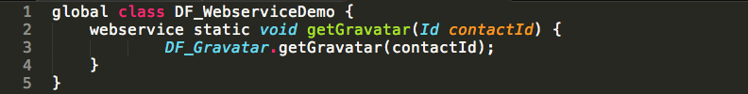
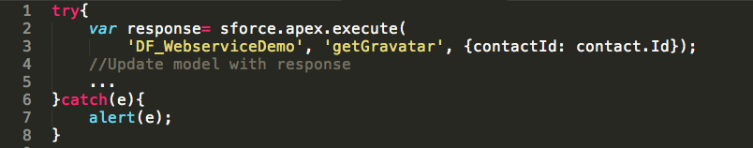
SOAP (continued)
SOAP Class
Javascript

Slide 13
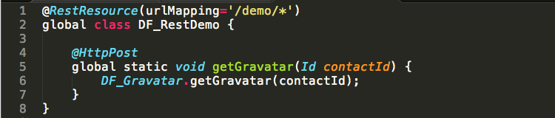
@RestResource
Use when you already have existing @RestResource code
Use “sforce.connection.remoteFunction”
REST Class

Slide 14
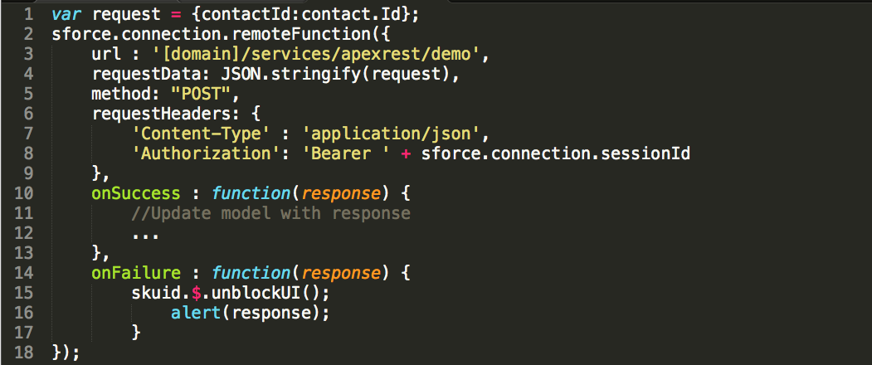
@RestResource (continued)
Javascript

Slide 15
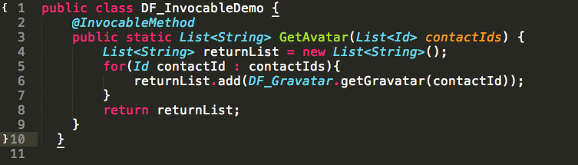
@InvocableAction
Use when you want to share code with the “Process Builder”
Bulkification required
Limited Documentation

Slide 16
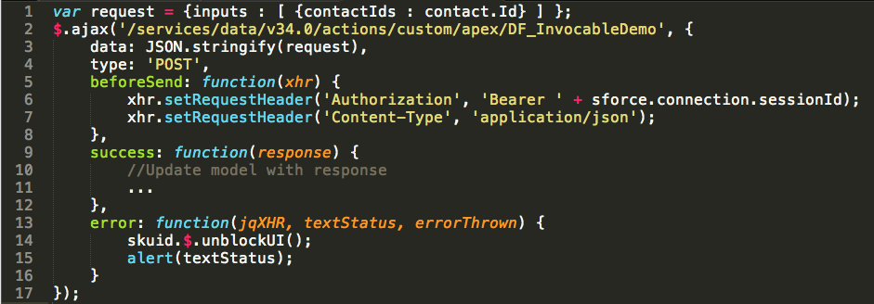
@InvocableAction (continued)
Javascript

Slide 17
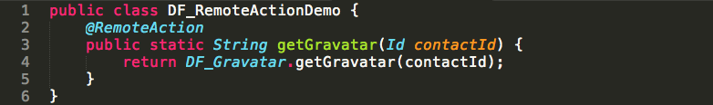
Javascript Remoting
Use when refactoring existing VF page
VisualForce
Apex

Slide 18
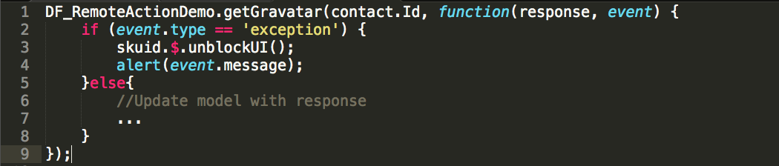
Javascript Remoting (continued)
Javascript

Slide 19
DEMO

Slide 20
References
Skuid Community: https://community.skuidify.com/skuid
Ajax Toolkit: http://sforce.co/1MXgt0N
Ajax Proxies: http://sforce.co/1KWLcq6
Custom WebServices: http://sforce.co/1JrByMf
Remote Actions: http://sforce.co/1EsGJi7
Run Your SOAP Web Services Asynchronously: http://bit.ly/1KWL9KX
Using Invocable Methods with Skuid: http://bit.ly/1hOeX5L

Slide 21
Skuid Dreamforce ’15
BOOTHS
Moscone North Hall – N2029
Moscone West Hall – Located right behind you
WWW.SKUIDIFY.COM or 1 (800) 515-2535
30 day free trial
Product, Services, Pricing, tutorials
COMMUNITY.SKUIDIFY.COM

