Slide 1
Week 2 Mini Project – Data Visualization Using Python
Analysis of Amazon E-commerce Sales Dataset
Details:
Name: Abhinav Harish
Internship Assignment – Week 2
Tools Used: Python, Pandas, Matplotlib

Slide 2
Objective of the Project
Perform data visualization on a real-world dataset
Generate different types of charts using Python
Analyze e-commerce sales performance
Interpret business insights from visualizations

Slide 3
Dataset Used
Source: Kaggle – Amazon Sale Report
Contains order and transaction details
Key columns used:
  Date
  Category
  Qty
  Amount
  Status
Purpose:
To analyze sales trends and patterns through visualizations.

Slide 4
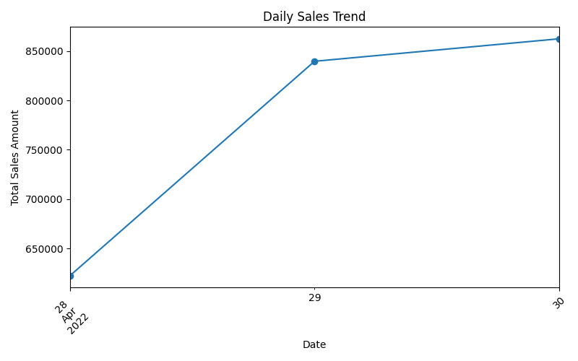
Line Chart
Visualization: Daily Sales Trend
Interpretation:
Shows total revenue generated on each date
Helps identify daily sales performance
Upward trend indicates increasing sales activity

Slide 5
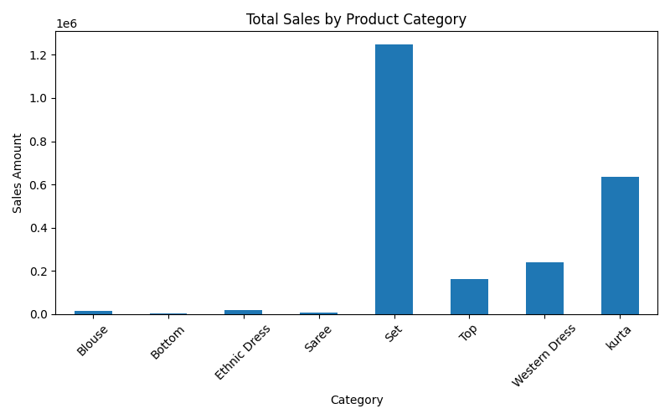
Bar Chart
Visualization: Total Sales by Product Category
Interpretation:
Compares revenue contribution of different categories
Categories like “Set” and “Kurta” contribute highest sales
Helps identify best-performing product segments

Slide 6
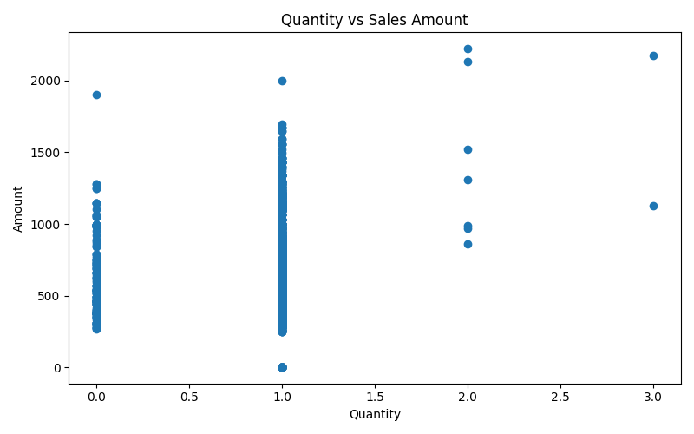
Scatter Plot
Visualization: Quantity vs Sales Amount
Interpretation:
Shows relationship between quantity sold and revenue
Higher quantities generally lead to higher sales
Most transactions involve single-item purchases

Slide 7
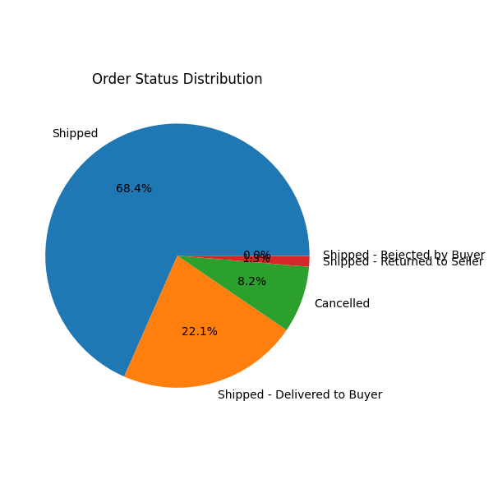
Pie Chart
Visualization: Order Status Distribution
Interpretation:
Displays proportion of shipped, cancelled, and delivered orders
Majority of orders are successfully shipped
Useful for operational performance analysis

Slide 8
Conclusion
Successfully created 4 different visualizations
Extracted meaningful business insights
Understood sales trends and patterns
Matplotlib used effectively for analysis
Deliverables Produced
Python code file
Four saved chart images
Presentation report

Slide 9
THANK YOU

