Slide 1
Week 2 Day 3 Assignment – My First Machine Learning Model
Dataset: Iris
Model: Logistic Regression
Task: Classification
Performed by: Abhinav Harish

Slide 2
Methodology & Results
Steps Performed
Loaded Iris dataset
Split data into training and testing
Built Logistic Regression model
Evaluated performance
Results
Model Accuracy: ~ (whatever accuracy you get, usually around 95–100%)
Confusion matrix used for evaluation
Visualized dataset using pairplot

Slide 3
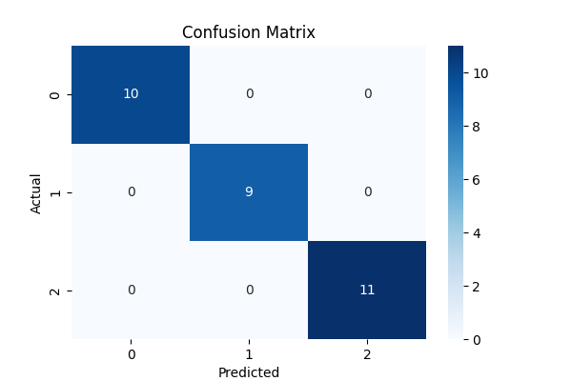

Slide 4
