Slide 1




RESTful
Web Services
DURGA ADIMULAM
July 9, 2019

Slide 2

PURPOSE OF THE SESSION
The purpose of this RESTful Web Services session is to make you understand what is RESTful services. Therefore this tutorial focuses on the core concepts of RESTful webservices.
Once you understand the core concepts, it is much easier to lookup detailed information in the respective documentation, or search for it on the internet.

Slide 3
WHAT IS WEB SERVICE?
A Web Service can be defined by following ways:
is a client server application or application component for communication.
method of communication between two devices over network.
is a software system for interoperable machine to machine communication.
is a collection of standards or protocols for exchanging information between two devices or application.

Slide 4
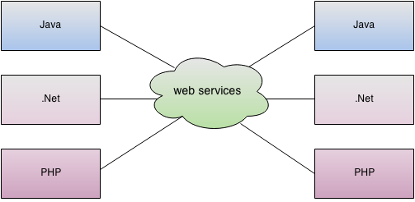
WHAT IS WEB SERVICE?
As you can see in the figure, java, .NET or PHP applications can communicate with other applications through web service over the network. For example, java application can interact with Java, .NET and PHP applications. So web service is a language independent way of communication.

Slide 5
Types of Web Services
There are mainly two types of web services.
SOAP web services.
RESTful web services.

Slide 6
What is REST?
REST stands for REpresentational State Transfer. REST is a web standards-based architecture and uses HTTP Protocol for data communication. It revolves around resources where every component is a resource and a resource is accessed by a common interface using HTTP standard methods. REST was first introduced by Roy Fielding in year 2000.
In REST architecture, a REST Server simply provides access to resources and the REST client accesses and presents the resources. Here each resource is identified by URIs/ Global IDs. REST uses various representations to represent a resource like Text, JSON and XML. JSON is now the most popular format being used in Web Services.

Slide 7
ARCHITECTURAL CONSTRAINTS
REST defines 6 architectural constraints/Guiding Principles which make any web service – a true RESTful API.
Uniform interface
Client–server
Stateless
Cacheable
Layered system
Code on demand (optional)

Slide 8
ARCHITECTURAL CONSTRAINTS
Uniform interface – The uniform interface constraint defines the interface between clients and servers. It simplifies and decouples the architecture, which enables each part to evolve independently. REST is defined by four interface constraints: identification of resources; manipulation of resources through representations; self-descriptive messages; and, hypermedia as the engine of application state.
Client–server – The uniform interface separates clients from servers. This separation of concerns means that, for example, clients are not concerned with data storage, which remains internal to each server, so that the portability of client code is improved. Servers are not concerned with the user interface or user state, so that servers can be simpler and more scalable. Servers and clients may also be replaced and developed independently, as long as the interface is not altered.
Notes:
Identification of resources - You use the URI (IRI) standard to identify a resource. Each resource must have a specific and cohesive URI to be made available
Manipulation of resources through these representations - You use the HTTP standard to describe communication. So for example GET means that you want to retrieve data about the URI identified resource. You can describe an operation with a HTTP method and an URI.
Self-descriptive messages
Each message includes enough information to describe how to process the message. For example, which parser to invoke may be specified by an Internet media type
Hypermedia as the engine of application state (A.K.A. HATEOAS) - We use hyperlinks and possibly URI templates to decouple the client from the application specific URI structure. A REST client enters a REST application through a simple fixed URL. All future actions the client may take are discovered within resource representations returned from the server. The media types used for these representations, and the link relations they may contain, are standardized. The client transitions through application states by selecting from the links within a representation or by manipulating the representation

Slide 9
ARCHITECTURAL CONSTRAINTS
Stateless – RESTful Web Service should not keep a client state on the server. This restriction is called Statelessness. It is the responsibility of the client to pass its context to the server and then the server can store this context to process the client's further request. For example, session maintained by server is identified by session identifier passed by the client.
RESTful Web Services should adhere to this restriction.
Cacheable – Caching refers to storing the server response in the client itself, so that a client need not make a server request for the same resource again and again. A server response should have information about how caching is to be done, so that a client caches the response for a time-period or never caches the server response.

Slide 10
ARCHITECTURAL CONSTRAINTS
Layered system – The layered system style allows an architecture to be composed of hierarchical layers by constraining component behavior such that each component cannot “see” beyond the immediate layer with which they are interacting.
A client cannot ordinarily tell whether it is connected directly to the end server, or to an intermediary along the way. Intermediary servers may improve system scalability by enabling load balancing and by providing shared caches. They may also enforce security policies.
Code on demand (optional) – REST allows client functionality to be extended by downloading and executing code in the form of applets or scripts. This simplifies clients by reducing the number of features required to be pre-implemented.

Slide 11
ADVANTAGES OF RESTful Services
REST is an architectural style and not a protocol.
Fast: RESTful Web Services are fast because there is no strict specification like SOAP.
Language and Platform independent: RESTful web services can be written in any programming language and executed in any platform.
Permits different data format: RESTful web service permits different data format such as Plain Text, HTML, XML and JSON.
REST requires less bandwidth and resource than SOAP.
REST is more preferred than SOAP.

Slide 12
QUIZ

Slide 13
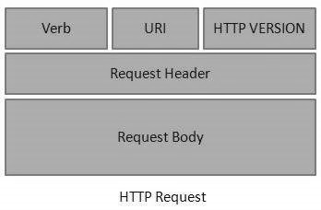
HTTP PROTOCOLS
RESTful Web Services make use of HTTP protocols as a medium of communication between client and server. A client sends a message in form of a HTTP Request and the server responds in the form of an HTTP Response. This technique is termed as Messaging. These messages contain message data and metadata i.e. information about message itself.
HTTP Request
An HTTP Request has five major parts −
Verb − Indicates the HTTP methods such as GET, POST, DELETE, PUT, etc.
URI − Uniform Resource Identifier (URI) to identify the resource on the server.
HTTP Version − Indicates the HTTP version. For example, HTTP v1.1.
Request Header − Contains metadata for the HTTP Request message as key-value pairs. For example, client (or browser) type, format supported by the client, format of the message body, cache settings, etc.
Request Body − Message content or Resource representation.

Slide 14
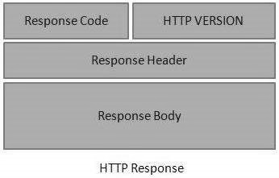
HTTP PROTOCOLS
HTTP Response
An HTTP Response has four major parts −
Status/Response Code − Indicates the Server status for the requested resource. For example, 404 means resource not found and 200 means response is ok.
HTTP Version − Indicates the HTTP version. For example HTTP v1.1.
Response Header − Contains metadata for the HTTP Response message as key/value pairs. For example, content length, content type, response date, server type, etc.
Response Body − Response message content or Resource representation.

Slide 15
HTTP METHODS
The following HTTP methods are most commonly used in a REST based architecture.
GET − Provides a read only access to a resource.
PUT − Used to create a new resource.
DELETE − Used to remove a resource.
POST − Used to update an existing resource or create a new resource.

Slide 16
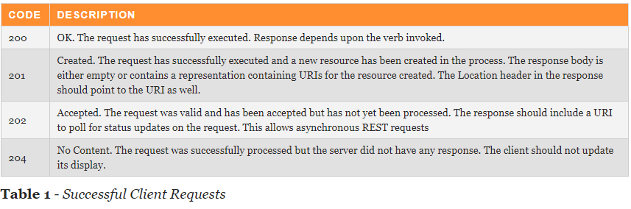
RESPONSE CODES
HTTP response codes give us a rich dialogue between clients and servers about the status of a request. Most people are only familiar with 200, 403, 404 and may be 500 in a general sense, but there are many more useful codes to use.

Slide 17
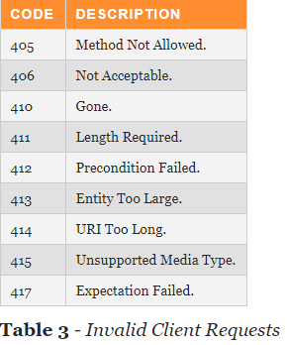
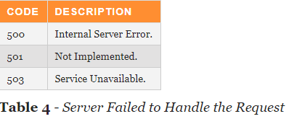
RESPONSE CODES

Slide 18
Constructing a Standard URI
The following are important points to be considered while designing a URI −
Use Plural Noun − Use plural noun to define resources. For example, we've used users to identify users as a resource.
Avoid using spaces − Use underscore (_) or hyphen (-) when using a long resource name. For example, use authorized users instead of authorized%20users.
Use lowercase letters − Although URI is case-insensitive, it is a good practice to keep the url in lower case letters only.
Maintain Backward Compatibility − As Web Service is a public service, a URI once made public should always be available. In case, URI gets updated, redirect the older URI to a new URI using the HTTP Status code, 300.
Use HTTP Verb − Always use HTTP Verb like GET, PUT and DELETE to do the operations on the resource. It is not good to use operations name in the URI.
Example
GET http://localhost:8080/UserManagement/rest/UserService/users/1

Slide 19
RICHARDSON MATURITY MODEL
Richardson Maturity model is a model developed by Leonard Richardson.
It grades APIs by their Restful maturity.
There are 4 levels. Only when the APIs reach level 4, then we can confirm it is a RESTful API. The levels are
Level 0
Level 1
Level 2
Level 3

Slide 20
LEVEL 0
Level 0, Plain Old Xml.
Http is used only as a Transport protocol. Http is used for remote interaction.
To get the data and to post the data we send request to the same URL, only POST request may be used.
To get the data,
POST http://localhost:8080/products
To post the data,
POST http://localhost:8080/products

Slide 21
LEVEL 1
In Level 0, there was only one URI.
In Level 1, each resource is mapped to a specific URI.
For example, the URI to get the products
POST http://localhost:8080/products
To get URI for a specific product
POST http://localhost:8080/products/1
Still, only one HTTP method POST is used for retrieving and creating data.

Slide 22
LEVEL 2
In Level 2, correct HTTP verbs are used with each request.
For each of those requests, correct HTTP response code is provided.
Example : GET http://localhost:8080/products
Response code : 200 OK

Slide 23
LEVEL 3
At Level 3, the APIs support HATEOAS.
Example : GET http://localhost:8080/customers
For this, the response we get is
Customer Json + Self-documenting Hypermedia
Helps in Self-documentation.

Slide 24
QUIZ

Slide 25
References
https://restfulapi.net/rest-architectural-constraints/

Slide 26
Q & A

