Slide 1


CODING STANDARDS, CLEAN CODE
AND REFACTORING
VENU KANDAGATLA
Feb 19, 2019

Slide 2
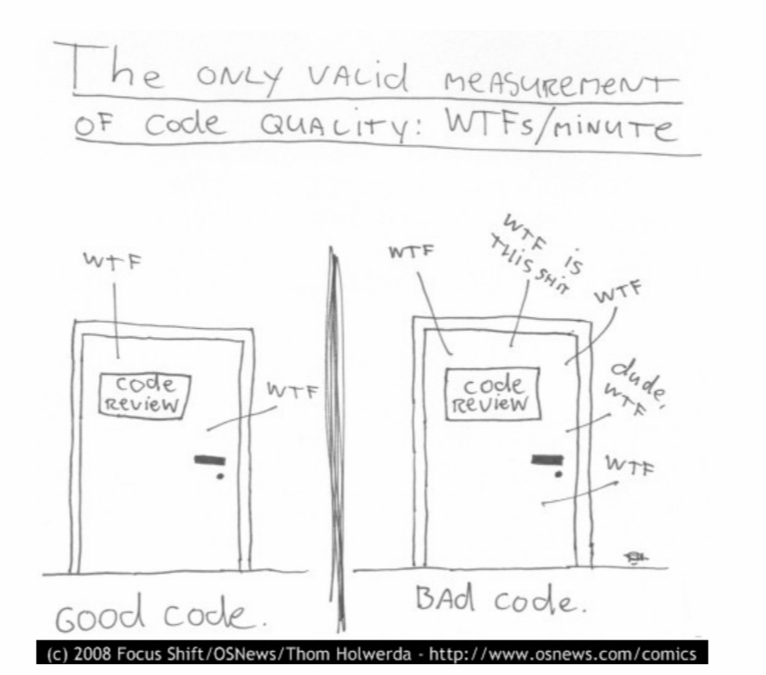
Code Quality

Slide 3
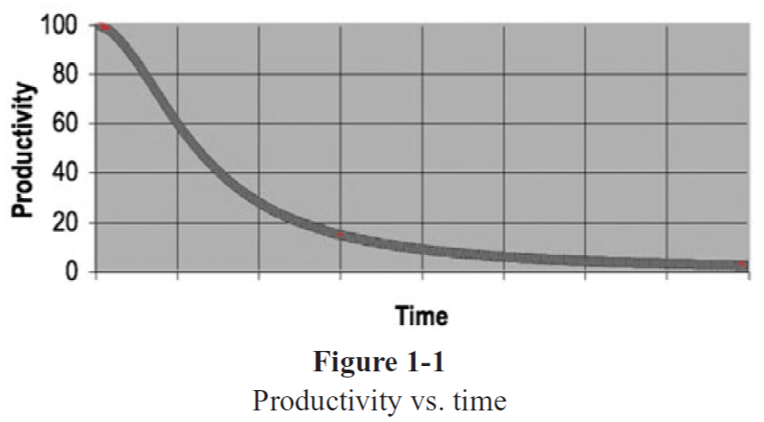
Code Quality and Productivity

Slide 4
Tasks
Write Calculator program
Should calculate addition of numbers
Should calculate multiplication of numbers
Should calculate division of number
Write Program to calculate simple interest, and compound interest
Write Program to estimate house construction cost, based on various materials
Construction cost per square feet is 1200INR if we use standard materials
1500INR if we use above standard materials
1800INR if customers needs high standard material
2500INR if customer needs high standard material and fully automated home
Input will be material standard, total area of house and if they want fully automated home
Notes:
Don’t use main method
Don’t use System.out.println
Try to write Unit test case if you know or
Write client application to use above services
You need to write Test cases for these tasks
Use C# or Java for completing these tasks

Slide 5
Resources
https://www.amazon.in/dp/B001GSTOAM/ref=dp-kindle-redirect?_encoding=UTF8&btkr=1
https://www.investigatii.md/uploads/resurse/Clean_Code.pdf
https://cleancoders.com/

Slide 6
THANK YOU
VENU KANDAGATLA

