Slide 1


GIT
VENU KANDAGATLA
Feb 19, 2019

Slide 2
AGENDA
Introduction
What is Version Control System?
What is GIT?
Q & A
Why GIT?
How!
Q & A
Tasks
Next Sessions
References

Slide 3
ABOUT ME
Working as Architect in EPAM SYSTEMS since 7 years
15+ Years of Experience as Software Engineer
Training Head for EPAM RD
EXPERIENCE

Slide 4
What is Version Control System?
Version control is a system that records changes to a file or set of files over time so that you can recall specific versions later
Examples:
SVN
CVS
SUBVERSION
PERFORCE
RCS
Three Kinds of Version Control Systems
Local
Centralized
Distributed
RCS – Local, from Unix base build
CVS
Subversion
Perforce
GIT
BitKeeper
Mercurial
Bazaar
Darcs
WHAT?
VARIANTS
EXAMPLES

Slide 5

LOCAL VERSION CONTROL SYSTEMS

Slide 6
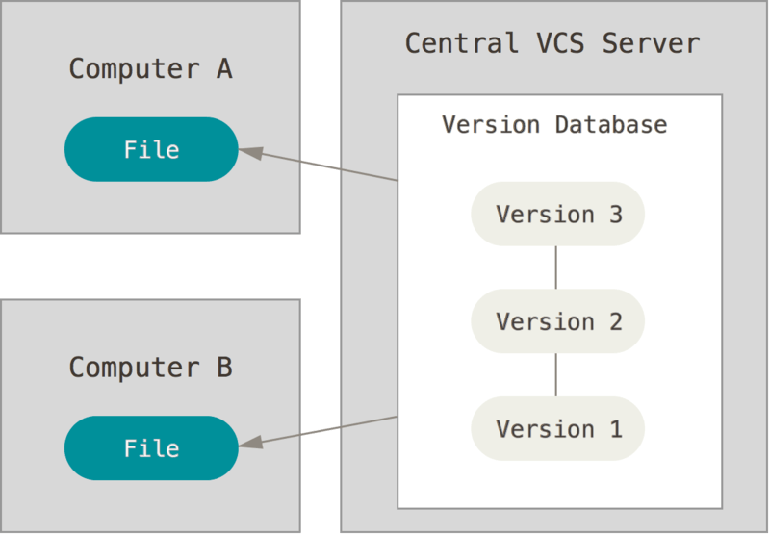
CENTRAL VERSION CONTROL SYSTEMS

Slide 7
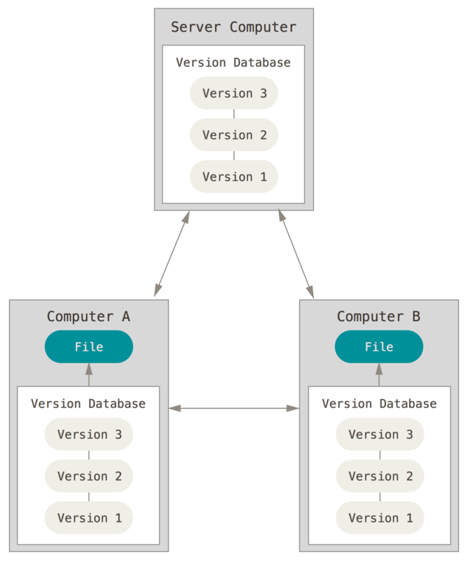
CENTRAL VERSION CONTROL SYSTEMS

Slide 8
What is GIT
DVCS
Stores snapshots, not differences
Most of the operations are local
GIT uses SHA-1 to check integrity of Files while it commits the code
GIT adds only data
Manages using three states
Committed
Modified
Staged

Slide 9
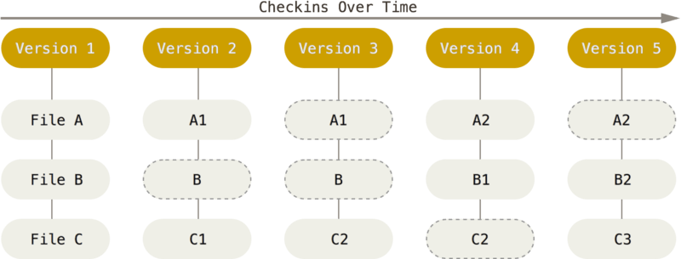
Checkins in GIT

Slide 10
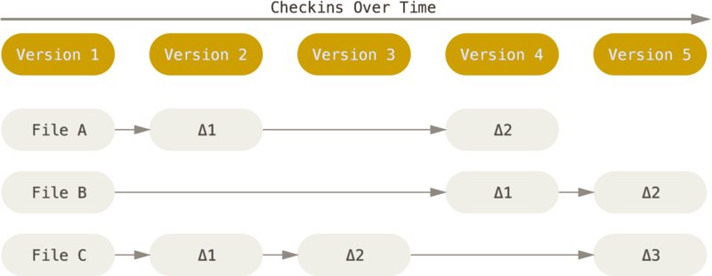
Checkins in Traditional VCS

Slide 11
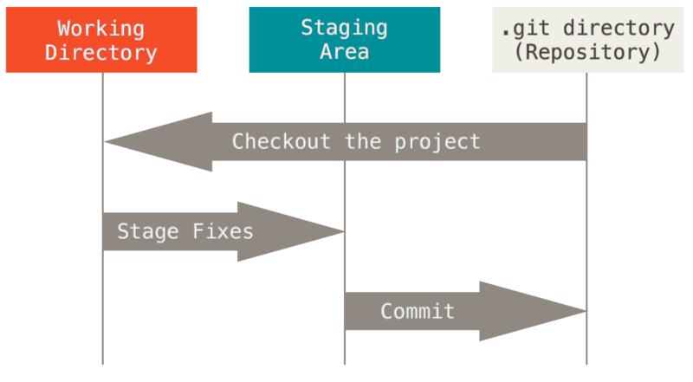
GIT File States

Slide 12
INSTALL GIT
https://git-scm.com/book/en/v2/Getting-Started-Installing-Git
https://git-scm.com/download/win
https://gitforwindows.org/

Slide 13
Q & A

Slide 14
WHY GIT?
Open Source
Distributed
Secured

Slide 15
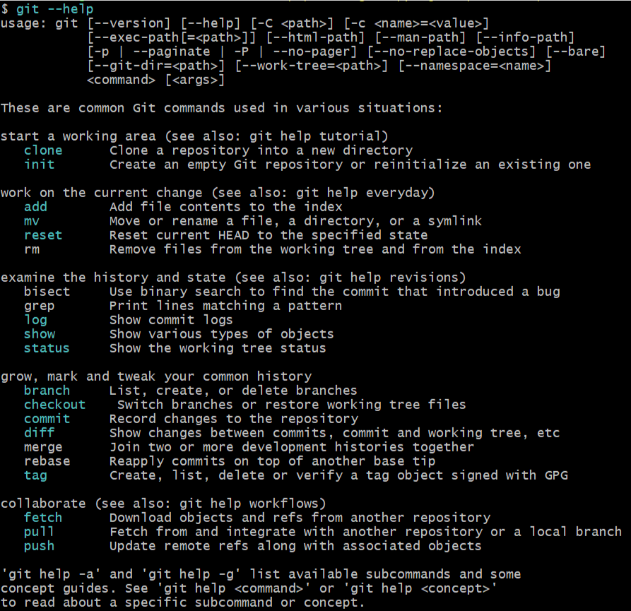
GIT COMMANDS

Slide 16
WHY GIT?
http://try.github.io/
https://learngitbranching.js.org/
https://git-scm.com/book/en/v2/Getting-Started-About-Version-Control
https://www.vogella.com/tutorials/Git/article.html

Slide 17
Q & A

Slide 18
TASKS!
Create GIT Account at https://github.com/
Create Local Repository, create few files in the repository
Create Sample Java Project using Maven in your local repository
Push the sample Java project to your github account
Create Branch in you sample java project and commit some file there
Merge branch to master branch

Slide 19
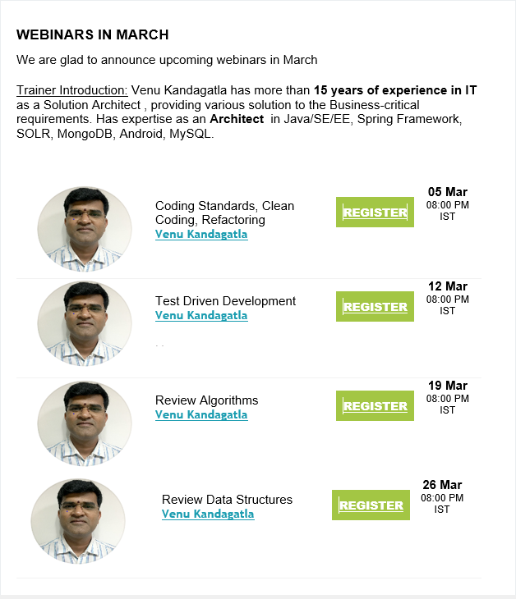
WEBINARS in MARCH

Slide 20
THANK YOU
VENU KANDAGATLA

