Slide 1
INTERNSHIP MAJOR PROJECT · ARTIFICIAL INTELLIGENCE
SentinelPay
Real-time anomaly detection in financial transactions
Isolation Forest · Local Outlier Factor · NVIDIA GenAI analyst
Case study: SecurePay FinTech
Live app: sentinelpaygit-…streamlit.app
Source: github.com/abhinavkhedwal4-maker/SentinelPay
Notes:
Introduce the project: an unsupervised fraud-detection system for the fictional FinTech SecurePay. It learns what normal transactions look like and flags deviations. Everything in this deck comes from the live dashboard.

Slide 2

Fraud is rare, so accuracy is a trap
99.70%
150
0.30%
1 : 332
fraud cases in 50,000 transactions
share of traffic that is fraud
fraud to legitimate ratio
accuracy of a model that always says “legitimate”
…and it catches 0 of the 150 frauds.
Our answer: do not teach the model what fraud looks like (it keeps changing). Teach it what normal looks like and flag deviations. Judge it with precision, recall, F1 and PR-AUC.
Notes:
In our data only 0.30% of transactions are fraud. A model that always answers legitimate is 99.70% accurate and catches nothing. That is why we ignore accuracy and use precision, recall, F1 and PR-AUC.

Slide 3






From raw transactions to a flagged alert
1
2
3
4
5
6
Data
EDA
Preprocess
Detect
Tune
Explain
30 features: Time, V1–V28, Amount, Class
Class imbalance, Amount and Time patterns
RobustScaler fitted on normal rows only
Isolation Forest and LOF trained on normal data
PR curve and contamination sweep pick the threshold
Dashboard plus NVIDIA LLM analyst
One click: The whole pipeline runs from one command (python run_pipeline.py) or from the Run detection button in the dashboard.
Notes:
Walk left to right. Data and EDA, scaling, two detectors trained on normal data only, threshold tuning with the PR curve, then the dashboard and the AI analyst. Everything can be reproduced with one command.

Slide 4


Two detectors, two ways to spot “different”
Isolation Forest
Local Outlier Factor
Fusion (IF + LOF)
How it works
Random trees split the data again and again. Points isolated in few splits are “few and different” and get a high score.
Strength
Very fast: 0.009 ms per transaction.
Setting
200 trees, 512 samples each.
How it works
Compares a point’s local density with its 35 nearest neighbours. Sparse area, crowded neighbours: high score.
Strength
Spots local, cluster-relative outliers.
Cost
Neighbour search is slow, so training rows are capped at 20,000.
How it works
Turns each score into a tail probability against normal calibration scores, then averages the two.
Strength
Blends the tree view and the density view.
Cost
Runs both models, so it is the slowest.
Training strategy: all models learn from normal transactions only. 20% of normal training rows are held out as a calibration set, so the alert threshold needs no fraud labels.
Notes:
Isolation Forest isolates points with random splits: anomalies need fewer splits. LOF compares local density with the neighbours. Fusion averages both after converting scores to tail probabilities. All of them train only on normal transactions; a calibration set of normal rows turns the contamination setting into a score threshold.

Slide 5
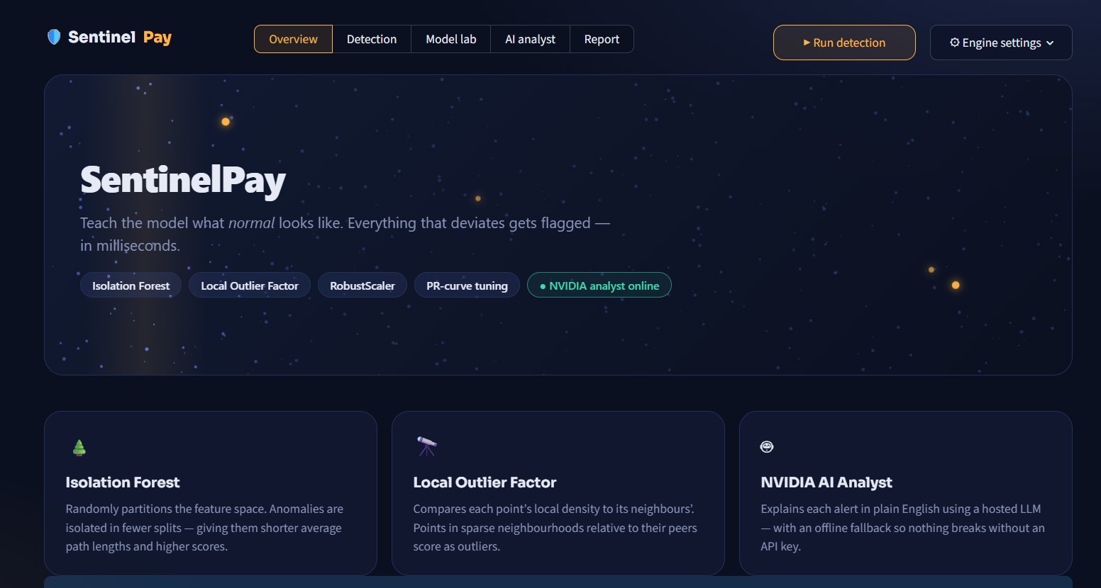
The command deck: everything on the front page
Navigation pills
Overview, Detection, Model lab, AI analyst and Report are the five sections.
Engine settings
Upload creditcard.csv, choose demo size, trees, neighbours and LOF training rows.
Run detection
Trains both models on normal traffic and scores the hold-out set.
Status chip
Green “NVIDIA analyst online” means the API key is connected.
Reading the page: In the hero, blue dots are normal traffic, amber dots are anomalies, and the glowing sweep is the scanner. The three cards below summarise the models.
Notes:
This is the landing view. There is no sidebar: navigation, engine settings and the Run button sit in the top bar. The hero is a live field of blue normal transactions with a few amber anomalies and a scanning sweep.

Slide 6
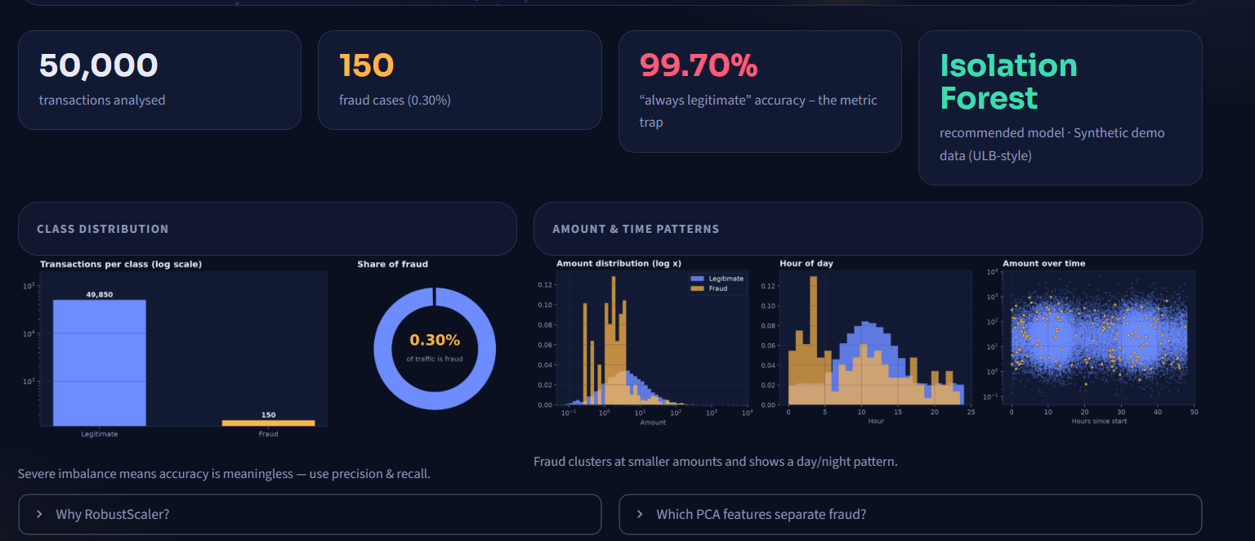
Overview: 150 frauds hidden in 50,000 payments
Four KPI tiles
50,000 transactions, 150 fraud (0.30%), 99.70% accuracy of “always legitimate”, and the recommended model.
Data source
The tile names the source. This run uses synthetic ULB-style demo data.
Recommended model
Isolation Forest: near-best PR-AUC and the lowest latency.
Class distribution: bar chart on a log scale (49,850 vs 150) and a donut showing fraud is 0.30% of traffic.
Amount and time: fraud (amber) clusters at small “card-testing” amounts and peaks at night hours.
Notes:
Top row: four KPI tiles. Left chart: class counts on a log scale, because the fraud bar would otherwise be invisible. Right: Amount distribution, hour of day and amount over time, fraud in amber. Fraud clusters at small amounts and shows a night-time pattern.

Slide 7
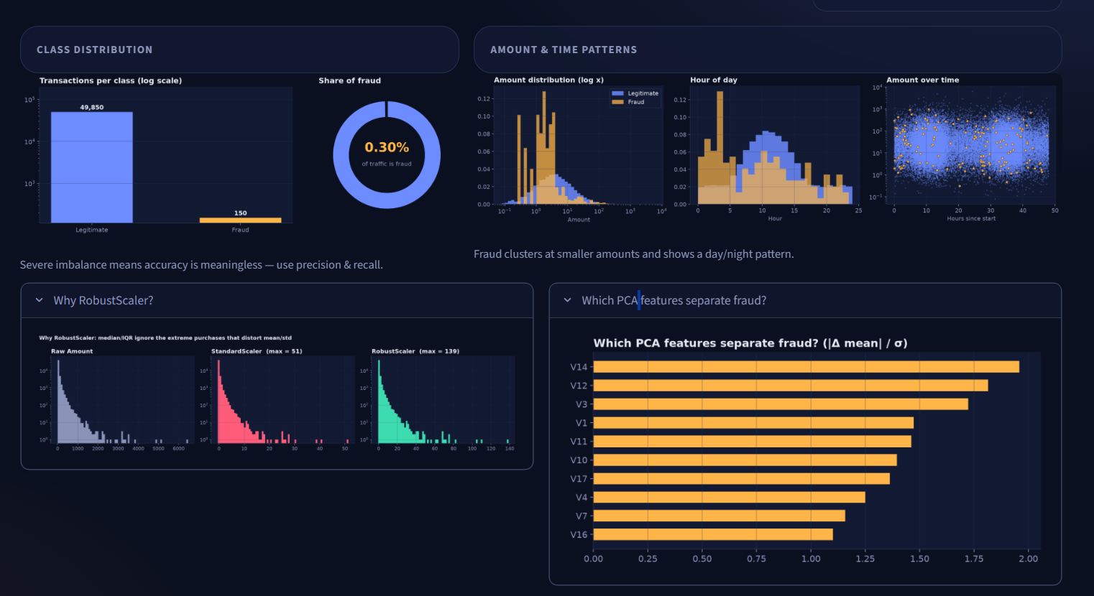
RobustScaler and the features that carry signal
Scaler comparison
Histograms on a log axis. Max values: 51 after StandardScaler, 139 after RobustScaler.
Why Robust
Median and IQR ignore a few huge purchases, so normal data keeps its spread and outliers stay extreme.
Feature separation
Bars show |mean(fraud) − mean(normal)| in standard deviations. V14, V12 and V3 lead at roughly 1.7–2.0.
No leakage: the scaler is fitted on normal training rows only, so nothing leaks from the test set. Models still use all 30 features.
Notes:
Left panel compares raw Amount, StandardScaler and RobustScaler. Standard scaling uses mean and standard deviation, which a few huge purchases inflate, squeezing normal data together. RobustScaler uses median and IQR so normal behaviour keeps a sensible scale and the outliers stay visibly extreme, which is exactly what a detector needs. The right chart ranks V-features by how far fraud and normal means differ.

Slide 8
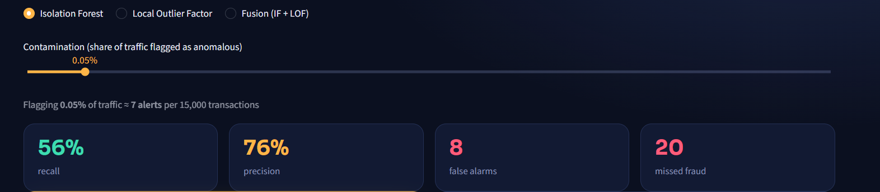
Detection: one slider trades recall for precision
Controls
The model switch picks Isolation Forest, LOF or Fusion. Contamination is the share of traffic flagged: 0.05% is about 7 alerts per 15,000 transactions.
The four tiles
Recall 56%: 25 of 45 frauds caught. Precision 76%: 25 of 33 alerts were real. 8 false alarms and 20 missed frauds.
Below the tiles
Dollar tiles: $2,678 of fraud prevented vs $1,580 missed. The PCA map shows caught fraud (amber), false alarms (coral) and missed fraud (rings).
Notes:
Choose a model and set contamination, the share of traffic to flag. At 0.05 percent that is about 7 alerts per 15,000 transactions. The test set has 45 frauds: we caught 25 and missed 20, with 8 false alarms. The dollar tiles show 2,678 dollars of fraud prevented and 1,580 dollars missed. Below them the PCA map shows where everything sits.

Slide 9
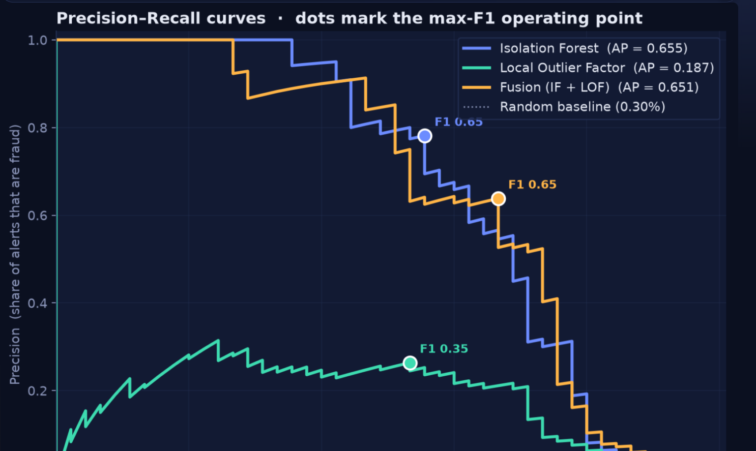
PR curves: Isolation Forest leads, LOF trails
Axes
x is recall (share of fraud caught). y is precision (share of alerts that are fraud).
AP = area under the curve
Isolation Forest 0.655, Fusion 0.651, LOF 0.187. The random baseline is only 0.30%.
Dots = max-F1 point
F1 is about 0.65 for Isolation Forest and Fusion and 0.35 for LOF.
Closer to top-right is better
Isolation Forest and Fusion stay high before dropping. LOF’s precision stays around 0.3 or lower at almost every threshold.
Notes:
Each point on a curve is one threshold. Moving right means catching more fraud, but precision usually drops. Isolation Forest has a PR-AUC of 0.655 and Fusion 0.651; LOF only 0.187. The random baseline is 0.30 percent. Dots mark the max-F1 point of each model.

Slide 10
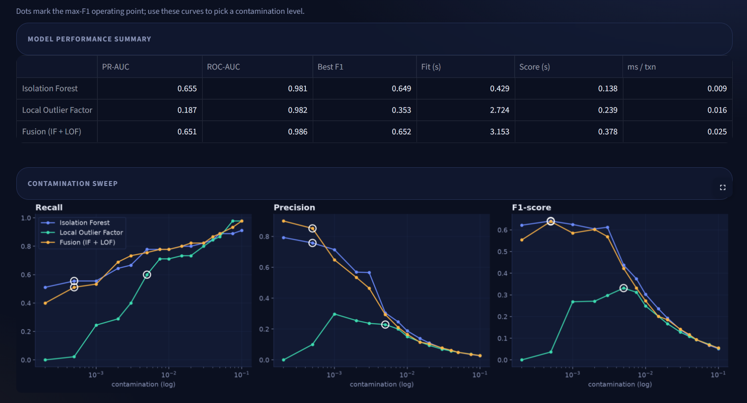
Model lab: comparing models across thresholds
Summary table
PR-AUC, ROC-AUC, best F1, fit time, scoring time and milliseconds per transaction.
ROC-AUC flatters
All models score about 0.98 because legitimate traffic dominates. PR-AUC separates them.
Contamination sweep
As more traffic is flagged, recall climbs and precision falls. F1 peaks at very small contamination.
White circles
Each model’s max-F1 point.
Insight: Isolation Forest and Fusion track each other closely on F1, while LOF needs about 1% contamination before its recall catches up.
Notes:
The table summarises the three models. Note that ROC-AUC is about 0.98 for all of them because of the class imbalance, which is why PR-AUC is the honest metric. The sweep charts show recall, precision and F1 as contamination grows. White circles mark each model's best F1.

Slide 11
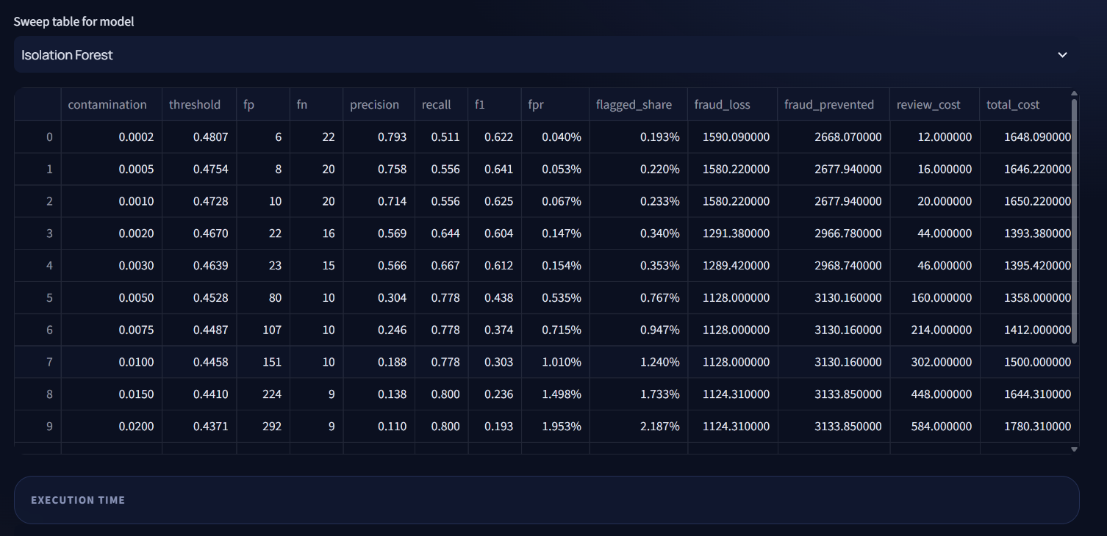
The sweep table: every threshold has a price
Columns
threshold is the score cut-off. fp and fn are false alarms and missed frauds. fpr is the false-positive rate.
Dollar columns
fraud_loss is missed fraud in $, fraud_prevented is caught fraud, and total_cost adds $2 per alert.
Three rows to remember
0.0005 gives best F1 (0.641). 0.005 has the lowest cost ($1,358). 0.015 is the first to reach 80% recall.
Trade-off: contamination 0.0005 flags only 8 false alarms but misses 20 frauds; 0.015 catches 80% of fraud but raises 224 false alarms.
Notes:
Each row is a contamination value. Threshold is the score cut-off. fp are false alarms, fn are missed frauds. fraud_loss is the dollar value of missed fraud, review_cost is two dollars per false alarm, and total_cost is missed fraud plus two dollars per alert. Highlight row 0.0005 for best F1, row 0.005 for lowest cost, row 0.015 for 80 percent recall.

Slide 12
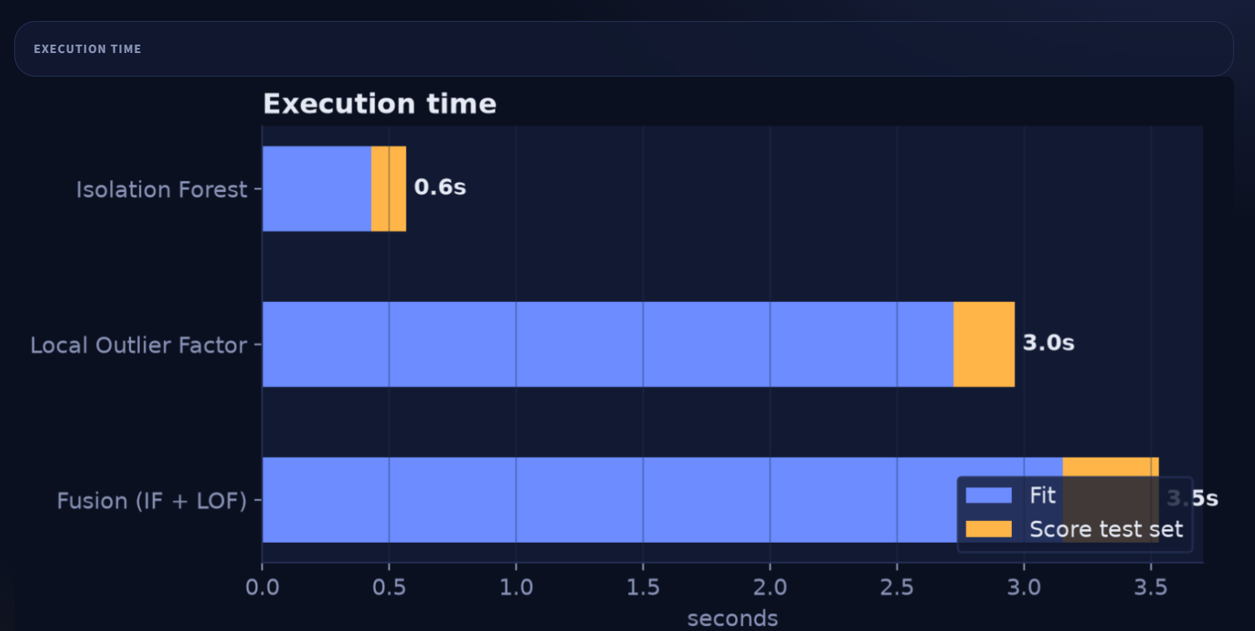
Execution time: Isolation Forest scores in 0.009 ms
What is measured
Blue is time to fit on normal data. Amber is time to score the 15,000-transaction test set.
Totals
Isolation Forest 0.6 s, LOF 3.0 s, Fusion 3.5 s.
Fit time
LOF takes 2.7 s to fit vs 0.4 s for Isolation Forest, about 6 times slower.
Per transaction
Scoring costs 0.009, 0.016 and 0.025 ms: all real-time capable.
Why it matters: LOF is slow because it searches for neighbours, which grows quickly with data size. That is why its training rows are capped at 20,000.
Notes:
Blue is fitting, amber is scoring the 15,000-transaction test set. Isolation Forest takes 0.6 seconds in total, LOF 3.0 and Fusion 3.5. Per transaction the scoring cost is 0.009, 0.016 and 0.025 milliseconds, so all are real-time capable, but LOF's neighbour search grows quickly with data size.

Slide 13
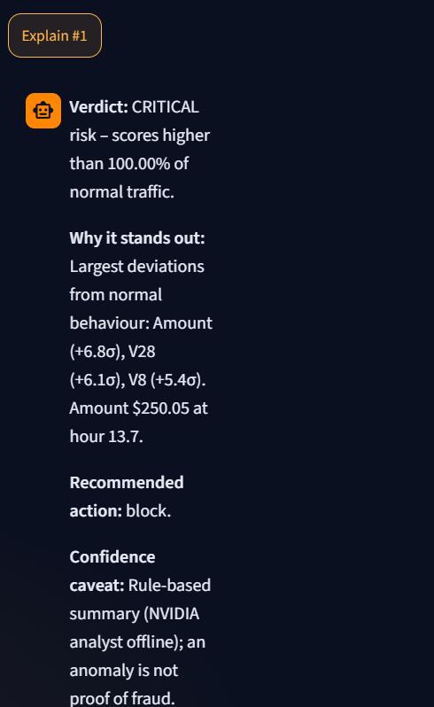
AI analyst: a plain-English verdict per alert
Alert card
Rank #1 shows a risk band (CRITICAL), the amount ($250.05), hour 13.7, the score 0.602 at the 100th percentile of normal traffic, and the true label (confirmed fraud).
What the LLM receives
Only the score, percentile, amount, hour and the top-5 robust-z feature deviations (here Amount +6.8σ, V28 +6.1σ, V8 +5.4σ). No raw card data.
What comes back
Verdict, why it stands out, recommended action (approve, step-up authentication, hold or block) and a confidence caveat.
Fallback
Shown here: with no valid key a rule-based explanation appears in the same format. With a key, an NVIDIA-hosted LLM (default meta/llama-3.3-70b-instruct) writes it.
Notes:
The AI analyst tab lists the top-scoring alerts as cards. Pressing Explain sends only anonymised PCA features, the anomaly score, percentile, amount and hour to an NVIDIA-hosted LLM. The reply has a verdict, why it stands out, a recommended action and a confidence caveat. The screenshot shows the offline fallback, which uses the same four-part format.

Slide 14
Recommendation: Isolation Forest at 0.0005
Balanced
Cost-optimal
Compliance
max F1
lowest total $
recall ≥ 80%
contamination 0.0005
contamination 0.005
contamination 0.015
Recall 56%
Precision 76%
8 false alarms
F1 0.641
Recall 78%
Precision 30%
80 false alarms
Total cost $1,358
Recall 80%
Precision 14%
224 false alarms
F1 0.236
Why this model: Isolation Forest has near-identical PR-AUC to Fusion (0.655 vs 0.651) and scores about 3× faster, so the real-time constraint decides. Results use synthetic ULB-style data (15,000 test transactions, 45 frauds).
Notes:
We recommend Isolation Forest. Its PR-AUC is 0.655 against 0.651 for Fusion, and it scores about three times faster per transaction. The business picks the operating point: balanced, cost-optimal or compliance-first. Numbers come from the synthetic demo data with 45 frauds in the test set; they must be refreshed on the Kaggle dataset.

Slide 15


Limitations and next steps
Limitations
Next steps
Synthetic demo data
Numbers come from ULB-style generated data. Re-run on the real Kaggle creditcard.csv for final figures.
Threshold tuned on the test set
Use a separate, time-based validation window in production.
Anonymised features
V1–V28 are PCA components, so explanations are statistical, not merchant-level.
Re-run on the Kaggle dataset
284,807 transactions, 492 frauds.
Drift monitoring
Re-calibrate thresholds on fresh normal traffic on a schedule.
Streaming and a second stage
Score live with Kafka or Flink, and add a supervised model on analyst-confirmed cases.
Notes:
Be upfront: results are from synthetic data and the threshold is tuned on the same hold-out set. The next steps make the system production-ready: real data, time-based validation, drift monitoring and a supervised second stage.

Slide 16


Try it live
Live dashboard
sentinelpaygit-hnfuyquyrwuyursy5aksil.streamlit.app
Source code on GitHub
github.com/abhinavkhedwal4-maker/SentinelPay
pip install -r requirements.txt
python run_pipeline.py
python -m streamlit run app/dashboard.py
Python · pandas · scikit-learn · matplotlib · Streamlit · NVIDIA API
Notes:
Close with the live demo and the repository. Anyone can run the pipeline with three commands. Invite questions.

