Slide 1
UMBeats DJ Club
Deliverable 03
Achal, Abhinav, Kuran, Mykiah

Slide 2
Context Level Diagram
This diagram represents the relationship between the system and its environment. It displays the entities and processes that interact with the system through data flows.

Slide 3
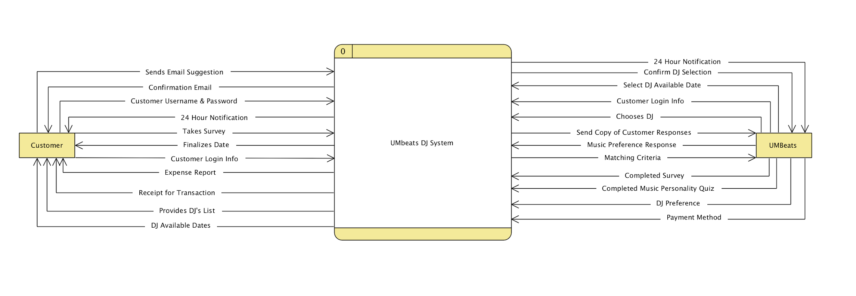
Context Level Diagram

Slide 4
Level 0 Diagram
Level 0 diagram is a decomposed version of the context level diagram. The diagram shows the main processes within the system and can be broken down further if needed.

Slide 5
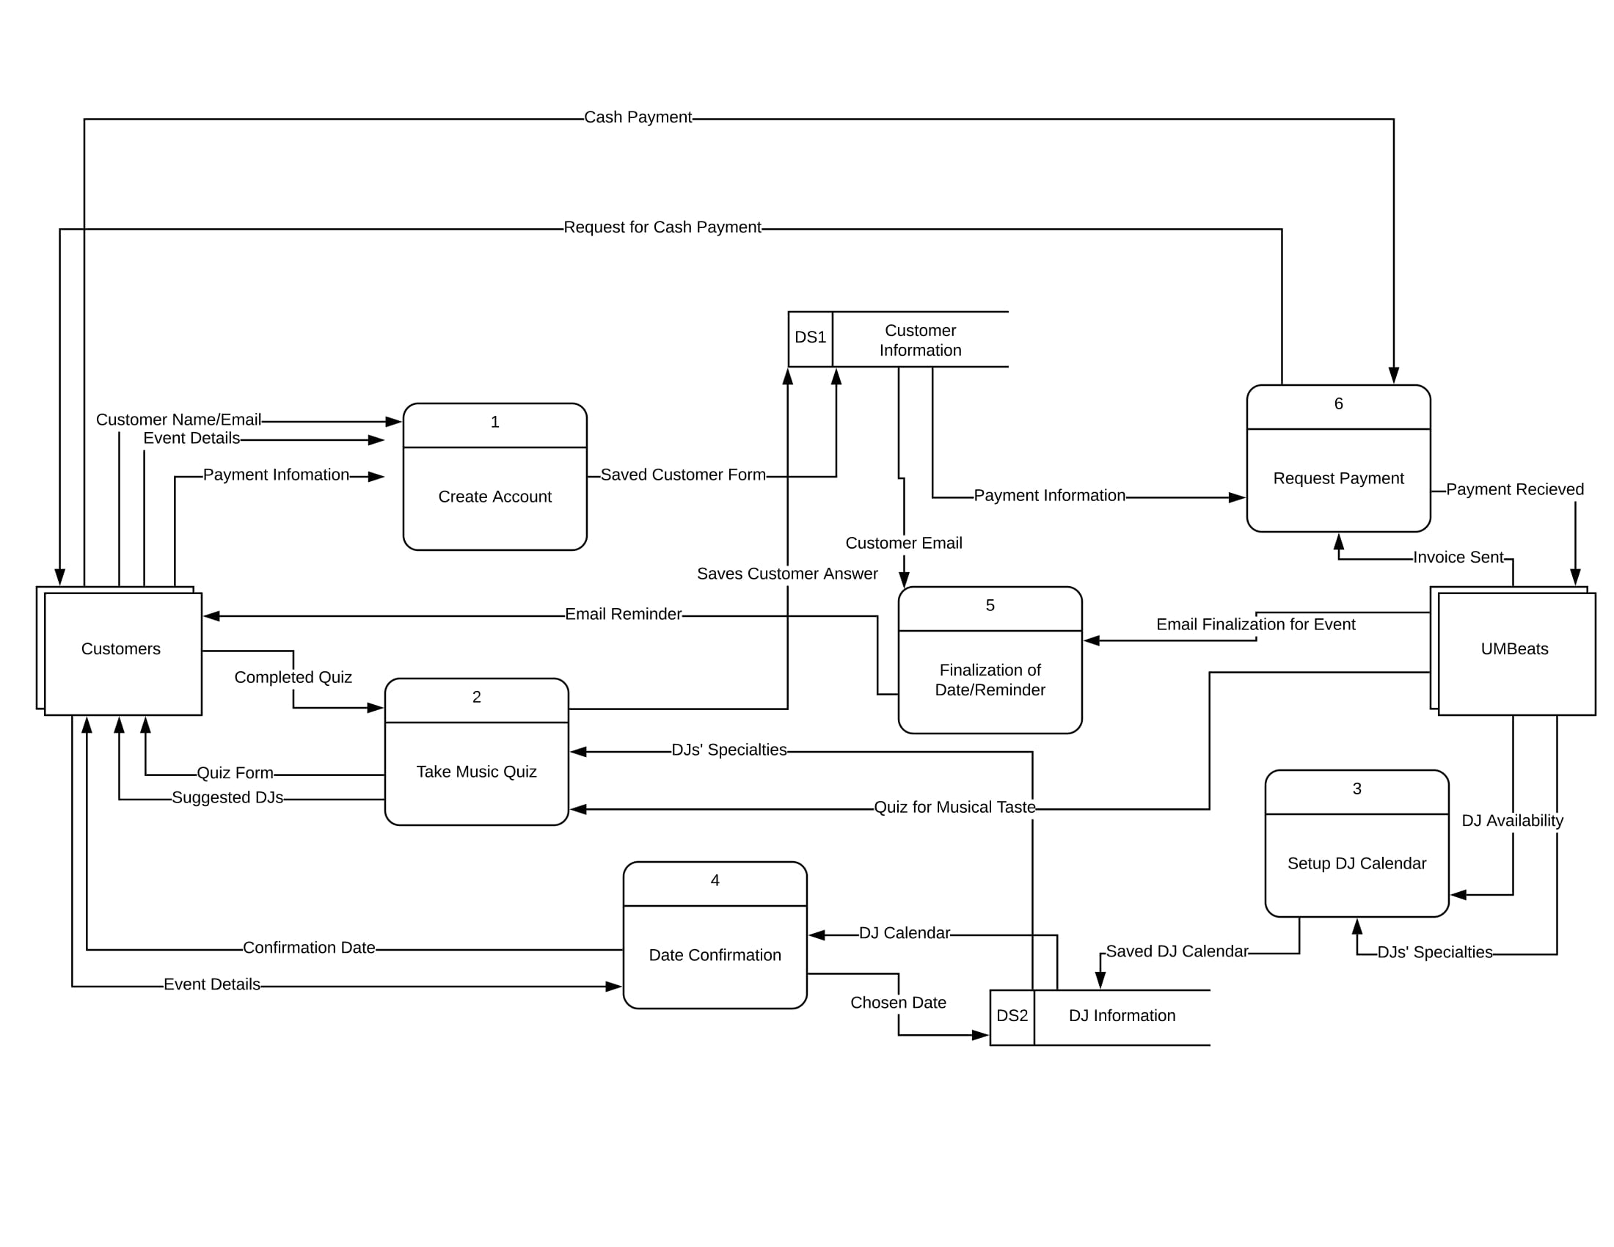
Level 0 Diagram

Slide 6
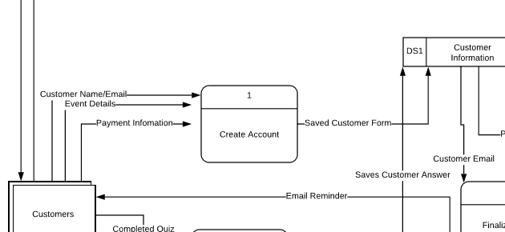
Level 0 Diagram - Process 1
Closer look at Process 1 (Create Account)

Slide 7
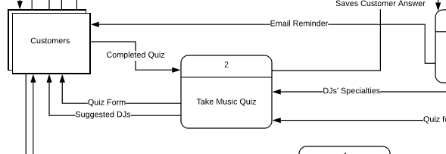
Level 0 Diagram - Process 2
Closer look at Process 2 (Take Music Quiz)

Slide 8
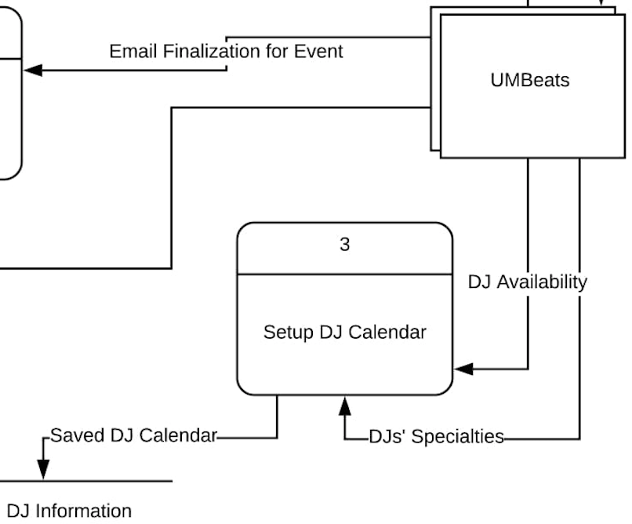
Level 0 Diagram - Process 3
Closer look at Process 3 (Setup DJ Calendar)

Slide 9
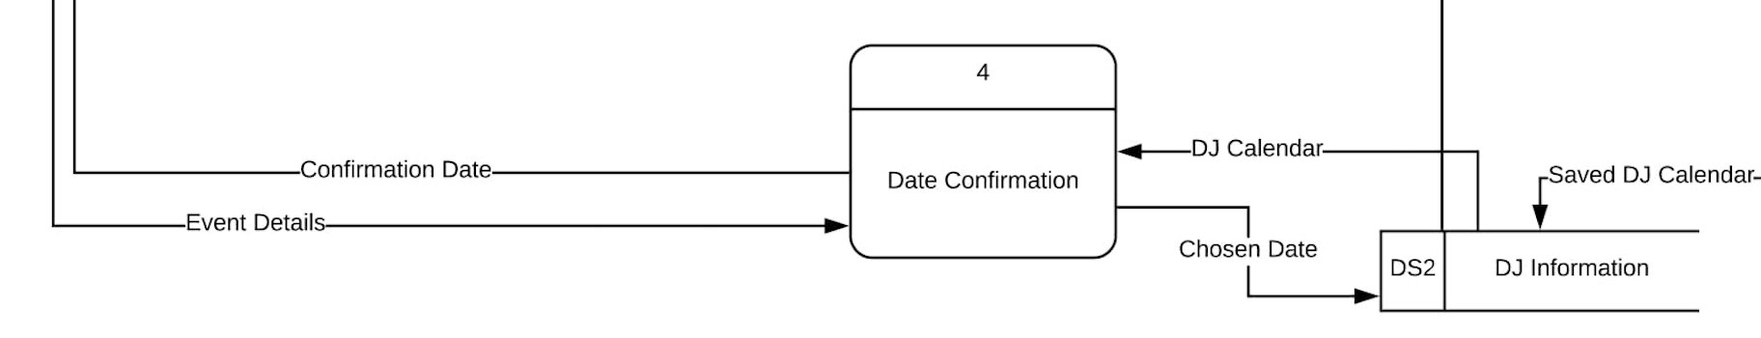
Level 0 Diagram - Process 4
Closer look at Process 4 (Date Confirmation)

Slide 10
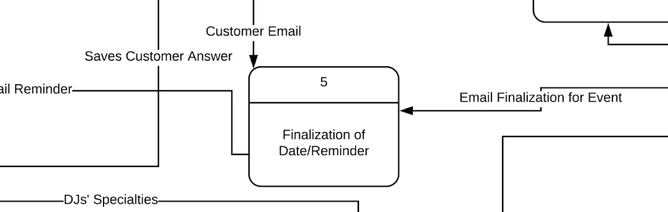
Level 0 Diagram - Process 5
Closer look at Process 5 (Finalization of Date/Reminder)

Slide 11
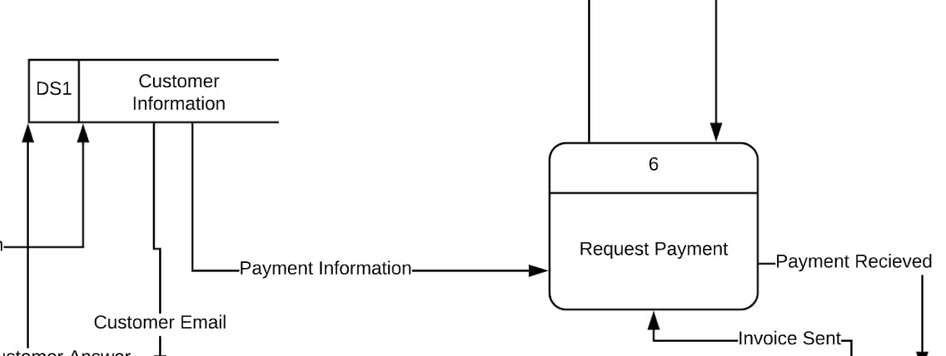
Level 0 Diagram - Process 6
Closer look at Process 6 (Request Payment)

Slide 12
THANK YOU!

