Slide 1
UMBeats DJ Club - Group 04
Kuran Chona
Abhinav Konagala
Mykiah Ashley
Achal Malik

Slide 2
Problem:
UMBeatsClub Client-DJ Connector:
This project has been created in order to increase sales and customer satisfaction, while also reducing the cost of performances of Disc Jockeys within and outside of the UMBC community by creating a product that questions the customer about music preferences before we assign a disc jockey to their event.

Slide 3
Functional Requirements:
The system will allow customers to view event details on the social networking sites.
The system will allow customers to make suggestions about their music styles and music preferences through email system.
The system will record customers answers to online surveys and music personality quiz.
The system will select DJ’s based on music event rather than on availability.

Slide 4
Alternative:
We chose the Alternative of Buying the system:
The organization does not have the technical prowess to build and maintain this system
This would make the process of switching over to a new system easier that having to build a new one.
Survey Legend, our final option, has all the details that we wanted, such as saving the information from the surveys as well as question creation and customization.

Slide 5
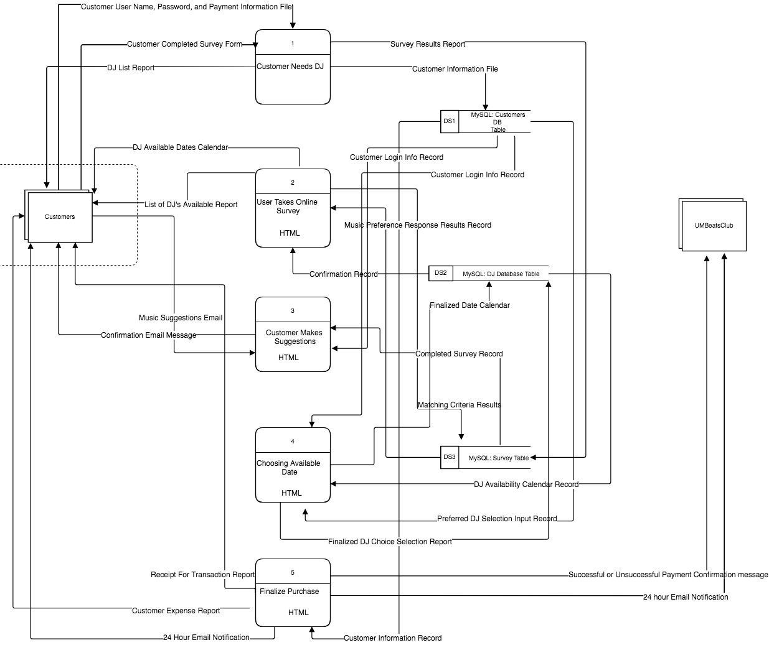
Physical
DFD Level 0

Slide 6
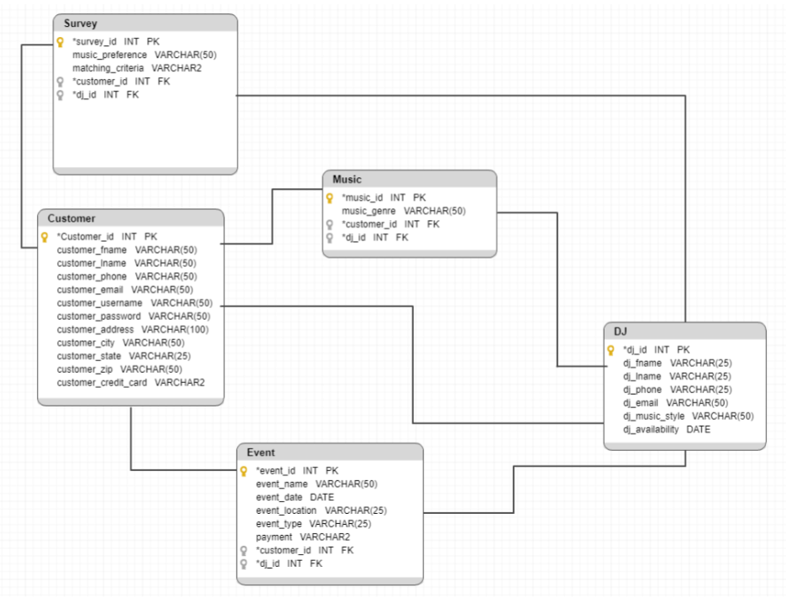
Physical ERD Diagram

Slide 7
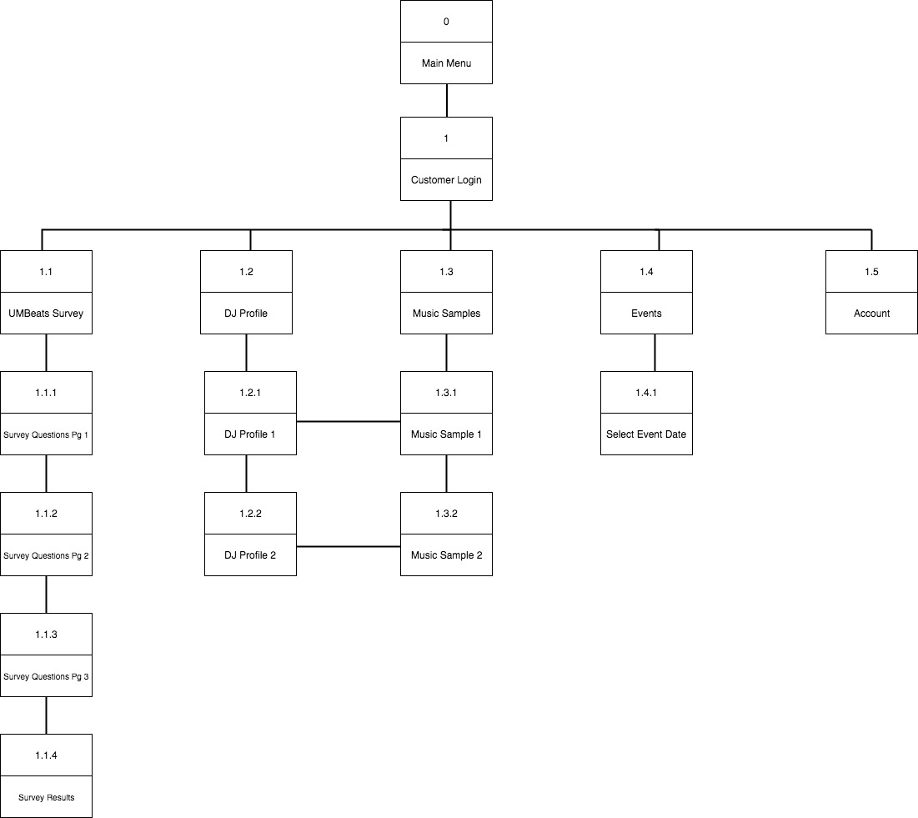
Interface Structure Diagram

Slide 8
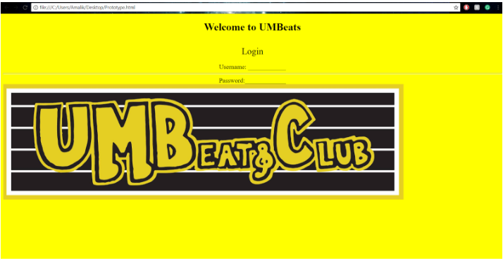
Screens:

Slide 9
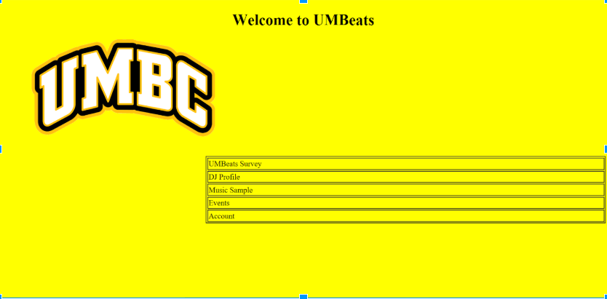
Screens cont.

Slide 10
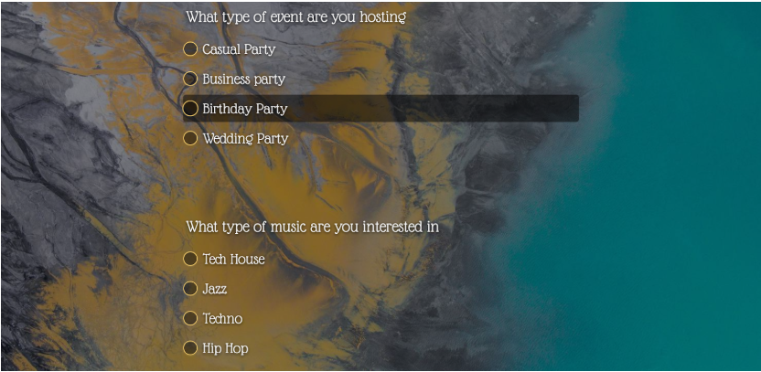
Screens cont.

Slide 11
Lessons Learned:
As a Group we have had many difficulties in the beginning with losing a member of our group, putting a bigger workload on the rest of us. Our communication in the beginning was very poor but over time we all became very aware that communication is the key to being a successful group.
We also started to help each other out on all the parts of the project rather than leaving the one person to do it themselves. We collectively came up that multiple brains is better than just one and we wanted to create a more powerful project and presentation of what we have done.

