Slide 1
GRADIENT 2K24

Slide 2
Team Name:
Squad Busters
Team Members:
Harshitha M P
Chinmayi B
Abhinav Kumar Singh
Lakshmi Narashima

Slide 3
Track:
Health and Wellness
Problem Statement:
Develop a machine learning model to accurately detect and classify sleep apnea events from physiological signals, such as respiratory flow, EMG, EOG and EEG data. The goal is to improve the estimation of the Apnea-Hypopnea Index (AHI) and provide more reliable diagnosis of sleep apnea severity.

Slide 4
Relevance
Machine learning is applied in this project by automating the detection and classification of Sleep Apnea events from complex physiological signals like respiratory flow and EEG data. ML models can extract important features, recognize patterns, and differentiate between normal and abnormal breathing. This improves the accuracy of detecting Apneas and estimating the Apnea-Hypopnea Index (AHI), leading to a more reliable diagnosis of sleep disorders.

Slide 5
Uniqueness
This project is unique in its focus on physiological signal processing, particularly time-series data like EOG, EMG, and EEG, which are more complex and noisier than typical ML inputs such as images or text. Unlike standard ML tasks, this project aims to improve the detection of Sleep Apnea, directly impacting health diagnostics and patient care, making it highly practical and medically relevant. By automating the detection process, it reduces the need for manual analysis, making the process more efficient and less labour-intensive, setting it apart from common ML applications.

Slide 6
Scalability
The scalability of this project comes from its ability to handle large volumes of physiological data across diverse populations and datasets.
It can be expanded to process multiple types of bio-signals and applied to larger patient datasets, enabling wide adoption in clinical environments.
Additionally, it can be deployed on real-time monitoring systems, such as wearable devices, enhancing its practical use.

Slide 7
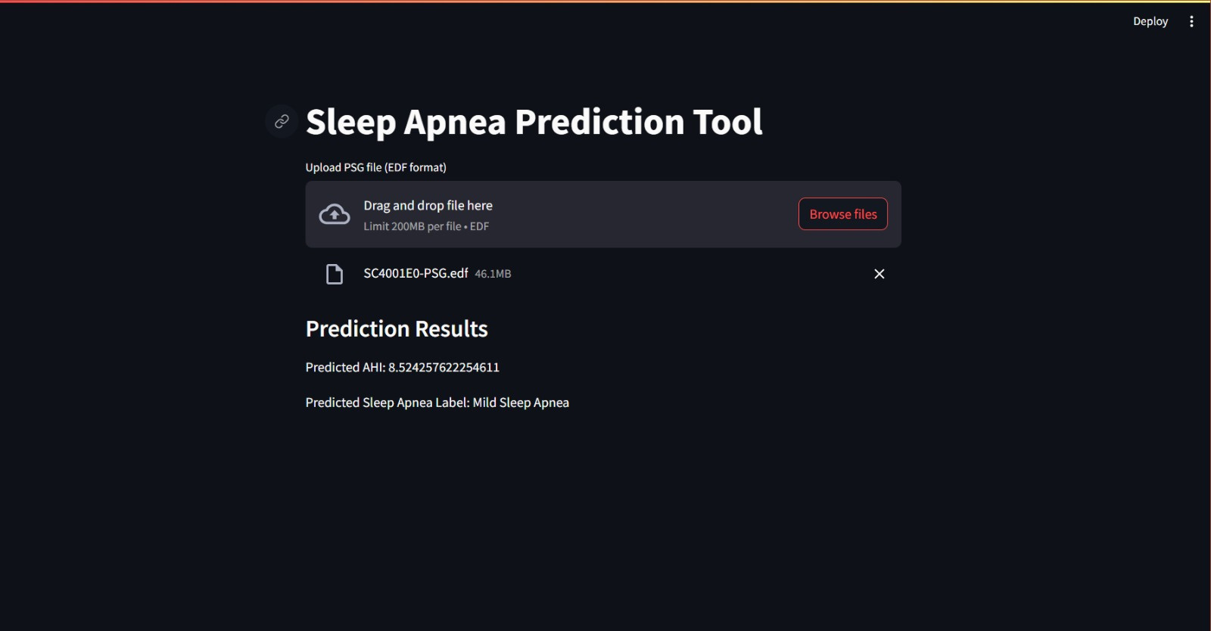
Interface

Slide 8
The project successfully applies machine learning to detect sleep apnea from physiological signals, improving diagnostic efficiency. Using a Streamlit interface, it enables easy data uploads, event visualization, and AHI calculation, reducing manual effort. This approach enhances real-time monitoring, supports early detection, and is scalable for broader clinical use, making it valuable for improving patient care in sleep diagnostics.
Conclusion

