Slide 1
ONLINE GIG MANAGEMENT SYSTEM
SPRINT 1 CASE STUDY
PRESENTED BY team 4

Slide 2
CONTENTS
1. INTRODUCTION
2. FUNCTIONALITIES
3. USE CASE DIAGRAM
4. REQUIREMENTS
5. TECHNOLOGIES USED
6. SYSTEM ARCHITECTURE
7. CLASS DIAGRAM
8. ER-DIAGRAM
9. OUTPUT

Slide 3
INTRODUCTION
Online Gig Management System is a web based application developed using C#.NET.
It is a mini social network that can prove to be very useful for all the music lovers who loves to track the music of their favourite artist
There are two types of end users for this application :
User
Artists

Slide 4
USER FUNCTIONALITIES
The user can perform the following operations in the application
Sign-up / Login to the application
Display all the gigs that are available
Search for a gig using name of the gig , venue or the gig date
Add upcoming gigs to their calendar
View the calendar
Follow their favourite artist
View the list of the artist they follow
Logout of application

Slide 5
ARTIST FUNCTIONALITIES
An artist can perform the following operations in the application :
Signup /Login to the application
List a new gig
Update details of already listed gigs such as the gig date or venue
The artist can also cancel a gig
Remove a gig from the list
Logout of application

Slide 6
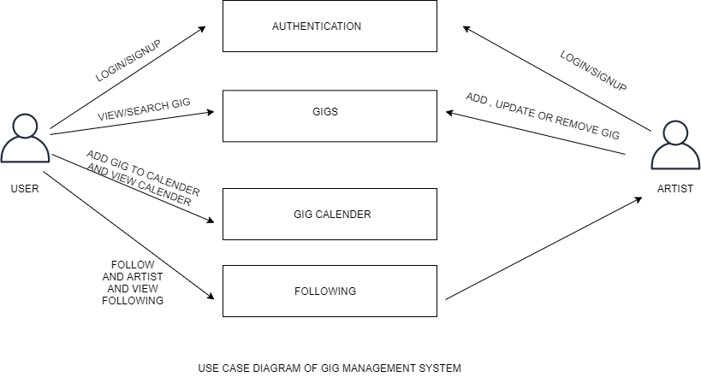
USE CASE DIAGRAM

Slide 7
SYSTEM REQUIREMENTS
Intel Pentium 4 and Windows 2010
Memory 4 GB
SQL Server 2012
SQL Server Management Studio 18
Visual Studio 2019
Git

Slide 8
TECHNOLOGIES USED
.NET Core 3.1 : minimum target framework used to develop the application
ADO.NET : a data access technology used for accessing and modifying data from database
C# 7.0 : an object oriented programming language used to code the application
SQL Server 2012 : used for creating, storing and retrieving data from database

Slide 9
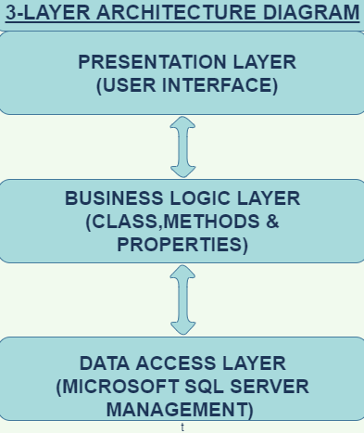
3-LAYERED ARCHITECTURE

Slide 10
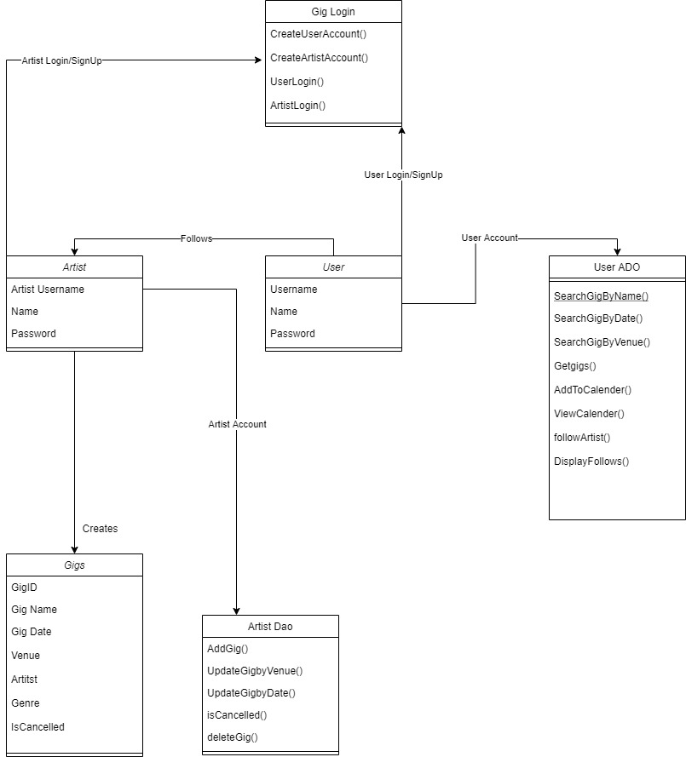
CLASS DIAGRAM

Slide 11
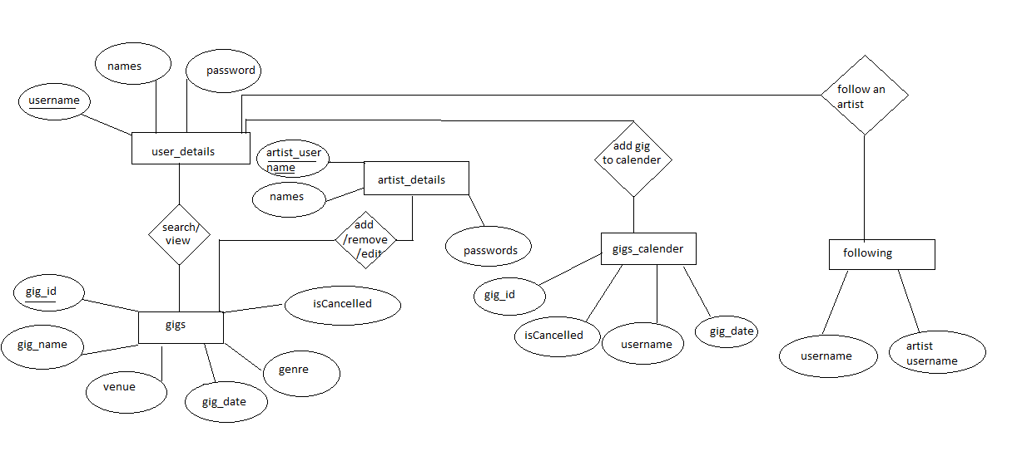
ER DIAGRAM

Slide 12
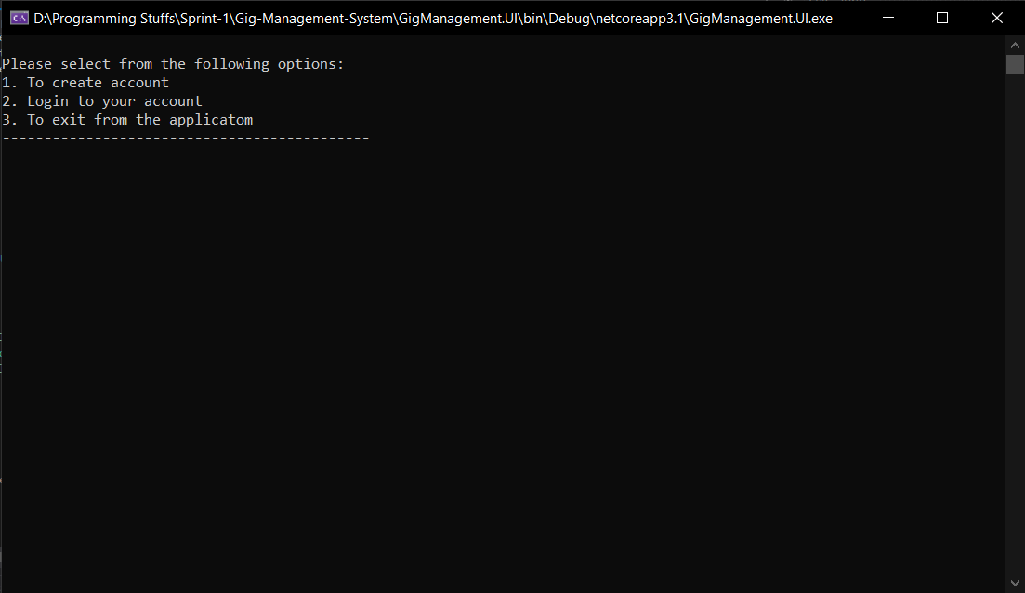
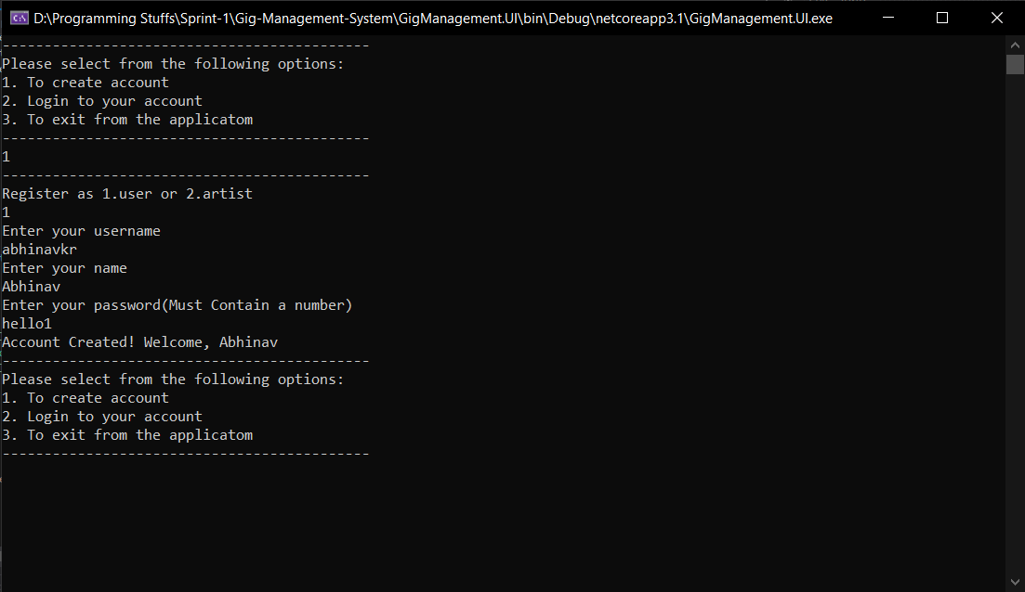
OUTPUT

Slide 13
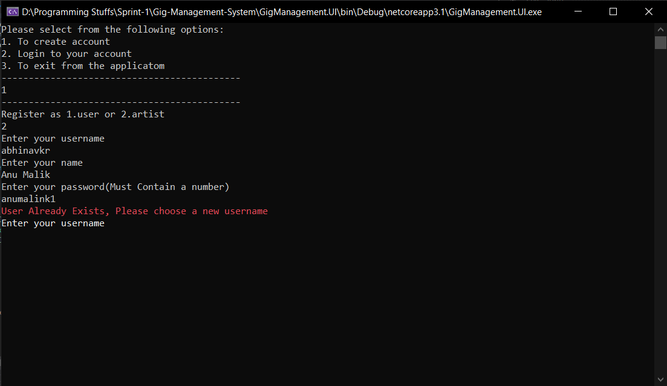
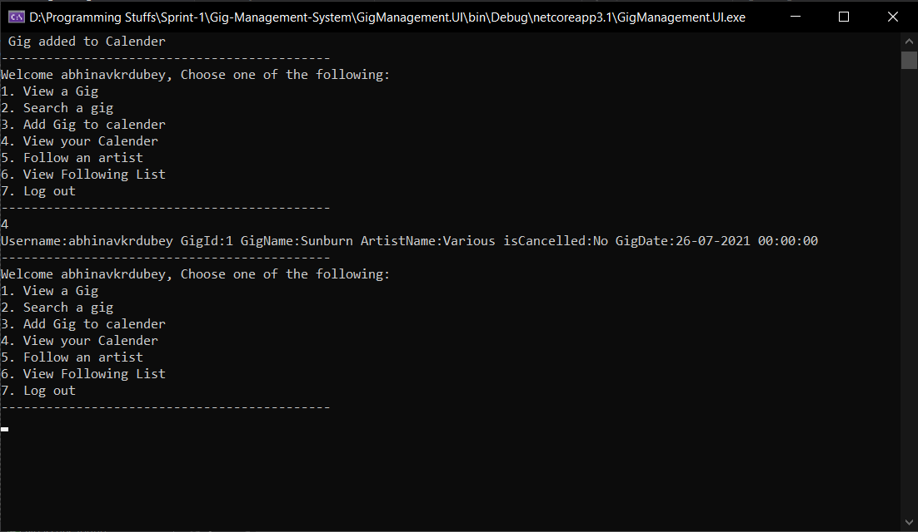
OUTPUT(contd..)

