Slide 1
Driver Onboarding application
Intuit Craft Demo Round

Slide 2

Driver Onboarding Application Backend Service
Problem Statement
High Level Design (HLD)
Low Level Design (LLD)
Working Demonstration
Enhancements
Requirements Gathering

Slide 3
PROBLEM STATEMENT
You are part of a team, building a ride management application like Uber. You are responsible for the driver onboarding module. As part of this module you are required to build an interface that will allow a driver to sign-up as a driver partner. The driver onboarding module should:
a) Allow a driver to sign-up and enter their profile information b) Trigger onboarding processes like document collection, background verification, shipping of tracking device, etc., c) Allow a driver to mark when they are ready to take a ride
Please create a list of the API interfaces you will expose to support these requirements and also come up with choices of data stores, tech stacks, etc.

Slide 4
Functional Requirements
A driver should be able to signup.
A driver should be able to login and logout.
A driver should be able to update its basic information
A driver should able to upload the documents or resources such as Photo, DL, Pan Card etc. for its onboarding to the application.
After onboarding is completed, driver should able to mark its status Ready.
Admin user should able to signup, login and logout.
Admin user should able to continue the various steps in driver onboarding process such as document verification, device shipping etc.
Admin should able to update the status of driver accordingly.
Admin should able to get the driver info.

Slide 5

Non Functional Requirements
Scalable
Resilient
No single point of failure
Performance
Available
Usability
Portability
Security
Documentation
Monitoring
Logging
Maintainable

Slide 6
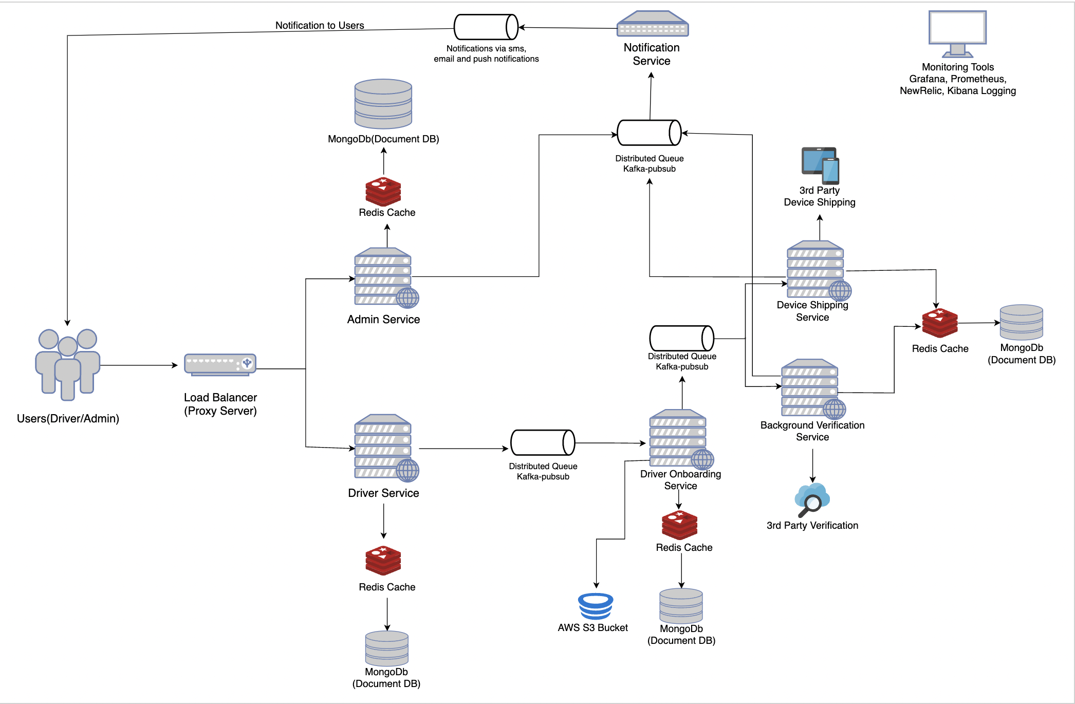
High Level Design (HLD)

Slide 7
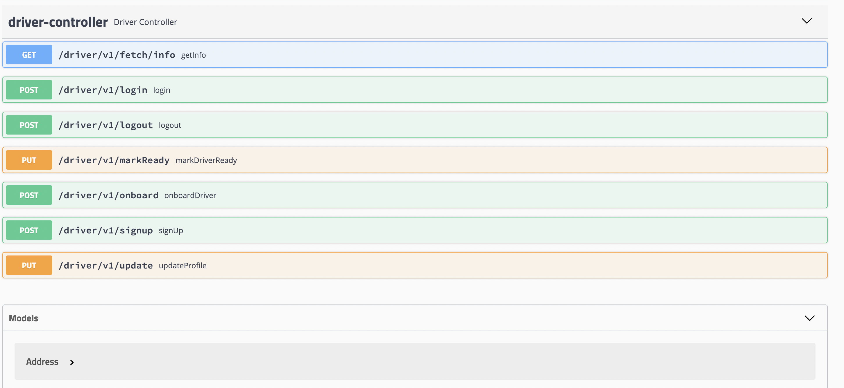
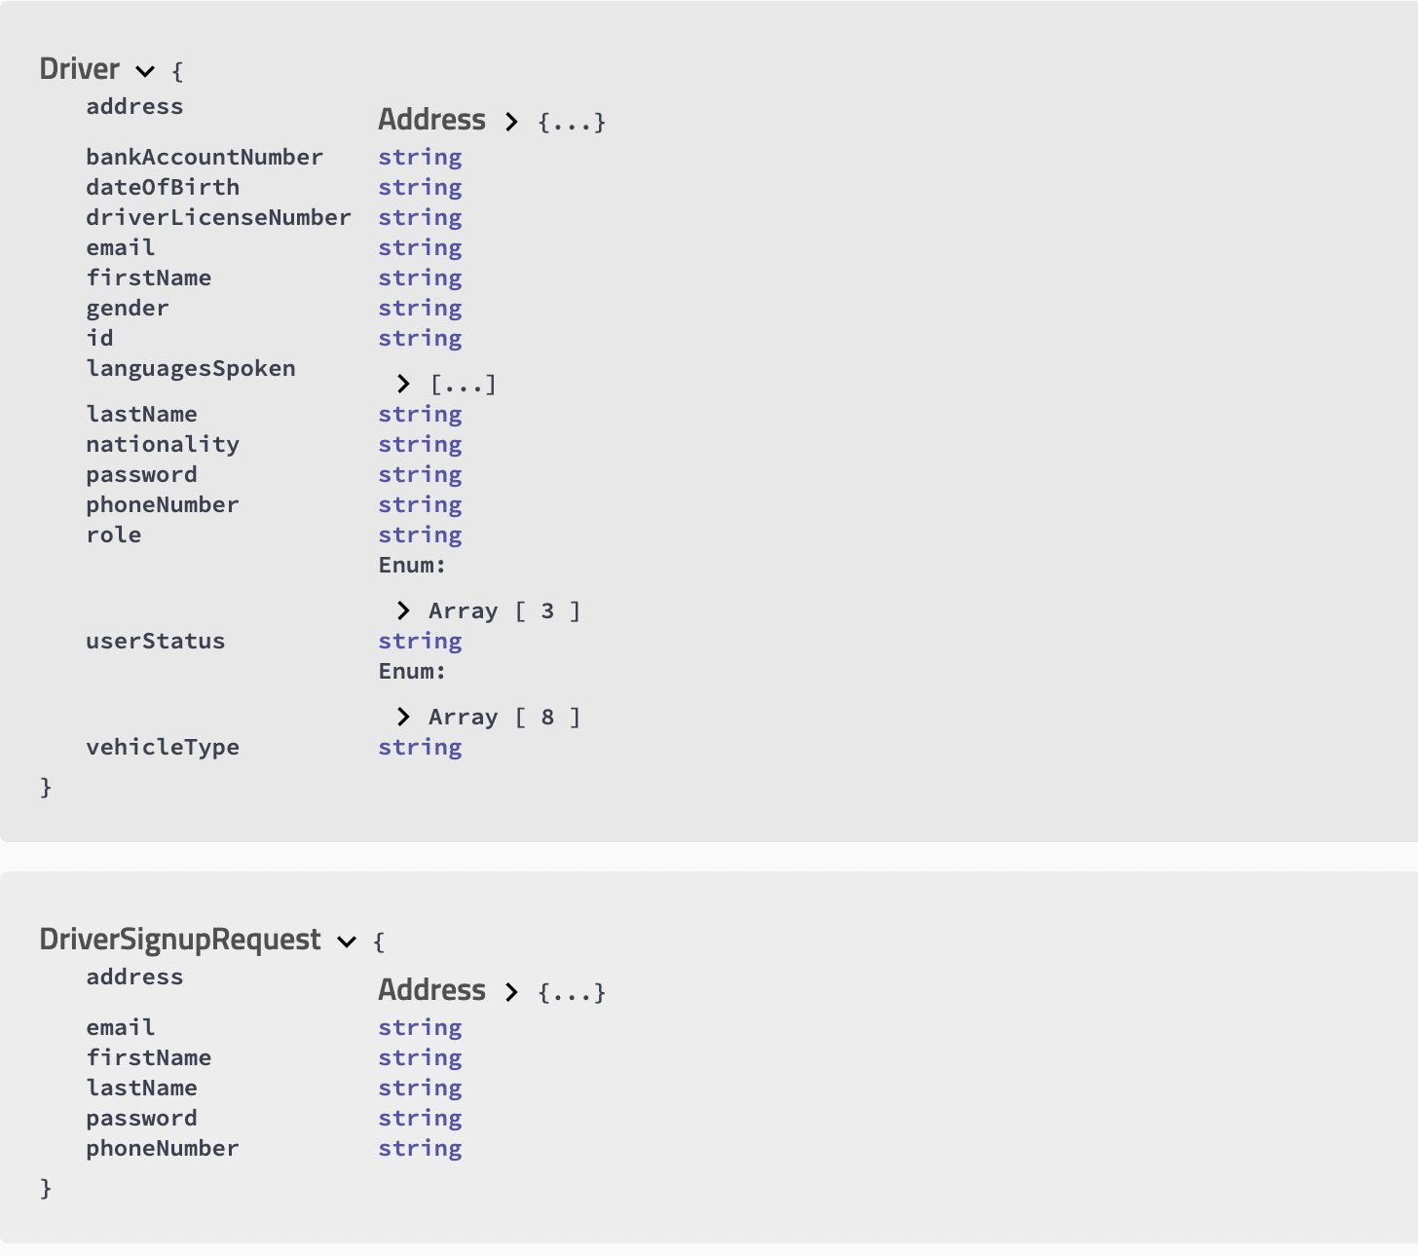
Low LeVel Design (LLD)
Swagger API Documentation: http://localhost:8080/swagger-ui.html#/
GitHub Repository https://github.com/abhinavkumar685/DriverOnboardingService/tree/master

Slide 8
Live Demo
Special Considerations:
Token based login and logout.
Error codes and messages with proper exception handling.
Data modeling to store data and resources in Mongo DB.
Uploading of documents or resources such as photo and retrieving it by admin user for a driver.
Pagination to fetch driver list by admin user.

Slide 9
TeCH Stack
Language and Framework – Java8 Spring Boot project using Maven
Database – Mongo DB (Document Database)
Design Patterns – Layered Architecture + Facade Design Pattern
Testing – Unit Testing (Junit)
Deployment – Docker
Monitoring – API Health Check etc. can be done through actuators.

Slide 10
Enhancements
Using Docker/Kubernetes for distributed system and microservice architecture.
Have proper replicas and redundancy to avoid single point of failure and to make system scalable
Decouple services using distributed messaging queue such as Kafka.
Use of distributed caching such as Redis before a DB Layer so that read is fast and scalable.
Have notification service to notify users about each activity
Have proper monitoring tools such as Grafana, NewRelic etc for metrics monitoring and alerts
Have logging system such as kibana for storing the logs
Use AmazonS3 bucket to store documents and resources

Slide 11
Thank you
Developed by- Abhinav Kumar

