Slide 1
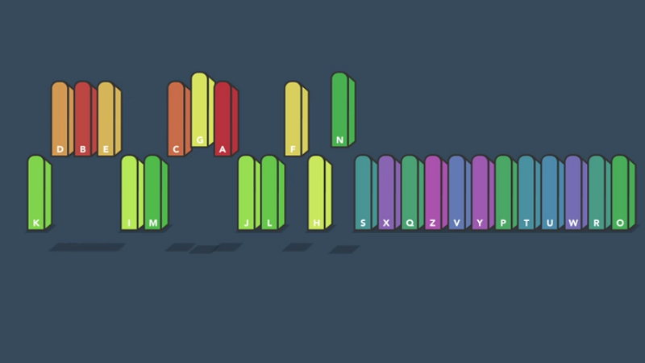
Sorting Algorithms Visualizer
Abhinav Lohia [2K19/CO/015]
Abhinav Ranjith [2K19/CO/016]

Slide 2
Project objective
This tool(project) is an attempt to visualize and help to understand how some of the most famous sorting algorithms work. This tool is for the ones who want to see these algorithms under a different light and hopefully appreciate the processing and brain power behind these piece of genius that in many ways have changed the way we live.

Slide 3
Overview
A sorting algorithm is an algorithm that organizes elements of a sequence in a certain order. Since the early days of computing, the sorting problem has been one of the main battlefields for researchers. Sorting visualizer makes it possible to compare as well as understand how different algorithms behave with different initial set of items. The reason behind this is not only the need of solving a very common task but also the challenge of solving a complex problem in the most efficient way.

Slide 4
Motivation
1
Sorting a sequence of items is one of the pillar of Computer Science. Hence it is very important to understand sorting for any computer science student.
2
In the course of learning algorithms one will discover advanced facets of a language along with programming design patterns that will give an edge as a developer. So with the help of our tool one can see these algorithms under a different light and hopefully appreciate the processing and brain power behind these piece of genius.

Slide 5
Building the Project using:
HTML → Basic structure and divisions
CSS → Styling
Javascript → Main implementation of Algorithms and Visualizer

Slide 6
Sorting Algorithms Visualized:
.Insertion Sort
.Quick Sort
1
5
2
.Selection Sort
.Heap Sort
6
3
.Bubble Sort
4
.Merge Sort

Slide 7
Project Scope:
1
Could be used as an educational tool enriching the standard methods of teaching.
2
In the course of learning algorithms one will discover advanced facets of a language along with programming design patterns that will give an edge as a developer.

Slide 8
Milestones
1
Collected all the information about the project .
2
Learnt Web Development and all the sorting algorithms that will be used.
3
Constructed the basic GUI of the project.
4
Implemented some code

Slide 9
Thank you.

