Slide 1
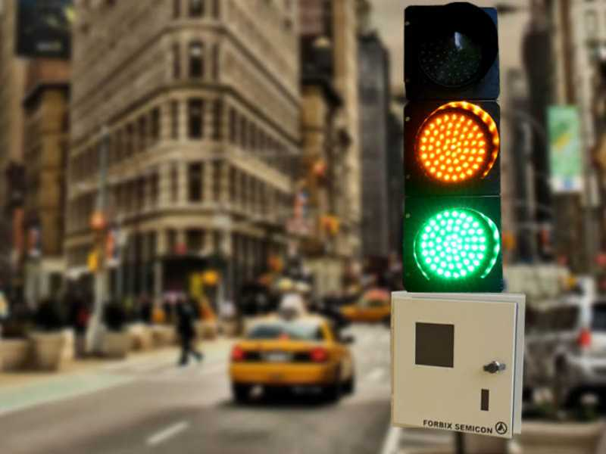
Traffic Light Circuit
Abhinav Lohia [2K19/CO/015]
Abhinav Ranjith [2K19/CO/016]

Slide 2
Aim
The main objective of this traffic light controller is to provide sophisticated control and coordination to confirm that traffic moves as smoothly and safely as possible. This project makes use of LED lights for indication purpose and a microcontroller is used for auto changing of signal at specified range of time interval. LED lights gets automatically turns on and off by making corresponding port pin of the microcontroller “HIGH”.

Slide 3
Abstract
Traffic lights were first invented in the year 1868 at London’s House of Commons where traffic light signals were placed at intersections of George and Bridge Street. During this period traffic lights were controlled either by timing or by switching manually. Over the years, controlling the traffic became a major issue because of rapid increase in automobiles and also because of large time delays between traffic lights. This project is just a one-way traffic controller, although it can be further modified as well. Project will work in a way, it provides the instruction to the driver whether to drive through the intersection or yield at the intersection.

Slide 4
Introduction
This traffic light is made with the help of counter IC, which is mainly used for Sequential Circuits. We can also call it as Sequential Traffic Lights. Sequential Circuits are used to count the numbers in the series.
Coming to the working principle of Traffic Lights, the main IC is 4017 counter IC which is used to glow the Red, yellow and green LED respectively. 555 timer acts as a pulse generator providing an input to the 4017 counter IC. Timing of glow of certain lights totally depends upon the 555 timer’s pulse, which we can control via the Potentiometer so if you want to change the time of glow, you can do so by varying the potentiometer, having the responsibility for the timing. LEDs are not connected directly with 4017 counter, as the lights won’t be stable. We have used the combination of 1N4148 diodes and the LEDs in order to get the appropriate output. Main drawback of this circuit is that you can never have an exact timing with this, however you will have best estimated.

Slide 5
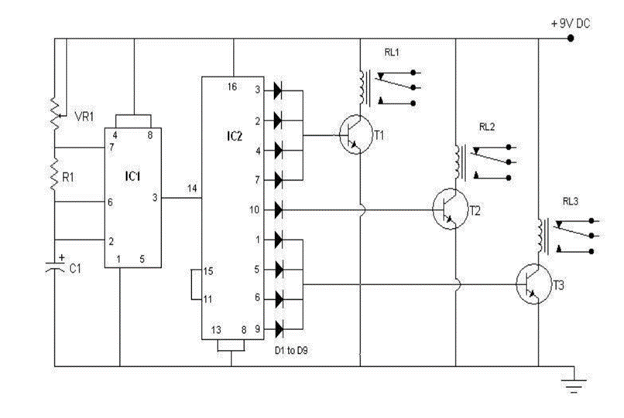
Traffic Light Circuit

Slide 6
Preliminaries/Basic Knowledge
Prerequisite:
Working, construction & uses of the basic electrical components(active & passive).
555 Timer IC working
4017 IC(digital counter) working
About the ICs:

Slide 7
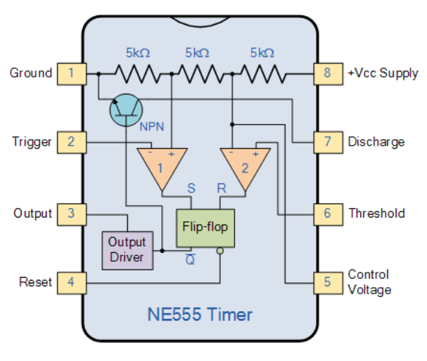
The 555 Timer is a switching circuit contained in a 8 pin IC that acts as a timer, oscillator or flip-flop. It gets its name from the fact that there are three internally connected 5kΩ resistors which it uses to generate the two comparators reference voltages. The 555 timer chip is extremely robust and stable 8-pin device that can be operated either as a very accurate Monostable, Bistable or Astable Multivibrator to produce a any sort of applications that requires some form of time control.
It has three mode of operation: astable mode, monostable mode and bistable, and in the traffic light circuit it will be operated in astable mode.

Slide 8
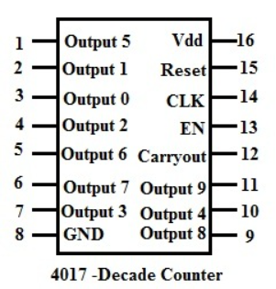
The CD4017 Decade counter is used for low range counting applications. It has the capability to turn on 10 outputs sequentially in a pre-defined time and reset the count or hold it when required. It also has the capability to indicate the status of counting using Carry pin. This is commonly used for Led chasers and other logical output projects. This IC will increment the count from 0 to 9 each time it senses a high pulse from the clock pin (pin 14).

Slide 9
Working Principle
This traffic light is made with the help of counter IC, which is mainly used for Sequential Circuits. We can also call it as Sequential Traffic Lights. Sequential Circuits are used to count the numbers in the series. The main IC is 4017 counter IC which is used to glow the Red, yellow and green LED respectively. 555 timer acts as a pulse generator providing an input to the 4017 counter IC. Timing of glow of certain lights totally depends upon the 555 timer’s pulse, which we can control via the Potentiometer so if you want to change the time of glow, you can do so by varying the potentiometer, having the responsibility for the timing. LED’s are not connected directly with 4017 counter, as the lights won’t be stable. We have used the combination of 1N4148 diodes and the LEDs in order to get the appropriate output.

Slide 10
Conclusion
This project is based on a very effective way of optimizing traffic, with redefinition of threshold values for a real time application.
This works to control traffic on four way roads according to traffic control barricades .
This proposed system will be able to build a developed country with less traffic jams and it will also help the emergency vehicle to reach in time to the destination. So, this intelligent system will help us to control traffic in more autonomous way.

Slide 11
Bibliography
www.researchgate.net
www.wikipedia.org
https://circuitdigest.com/
www.electricaltechnology.org
www.electronicshub.org

Slide 12
Thank you.

Slide 13
Aim
Abstract
Introduction
Preliminaries/Basic Knowledge
Methodology and Mainwork of your project
Conclusion
Bibliography
Please prepare a report ( around 20 pages, the initial pages of the report like abstract, contents, acknowledgement, etc. can be seen from the format attached. The report should be chapterwise) and power point presentation (8-10 slides) of your project. The presentations will be scheduled from 9th Nov onwards, the schedule for which I'll send.

Slide 14
Components Used:
555 Timer IC
4017 IC (Digital counter)
Resistors
Capacitors
LED’s
Diodes
POT (P1)

Slide 15
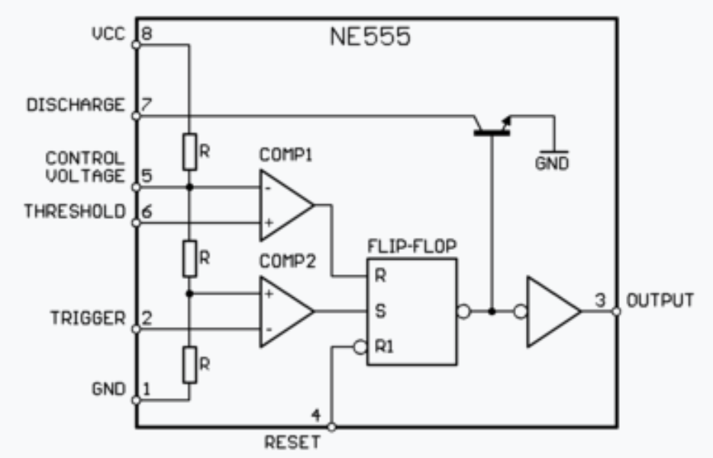
The 555 timer IC is an integrated (chip) used in a variety of timer, delay, pulse generation, and oscillator applications. It gets its name from the fact that there are three internally connected 5kΩ resistors which it uses to generate the two comparators reference voltages. The 555 timer chip is extremely robust and stable 8-pin device that can be
operated either as a very accurate Monostable,
Bistable or Astable Multivibrator to produce a
any sort of applications that requires some form of
time control.

Slide 16
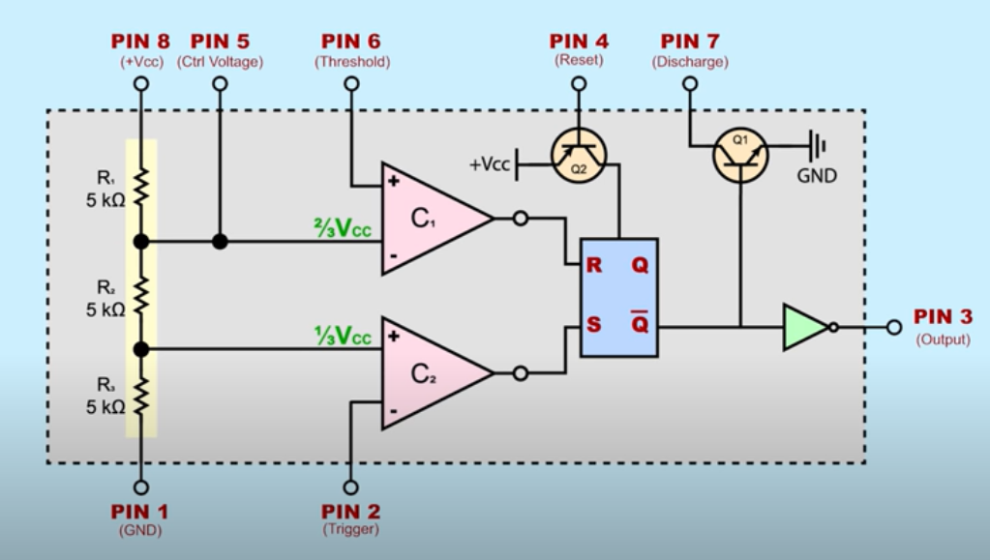
555 TIMER IC

Slide 17
Project Scope
The system can be replaced by image processing system which will give efficient results.
(add density based detection as 1st point if not doing so)
1
3
2
Automatic detection of emergency vehicles and switch the lights accordingly.
4
(if something came up)

Slide 18
Milestones
Collected all the information about the project .
1
2
Constructed some basic circuits for study .
3
Improved the circuit by using more efficient microprocessor.

