Slide 1



SMART INDIAHACKATHON 2025
TITLE PAGE
•Problem Statement ID - 26167
•Problem Statement Title - An interactive vision-language Assistant for multimodel remote sensing image Analysis through Text Queries
through Text Querie
•Theme - space technology
•PS Category - Software
•Team ID -
•Team Name - THE AI-Vengers

Slide 2
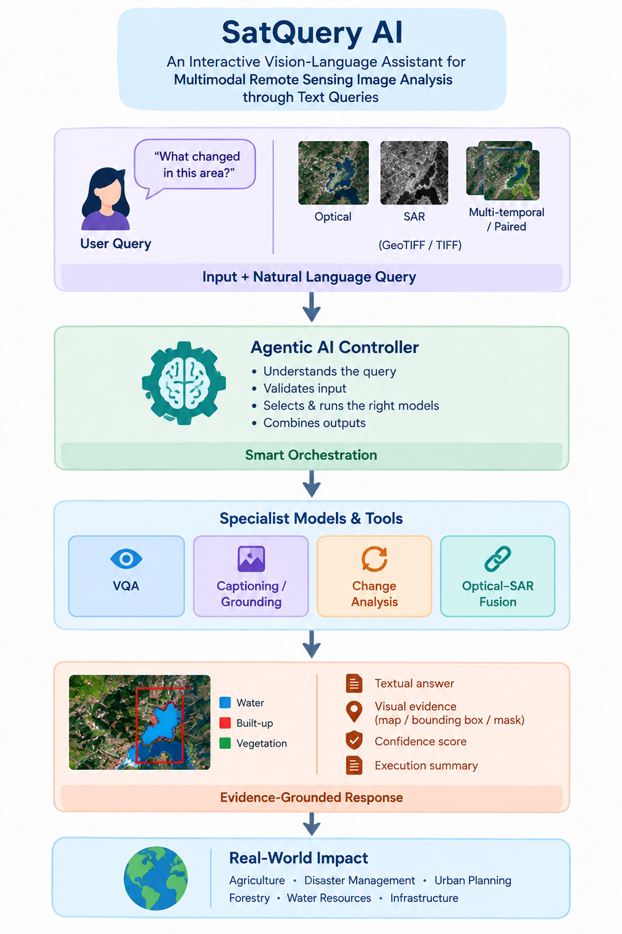
IDEA
AI-VENGERS
SatQuery AI is an interactive, agentic vision-language assistant for analysing single and pairedremote-sensing images through natural language queries. It selects suitable specialist models and returns evidence-grounded textual and visual results.
Features
Single-image visual question answering (VQA)
Captioning / scene description or text-guided region grounding
Bi-temporal change description and change-based VQA
Optical/multispectral + SAR joint analysis
Automatic specialist model/tool selection
Visual evidence, confidence and execution summary
SATQUERY AI
What changed between these images?
Ask
Optical + SAR pair detected

Slide 3
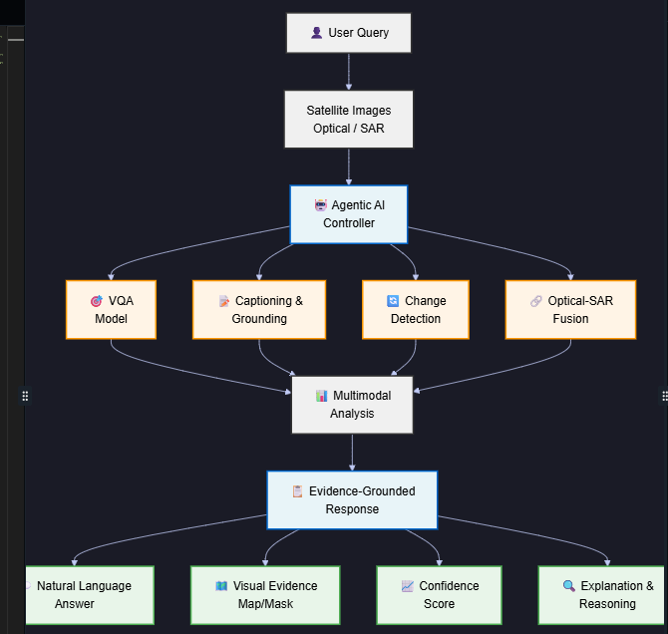
AI-Venger
SYSTEM ARCHITECTURE

Slide 4
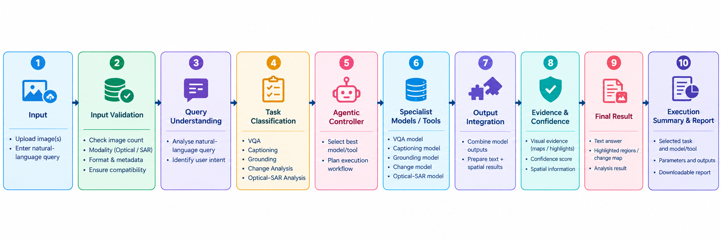
AI-Vengers
TECHNICAL APPROACH
Input & Compatibility: image count, modality, format, metadata and pairing
Query Understanding: classify VQA, captioning, grounding or change analysis
Agentic Controller: select and sequence specialist models/tools
Specialist Models: VQA, captioning/grounding, change and optical-SAR fusion
Output Integration: textual + spatial evidence and confidence
Audit & Report: selected task, models/tools, parameters and outputs

Slide 5
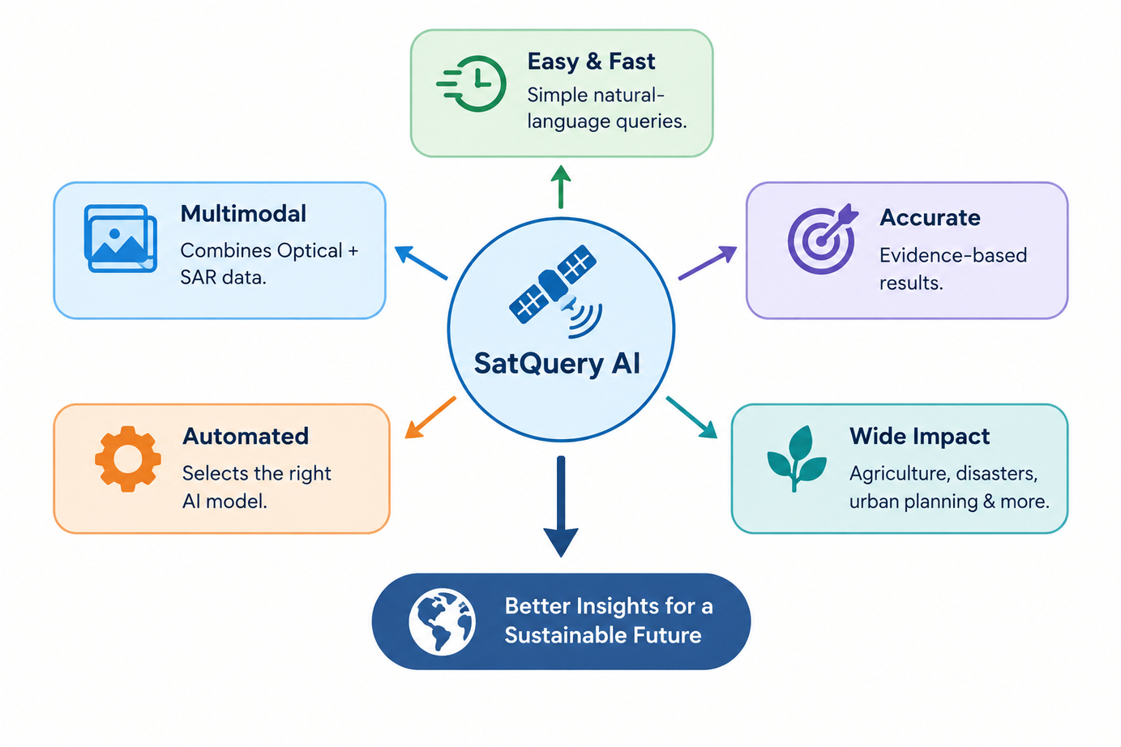
IMPACT AND BENEFIT
AI-VENGERS
IMPACT
Democratizes Remote Sensing – Enables non-experts to analyse satellite imagery using simple natural-language queries.
Faster Decision Making – Reduces manual GIS workflows and model-selection effort.
Multimodal Intelligence – Combines Optical + SAR data for more reliable interpretation.
Change Monitoring – Identifies and explains changes across different dates.
Evidence-Based Analysis – Provides visual evidence, confidence scores, and execution summaries.
Scalable Applications – Useful for agriculture, disaster management, urban planning, forestry, water resources, and infrastructure monitoring.
I I mppaacct t
Benefit
BENEFIT
Easy & Fast – Simple natural-language queries.
Multimodal – Combines Optical + SAR data.
Accurate – Evidence-based results.
Automated – Selects the right AI model.
Wide Impact – Agriculture, disasters, urban planning & more.

Slide 6
AI-Vengers
Research And References
BigEarthNet.txt – Multi-Sensor Image-Text Dataset
Herzog et al., 2026 — supports remote-sensing VLM/domain adaptation and Optical + SAR image-text learning.
RSVQA – Visual Question Answering for Remote Sensing Data
Lobry et al., IEEE TGRS, 2020 — supports natural-language queries over satellite images.
Change Detection Meets Visual Question Answering
Yuan et al., IEEE TGRS, 2022 — supports bi-temporal change analysis + question answering.
Change Detection Question Answering and Grounding (CDQAG)
Li et al., 2024 — supports textual answers + visual change masks/evidence.
BigEarthNet – Large-Scale Remote Sensing Benchmark
Sumbul et al., 2019 — supports remote-sensing image understanding and model training.

