Slide 1
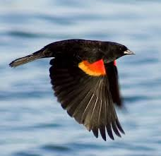
Bird Sight Predictor
Abhinav maurya
VIKAS JANARDHANAN

Slide 2
Random Forest

Slide 3
Random Forest in Spark

Slide 4
Our Solution

Slide 5
Results

Slide 6
Conclusion

