Slide 1


Team Details
  Team name: AS FinTech Developer
  Team leader name: Abhinav Mukwane
  Problem Statement: Intelligent Risk, Fraud & Financial Experiences (BFSI). FinRiskLens — fraud detection and risk analysis for every MSME customer, from shared data to a grounded AI credit decision
Notes:
FinRiskLens — evidence-based fraud detection and risk analysis for MSME lending, built on Google Cloud by team AS FinTech Developer.

Slide 2




Brief about the idea
₹36,014 cr
₹33,148 cr
Every source, one page
Udyam, GST, bank, ITR, MCA and uploads, section by section
involved in bank frauds in FY25
of it in loans — the largest category
Source: RBI Annual Report 2024-25 (date of reporting)
The bank's own record
MSME loans are decided on shared data and uploaded documents. A statement or ITR can be edited in minutes; one fabricator can supply many applicants.
FinRiskLens gives the bank one fraud and risk page per customer. Customers share bank data through Account Aggregator, fetch GST, ITR and MCA, and upload documents. Gemini reads every page, code checks the arithmetic and the bank's own record, and the network lens links related customers.
Every finding links to its evidence. A Clear customer gets a grounded AI credit decision, sent to the LOS, ULI (OCEN) or ONDC.
Uploaded statements against the Account Aggregator feed
The network
Shared directors, contacts and files; circular GST trading
Grounded AI decisions
Investigation and credit decision; every figure traced
Notes:
RBI figures from the RBI Annual Report 2024-25 (released May 2025), date-of-reporting basis.

Slide 3



Opportunities
How it differs from existing tools
How it solves the problem
USP
Statement analysers look at one document — FinRiskLens combines every source of a customer and returns findings with evidence
Arithmetic checks pass a careful forgery — FinRiskLens also compares it with the bank's own record
Single-customer review misses organised fraud — the network lens links related customers
Fast: a customer is reassessed as soon as a source arrives
Verifiable: every finding opens the document at its page and row
Decisive: the officer confirms or dismisses each finding; a Clear customer goes straight to a loan case
Policy-aware: findings and credit decisions cite the lender's credit policy
Grounded AI: a claim or figure that cannot be traced is set aside — and shown
Bank-record cross-check through Account Aggregator
Linked customers through directors, contacts, files and GST invoices
Risk to loan: AI credit decision, then LOS, ULI (OCEN) or ONDC
Documents stay in India: read and stored in Mumbai
Who gains
Credit officers
Fraud teams
Honest MSMEs
One page per customer, findings with evidence
Linked customers across the portfolio
A Clear verdict — a faster loan

Slide 4




List of features offered by the solution
Customer data, one place
Document reading
Checks on every source
Udyam registration, Account Aggregator consent
GST, ITR and MCA fetched; documents uploaded
Reassessed whenever a source arrives
Gemini Flash in Mumbai reads every page in parallel
Numbers copied as printed, never corrected
A page that does not add up is read again
Nine checks: balances, totals, slips, file history
Statement vs the bank's Account Aggregator record
Bank risk flags: pass-through, cash, bounces
Linked customers
AI investigator, grounded
AI credit decision
Same file, template or salary account
Same director, mobile, email or address
Circular trading in GST invoices
Gemini Pro with tools bound to one customer
Every claim cites rows; amounts must trace
Rejected claims shown, never hidden
Credit capacity (FOIR) computed in code
Gemini Pro decides within it, citing policy
Accepted decisions go to LOS, ULI or ONDC

Slide 5



Process flow diagram
1. Share
2. Extract
3. Check
4. Link
5. Investigate
6. Risk Lens
7. Decide
AA consent; GST, ITR, MCA; uploads
Gemini Flash reads every page in Mumbai
Nine checks, bank record, bank risk flags
Directors, contacts, files, GST loops
Gemini Pro agent; every claim verified
Verdict per customer; officer reviews
AI credit decision → LOS · ULI · ONDC
■ Gemini on Vertex AI ■ Deterministic code
Customer (MSME)
Credit officer
LOS · ULI · ONDC
Registers with the Udyam number, shares bank data through Account Aggregator, fetches GST, ITR and MCA, uploads documents
One Risk Lens per customer: reviews each finding, generates and accepts the credit decision, sends the loan case
Receive the accepted loan case with its risk assessment and the AI credit decision
Notes:
Steps 2–5 run in a background worker whenever a customer shares a source or uploads a document; the Risk Lens refreshes until they finish. Step 7 runs only for a Clear customer — a confirmed finding blocks it — and only an accepted Approve can be sent.

Slide 6
Wireframe — a finding on the Risk Lens
HIGH
Tampering STATEMENT_VS_AA_MISMATCH Deterministic
1
Severity, category, type and source
Statement disagrees with the bank's own record
Deterministic or AI · verified
91 of 93 rows agree with the bank's Account Aggregator record, with 2 amounts changed and 4 transactions left out. Net effect: ₹3,65,800 more in credits and ₹1,30,000 less in debits than the bank recorded.
2
What is wrong, in rupees
Plain language a credit officer can act on
↳ Assess the customer on the Account Aggregator data and ask them to explain every difference.
3
What to do next
Names the policy clause when one applies
↗ statement.pdf, p. 2 · row 28 — bank recorded ₹1,09,500
Evidence links
4
↗ statement.pdf, p. 3 · row 54 — bank recorded ₹73,400
Open the document at that page; rows, fields or policy
↗ statement.pdf, p. 1 · 05 Jun NACH EMI ₹32,500 — not on the statement
Note for the review (optional)
Confirm
Dismiss
Review in one click
5
A confirmed finding blocks the loan case; a dismissed one does not

Slide 7



Architecture diagram of the proposed solution
Customer (MSME)
Credit officer
Source and lending systems
Registration · AA consent · fetch and upload
Bank portal: Customers · Risk Lens · loan case
AA, GST, ITR, MCA in · LOS, ULI, ONDC out
Cloud Run · asia-south1 (Mumbai) — ASP.NET Core 8, one warm instance, built from source by buildpacks
Web
Extractor
Checks + network lens
Investigator
Credit decision
Knowledge (RAG)
Customers, Risk Lens, uploads; loan-case push
Page-parallel reading, re-read on failure
Nine checks, bank flags; links between customers
Function calling, customer-scoped; claims verified
Capacity in code; Pro decides; figures verified
tsvector + HNSW, RRF, rerank
Vertex AI · Gemini
Cloud SQL · PostgreSQL 16
Cloud Storage · Mumbai
Mumbai: Flash extraction, embeddings
global: Pro investigator and credit decision
pgvector + full-text: assessments,
findings, credit decisions, knowledge
uploads · sources: AA, GST, ITR
keys: sign-in keys
Notes:
Customer documents are stored, read and embedded in Mumbai; only Gemini Pro (investigator and credit decision) and the Flash reranker run on the global endpoint, and Pro sees extracted facts, never the files.

Slide 8



Technologies to be used in the solution
Google Cloud
AI techniques
Vertex AI — Gemini 3.5 Flash (extraction), Gemini 3.1 Pro (investigator, credit decision), Gemini 3.8 Flash (rerank), gemini-embedding-001
Cloud Run (buildpacks, no Dockerfile) · Cloud Build
Cloud SQL for PostgreSQL 16 + pgvector · Cloud Storage
Multimodal structured output: PDF and image to a fixed schema
Function-calling agent with tools bound server-side to one customer
Grounding verifier · hybrid RAG: full-text + HNSW vectors, reciprocal rank fusion, LLM rerank
Application
Data, quality and trust
.NET 8 · ASP.NET Core MVC · Razor + Bootstrap 5
EF Core 8 + Npgsql · Autofac · Serilog
PdfPig (PDF metadata) · background worker · LOS, ULI (OCEN) and ONDC (beckn) payloads
Account Aggregator on the Finvu sandbox; Udyam, GST, ITR and MCA as sample data in the demo
QuestPDF synthetic documents with ground truth · 70 xUnit tests
Secrets outside the public repo · encrypted DB connections only

Slide 9
Estimated implementation cost (optional)
₹ 18 L
₹ 32 L / yr
~ ₹ 1.14 Cr
One-time — production hardening, security and compliance audit
Recurring — Google Cloud, Gemini usage, data access, support
3-year total cost of ownership
Estimate for one lender, about 1 lakh customers assessed a year, on Google Cloud in Mumbai
Cost head | Type | Estimate (INR)
Production hardening — 3-member team, about 4 months | One-time | ₹ 14 L
Security testing and RBI / DPDP compliance audit | One-time | ₹ 4 L
Google Cloud — Cloud Run (HA), Cloud SQL (HA), Cloud Storage | Annual | ₹ 8 L
Vertex AI — Gemini extraction, investigation, credit decisions, embeddings | Annual | ₹ 6 L
Data access — Account Aggregator and registry APIs | Annual | ₹ 10 L
Maintenance, support and model re-evaluation | Annual | ₹ 8 L
Notes:
All figures are planning estimates for budgeting. Gemini usage scales with pages read, investigations run and credit decisions made.

Slide 10
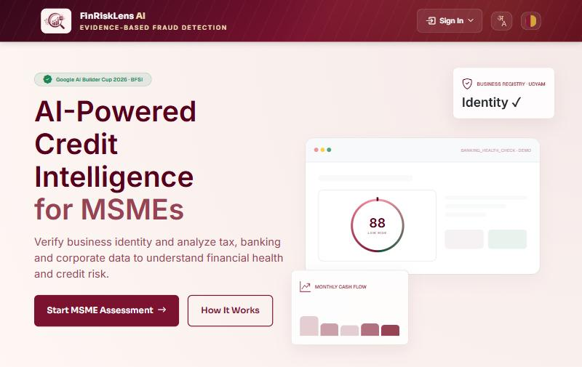
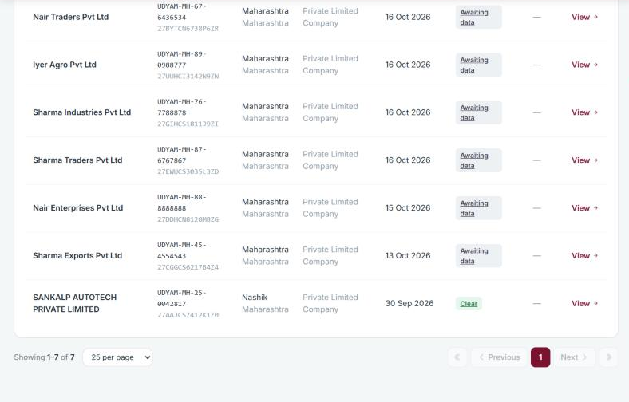
Snapshots of the prototype
Home page
Customers
Customers start here with their Udyam number
A risk status for every customer

Slide 11
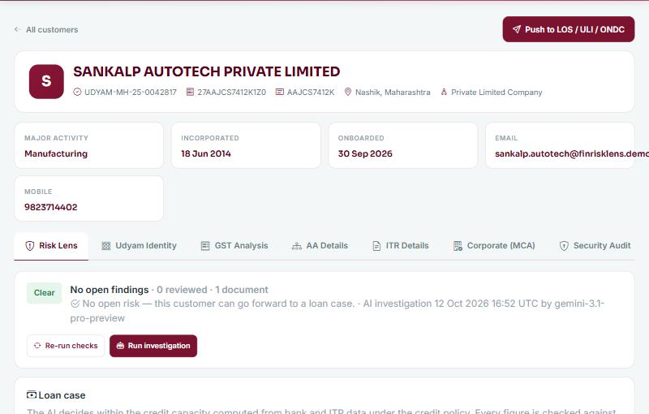
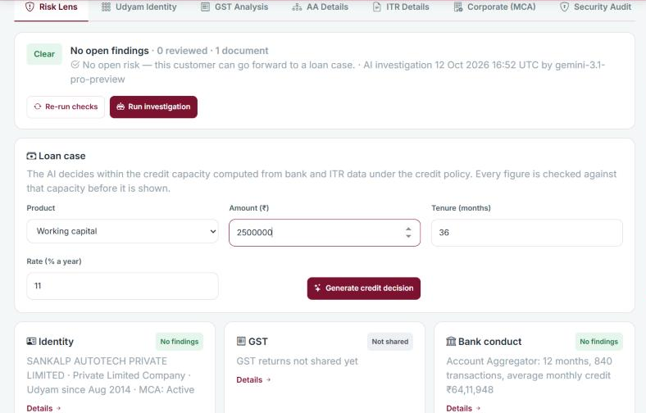
Snapshots of the prototype
One page per customer
Clear → loan case
Opens on the Risk Lens; every source in its own tab
Sections by source; the AI credit decision once Clear

Slide 12
Prototype Performance report/Benchmarking
99.8–100%
20 / 20
0
5 / 5
of 1,298 statement rows read exactly — two live runs
demo assessments raise exactly their expected findings
false alarms on genuine applicants — checks and AI
expected AI findings found by the investigator
How it is measured: synthetic documents with known ground truth, read by live Gemini, scored row by row, checks run on Gemini's own reading
Check | Manual review | FinRiskLens
Statement arithmetic | Spot-checked by eye | Every row and page: balance, carry-over, totals
Statement vs bank | Ask for a bank-certified copy | Automatic when Account Aggregator is linked
Edited files | Rarely examined | Producer, creator and edit dates read on upload
Links across customers | One customer at a time | Shared file, account, director or contacts; GST loops
Credit decision | FOIR worked out by hand | Capacity computed in code; every AI figure traced
Speed | Analyst time per file | 10–60 s per statement · 12–43 s per investigation
Notes:
Extraction accuracy: two consecutive live runs on 14 scenarios (17 documents, 1,298 rows) scored 99.8% and 100%; the 6 linked-applicant scenarios scored 428/428. The eval also caught a model drift (95.6%) that day-first date guidance and an arithmetic-triggered re-read fixed.

Slide 13



Additional Details/Future Development (if any)
Registry cross-checks
Evidence highlighting
GST, ITR and bank turnover reconciled
Name, PAN and address across every source
Password-protected and scanned statements
Highlight the exact row on the PDF page
Bounding boxes already in the extraction contract
Side-by-side PDF and bank record view
Case memory and policy Q&A
Scale and integration
Confirmed findings feed the knowledge base
Policy questions answered with citations
Refusal when the policy is silent
Entity link tables for portfolio-scale customer links
Live GST, ITR and MCA through licensed providers
Per-lender policies and thresholds

Slide 14


Provide links to your:
GitHub Public Repository: https://github.com/abhinavmukwane/FinRiskLensAI-RAG-V2
Demo Video Link (3 Minutes): add the link after uploading the video
Final Product Link: https://finrisklensai.cloud.run
For the evaluation panel
Bank portal: https://finrisklensai.cloud.run/Auth/BankLogin — credentials are shared with the panel directly.
All demo data is synthetic. GST, ITR and MCA are generated samples; OFAC/AML screening is a demo.
In the repository
README — how it works and every measurement · Doc/12_CUSTOMER_RISK_LENS.md — the customer flow · Doc/ARCHITECTURE.md
Run it yourself: dotnet test (70 tests) · DemoData eval (live extraction scored against ground truth)

Slide 15
Demo customers on the live site
Customer (Udyam) | Story | What FinRiskLens shows
Clear · …-0301 | Consistent everywhere | Clear → AI credit decision → Approve → LOS
Edited statement · …-0302 | Uploaded statement disagrees with the bank | High risk — statement vs Account Aggregator
Turnover inflation · …-0303 | Bank credits about 3× GST and ITR turnover | High risk — turnover mismatch across sources
Edited ITR · …-0304 | Uploaded ITR shows more than the filed return | High risk — uploaded vs filed ITR
Mule-like account · …-0305 | Every receipt forwarded the same day | High risk — pass-through in the bank data
Circular traders · …-0306–0308 | Invoice each other in a loop; one director | High risk for all three — linked customers
Udyam numbers UDYAM-MH-99-0000301 to 0000308 · bank sign-in details for the panel are on the links slide

Slide 16


