Slide 1
Multi-layer Perceptron Design for Human Activity Recognition
Fall 2026 – ECE Design Project
Project Description Video
https://uwmadison.zoom.us/rec/share/f0gPxcT_qa_EAfUAWKGF_MIoAXOaPPcNypBLNuIar7kwDw_2SHiqrBxl2Tw6PyrF.vc-Afy8A0IVq4mg8?startTime=1791924785000
Passcode: 11%&XADF

Slide 2
Motivation for the Project
Deep learning is currently perhaps the most popular application area
  From applications to algorithms and hardware design
One can follow a modular hardware design methodology
  Start from a basic building block a neuron
  Form a hidden layer by instantiating neurons
  Instantiate multiple hidden layers by reusing one hidden layer template
    e.g., a parameterized number of layers can be pipelined
The basic building block itself involves fundamental components
  Adder
  Shifter
  Multiplier (simplified version)
  Multiplexer

Slide 3
Motivation for the Project (cont’)
An opportunity for you to
  Design the basic building block of a fundamental architecture
  Practice design and layout skills on fundamental datapath components (e.g., adder, shifter)
  Learn how to contribute towards a system-level goal
Input nodes
  Simply pass the information from the environment without processing
  Each input can be a pixel in an image, or a single sensor datapoint
Hidden layer(s)
  Perform computations
  Inner product of inputs and weights, followed by an activation function
  Transfer the information towards the ouput
Output nodes
  Convert the information from the network back to the environment (e.g., a classification result)
Input Layer
Hidden Layer(s)
Output Layer

Slide 4




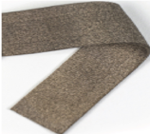

System—level View: Human Activity Recognition (HAR)
Identify activities, such as walk, sit, and exercise
First step to solutions for movement disorders
Your task in this project
  A *simplified* version of the activity classifier design
  You will focus on only inference (forward
  pass), i.e., the weights are given to you
  It will classify two activities (i.e., binary output)
    Sit, Run
  The inputs* are
    1D accelerometer measurement
    Stretch sensor attached on a knee sleeve
  *You do not need to worry about the application or input; everything you need will be given to you
Stretch Sensor
Segmentation Algorithm
Window Boundaries
Feature Generation
Accelerometer
Fast Fourier Transform
Discrete Wavelet Transform
Offline
Feature Vectors
Online
Classifier
Design
Reinforcement Learning
Activity Classification
User feedback
Weight update with
Policy Gradient
Weights
[1] Bhat, Ganapati, et al. "Online human activity recognition using low-power wearable devices." Intl. Conf. on Computer-Aided Design (ICCAD). IEEE, 2018.
Notes:
Human activity recognition identifies daily activities, such as walking, sitting, and driving.
Knowing what a patient is doing is the first step to address movement disorder problems
Therefore, human activity recognition can provide very valuable insights to health specialists
Other applications of HAR include patient rehabilitation, fall detection and physical activity recognition

Slide 5







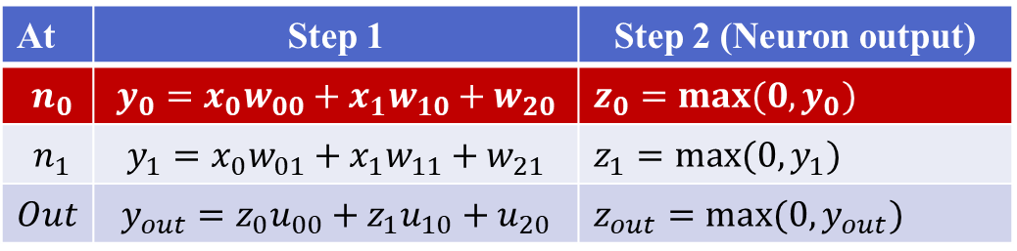
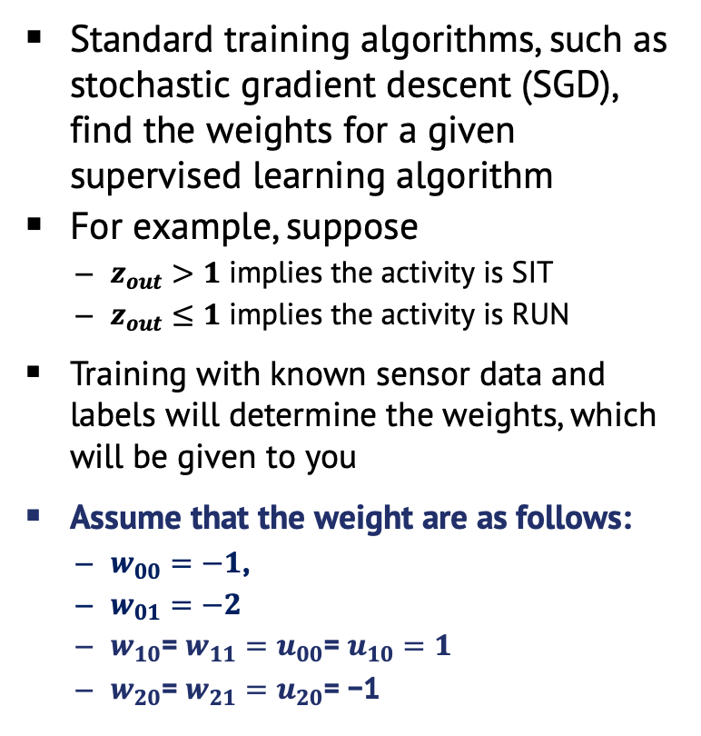





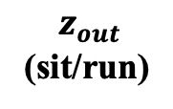



Multi-layer Perceptron Operation and Weights
Input Layer
Hidden Layer(s)
Output Layer
MLP Network Weights
Accelerometer input
$$x_{0}$$
$$w_{00}$$
$${ n}_{0}$$
$$z_{0}$$
Standard training algorithms, such as stochastic gradient descent (SGD), find the weights for a given supervised learning algorithm
For example, suppose
  $z_{out}>1$ implies the activity is SIT
  $z_{out}≤1$ implies the activity is RUN
Training with known sensor data and labels will determine the weights, which will be given to you
Assume that the weight are as follows:
  $w_{00}=−1$,
  $w_{01}=−2$
  $w_{10}$= $w_{11}=u_{00}\text{= }u_{10}=1$
  $w_{20}$= $w_{21}=u_{20}\text{= }\text{−1}$
$$w_{01}$$
$$u_{00}$$
Stretch sensor input
$${ x}_{1}$$
$$w_{10}$$
$${ n}_{1}$$
$$z_{1}$$
$$u_{10}$$
0ut
$$w_{11}$$
$$w_{20}$$
$$u_{20}$$
$$z_{out}$$
(sit/run)
$$w_{21}$$
Bias
1
1
Computations
At | Step 1 | Step 2 (Neuron output)
$${ n}_{0}$$ | $${y_{0}=x}_{0}w_{00}+x_{1}w_{10}+w_{20}$$ | $z_{0}=max⁡(0,y_{0})$
$${ n}_{1}$$ | $$y_{1}=x_{0}w_{01}+x_{1}w_{11}+w_{21}$$ | $z_{1}=max⁡(0,y_{1})$
$$Out$$ | $$y_{out}=z_{0}u_{00}+z_{1}u_{10}+u_{20}$$ | $z_{out}=max⁡(0,y_{out})$
Inner product of the input and weights
Relu Activation

Slide 6






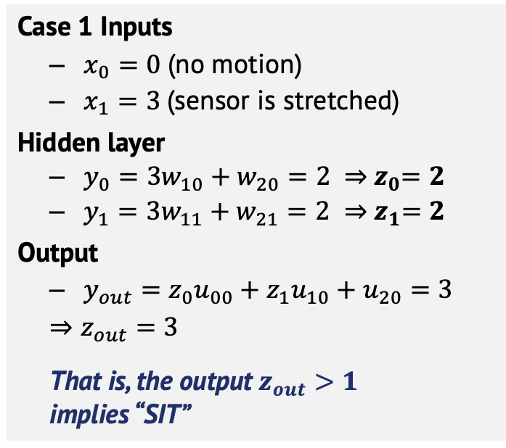





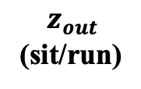



Multi-layer Perceptron: A simple illustration - 1
Input Layer
Hidden Layer(s)
Output Layer
Example Input/Output
Accelerometer input
$$w_{00}$$
$$z_{0}$$
Case 1 Inputs
  $x_{0}=0$(no motion)
  $x_{1}=3$(sensor is stretched)
Hidden layer
  $y_{0}={3w}_{10}+w_{20}=2 ⇒{ z}_{0}=2$
  $y_{1}={3w}_{11}+w_{21}=2$ $⇒{ z}_{1}=2$
Output
  $y_{out}=z_{0}u_{00}+z_{1}u_{10}+u_{20}=3$
  $⇒z_{out}=3$
  That is, the output $z_{out}>1$
  implies “SIT”
$$x_{0}$$
$${ n}_{0}$$
$$w_{01}$$
$$u_{00}$$
Stretch sensor input
$${ x}_{1}$$
$$w_{10}$$
$${ n}_{1}$$
$$z_{1}$$
$$u_{10}$$
0ut
$$w_{11}$$
$$w_{20}$$
$$u_{20}$$
$$z_{out}$$
(sit/run)
$$w_{21}$$
Bias
1
1
Computations
At | Step 1 | Step 2 (Neuron output)
$${ n}_{0}$$ | $${y_{0}=x}_{0}w_{00}+x_{1}w_{10}+w_{20}$$ | $z_{0}=max⁡(0,y_{0})$
$${ n}_{1}$$ | $$y_{1}=x_{0}w_{01}+x_{1}w_{11}+w_{21}$$ | $z_{1}=max⁡(0,y_{1})$
$$Out$$ | $$y_{out}=z_{0}u_{00}+z_{1}u_{10}+u_{20}$$ | $z_{out}=max⁡(0,y_{out})$
Inner product of the input and weights
Relu Activation

Slide 7
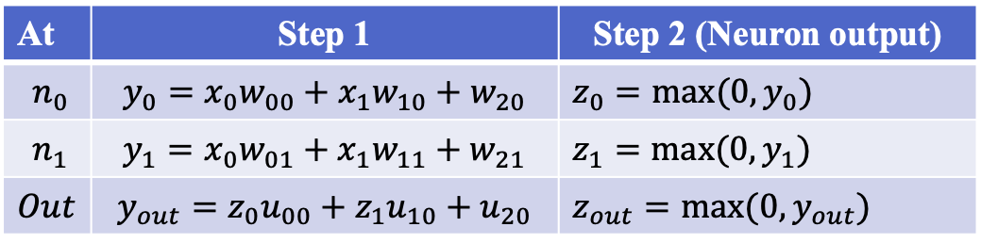
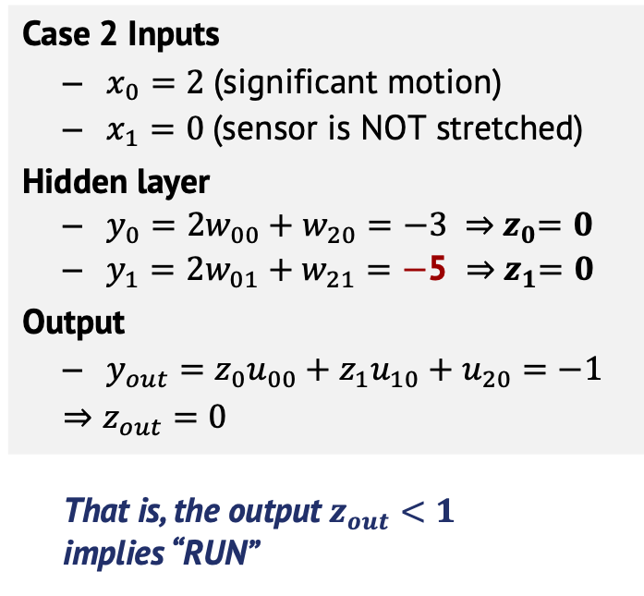
Multi-layer Perceptron: A simple illustration - 2
Input Layer
Hidden Layer(s)
Output Layer
Example Input/Output
Accelerometer input
$$w_{00}$$
$$z_{0}$$
Case 2 Inputs
  $x_{0}=2$(significant motion)
  $x_{1}=0$(sensor is NOT stretched)
Hidden layer
  $y_{0}={2w}_{00}+w_{20}=−3 ⇒{ z}_{0}=0$
  $y_{1}={2w}_{01}+w_{21}=−$5 $⇒{ z}_{1}=0$
Output
  $y_{out}=z_{0}u_{00}+z_{1}u_{10}+u_{20}=−1$
  $⇒z_{out}=0$
  That is, the output $z_{out}<1$
  implies “RUN”
$$x_{0}$$
$${ n}_{0}$$
$$w_{01}$$
$$u_{00}$$
Stretch sensor input
$${ x}_{1}$$
$$w_{10}$$
$${ n}_{1}$$
$$z_{1}$$
$$u_{10}$$
0ut
$$w_{11}$$
$$w_{20}$$
$$u_{20}$$
$$z_{out}$$
(sit/run)
$$w_{21}$$
Bias
1
1
Computations
At | Step 1 | Step 2 (Neuron output)
$${ n}_{0}$$ | $${y_{0}=x}_{0}w_{00}+x_{1}w_{10}+w_{20}$$ | $z_{0}=max⁡(0,y_{0})$
$${ n}_{1}$$ | $$y_{1}=x_{0}w_{01}+x_{1}w_{11}+w_{21}$$ | $z_{1}=max⁡(0,y_{1})$
$$Out$$ | $$y_{out}=z_{0}u_{00}+z_{1}u_{10}+u_{20}$$ | $z_{out}=max⁡(0,y_{out})$
Inner product of the input and weights
Relu Activation

Slide 8
Simplifying Assumptions
Inputs
  Assume that each input is discretized to 2 bit signed numbers: 2’b11 = -1; 2’b00 = 0; 2’b01 = 1
  Assume that 2’b10 = -2 will not be used.
Weights
  Assume the weights are 2 bit signed numbers: 2’b11 = -1; 2’b00 = 0; 2’b01 = 1
  Assume that 2’b10 = -2 will not be used.
Activation function output z = f(y)
  z = 0: If the input is negative
  z = y: If the input is positive
z (2-bit output)
01
y (2-bit)

Slide 9






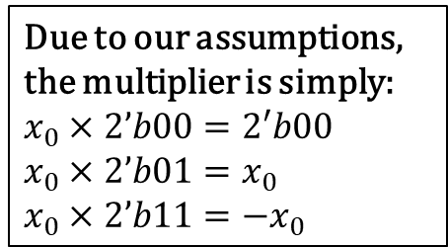








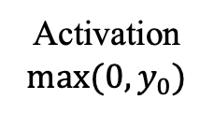



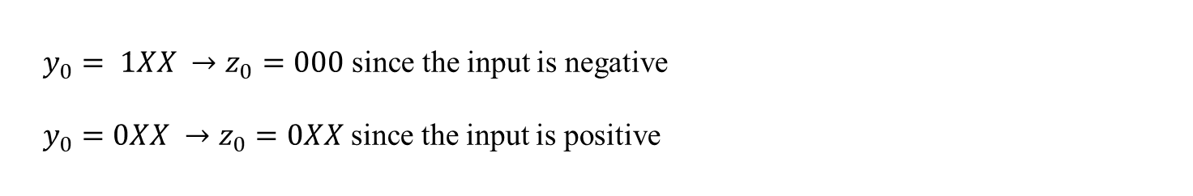










Example Datapath for a Neuron
Input Layer
Hidden Layer
$$2$$
$$×$$
$$w_{00}$$
$$x_{0}$$
$$2$$
$$x_{0}$$
$${ n}_{0}$$
$$z_{0}$$
$$w_{00}$$
$$2$$
$$w_{10}$$
+
$$3$$
Sign bit
$${ x}_{1}$$
$$w_{20}$$
$$2$$
$$×$$
$$x_{1}$$
$$2$$
+
$$3$$
1
$$0$$
$$3$$
$$w_{10}$$
$$z_{0}$$
$$2$$
$$w_{20}$$
$$1$$
$$3$$
$$0$$
Due to our assumptions, the multiplier is simply:
$x_{0}×2’b00=2′b00$
$x_{0}×2’b01=x_{0}$
$x_{0}×2’b11=−x_{0}$
Multiply Accumulate (MAC) Unit
Activation
$max⁡(0,y_{0})$
$y_{0}= 1XX →z_{0}=000$ since the input is negative
$y_{0}=0XX →z_{0}=0XX$ since the input is positive

Slide 10
Project Specifications
Each neuron of MLP is homogeneous (MAC+activation)
Design a single neuron of MLP
Notes about real designs:
  In general, one can replicate the hidden layers
  One can use 8 or a larger number of bits (with a proper MAC design)
    8-bit quantized weights/activations provide >90% accuracy for HAR

Slide 11
Milestones & Expected Outcome
The project involves all phases of design:
  Schematic design and capture Cadence
  Pre-layout simulation
  Layout with Cadence Virtuoso (LVS/DRC clean)
  Parasitic extraction and resimulation/characterization with extracted parasitics
Final design will be evaluated based on operating frequency and area

Slide 12
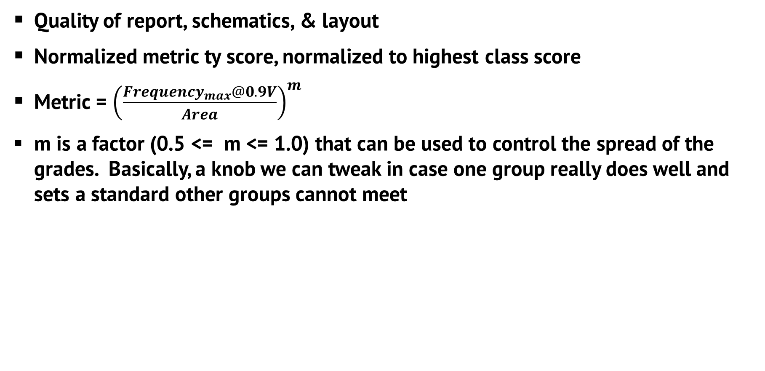
Evaluation Criteria
Quality of report, schematics, & layout
Normalized metric ty score, normalized to highest class score
Metric = ${\left(\frac{Frequency_{max}@0.9V}{Area}\right)}^{m}$
m is a factor (0.5 <= m <= 1.0) that can be used to control the spread of the grades. Basically, a knob we can tweak in case one group really does well and sets a standard other groups cannot meet

Slide 13
Evaluation Criteria (contd.)
Report does not need to contain lengthy text. Explain the design (e.g. why is a neuron important? Potential applications?). Explain the digital components in the design, and also explain your thought process in sizing transistors.
The following data is expected:
  Max speed design could run post-layout: T
    i.e., Delay from input to output
  Frequency = 1/T
  Area (rectilinear area)
Area to be reported is the area
of the boundary region that
encompasses all the polygons of
your design.
If your block looked like this (it shouldn’t ☺), this is the area you would report.

Slide 14
Example Design Steps (You don’t have to follow)
Blocks needed: multiplier, 2-bit adder, 3-bit adder, 3-bit 2-to-1 MUX
  Multiplier is extremely simplified thanks to our assumptions
Implement each block separately
  First implement their schematic and test their functionality through simulations
  Then design their layout and extract parasitic netlists.
Combine the blocks to create your perceptron
  First, implement the schematic using the symbols (or the schematic views) of the building blocks
  Then, design the layout using the layouts of the building blocks.
    It’s extremely important to follow this modular methodology, otherwise you will get lost!
    You can use the M2 and M3 layers and their Vias to route your design.
    Remember, the higher the metal layers you use, the higher the delay gets.

Slide 15
Milestones
Remember the overall project weight is 25%
Milestone | Deadline | Weight in the project grade | Overall Weight
Team sign up* | Oct 15th | 0% | 0%
Gate-level design (PDF/PPT) | Nov 13th | 25% | 5%
Functionality verification of layout | Dec. 4th | 25% | 5%
Optimized layout | Dec. 11th | 25%** | 5%
Final project report | Dec 16th | 25% | 5%
** Normalized across the class based on the quality metric

