Slide 1
IPL Data Analysis: Patterns, Trends & Insights
Exploring Matches & Deliveries Dataset (2008–2025)
Analyzing IPL data to discover trends, performance patterns, and strategic insights.
Presented by: Abhinav Parashri

Slide 2
Problem Statement
Goal: Extract meaningful insights from IPL datasets.
• Toss impact on victory
• Phase-wise match influence
• Top performers analysis
• Hidden trends & venue effects

Slide 3
Dataset Overview
matches.csv → Season, teams, toss, winner, venue
deliveries.csv → Ball-by-ball runs, wickets, overs, batters & bowlers
Dataset contains millions of ball-by-ball records.

Slide 4
Data Cleaning & Processing
• Removed duplicates
• Filled missing values
• Standardized franchise names
• Converted dates & categorical data
Improved dataset consistency and accuracy.

Slide 5
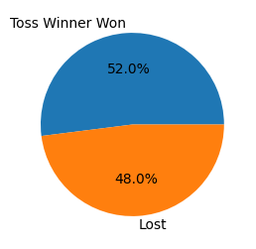
Toss Impact Analysis
Teams winning toss win around 51–53% matches.
Toss provides a slight advantage but is not decisive.
Venue and dew conditions influence chasing success.

Slide 6
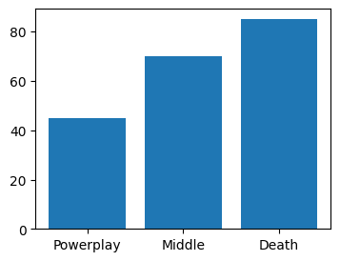
Phase-wise Match Analysis
Powerplay: Early momentum
Middle Overs: Stability control
Death Overs: Explosive scoring phase
Death overs contribute most match-defining runs.

Slide 7
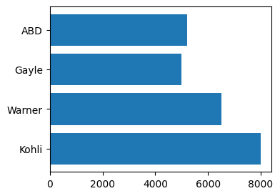
Top Batters
Virat Kohli → Consistency
Chris Gayle → Powerplay dominance
AB de Villiers → Death overs specialist
David Warner → Reliable opener

Slide 8
Top Bowlers
Lasith Malinga → Highest wickets
Jasprit Bumrah → Death overs specialist
Sunil Narine → Economy master
Rashid Khan → Middle overs control

Slide 9
Hidden Patterns
• Chasing teams dominate certain venues
• IPL scoring rates increasing yearly
• Dew factor affects second innings
• Matchups influence outcomes

Slide 10
Conclusions
• Toss has marginal impact
• Death overs are most crucial
• Venue conditions strongly matter
• IPL evolved into high-scoring tournament

Slide 11
Future Work
• Machine learning winner prediction
• Advanced player matchup analytics
• Venue-specific strategies
• Real-time dashboard creation

