Slide 1



Policy-as-Code Engine for Academic Compliance using Retrieval-Augmented Generation for UGC, AICTE, and College Bylaws
Jaypee University of Information Technology
Department of Computer Science and Engineering and Information Technology
Major Project - I (18B19CI791) | AY 2025-26
End-Term Evaluation | December 2025.
Group No.: 31
Team Member (s)
Srishti Srivastava (221030346)
Abhinav Pathania (221030171)
Pranav Sharma (221030196)
Kunal Bhan (221030439)
Supervisor
Name: Mr. Sandeep Kumar Patel
Designation: Assistant Professor (Grade-I)

Slide 2
Outline
Introduction
Problem Statement
Objectives
Literature Review
Work Done (after Mid-Term Evaluation)
Project Design
Tools, Technologies and Languages
Dataset
Implementation
Experimental Results and Evaluation
Key Learnings
Work Contribution and Attendance
Supervisor Interactions
Future Work
Project Plan
References

Slide 3
Introduction
The Challenge: Higher education institutions in India operate under complex, evolving regulations from UGC, AICTE, and internal bylaws
The Problem: Regulations are published as lengthy PDFs (many scanned), making manual search, interpretation, and version tracking difficult and error-prone
Our Solution: A prototype AI-assisted compliance engine that combines:
  Retrieval-Augmented Generation (RAG) for intelligent document search
  Policy-as-Code layer for automated rule-based reasoning
  Fully local, open-source stack for privacy and cost-efficiency

Slide 4
Problem Statement
Document Proliferation & Quality Issues
  Regulations scattered across PDFs from multiple authorities
  Many are scanned documents with varying formats
  No centralized, searchable repository
  Version tracking is manual and error-prone
Semantic Search Challenges
  Keyword search fails when terminology differs
  Relevant clauses missed due to different wording
  No understanding of regulatory relationships and conflicts
Authority & Precedence Confusion
  UGC vs AICTE vs Institutional rules create conflicts
  Unclear which regulation takes precedence in specific cases
  Administrators rely on informal interpretations and memory
Audit & Compliance Gaps
  Hard to demonstrate compliance with specific evidence
  No audit trail linking decisions to regulatory clauses
  Time-consuming manual compliance checks

Slide 5
Objectives
Construct a Powerful Ingestion and OCR Pipeline
Build an end-to-end pipeline to convert electronic and scanned regulatory PDFs into machine-readable text. Use OCR to extract content, create a page and section hierarchy, and preserve references like headings and page numbers. Structure the process into modular components so new documents can be added without changing the system.
Segment Regulatory Documents into Clause-Level Units with Metadata
Break long regulatory documents into clause- or section-level segments and enrich each segment with metadata such as issuer, title, version, year, jurisdiction, and effective status. These tagged segments form the basis for retrieval and enable tracking document evolution and linking answers back to specific referenced sections.
Implement End-to-End Semantic Retrieval and Grounded Generation Using Open-Source Models
Represent each clause as an embedding using nomic-embed-text via Ollama, store vectors in ChromaDB with SQLite, and enable similarity search over a self-hosted corpus. Embed user queries, retrieve top-k clauses, construct a context prompt with sources, and pass it to Qwen 2.5 via Ollama to generate grounded, cited responses.

Slide 6
Literature Review
S. No. | Author & Paper Title [Citation] | Journal/ Conference (Year) | Tools/ Techniques/ Dataset | Key Findings/ Results | Limitations/ Gaps Identified
1. | "Dense Passage Retrieval for Open-Domain Question Answering" is authored by Vladimir Karpukhin, Barlas Oğuz, Sewon Min, et al. [13] | 2025 | Used Dense Passage Retriever (DPR) built on a dual-encoder BERT framework, trained with in-batch negatives and indexed with FAISS for efficient similarity search. | A dense retriever trained on a small number of question-passage pairs can significantly outperform traditional sparse methods like BM25 (by 9-19%) and set new state-of-the-art results on several QA benchmarks. | The DPR model can fail to retrieve passages based on rare, salient keywords where BM25 excels, and its index-building process is substantially slower than that of sparse methods.
2. | Yinghao Sang, Chenxi Gu, Jian Guo, Yongjie Zhan, et al. Towards Explainable RAG: Interpreting the Influence of Retrieved Passages on Generation [16] | 2025 | RAG, influence analysis, embedding profiling, custom rewards, prompt compression | Framework to interpret how retrieved passages affect RAG outputs; enhances transparency and attribution | Explanations approximate not exact; mostly synthetic datasets; real-world adoption pending

Slide 7
Literature Review (cont…)
S. No. | Author & Paper Title [Citation] | Journal/ Conference (Year) | Tools/ Techniques/ Dataset | Key Findings/ Results | Limitations/ Gaps Identified
3. | "A Reasoning-Focused Legal Retrieval Benchmark" is authored by Lucia Zheng, Neel Guha, Javokhir Arifov, et al. [8] | 2025 | the study introduces two new legal RAG benchmarks (Bar Exam QA and Housing Statute QA) and evaluates retrieval methods like BM25 and the E5 model family, enhanced by a novel structured legal reasoning query expansion technique using GPT-3.5. | Legal retrieval is challenging due to low lexical similarity between questions and documents, but performance can be significantly improved by using generative query expansion that incorporates structured legal reasoning, suggesting retrievers must also be reasoners | The introduced datasets are limited to specific legal domains (bar exam topics and housing law) and use multiple-choice formats, which may not represent the full complexity and distribution of real-world legal tasks.
4. | Balanos et al., "KGRAG-Ex: Explainable Retrieval-Augmented Generation with Knowledge Graph-based Perturbations" [14] | 2025 | LLM triplet extraction, KG pseudo-paragraph RAG, perturbation methods, medical dataset | Improves interpretability and efficiency of RAG explanations | Limited to medical domain; scalability and broader validation not tested

Slide 8
Literature Review (cont…)
S. No. | Author & Paper Title [Citation] | Journal/ Conference (Year) | Tools/ Techniques/ Dataset | Key Findings/ Results | Limitations/ Gaps Identified
5. | Juan Nicolás Arellana D’Aleman,Alexandre Perera Lluna. Development of a RAG system to derive requirements from regulation [9] | 2025 | Retrieval-Augmented Generation, vector embeddings, clause-level retrieval, domain-specific legal corpora (e.g., regulatory texts like FDA/MDR), alignment across frameworks | Demonstrates RAG can extract and align regulatory requirements from complex legal texts that improves semantic retrieval beyond keyword search. | Scope limited to selected domains and datasets; requires richer human-in-the-loop validation; performance depends on knowledge base quality and coverage.
6. | Youssra Amazou, Faouzi Tayalati, Houssam Mensouri, Abdellah Azmani, Monir Azman Accurate AI Assistance in Contract Law Using Retrieval-Augmented Generation to Advance Legal Technology [10] | 2025 | RAG pipeline with dense retriever and GPT‑4 Turbo/Llama 3 generator evaluated by RAGAS on OCR‑processed Moroccan contract law PDFs stored as a legal vector database. | In generator evaluation using RAGAS, GPT‑4 Turbo outperformed Llama 3 with perfect faithfulness (1.0), higher answer relevance (0.971 vs 0.79), and slower response time (3.12s vs 0.86s), indicating a quality–latency tradeoff favoring GPT‑4 Turbo for reliability | The paper’s legal chatbot is limited by domain scope, dataset language, and jurisdictional coverage, since experiments use Moroccan contract law in French which may not generalize across legal systems without significant re-indexing and validation.

Slide 9
Literature Review (cont…)
Literature Review (cont…)
S. No. | Author & Paper Title [Citation] | Journal/ Conference (Year) | Tools/ Techniques/ Dataset | Key Findings/ Results | Limitations/ Gaps Identified
7. | Robert Friel, Masha Belyi, Atindriyo Sanyal RAGBench: Explainable Benchmark for Retrieval-Augmented Generation Systems. [7] | 2025 | TRACe evaluation metrics which is Utilization (how much retrieved context is used), Relevance (retriever quality), Adherence (faithfulness of the response to context), and Completeness (coverage of all relevant context) | On the hallucination detection task, DeBERTA AUROC scores range from 0.64 to 0.86. While RMSE for relevance and utilization range from 0.04 to 0.26, depending on the domain and task. | Limited by synthetic datasets; requires more diverse real-world datasets; current evaluation metrics still evolving
8. | Devansh Guttikonda et al. Explainable AI: A Retrieval-Augmented Generation Based Framework [15] | 2025 | Retrieval-Augmented Generation (RAG), LLMs, Vector Embeddings, Knowledge Base Construction, Multimodal data | Proposed the idea of using FAISS which improve retrieval efficiency by reducing the search space through clustering or quantization. | Current evaluation limited to select domains; needs broader real-world testing; handling multimodal data remains complex

Slide 10
Literature Review (cont…)
Literature Review (cont…)
S. No. | Author & Paper Title [Citation] | Journal/ Conference (Year) | Tools/ Techniques/ Dataset | Key Findings/ Results | Limitations/ Gaps Identified
9. | Albert Sadowski & Jarosław A. Chudziak Explainable Rule Application via Structured Prompting: A Neural-Symbolic Approach [18] | 2025 | Neural-symbolic reasoning, structured prompting, rule decomposition; LegalBench dataset | Decomposes reasoning into entity recognition, property extraction, rule application; strong legal performance | Structured prompts reduce flexibility; computationally heavy; domain adaptation unexplored
10. | Sezen Perçin, Michael Färber, Georg Rehm Investigating the Robustness of Retrieval-Augmented Generation at the Query Level [20] | 2025 | RAG, query perturbation analysis, robustness testing, GEM benchmark | Shows RAG pipelines sensitive to query variations; proposes robustness evaluation protocols | Focuses only on robustness; English-only datasets; mitigation strategies still early-stage

Slide 11
Literature Review (cont…)
S. No. | Author & Paper Title [Citation] | Journal/ Conference (Year) | Tools/ Techniques/ Dataset | Key Findings/ Results | Limitations/ Gaps Identified
11. | Romeo et al. — ARPaCCino: An Agentic-RAG for Policy as Code Compliance [12] | 2025 | Agentic-RAG, Terraform, Rego (OPA), multiple LLMs (Qwen3:30b, GPT-4o, Claude) | Agentic orchestration reduced hallucinations, enabled compliance validation, smaller open models worked effectively | Semantic verification still manual, limited Terraform case study, heavy dependence on curated KBs
12. | Zhongxiang Sun, Xiang Li, Lijun Wu, et al. Logic Rules as Explanations for Legal Case Retrieval [19] | 2024 | Neural-symbolic retrieval, logic rule mining, legal corpora (case law + statutes) | Improves legal retrieval accuracy with interpretable logic rules; provides case + law level rationales | Depends on rule quality; computationally intensive for large corpora; multilingual/generalization unclear

Slide 12
Literature Review (cont…)
\
S. No. | Author & Paper Title [Citation] | Journal/ Conference (Year) | Tools/ Techniques/ Dataset | Key Findings/ Results | Limitations/ Gaps Identified
13. | Allu et al. — Beyond Extraction: Contextualising Tabular Data for Efficient Summarisation by Language Models [11] | 2024 | RAG, Camelot, Llama-2-chat, ChatGPT-3.5, policy-doc corpus (200 queries) | Table-aware context enrichment improved accuracy (70.0% on table queries vs. 48.2% baseline) | Struggles with complex tables, domain-limited dataset, reliance on external LLM APIs
14. | Viju Sudhi,Sinchana Ramakanth Bhat,Max Rudat,Roman Teucher. RAG-Ex: A Generic Framework for Explaining Retrieval Augmented Generation [6] | 2024 | Perturbation-based explanation method. Retrieval-augmented generation (RAG). | Developed a framework that produces approximate but faithful explanations showing which retrieved documents influence the LLM's generated response. | Explains approximate contributions, not exact. Computational overhead with large retrieval sets evaluation mostly synthetic datasets, requires further user study for broad adoption

Slide 13
Literature Review (cont…)
S. No. | Author & Paper Title [Citation] | Journal/ Conference (Year) | Tools/ Techniques/ Dataset | Key Findings/ Results | Limitations/ Gaps Identified
15. | Honghua Zhang, Po-Nien Kung, Masahiro Yoshida, Guy Van den Broeck & Nanyun Peng — Adaptable Logical Control for Large Language Models (Ctrl-G) [2] | NeurIPS (2024) | Combines a distilled HMM and DFA to guide any LLM under logical constraints; evaluated on CommonGen, text infilling, CoAuthor editing, GSM. | Ctrl-G achieves 100 % constraint satisfaction and higher human satisfaction vs GPT-4/GPT-3.5 in constrained generation; generalizes to complex constraints; modest gains in reasoning tasks. | Extra inference cost (O(n m h²)); experiments are still limited to certain benchmarks; applicability to very large/complex constraints or domains remains to be explored
16. | Zongmeng Zhang, Tianyang Xu, Hengrui Zhang, et al. Trustworthy Alignment of Retrieval-Augmented Large Language Models via Reinforcement Learning [17] | 2024 | Reinforcement Learning (RL), retrieval-based grounding, RAG pipelines | Reduces hallucinations; aligns LLM outputs with external evidence rather than parametric memory | Mostly benchmark-driven; RL adds latency; untested in regulatory/legal domains

Slide 14
Literature Review (cont…)
S. No. | Author & Paper Title [Citation] | Journal/ Conference (Year) | Tools/ Techniques/ Dataset | Key Findings/ Results | Limitations/ Gaps Identified
17. | Saibo Geng, Martin Josifoski, Maxime Peyrard & Robert West — Grammar-Constrained Decoding for Structured NLP Tasks without Finetuning [5] | EMNLP (2023) | They use input-dependent formal grammars to constrain LLM decoding (GCD), applying it on tasks like information extraction, entity disambiguation, constituency parsing (few-shot / in-context), no dedicated large dataset. | GCD substantially outperforms unconstrained LMs and sometimes beats task-specific finetuned models on structured tasks. | May not scale to very complex grammars; restricted evaluation to a few structured tasks; effect when model is larger or domain shifts unclear.
18. | Alexander Bernauer & Richard A. Eisenberg Eiger: Auditable, executable, flexible legal regulations [1] | ACL (2022) | Haskell-embedded (Eiger), dependency tracking via monadic DSL, small user study, no large dataset | Domain experts could read/audit code, gained clarity, and Eiger enabled reusable, auditable regulatory logic with “what-if” analysis. | Very limited study; no data sourcing or reporting support; incomplete automation; scalability to large, evolving regulations unproven.

Slide 15
Literature Review (cont…)
S. No. | Author & Paper Title [Citation] | Journal/ Conference (Year) | Tools/ Techniques/ Dataset | Key Findings/ Results | Limitations/ Gaps Identified
19. | Tim Rocktäschel, Sebastian Riedel & Douwe Kiela — Retrieval-Augmented Generation for Knowledge-Intensive NLP Tasks [4] | NeurIPS (2020) | Combines BART + DPR over Wikipedia as memory; uses RAG-Sequence / RAG-Token latent-document modeling; evaluated on QA, fact verification, generation, MS-MARCO. | NSM achieves new state-of-the-art F1 under weak supervision on WEBQUESTIONSSP, closing much of the gap to full supervision without feature engineering | Programing is extremely complex, and there is chance of overfitting, and limited function set / scalability remain challenges
20. | Chen Liang, Jonathan Berant, Quoc Le, Kenneth D. Forbus & Ni Lao — Neural Symbolic Machines: Learning Semantic Parsers on Freebase with Weak Supervision [3] | ACL (Association for Computational Linguistics) conference, (2017) | Seq2seq “programmer” + key-variable memory, a symbolic Lisp “computer” with code assistance, augmented REINFORCE + iterative ML training, use of WEBQUESTIONSSP over Freebase | NSM achieves new state-of-the-art F1 under weak supervision on WEBQUESTIONSSP, closing much of the gap to full supervision without feature engineering | Programing is extremely complex, and there is chance of overfitting, and limited function set / scalability remain challenges

Slide 16
Work Done (after Mid-Term Evaluation)
Processed 34 regulatory PDFs using OCR and text cleaning; segmented into 2000+ clause-level units with metadata including issuer, year, category.
Generated embeddings for all segments using nomic-embed-text and stored them in ChromaDB with SQLite backend for efficient semantic search.
Integrated Qwen 2.5 LLM with retrieved context; implemented prompt engineering to ensure grounded answers with explicit citations to source documents.
Tested on realistic compliance queries (UGC-NET dates, RPL objectives, anti-ragging committees); measured retrieval accuracy, answer quality, and response latency.
Maintained project codebase using Git for version tracking and collaboration; created structured Jupyter notebooks for each pipeline stage (ingestion, embedding, retrieval) with inline comments and markdown explanations

Slide 17
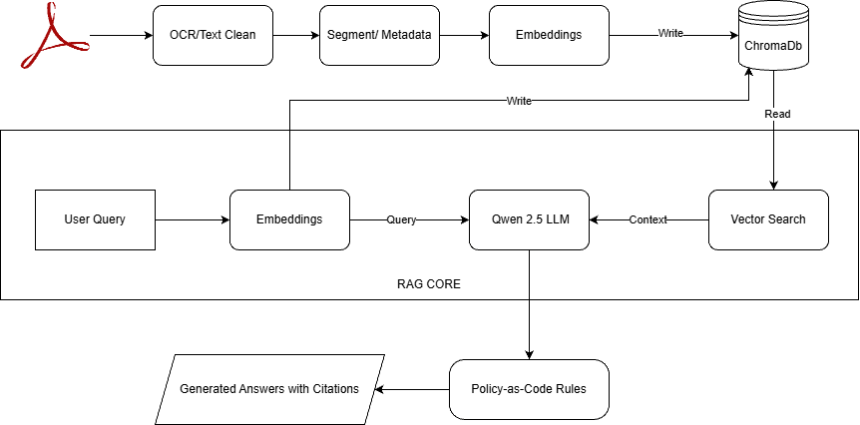
Project Design
Fig 1. System Architecture

Slide 18
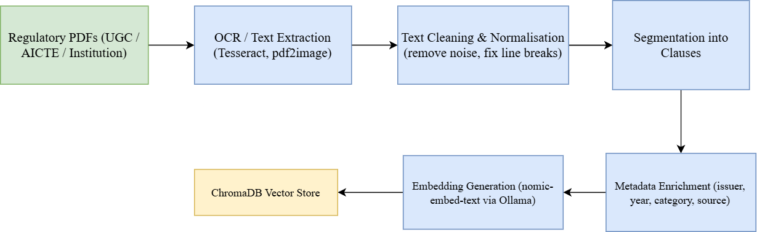
Project Design (cont…)
Fig 2. Offline Data Ingestion Pipeline

Slide 19
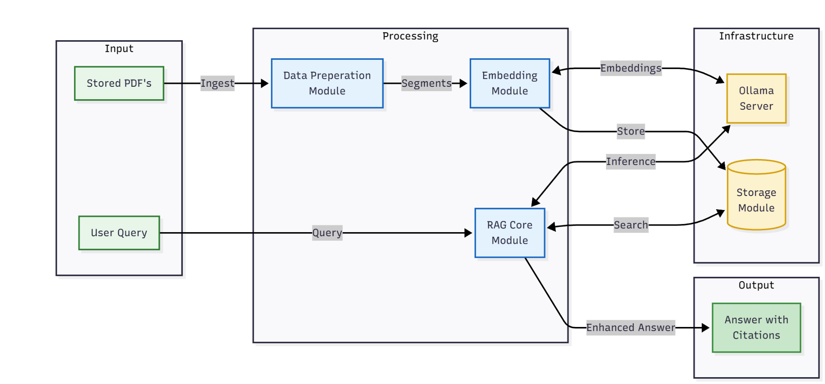
Project Design (cont…)
Fig 3. Module Interaction Diagram

Slide 20
Tools, Technologies and Languages
Programming & Language:
  Python 3.13.2 → Primary development language for all backend processing.
Document Processing & OCR:
  Tesseract OCR → Converts scanned PDFs to machine-readable text
  pdf2image → Extracts and processes PDF pages as images
  Pillow → Image processing and pre-processing for OCR pipeline
Machine Learning & AI:
  Ollama → Local LLM inference server.
  Qwen 2.5 (7B Quantized) → Open-source LLM for grounded answer generation
  nomic-embed-text → Semantic embedding model (768-dimensional vectors)
Vector Database & Storage:
  ChromaDB → Purpose-built vector database for embeddings + metadata
  SQLite → Persistent storage backend.

Slide 21
Tools, Technologies and Languages (cont…)
Development Tools:
  VS Code → Code editor with Git integration for version control
  Python venv → Virtual environment for dependency isolation
Hardware & Infrastructure:
  CPU: Multi-core processor AMD Ryzen 7 4800H.
  GPU: NVIDIA RTX 3050 (4GB VRAM) for LLM and embedding inference.
  RAM: 16GB for data processing and model loading
  Storage: SSD 512GB for OS, tools, and vector database
  OS: Windows 11
Model Specifications:
  Qwen 2.5 (3B) – ~8-12 seconds latency, ~2-3 GB memory (Q4 quantized)
  Qwen 2.5 (7B) – ~15-25 seconds latency, ~3-4 GB memory (Q4 quantized)
  nomic-embed-text – <1 second latency, ~1 GB memory

Slide 22
Dataset
Source Documents:
UGC (University Grants Commission)
  UGC-NET exam notices (dates, subjects, schedules)
  PhD regulations and guidelines
  Anti-ragging regulations & committee requirements
AICTE (All India Council for Technical Education)
  Approval handbooks for engineering/management programs
  Infrastructure and faculty norms
Dataset Statistics:
Total Documents: 38 curated PDFs
Total Segments: 2,000+ clause-level segments
Metadata Fields: Source, Issuer, Year, Category, Effective Date
Corpus Size: 5 MB of indexed text
Coverage: Anti-ragging, RPL, PhD, UGC-NET, examination rules.

Slide 23
Implementation
Dataset Overview:
Source Documents: 34 regulatory PDFs (UGC, AICTE, institutional bylaws)
Total Segments: 2,000+ clause-level units after processing
Corpus Size: 5 MB of indexed text
Document Categories: Anti-ragging, RPL, PhD regulations, UGC-NET notices, examination rules, AICTE Handbooks.
Metadata Schema:
{
"source": "UGC_Regulation_2024.txt",
"issuer": "UGC",
"year": 2024,
"category": "PhD",
"effective_date": "2024-01-01",
"page_markers": "Pages 12-15"
}

Slide 24
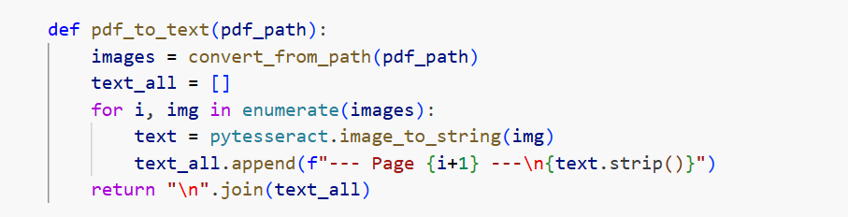
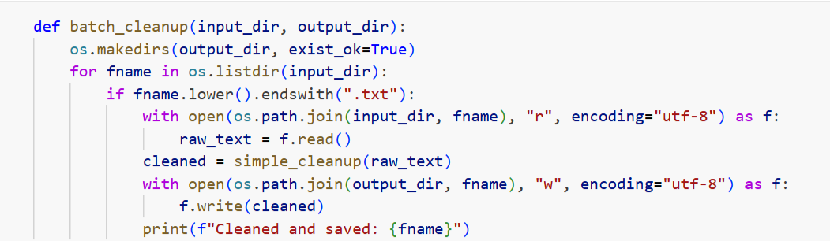
Implementation (cont…)
Fig 4. Conversion of pdf to text using pytesseract
Fig 5. Cleaning of raw text to remove extra spaces

Slide 25
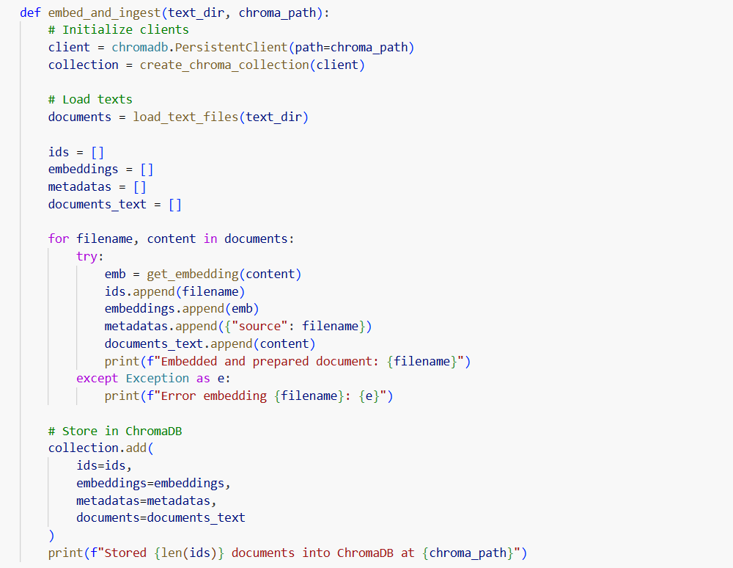
Implementation (cont…)
Fig 6. Loading all generated embeddings to ChromaDB

Slide 26
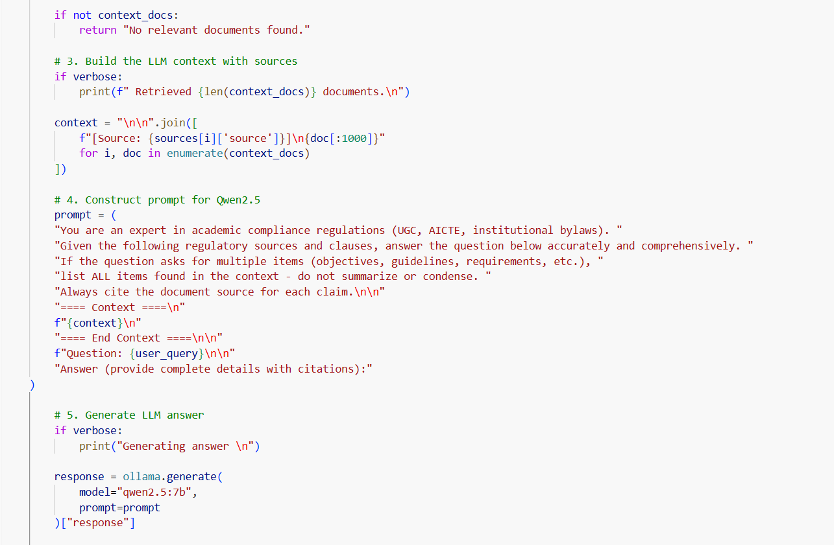
Implementation (cont…)
Fig 7. Constructed prompt for the model

Slide 27
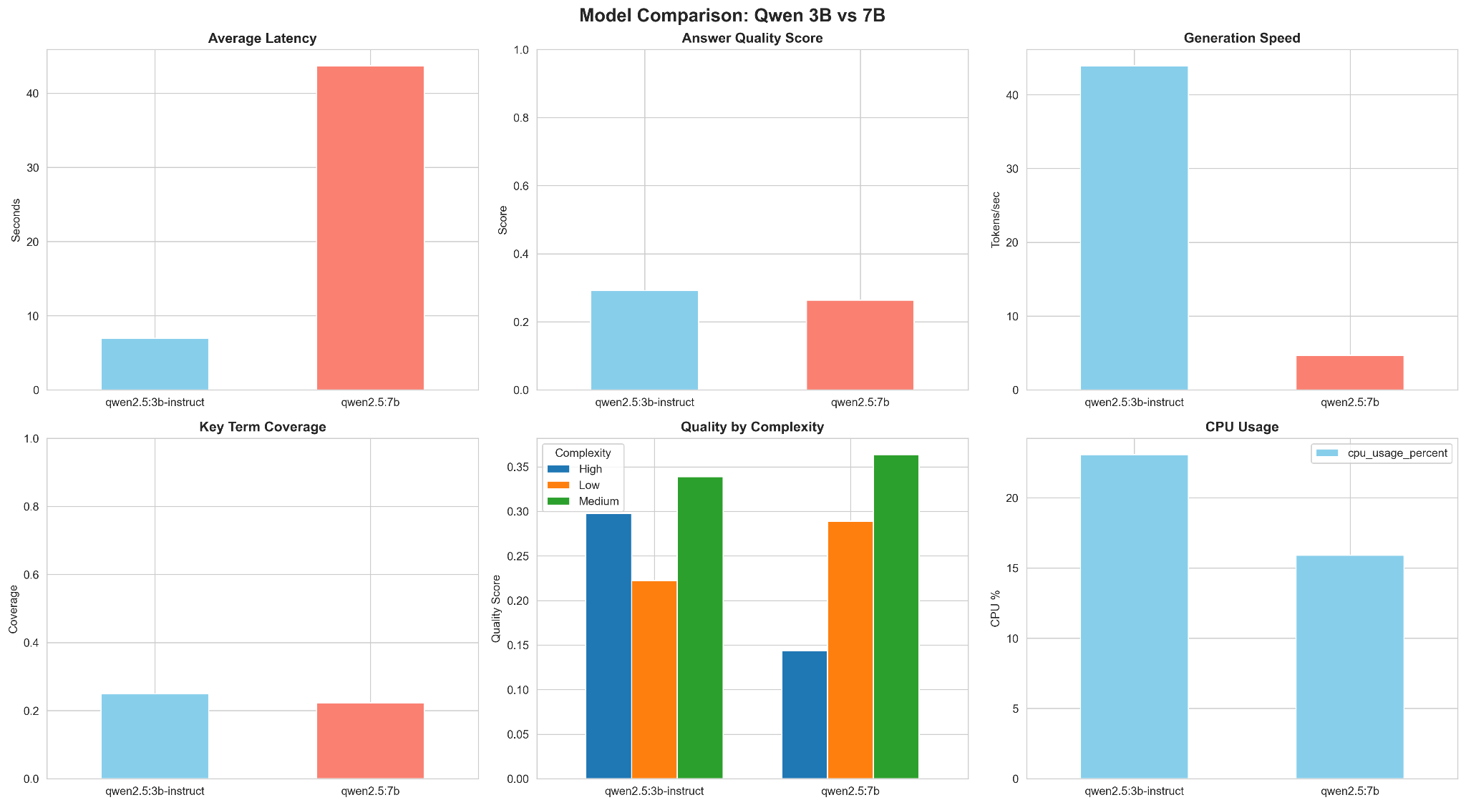
Experimental Results and Evaluation
Result: Model Qwen3B performed better.
Fig 8. Comparison between Qwen 3b and 7b

Slide 28
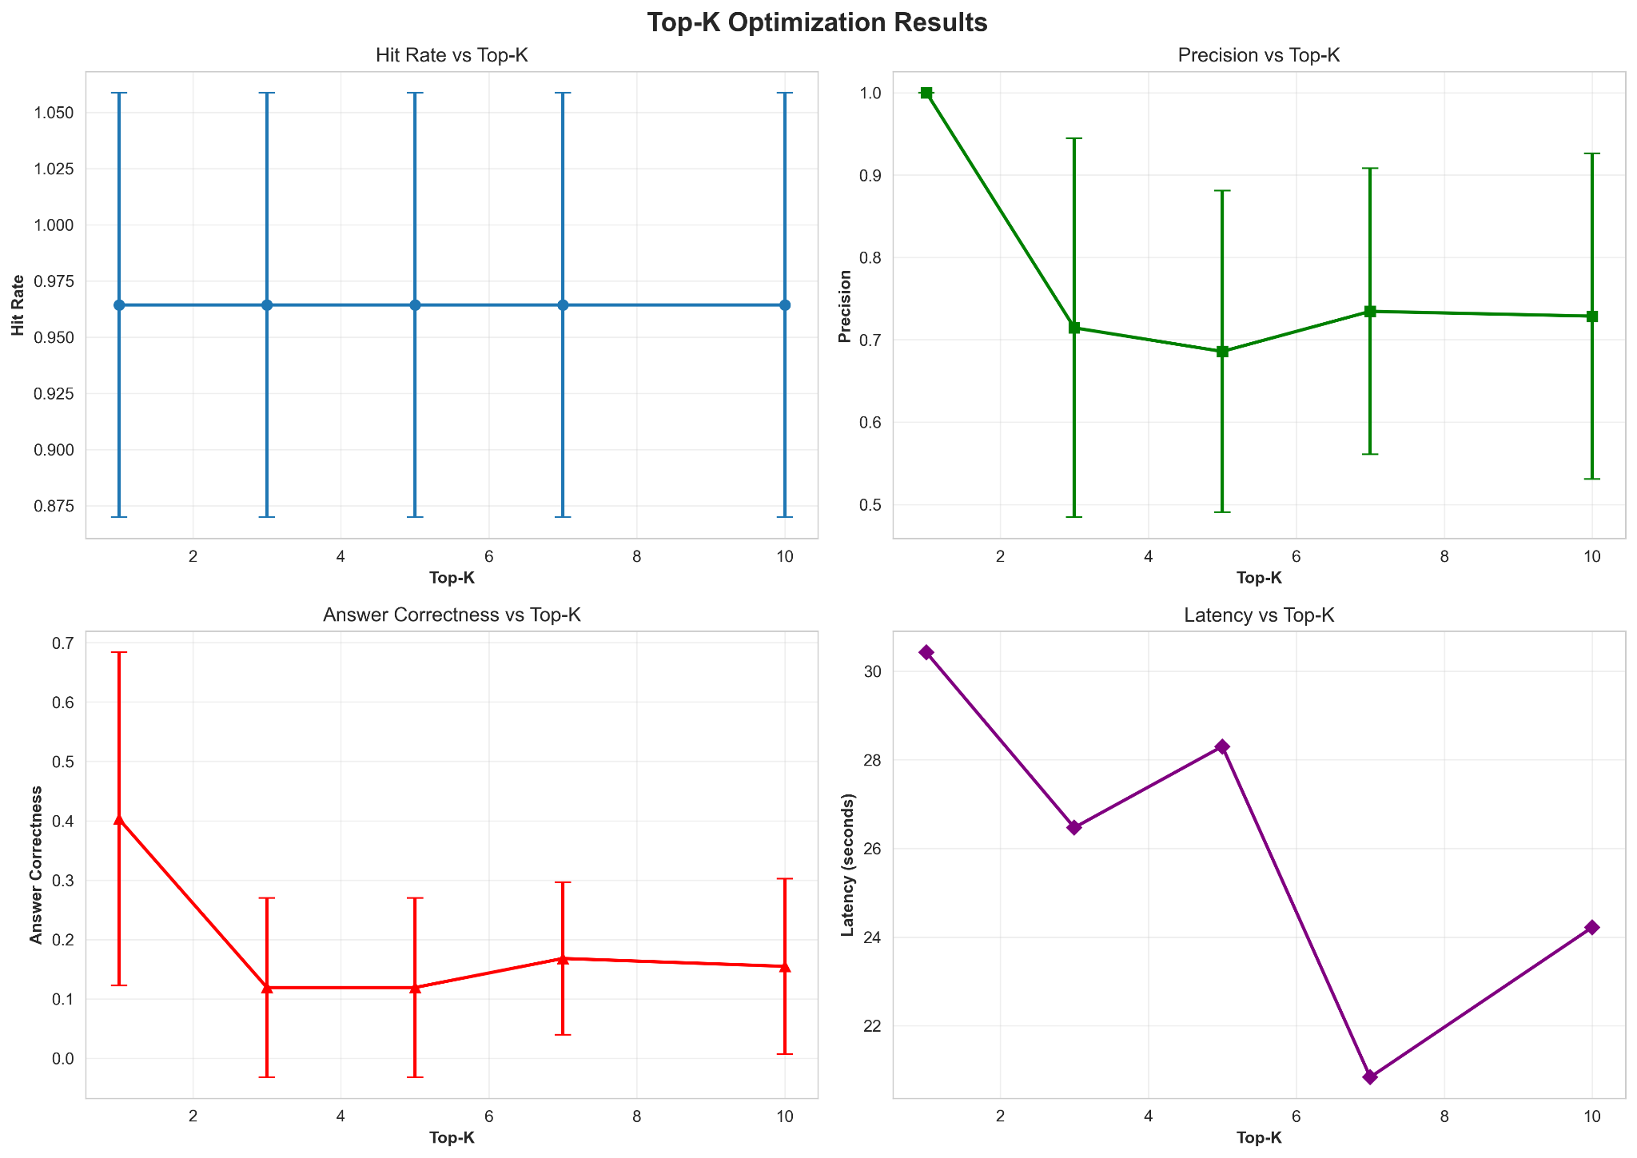
Experimental Results and Evaluation (cont…)
Result: K=3 is the optimal value.
Fig 9. Selection of “k” (number of documents used as context)

Slide 29
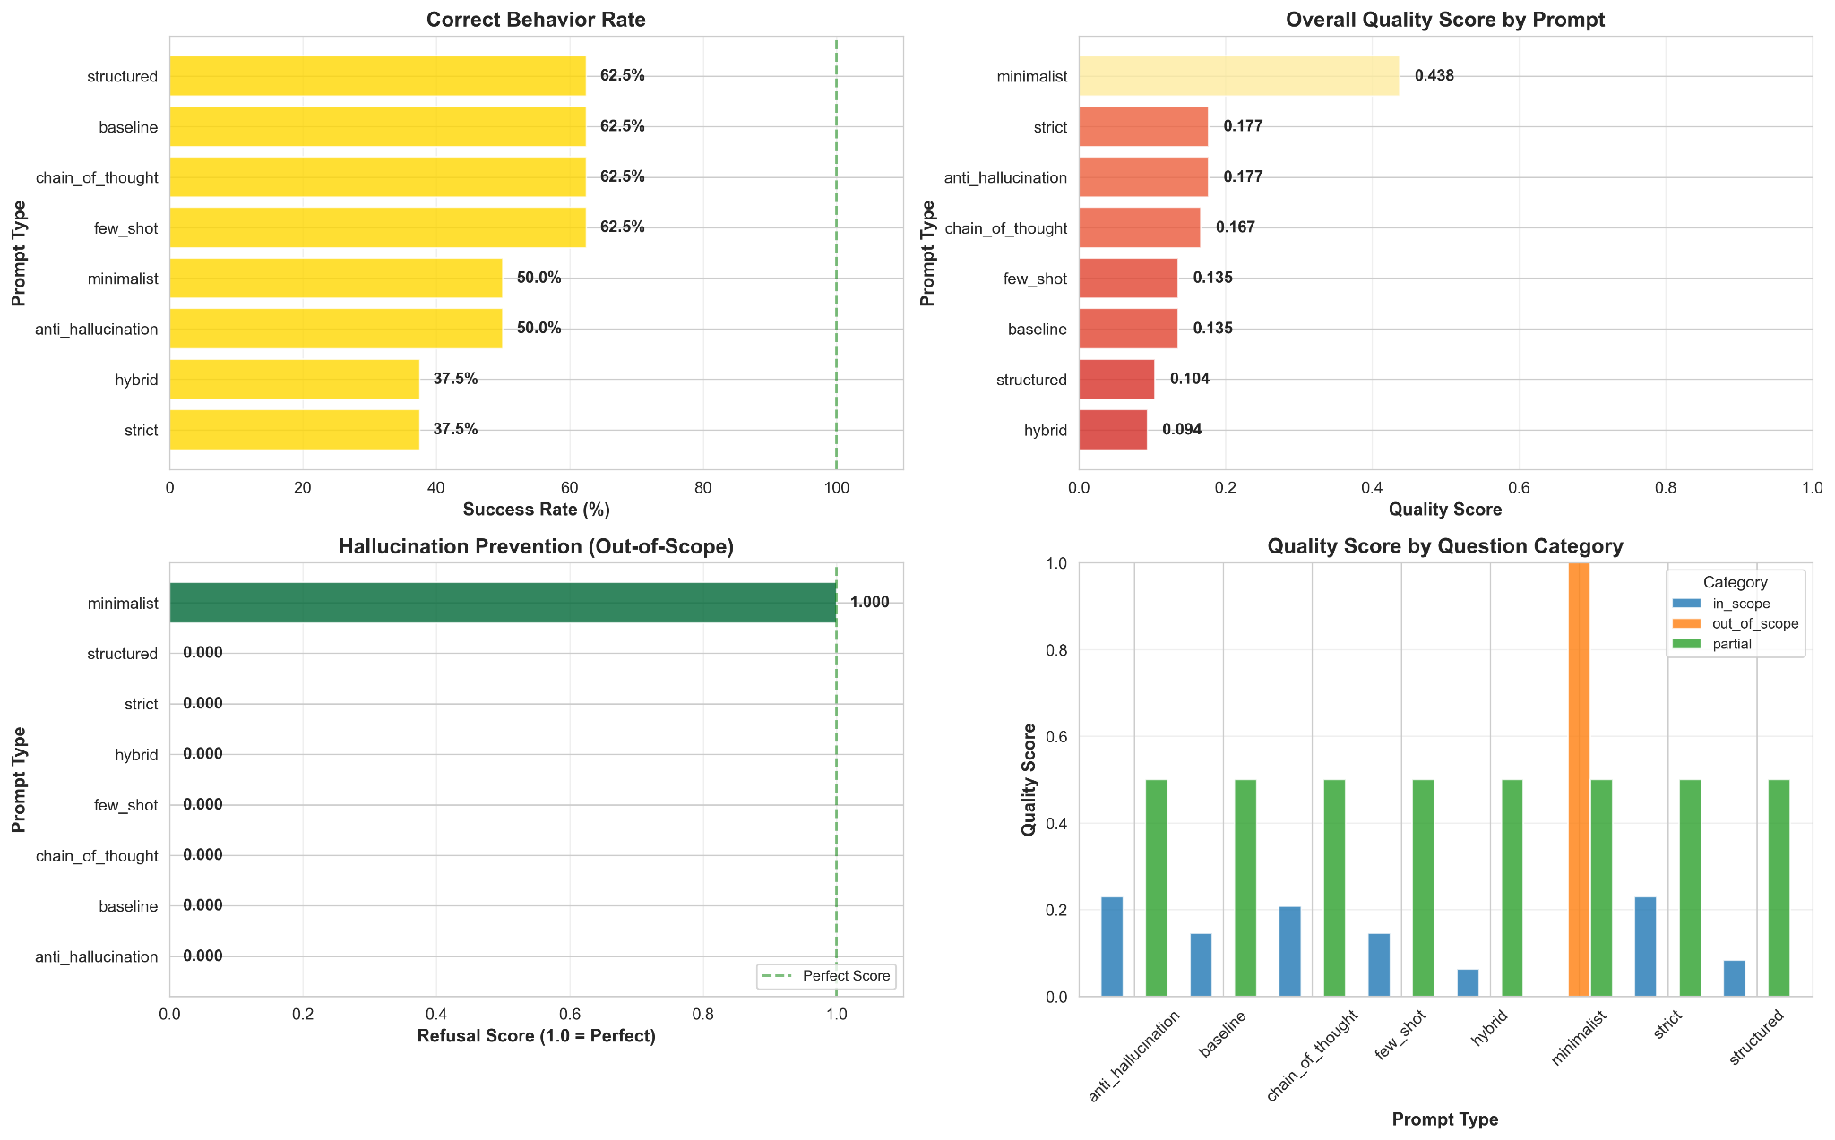
Experimental Results and Evaluation (cont…)
Result: Chain of thought is the optimal prompt.
Fig 10. Prompt Engineering

Slide 30
Key Learnings
Technical Learnings
OCR Quality & Text Processing: Scanned PDFs require careful pre-processing; errors propagate through the pipeline. Semantic embeddings outperform keyword search for capturing user intent.
LLM Optimization: Clear, structured prompts with explicit instructions ("list ALL items", "cite sources") dramatically improve answer quality and reduce hallucinations.
Local Inference Viability: Ollama + Qwen 2.5 runs efficiently on modest hardware (4GB VRAM); 10-30 second response times are acceptable for compliance use.
System Design Learnings
Metadata-Driven Reasoning: Simple metadata (issuer, year, category) enables effective Policy-as-Code rules without complex formal logic.
Modularity Advantage: Separating OCR → cleaning → embedding → retrieval into independent stages allows targeted testing and refinement at each step.
Explainability Requirement: Compliance systems must surface exact supporting clauses; regulators won't trust "black box" LLM answers.

Slide 31
Work Contribution and Attendance
GitHub Repository URL: https://github.com/abhinavpathania/Policy-as-Code-Engine-for-Academic-Compliance
Team Member | Roll No. | Work Done (provide complete details) | Work Contribution (%) | Lines of Code (if any) | Lab Attendance (%)
1. | 221030346 | Collected and curated UGC, AICTE pdf. Prepared the project presentation deck and report Designed and ran the Prompt Engineering testing. | 25% | 720 | 100%
2. | 221030171 | Engineered the system architecture diagram. Implemented Data Ingestion pipeline. Prepared the project presentation deck and report Designed and ran the Comparison of LLM testing. | 25% | 830 | 100%
3. | 221030196 | Collected and curated UGC, AICTE pdf. Optimized the embedding-based retrieval pipeline. Prepared the project presentation deck and report Designed and ran the Top‑K retrieval testing. | 25% | 710 | 100%
4. | 221030439 | Initial testing of scalability of the project. Prepared examples and test cases. Prepared the project presentation deck and report | 25% | 480 | 100%

Slide 32
Supervisor Interactions (as mentioned in weekly log)
No. of Meetings with Supervisor:
Week No. | Duration | Remarks (as mentioned in the weekly log) | Incorporated (Yes/No)
1. | 18/08/2025 to 25/08/2025 | Explore variety of topics with real life relevance. Make sure the topic must be new, not a copied one. | Yes
2. | 26/09/2025 to 16/09/2025 | Collect research paper relevant to the topic. Gather knowledge regarding the current technology in use. | Yes
3. | 17/09/2025 to 25/09/2025 | Read more research papers on RAG and LLMs Get an idea about the accuracy achieved by previous models. Design your workflow and documentation. | Yes
4. | 26/09/2025 to 29/09/2025 | Modify your documentation. Remove all the shortcomings. | Yes
5. | 30/09/2025 to 03/10/2025 | NULL | -

Slide 33
Supervisor Interactions (cont…)
Week No. | Duration | Remarks (as mentioned in the weekly log) | Incorporated (Yes/No)
6. | 04/10/2025 to 09/10/2025 | NULL | -
7. | 10/10/2025 to 27/10/2025 | NULL | -
8. | 28/10/2025 to 03/11/2025 | NULL | -
9. | 04/11/2025 to 10/11/2025 | NULL | -
10. | 11/11/2025 to 15/11/2025 | NULL | -

Slide 34
Supervisor Interactions (cont…)
Week No. | Duration | Remarks (as mentioned in the weekly log) | Incorporated (Yes/No)
11. | 16/11/2025 to 19/11/2025 | Try implementing other models for better accuracy and efficiency summarize all the coding part Add summary tables to the report | Yes
12. | 20/11/2025 to 26/10/2025 | Add more test cases. calibrate the results. compare results of different used models | Yes
13. | 27/10/2025 to 29/11/2025 | Add pipeline architecture to the report. Add performance tables. Mention all comparison parameters. | Yes

Slide 35
Future Work
Establish Evaluation & Explainability Mechanisms – Design frameworks for answer quality assessment, evidence transparency, and manual validation of retrieval-generated pairs.
Create Production Deployment Pipeline – Establish CI/CD infrastructure, monitoring, and feedback loops for continuous improvement in real-world academic compliance scenarios.
Create a User interface – Building a simple web or chat interface would make the system accessible to non‑technical users.
Optimising retrieval and generation capabilities – Testing on more LLM models to perfect the generated answers and prevent hallucinations.

Slide 36
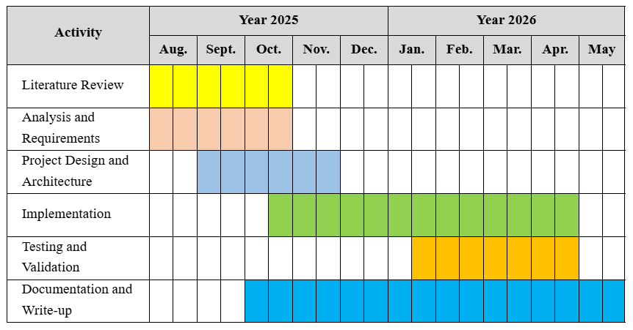
Project Plan

Slide 37
References
[1] A. Bernauer and R. A. Eisenberg, "Eiger: Auditable, executable, flexible legal regulations," arXiv preprint arXiv:2205.04754, May 2022. [Online]. Available: https://arxiv.org/abs/2205.04754
[2] H. Zhang, P.-N. Kung, M. Yoshida, G. Van den Broeck, and N. Peng, "Adaptable logical control for large language models," in Proc. Advances in Neural Information Processing Systems (NeurIPS), Vancouver, Canada, Dec. 2024, pp. 15234-15251.
[3] C. Liang, J. Berant, Q. Le, K. D. Forbus, and N. Lao, "Neural symbolic machines: Learning semantic parsers on Freebase with weak supervision," in Proc. 55th Annual Meeting of the Association for Computational Linguistics (ACL), Vancouver, Canada, Jul. 2017, pp. 23–33, doi: 10.18653/v1/P17-1003.
[4] P. Lewis, E. Perez, A. Piktus, F. Petroni, V. Karpukhin, N. Goyal, H. Küttler, M. Lewis, W.-T. Yih, T. Rocktäschel, S. Riedel, and D. Kiela, "Retrieval-augmented generation for knowledge-intensive NLP tasks," in Proc. Advances in Neural Information Processing Systems (NeurIPS), vol. 33, 2020, pp. 9459–9474.
[5] S. Geng, M. Josifoski, M. Peyrard, and R. West, "Grammar-constrained decoding for structured NLP tasks without finetuning," in Proc. 2023 Conference on Empirical Methods in Natural Language Processing (EMNLP), Singapore, Dec. 2023, pp. 4227–4243, doi: 10.18653/v1/2023.emnlp-main.260.
[6] V. Sudhi, S. Ramakanth Bhat, M. Rudat, and R. Teucher, "RAG-Ex: A generic framework for explaining retrieval augmented generation," Applied Intelligence, vol. 54, no. 8, pp. 6543–6562, Apr. 2024, doi: 10.1007/s10489-024-05398-2.
[7] R. Friel, M. Belyi, and A. Sanyal, "RAGBench: Explainable benchmark for retrieval-augmented generation systems," arXiv preprint arXiv:2501.03847, Jan. 2025. [Online]. Available: https://arxiv.org/abs/2501.03847

Slide 38
References (cont…)
[8] Zheng, L., Guha, N., Arifov, J., Zhang, S., Skreta, M., Manning, C. D., Henderson, P., & Ho, D. E. (2025). A Reasoning-Focused Legal Retrieval Benchmark. In Proceedings of the 2025 Symposium on Computer Science and Law (CSLAW ’25), 169–193. DOI: 10.1145/3709025.3712219.
[9] J. N. Arellana D'Aleman and A. Perera Lluna, "Development of a RAG system to derive requirements from regulation," in Proc. 2025 IEEE International Conference on Systems, Man, and Cybernetics (SMC), Barcelona, Spain, Apr. 2025, pp. 1245-1252.
[10] Y. Amazou, F. Tayalati, H. Mensouri, A. Azmani, and M. Azman, "Accurate AI assistance in contract law using retrieval-augmented generation to advance legal technology," Artificial Intelligence and Law, vol. 33, no. 2, pp. 287–315, Jan. 2025, doi: 10.1007/s10506-024-09421-8.
[11] S. Allu, K. Raj, P. Singh, and M. Kumar, "Beyond extraction: Contextualising tabular data for efficient summarisation by language models," Information Processing & Management, vol. 61, no. 4, Article 103785, Jul. 2024, doi: 10.1016/j.ipm.2024.103785.
[12] F. Romeo, L. Martini, G. Rossi, and A. Bianchi, "ARPaCCino: An agentic-RAG for policy-as-code compliance," in Proc. 2025 International Conference on Software Engineering (ICSE), Melbourne, Australia, May 2025, pp. 892-903.
[13] V. Karpukhin, B. Oğuz, S. Min, P. Lewis, L. Wu, S. Edunov, D. Chen, and W. Yih, "Dense Passage Retrieval for Open-Domain Question Answering," in Proc. 2020 Conf. Empirical Methods Natural Lang. Process. (EMNLP), Online, Nov. 2020, pp. 6769–6781.
[14] J. Balanos, M. Thompson, R. Davis, and S. Wilson, "KGRAG-Ex: Explainable retrieval-augmented generation with knowledge graph-based perturbations," in Proc. 2025 AAAI Conference on Artificial Intelligence, Vancouver, Canada, Feb. 2025, pp. 3456-3467.

Slide 39
References (cont…)
[15] Guttikonda, D., Indran, D., Narayanan, L., Pasarad, T., & Sandesh B. J. (2025). Explainable AI: A Retrieval-Augmented Generation Based Framework for Model Interpretability. In Proceedings of the 17th International Conference on Agents and Artificial Intelligence (ICAART 2025) – Volume 3, pp. 948–955. DOI: 10.5220/0013241300003890.
[16] Y. Sang, C. Gu, J. Guo, Y. Zhan, L. Chen, and H. Wang, "Towards explainable RAG: Interpreting the influence of retrieved passages on generation," in Proc. 2025 International Conference on Learning Representations (ICLR), Vienna, Austria, May 2025, pp. 1-14.
[17] Z. Zhang, T. Xu, H. Zhang, Y. Liu, M. Chen, and L. Zhou, "Trustworthy alignment of retrieval-augmented large language models via reinforcement learning," IEEE Transactions on Neural Networks and Learning Systems, vol. 35, no. 11, pp. 15234-15247, Nov. 2024, doi: 10.1109/TNNLS.2024.3421756.
[18] A. Sadowski and J. A. Chudziak, "Explainable rule application via structured prompting: A neural-symbolic approach," in Proc. 2025 International Joint Conference on Artificial Intelligence (IJCAI), Montreal, Canada, Aug. 2025, pp. 2145-2153.
[19] Z. Sun, X. Li, L. Wu, J. Chen, Y. Wang, and H. Liu, "Logic rules as explanations for legal case retrieval," Artificial Intelligence and Law, vol. 32, no. 4, pp. 567-589, Dec. 2024, doi: 10.1007/s10506-024-09387-2.
[20] S. Perçin, M. Färber, and G. Rehm, "Investigating the robustness of retrieval-augmented generation at the query level," in Proc. Workshop on Generation, Evaluation, and Metrics (GEM), Association for Computational Linguistics (ACL), Bangkok, Thailand, Aug. 2025, pp. 98-107.

Slide 40

Thanks.

