Slide 1
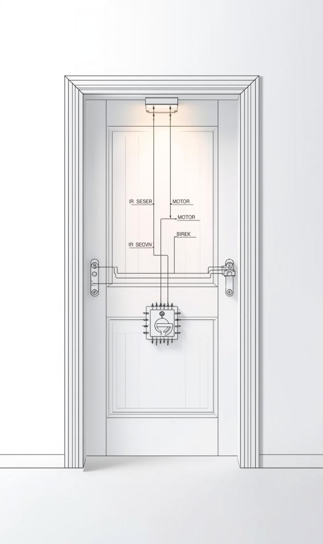
Introduction to the Automatic Door System
PURPOSE AND OBJECTIVES
The project aims to design an automatic door system utilizing a servo motor and IR sensor, enhancing convenience in various applications.

Slide 2
Fundamentals of Control Systems
DEFINITION
OPEN-LOOP
CLOSED-LOOP
A control system is a set of devices that manage, command, direct, or regulate the behavior of other devices or systems.
An open-loop control system operates without feedback, meaning the output is not compared to the input for adjustments or corrections.
A closed-loop control system uses feedback to compare the actual output with the desired output, allowing for automatic corrections and adjustments.

Slide 3
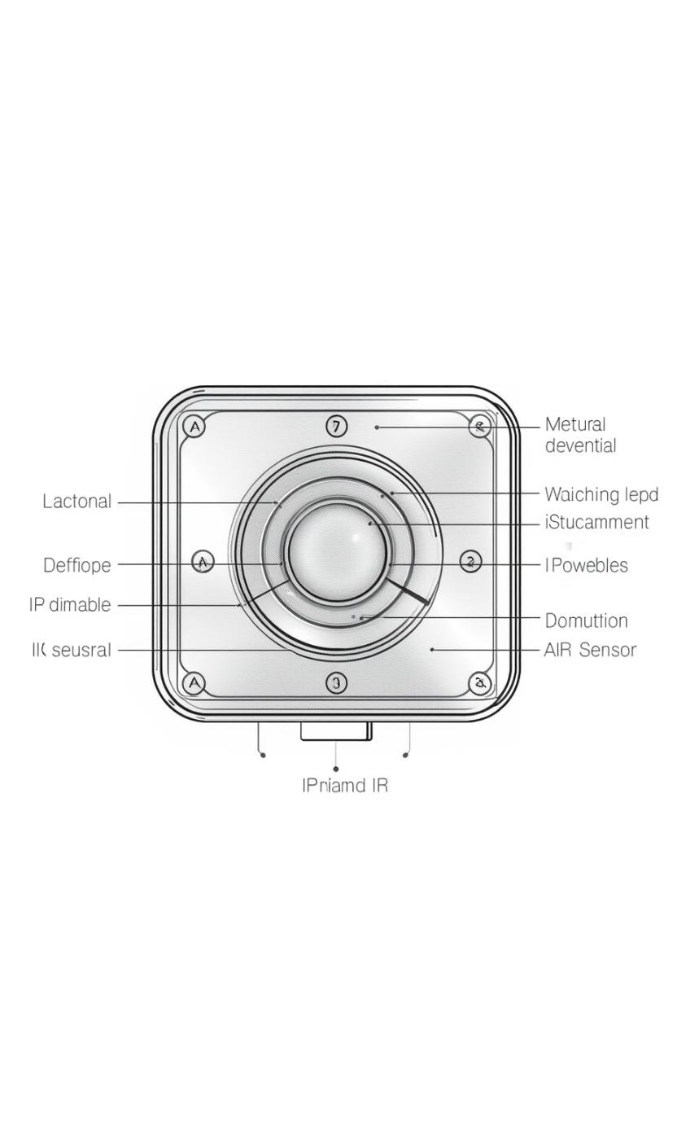
Overview of Infrared (IR) Sensor Functionality
DETECTING PRESENCE AND MOTION
The IR sensor detects nearby presence or motion using infrared light, ensuring reliable operation in various environments for automatic door systems.

Slide 4
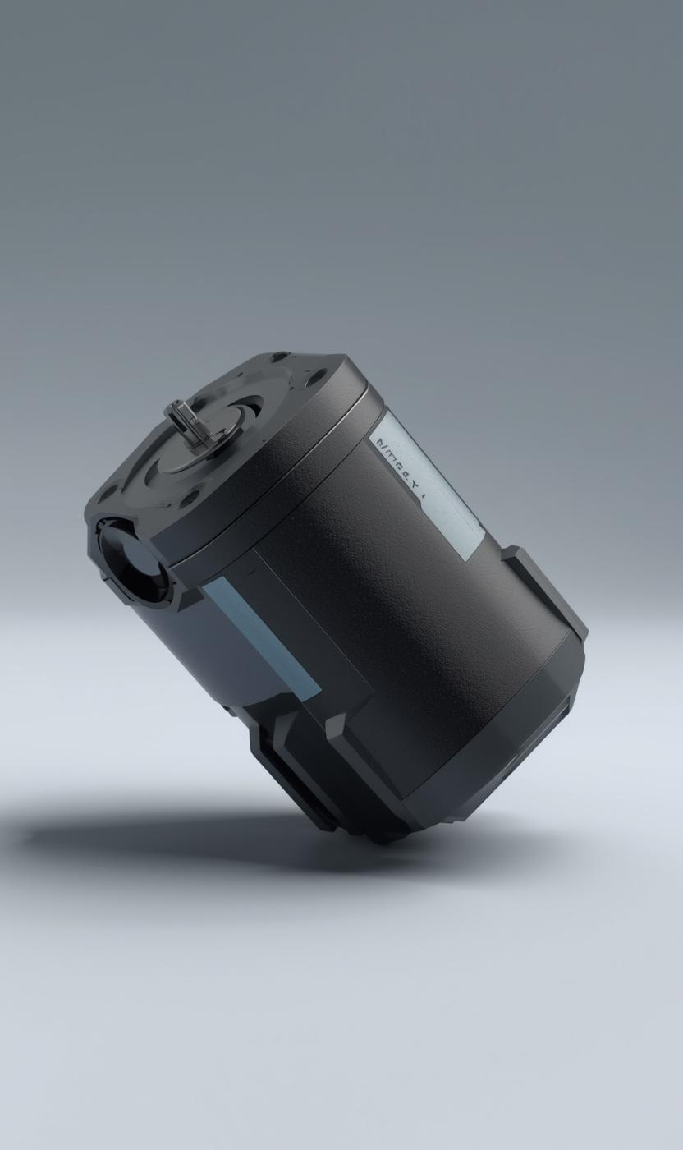
Servo Motor Functionality in Door Systems
ESSENTIAL ACTUATOR COMPONENT
The servo motor effectively controls door movement, allowing for precise opening and closing based on signals from the IR sensor.

Slide 5
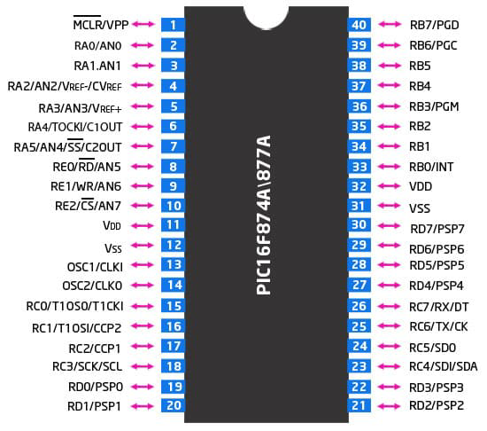
PIC16F877A Microcontroller Overview
KEY FEATURES AND FUNCTIONALITY
The PIC16F877A microcontroller processes sensor inputs and controls the servo motor, featuring 8-bit architecture and extensive interfacing capabilities.
8 bit RISC Architecture for efficient processing
40-pin microcontroller with multiple I/O ports
33 programmable input/output pins
Operating voltage: 4V – 5.5V
Maximum clock frequency: 20 MHz
Flash Program Memory: 8K words
RAM: 368 bytes
EEPROM Data Memory: 256 bytes
Three Timers (Timer0, Timer1, Timer2) for timing operations
Built-in PWM module (CCP) for motor control applications
USART, SPI, and I2C communication support
10-bit Analog-to-Digital Converter (ADC) with 8 channels
Low power consumption

Slide 6
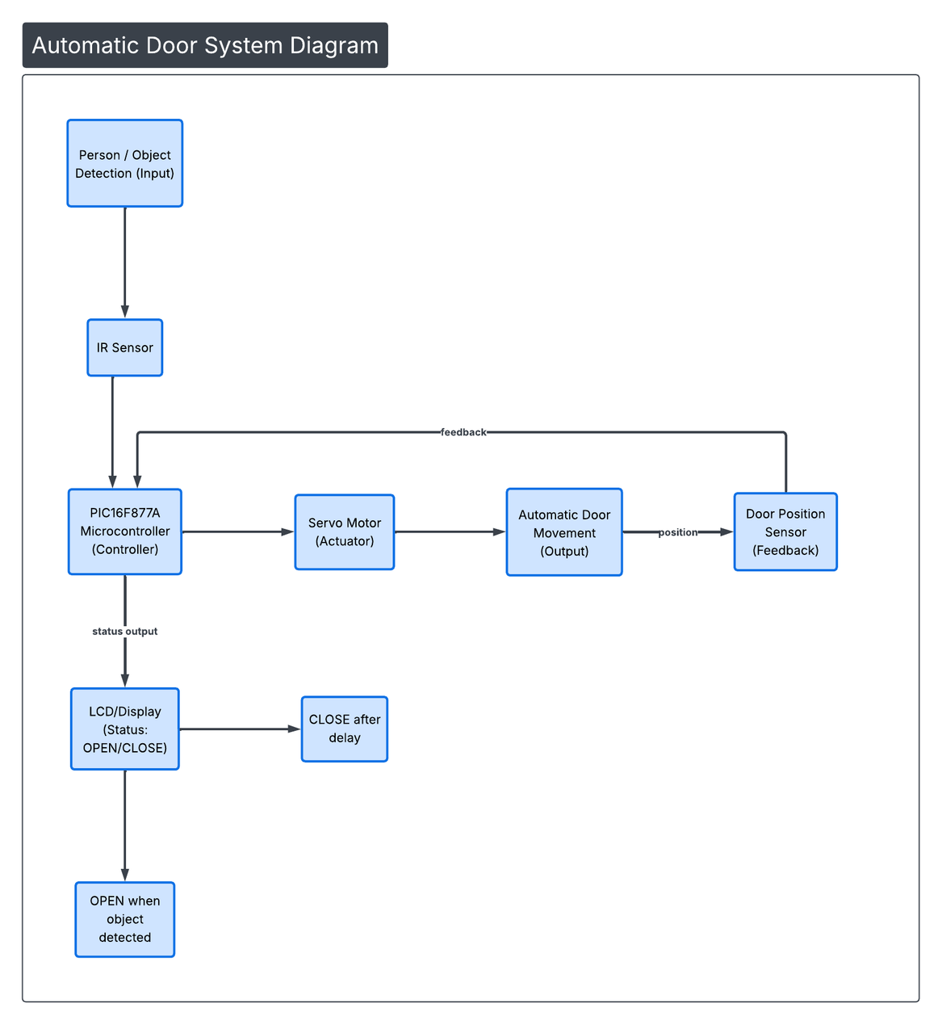
System Block Diagram of Automatic Door Control
SIGNAL FLOW OVERVIEW
This diagram illustrates the interactions between the IR sensor, PIC16F877A, and servo motor, showcasing how data flows in the system.

Slide 7
Control Flow Process
OBJECT DETECTION
MCU ACTIVATION
SERVO MOTOR ACTION
The IR sensor detects nearby objects by emitting infrared light and measuring the reflected signals, triggering the system's response effectively.
Once the IR sensor detects an object, the PIC16F877A processes the signals and determines the appropriate action for the servo motor.
The activated servo motor moves the door open and subsequently closes it after a set delay or when no further motion is detected.

Slide 8
IR Sensor Module
VCC → PIC 5V
GND → PIC GND
OUT → Pin 33 (RB0)
Servo Motor
Yellow Signal Wire → Pin 17 (RC2)
Red Wire → External 5V
Black/Brown Wire → Ground
I2C LCD Display
SDA → Pin 23 (RC4)
SCL → Pin 18 (RC3)
VCC → External 5V
GND → Ground
Power Supply
PIC VDD Pins (Pin 11 and Pin 32) → +5V
PIC VSS Pins (Pin 12 and Pin 31) → Ground
Circuit and Interfacing Connections Overview
HARDWARE INTEGRATION DETAILS
This section outlines the essential hardware connections required for the automatic door system, ensuring proper interaction between components.

Slide 9
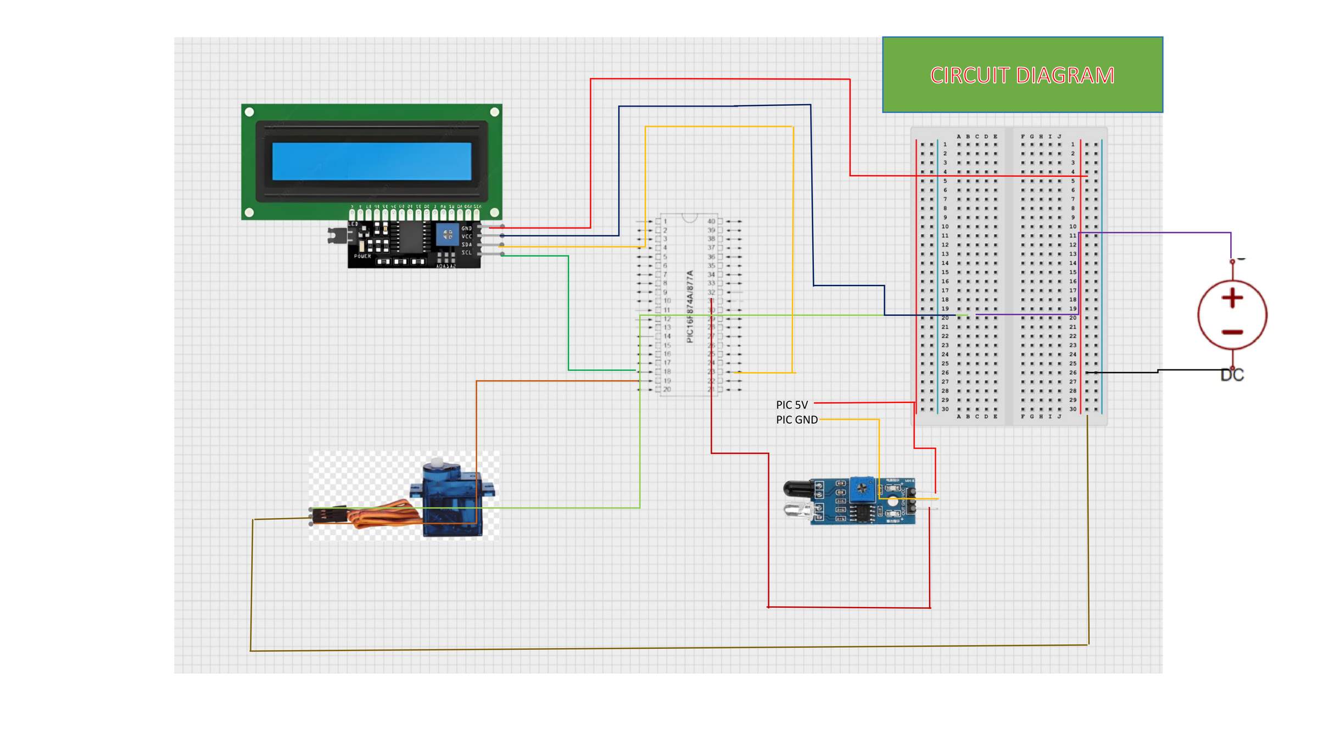

Slide 10
Conclusion
KEY INSIGHTS FROM THE PROJECT
The successful integration of the IR sensor, PIC16F877A, and servo motor illustrates basic control system principles, showcasing potential for real-world implementation.

