Slide 1


Internship Project Presentation on “Comment Toxicity Classification”
Abhinav Prasoon 1RN20IS002
Divyam Divesh 1RN20IS053
Department of Information Science and Engineering
RNS Institute of Technology
2023-24

Slide 2
CONTENTS
INTRODUCTION
OBJECTIVES
PROBLEM STATEMENT
METHEDOLOGY
RESULTS AND DEMONSTRATION
CONCLUSION
Dept. of ISE,RNSIT
2023 - 24

Slide 3
INTRODUCTION
Toxic comments are disrespectful, abusive, or unreasonable online comments that usually make other users leave a discussion. The danger of online bullying and harassment affects the free flow of thoughts by restricting the dissenting opinions of people. Sites struggle to promote discussions effectively, leading many communities to limit or close down user comments altogether. This paper will systematically examine the extent of online harrasement.The importance of maintaining civility on an online forum cannot be overstated. Cyber bullying is defined as “willful and repeated harm inflicted through the medium of electronic text.” It involves sending degrading, threatening, and/or sexually explicit messages and images to targets via web sites, blogs, instant messaging, chat rooms, e-mail, cell phones, web sites and personal online profiles. As a result, detecting and deleting poisonous communication from public forums is a vital duty that is impossible for human moderators to do.
Dept. of ISE,RNSIT
2023 - 24

Slide 4
OBJECTIVES
The goal of this project is to create a safer environment online. By detecting toxic comments on socialmedia, they can be easily reported and removed. In the long term, this would allow people to betterconnect with each other in this increasingly digital world.
PROBLEM STATEMENT
The problem at hand is the prevalence of toxic comments on online platforms. Toxic comments include hate speech, harassment, and other harmful content that can create a hostile environment, deter user engagement, and pose significant challenges for content moderation teams

Slide 5
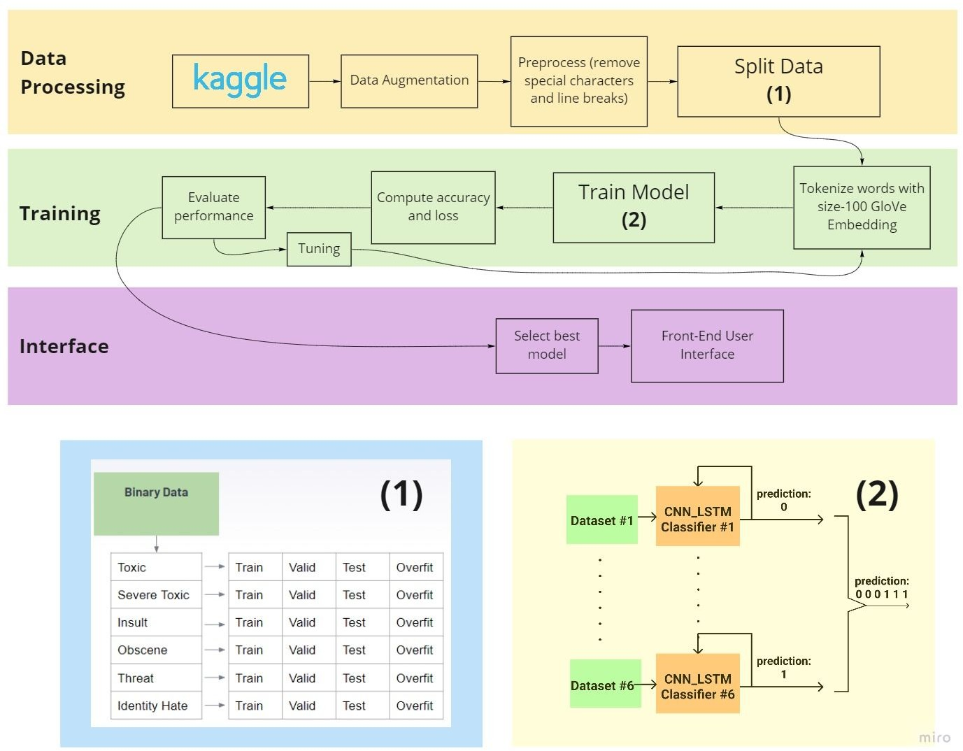
METHEDOLOGY

Slide 6
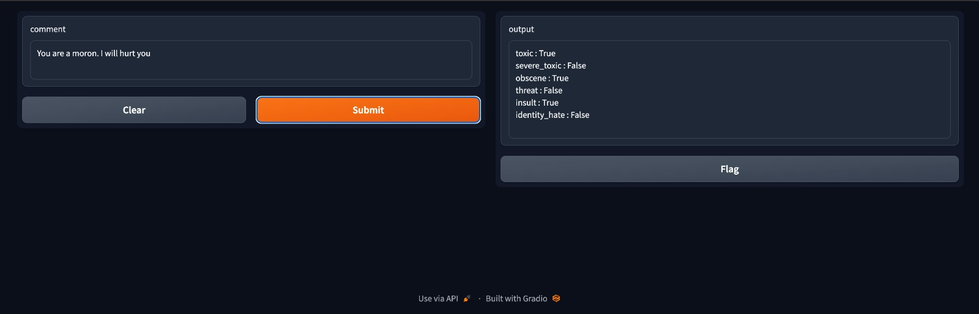
RESULTS AND DEMONSTRATION

Slide 7
CONCLUSION
To conclude, this presentation highlights the significance of addressing comment toxicity on online platforms and introduces a deep learning-based solution. We underscore the potential impact of our approach in fostering healthier online discussions and enhancing user experiences

