Slide 1
Christopher Columbus Adventure
Software Engineering (CSCI-513)
Professor Mona Rahimi
30th April 2020.

Slide 2
Objective
Implement Design Pattern
Strategy Design Pattern
Observer Design Pattern
Singleton Design Pattern
Factory Design Pattern
Composite Design Pattern
Testing
Class Diagram
Sequence Diagram

Slide 3
Christopher Columbus Adventure
The game begins with Christopher Columbus Ship (CCS), Pirate ships, the Monsters, Treasure and the Islands.
The aim of the CCS is to find the treasure with out getting caught to Pirate ships or the Monster.
The Game starts with choosing the difficulty level of game as : Easy, Normal or Hard.
The Application was created using the Java and JavaFx.
We developed the project from scratch as our previous assignment had some issues (no SOLID design).

Slide 4
Ocean Explorer
The class Ocean Explorer is the main class that launches “JavaFx” application by calling the “launch” method extended from the Application Class.
The overridden start method creates the grid, places the islands, Create Christopher Columbus Ship, Instantiate the pirate ships, Treasure and the Monsters.
It also has the methods like: addButtons(), startSailing(),loadPirates(), drawMap() and more.
The Execution Starts from this Class.
Notes:
Functionality Explain: addButtons: Normal,easy and more. Startsailing: keys evets like A,S,D,W for the directions

Slide 5
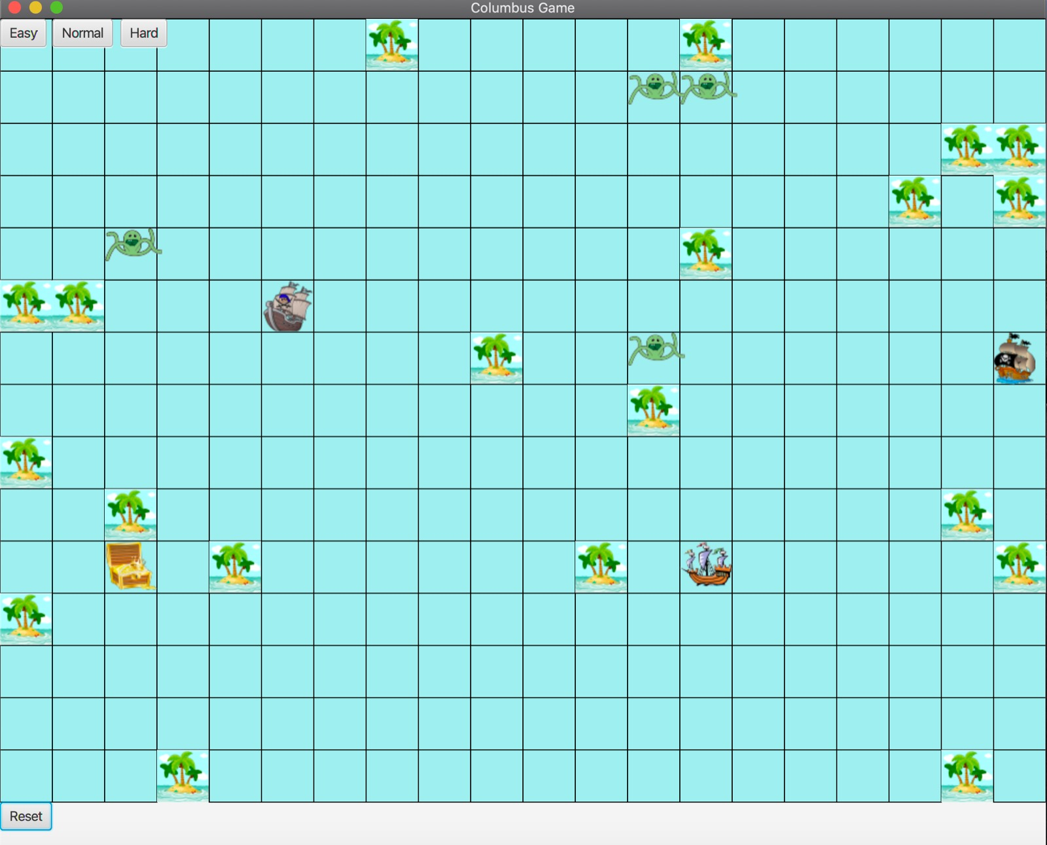
Initial Grid

Slide 6
Observer Design Pattern
Observer design is used in the program where the Columbus ship is to be observed and the pirate ships are the observers.
The Interface “Observer.Java” implements the Observer design pattern which has the update method.
This interface is implemented by the pirate ship class which also uses the update method. This update method updates the location of the Columbus ship to the pirate ships.
The Ship class implements the “Subject.Java” interface which has methods to register observer, notify observer and remove observer.
The use of Observer design pattern is to reflect the state of an object to another object.
Notes:
To notify the pirate ship if there is any moment of the CCS. We did not use the random function

Slide 7
Singleton Design Pattern
The Class “singletonMap” implements the singleton design pattern.
This class creates the map grid (20*15) and is responsible for placing the islands and returning the coordinates.
We can access the map grid from any class without any object passing.
Notes:
singleton pattern restricts the instantiation of a class to one "single" instance. Clears the map, locates the islands. Mainly used when only object is needed to run throught the system.

Slide 8
Factory Method Design Pattern
The Class “pirateFactory” implements the Factory Method design pattern.
The “createPirate” method in the “pirateFactory” class is used to create the pirateships.
The Factory method suggest that you replace direct object construction calls by using the factory method as used in the “OceanExplore” class
Notes:
Example: Transportation: Road and Sea Transportation relate to normal and abnormal pirate ships in the Pirate Factory. Save system resources by reusing exsisting objects instead of rebuilding them.

Slide 9
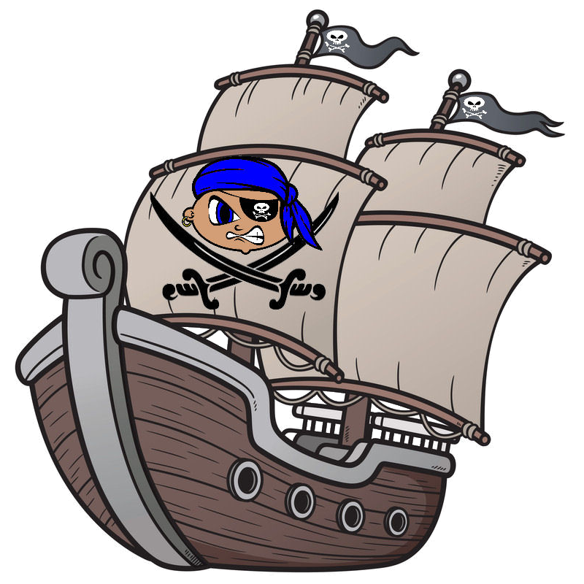

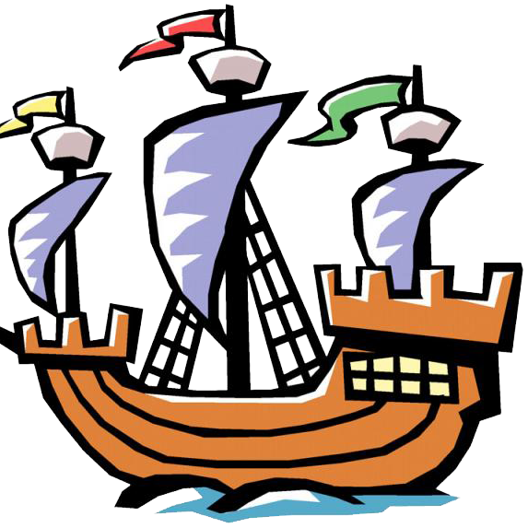
Sample Images Created from Singleton and Factory method

Slide 10
Strategy Design Pattern
The interface “MoveStrategy” implements Strategy design pattern.
The methods “movePirateShip” and “getStrategy” are the methods in the interface used to move the pirate ship to the CCS location and the “getStrategy” is used to know the difficulty level of the game.
The “getStrategy” method is updated in the EasyMove, NormalMove, HardMove classes.
Notes:
movePirate: takes arguments current and ship locations. The strategy pattern is used to where you want to choose the algorithm at run time.

Slide 11
Composite Design Pattern
The interface “AreaorMonster” implements the Composite Design Pattern.
The Classes “Area” and “Monster” implements the Interface and use the methods like move(), addChildren(), getX() for the use of the their own. It aim is to comopse objects into tree structures to represent part-whole hierarchies.
Here the Composite is ”AreaorMonster” and leafs are: “Area” ,“ Monster” .
Notes:
pattern describes a group of objects that are treated the same way as a single instance of the same type of object. The intent of a composite is to "compose" objects into tree structures to represent part-whole hierarchies.

Slide 12
Junit Testing:
We had Junit testing for two classes.
The first test case was to see the generated map, OceanMapTest.
In this we test if we could get the map and the dimensions.
The second test case is to see the ship movement, shiptest.
In this we test to see if the ship movement is same as what we wanted and the ship image is updated on the map.

Slide 13
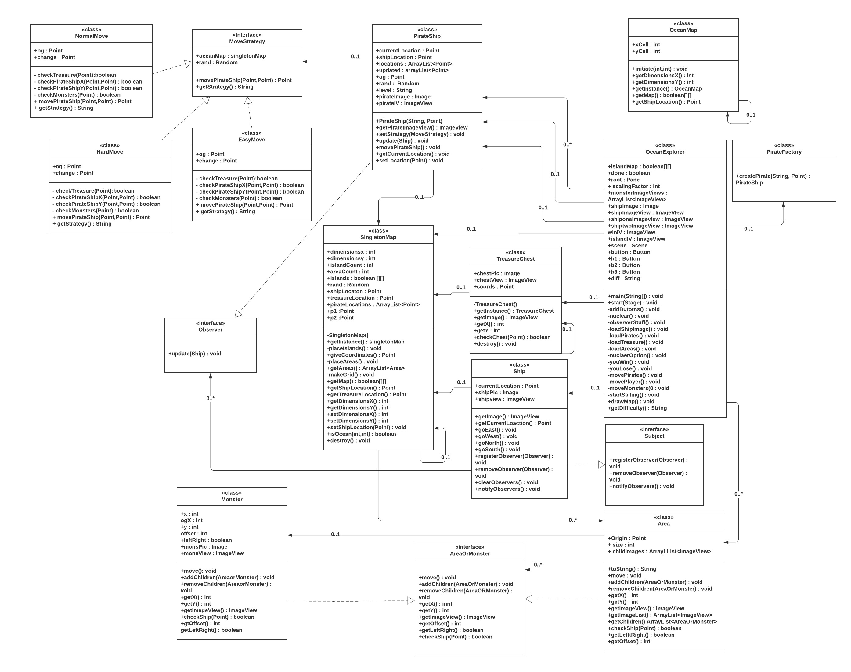
UML CASE DIAGRAM

Slide 14
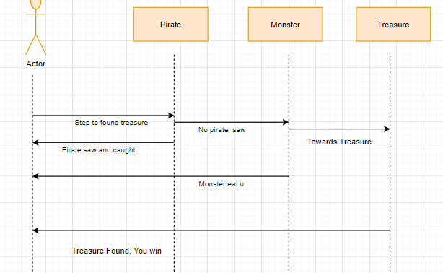
UML SEQUENCE DIAGRAM

Slide 15
Work done by individual
Abhinav implemented the observer design pattern which includes the oceanexplorer class, oceanMap class, observer interface, subject interface, ship and the pirate ship classes. Also implemented the sequence diagram and did the documentation.
Anurag implemented the Singleton, the Factory design pattern’s which includes singleton map class and the pirate factory class. Also implemented two strategies (Normal class and Hard class) and ocean explorer class.
Aravind implemented the strategy and composite design pattern which includes Movestrategy class, Monster class, Area class and AreaorMonster interface. Also implemented other one strategies (Easy class).
Pooja implemented the Testing which includes the shiptest class and oceanmaptest class. Also implemented treasurechest class and UML.

Slide 16
Thank You
Abhinav Reddy Gopidi (Z1862225)
Anurag Gudipati (Z1862977)
Venkata Aravind Puppala (Z1859953)
Pooja Reddy Poddutoori (Z1888584)

