Slide 1
NOVA Executive Briefing
Sovereign AI Performance & Analytics

Slide 2
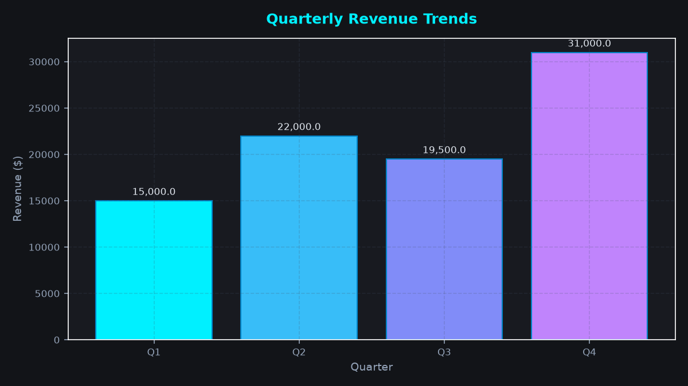
System Performance
• 100% On-Premise Execution
• Zero Cloud Dependency
• Deterministic Tool Verification

