Slide 1
NOVA / PRESENTATION
AI in Industrial Automation
Revolutionizing Manufacturing Processes
LOCAL • SECURE • AGENTIC • MULTIMODAL
NOVA / SOVEREIGN INDUSTRIAL INTELLIGENCE
01

Slide 2
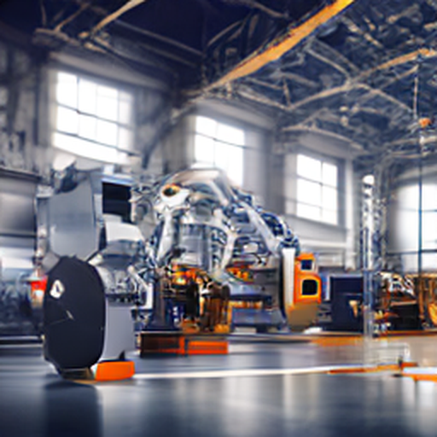
/// EXECUTIVE SUMMARY
Introduction to AI in Industrial Automation
1
2
3
Overview of AI and its role in industrial automation
Historical context and current trends
Key benefits of integrating AI into manufacturing
NOVA / SOVEREIGN INDUSTRIAL INTELLIGENCE
02

Slide 3
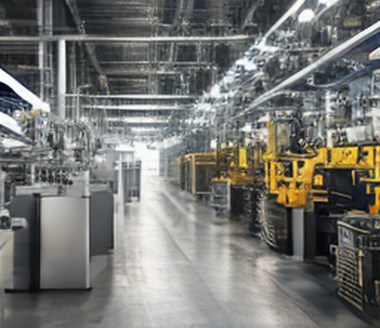
/// SECTION 02
AI Technologies for Industrial Automation
KEY INSIGHTS
◆Machine Learning Algorithms (Supervised, Unsupervised)
◆Deep Learning Models (Convolutional Neural Networks, Recurrent Neural Networks)
◆Natural Language Processing (NLP) for Process Optimization
LOCAL VISUAL ASSET / TOPIC MATCHED
NOVA / SOVEREIGN INDUSTRIAL INTELLIGENCE
03

Slide 4
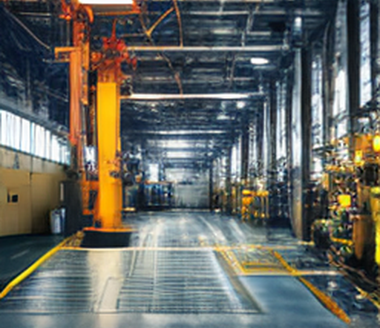
/// SECTION 03
Applications of AI in Manufacturing
KEY INSIGHTS
◆Predictive Maintenance and Equipment Health Monitoring
◆Supply Chain Optimization and Inventory Management
◆Process Optimization and Quality Control
LOCAL VISUAL ASSET / TOPIC MATCHED
NOVA / SOVEREIGN INDUSTRIAL INTELLIGENCE
04

Slide 5
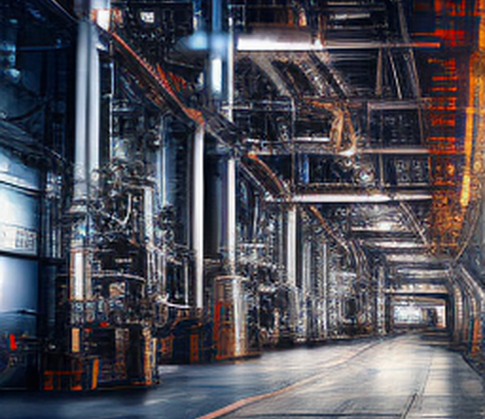
/// SECTION 04
Implementing AI in Industrial Automation
KEY INSIGHTS
◆Integration with Existing Systems (PLC, SCADA)
◆Data Collection and Storage Solutions
◆Scalability and Security Considerations
LOCAL VISUAL ASSET / TOPIC MATCHED
NOVA / SOVEREIGN INDUSTRIAL INTELLIGENCE
05

Slide 6
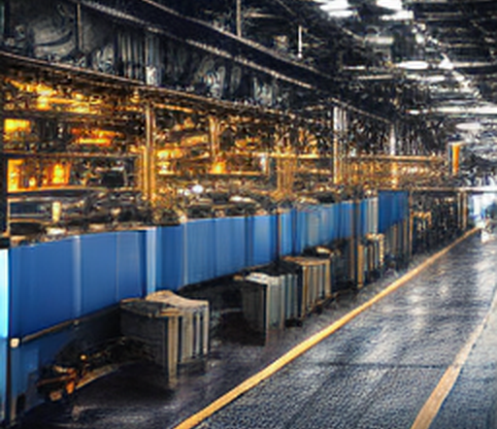
/// SECTION 05
Challenges in Implementing AI in Industrial Automation
KEY INSIGHTS
◆Data Quality and Privacy Concerns
◆Interoperability Issues with Existing Systems
◆Cost-Effectiveness of AI Solutions
LOCAL VISUAL ASSET / TOPIC MATCHED
NOVA / SOVEREIGN INDUSTRIAL INTELLIGENCE
06

Slide 7
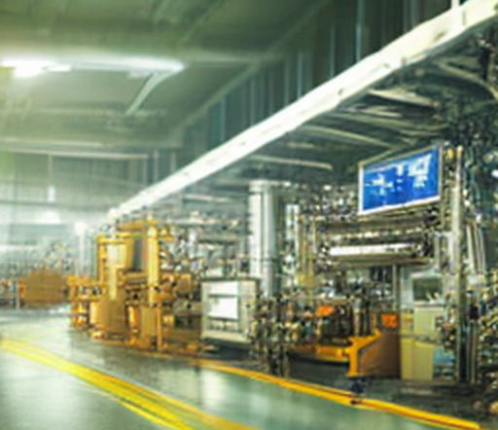
/// SECTION 06
Future Trends in AI for Industrial Automation
KEY INSIGHTS
◆Edge Computing and Real-Time Processing
◆AI-driven Decision Support Systems
◆Integration with IoT Devices
LOCAL VISUAL ASSET / TOPIC MATCHED
NOVA / SOVEREIGN INDUSTRIAL INTELLIGENCE
07

Slide 8
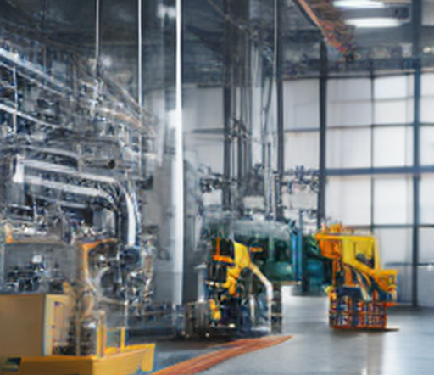
/// SECTION 07
Conclusion: The Future of AI in Manufacturing
KEY INSIGHTS
◆AI as a Game-Changer in Industrial Automation
◆Strategic Planning for AI Adoption in Manufacturing
◆Continuous Learning and Adaptation in the Industry
LOCAL VISUAL ASSET / TOPIC MATCHED
NOVA / SOVEREIGN INDUSTRIAL INTELLIGENCE
08

