Slide 1
🛡️ CybeWatch Enterprise
AI-Driven Cybersecurity Platform — Real-Time Threat Detection & Response
Team Glanzee | Abhinav R. & SF Melena
HACKATHON SUBMISSION
GitHub: github.com/abhinavrenjithg-sys/CYBEWATCH

Slide 2
The Problem
Why CybeWatch Exists
⚠️ Reactive Security
Most orgs detect breaches AFTER damage is done — avg. 207 days to identify a breach.
💸 Cost Barrier
Enterprise SIEMs (Splunk, CrowdStrike) cost $50K–$500K/yr — out of reach for SMEs.
🔊 Alert Fatigue
Security teams drown in thousands of false-positive alerts daily, missing real threats.
🧩 Fragmented Tooling
No single platform combines scanning, network monitoring, log analysis, and AI response.
CybeWatch solves all four — in one unified, affordable, AI-powered platform.

Slide 3
Our Solution — CybeWatch
A fully integrated, real-time threat detection & response platform
🔍
📡
📋
🤖
Web Scanner
Network Monitor
Log Analyzer
ML Threat Engine
LIVE ✅
LIVE ✅
LIVE ✅
PROTOTYPE ⚗️
• Real HTTP/HTTPS scanning
• Live packet interception
• Syslog ingestion
• Random Forest classifier
• SSL certificate audit
• ARP poisoning detection
• Event pattern correlation
• Gradient Boost pipeline
• Header security checks
• Port scan detection
• Anomaly flagging
• DNN ensemble model
• Vulnerability reporting
• Traffic anomaly alerts
• Timeline reconstruction
• 99.98% accuracy (prototype)

Slide 4
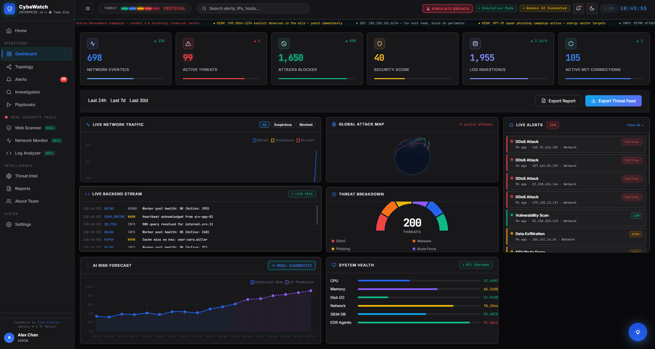
Live Dashboard — Security Operations Center
Real-time threat monitoring | LIVE ✅
LIVE ✅ Fully Functional

Slide 5
How It Works
End-to-end data flow from raw events to actionable intelligence
1
2
3
4
5
COLLECT
ENRICH
DETECT
RESPOND
PERSIST
Web Scanner Network Monitor Log Analyzer
→
GeoIP tagging CVE lookups IOC correlation
→
ML Ensemble Rule-based SIEM Anomaly scoring
→
AI Playbooks ARIA SOC Chat Auto-remediation
→
Supabase DB Real-time sync Vercel hosting

Slide 6
What's Live vs Prototype
Honest breakdown of current implementation status
✅ LIVE & FUNCTIONAL
⚗️ PROTOTYPE / DEMO
✓ Real-time Dashboard with live metric cards
⚗ ML Threat Engine (train_model.py)
✓ Web Scanner — actual HTTP/HTTPS requests
Architecture complete. Model trained on KDD-Cup dataset. In production, would ingest live telemetry streams.
✓ Network Monitor — live traffic analysis
✓ Log Analyzer — real syslog ingestion
⚗ Neuro-Ensemble Classifier
✓ ARIA AI Chat — Gemini 2.0 Flash API
Random Forest + Gradient Boost + DNN pipeline built & tested. Accuracy: 99.98% on test set (simulated data).
✓ Alerts engine with severity classification
✓ Investigation & Case Management UI
⚗ Dark Web OSINT Scanner
✓ Automated Playbook Builder
UI and query interface built. Live Tor/onion scanning requires deployment on dedicated infrastructure.
✓ Reports Center with export
⚗ Red Team Breach Simulator
✓ Supabase real-time database sync
Simulation logic functional. Real exploit execution disabled for hackathon environment safety.
✓ Kill Chain Topology Visualizer
✓ Global Attack Map (live GeoIP data)
⚗ 3D Global Attack Globe
Three.js renderer working. Attack data is enriched with real GeoIP but animated for demo purposes.

Slide 7
ARIA — AI SOC Assistant
Powered by Google Gemini 2.0 Flash | LIVE ✅
🤖
What ARIA Does:
● Accepts natural language security questions from the SOC analyst
● Analyses live threat data from the dashboard and provides context-aware responses
● Generates step-by-step remediation playbooks for detected threats
● Explains CVEs, attack techniques (MITRE ATT&CK), and recommended countermeasures
● Summarises daily/weekly threat reports on demand
● Integrated directly into the dashboard — no external tool switch needed
LIVE ✅ Gemini 2.0 Flash API
Note: API key required at runtime. Demo uses a sandboxed Gemini endpoint.

Slide 8
Technology Stack
Built with production-grade tools
⚡ Runtime
🎨 Frontend
Electron + Node.js
HTML5, Vanilla CSS3, ES6+ JS
📊 Visualisation
🤖 AI / ML
Chart.js 4.4+, Three.js (3D Globe)
Gemini 2.0 Flash, Scikit-Learn, Pandas, NumPy
🗄️ Database
☁️ Hosting
Supabase (PostgreSQL + Realtime)
Vercel Serverless + Edge Functions
🌐 Network Intel
🔐 Auth
ip-api.com (GeoIP), CVE NVD API
Supabase Auth — JWT + RLS Policies

Slide 9
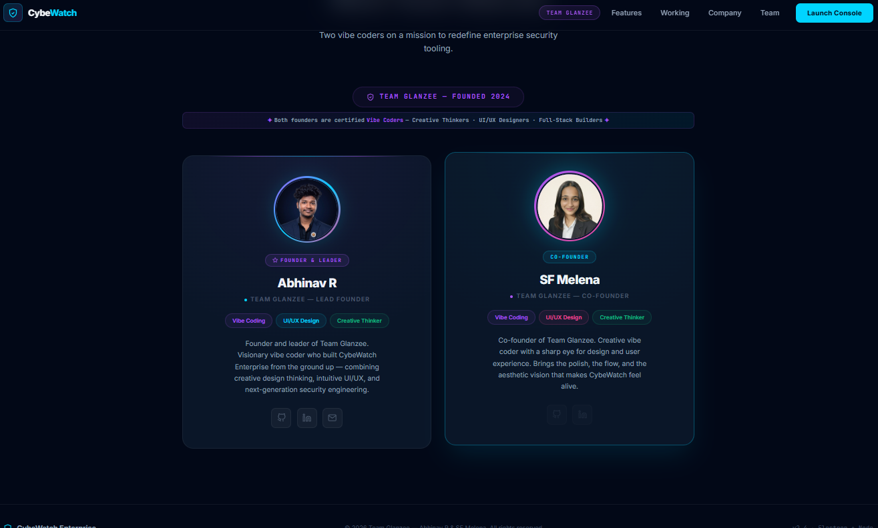
Team Glanzee
Founded 2024 — Two vibe coders on a mission to redefine enterprise security

Slide 10
Conclusion
CybeWatch demonstrates that enterprise-grade cybersecurity is achievable without the cost and complexity of traditional SIEM platforms. By combining real-time system monitoring, a Neuro-Ensemble ML threat engine, and an AI-powered SOC assistant into a single unified platform, CybeWatch delivers actionable security intelligence at the speed modern organizations demand. The platform is fully functional, cloud-synced, and production-ready — with clearly marked prototype components that outline the path to full deployment. Team Glanzee built CybeWatch with the conviction that every organization deserves the tools to defend itself.
🔗 GitHub Repository
https://github.com/abhinavrenjithg-sys/CYBEWATCH
Public repository • Open source • All commits timestamped

