Slide 1
Natural language processing
Term project : Fact and Opinion Classification Group : 19
Team members- Somrup Abhinav (13IE10030) Shubham Anum

Slide 2
Facts and Opinion Classification of News Articles
Here we attempt to distinguish entire articles as reporting news/fact or expressing opinion.
A fact is considered something proven to be true and An opinion is a personal belief that is not founded on proof or certainity.
We also try to give a percentage of opinon in the article.

Slide 3
Training Data
Data was collected from the news articles of Guardian from the domains of sports ,technology ,lifestyle ,politics etc.
Sentences from the news articles were classified into opinions and facts manually.
Then the opinions were classified into subcategories of Reporting, Judgement, Advise and Sentiment.

Slide 4
Features
acomp – Adjectivial complement
advcl- Adverbial clause
amod: adjectival modifier
cc: coordination
ccomp: clausal complement
Presence of root verb
Number of nouns
Presence of strong and weak words
Presence of number

Slide 5
Features
Examples : She looks very beautiful
Looks -> beautiful: Adjectivial complements
She looks very beautiful : opinion
The presence of adjectivial complements tend to denote opinions
Similarly the presence of strong and weak adjectives signifies an opinion and
Presence of numbers indicate facts

Slide 6
Feature Extraction
Stanford POS tagger was used to extract the number of nouns and pronouns used in the text
Stanford Dependency parser was used to extract the dependencies
All the features were stored in a csv file and then used in machine learning

Slide 7
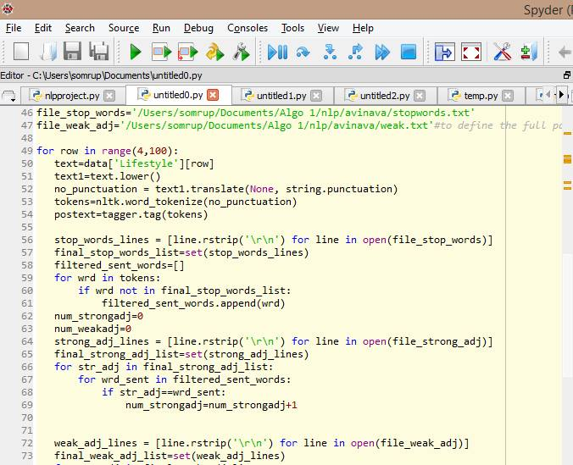
Snippets for feature extraction

Slide 8
Machine Learning
Out of the nearly a thousand sentences whose features could be extracted from POS tagger and the dependency parsers, we take approximately 70% of the dataset for training our model.
The remaining 30% was used to test the model.
The model used for training was logistic regression using eXtreme Gradient Boosting.

Slide 9
XGB Model
Parameters of the xgboost were set as follows :
Objective : “reg:logistic”, other approaches such as “multi:softprob” were tried as well.
Eval_Metric : “merror” identifies the rate of mis classification
Min child weight : 4
Max_depth : 10
The total number of trees used for boosting = 1000.

Slide 10
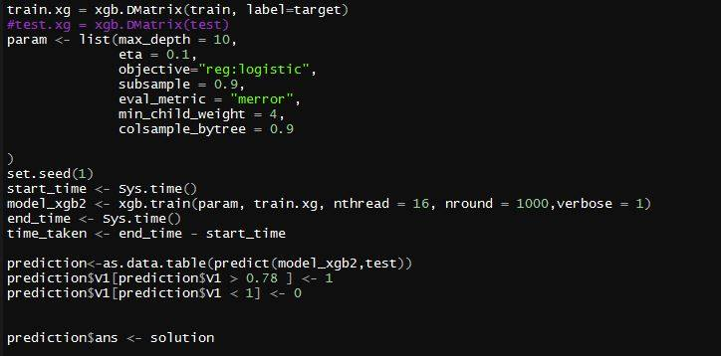
Snippet for ML

Slide 11
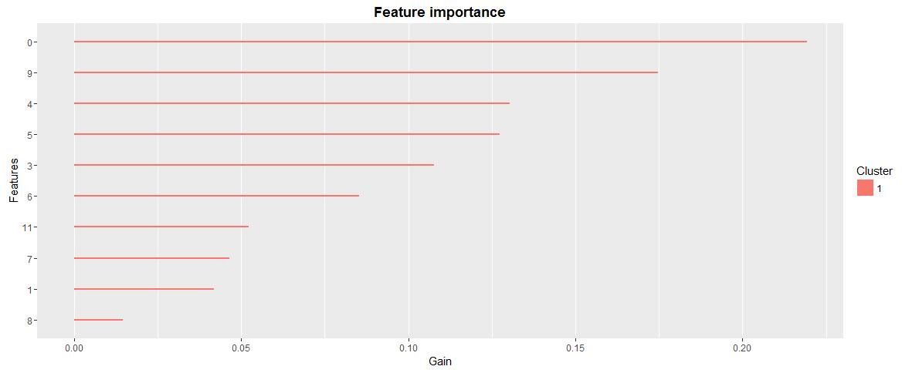
Variable Importance
Below graph shows the feature importance plot ; the most important features being number of strong adjectives, number of numeric ordinals, number of adverb modifier and number of adverb clause modifier respectively.

Slide 12
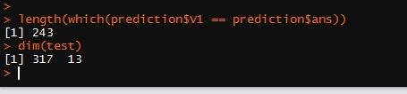
Results
From testing dataset of 317 sentences, the logistic regression model correctly identifies 243 of the sentences, thereby giving an accuracy of nearly 77.91%

Slide 13
THANK YOU

