Slide 1
P R O M P T E N G I N E E R I N G C A S E S T U D Y
Syntactic Intelligence
Engineering Prompt Variations to Drive Multi-Functional AI Behaviors
System: Flask Framework | Core LLM: Llama-3.1-8B NIM API | Design: Flat Corporate Minimalist

Slide 2
01. INTRODUCTION
Overview & Prompt Strategy
Educational Focus
This project aims to enhance students' capabilities to formulate systemic prompts that inspire structured thinking, logical evaluation, and entrepreneurial creativity.
By comparing response outputs side-by-side, developers learn to design constraints (length, specificity, output format) that yield optimal business and creative utility.
Expected Outcomes
• A collection of highly structured prompt variations that yield unique, actionable AI outputs.
• Demonstrated understanding of tone, complexity, and format control through system instructions.
• An active feedback loop that stores and logs rating statistics to drive systematic prompt optimization.
• A highly intuitive, developer-centric single page web workspace.

Slide 3
02. TECHNOLOGY STACK
System Architecture & Execution Flow
01
02
03
Backend Flow
FLASK CORE
• Handles endpoint routing securely.
• Assembles dynamic prompt messages.
• Pipeline endpoints: /, /generate, /feedback.
AI Model Pipeline
NVIDIA NIM
• Model: Llama-3.1-8B-Instruct.
• Maintains 9 separate configurations.
• Requests-based chat completion endpoint.
Data Metrics
CSV DATABASE
• Records logs in feedback_log.csv.
• Thread-locked structure to ensure safety.
• Dashboard: aggregates analytics at runtime.

Slide 4
03.A FUNCTION DETAILS
1. Function: Answer Questions
SYSTEM ROLE & CONTEXT: You are a knowledgeable AI assistant specialized in answering questions accurately. Provide clear, well-structured answers.
Provides specialized guidance to Llama-3.1 before formatting the user queries.
Short Factual
PROMPT TEMPLATE
"Answer briefly and factually: {input}"
PROMPT STRATEGY
Restricts response length. Eliminates preambles, focusing solely on core, direct facts.
Detailed Explainer
PROMPT TEMPLATE
"Explain in detail with context and examples: {input}"
PROMPT STRATEGY
Instructs Llama-3.1 to generate fully fleshed-out contextual write-ups with use cases.
Bullet-Point Facts
PROMPT TEMPLATE
"Give me 3 concise facts about: {input}"
PROMPT STRATEGY
Strict structural layout constraint. Limits the output to exactly 3 high-contrast facts.

Slide 5
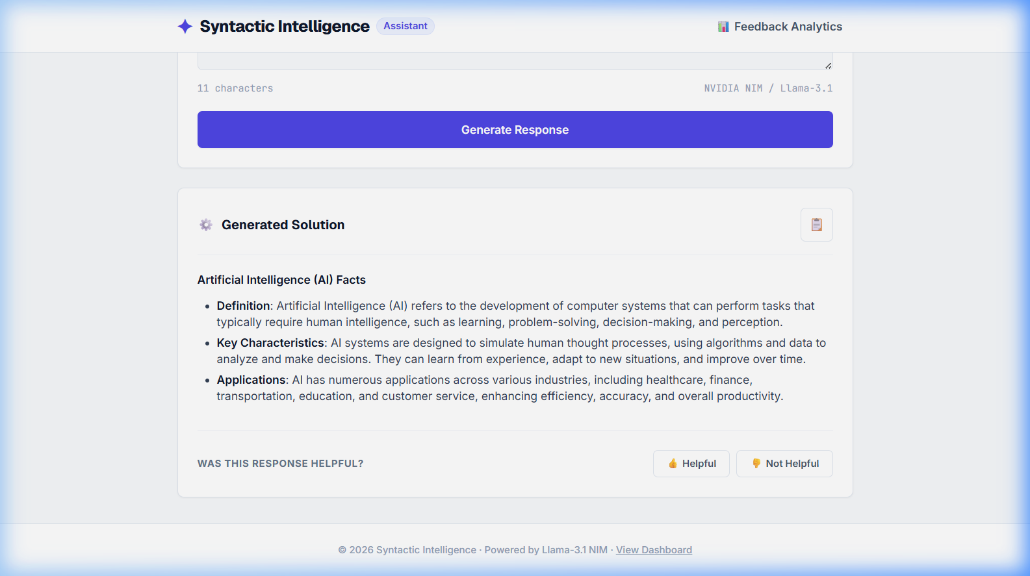
03.A RESPONSE INTERFACE
Q&A System Response Interface Mockup
Interface Details
• Query Input: User asks 'what is ai' under the Answer Questions workspace.
• Prompt Style: 'Bullet-Point Facts' dropdown is selected.
• AI Output: Llama-3.1 renders 3 concise facts structured under sub-headers.
• Interactive Action: Copy clipboard and helpful feedback controls log seamlessly.

Slide 6
03.B FUNCTION DETAILS
2. Function: Summarize Text
SYSTEM ROLE & CONTEXT: You are an expert text summarizer. Distill the provided content into its most essential points while preserving key meaning.
Provides specialized guidance to Llama-3.1 before formatting the user queries.
One-Paragraph
PROMPT TEMPLATE
"Summarize the following text in one paragraph: {input}"
PROMPT STRATEGY
Aggregates lengthy passages into a single cohesive synthesis block, optimized for quick scanning.
Key Points List
PROMPT TEMPLATE
"Extract the main points of this text as a bulleted list: {input}"
PROMPT STRATEGY
Structures key topics as clear bullet lists, improving legibility of dense reports.
Executive Brief
PROMPT TEMPLATE
"Provide a brief executive overview (2-3 sentences) of this document: {input}"
PROMPT STRATEGY
Generates hyper-condensed high-level summaries for fast management assessments.

Slide 7
03.C FUNCTION DETAILS
3. Function: Generate Creative Content
SYSTEM ROLE & CONTEXT: You are a creative writing assistant with a flair for vivid imagery and engaging narratives. Produce original, compelling content.
Provides specialized guidance to Llama-3.1 before formatting the user queries.
Short Story
PROMPT TEMPLATE
"Write a short story (under 300 words) about: {input}"
PROMPT STRATEGY
Tests narrative development capabilities while enforcing a strict parameter length constraint.
Poem
PROMPT TEMPLATE
"Write a poem in a creative tone about: {input}"
PROMPT STRATEGY
Directs the AI model to express metaphors, rhythm, and artistic structures for creative tasks.
Idea Generator
PROMPT TEMPLATE
"Generate 3 creative concept ideas for a story/essay about: {input}"
PROMPT STRATEGY
Enables ideation brainstorming, producing three unique business/creative outlines.

Slide 8
04. OPTIMIZATION
Feedback Loop & Analytics Dashboard
Interactive Feedback Mechanism
• Inline Rating: 👍 Helpful / 👎 Not Helpful buttons appear dynamically immediately beneath each generated response block.
• Asynchronous AJAX: Submit ratings immediately without page reloading to maximize user convenience.
• Logged Columns: Records timestamp, active function, selected style variation, truncated input prompt, LLM response, and feedback rating.
Evaluation & Prompt Iteration
• Aggregate Dashboard: The /feedback-summary route calculates approval ratings across the 9 prompts dynamically.
• Empirical Alignment: Visual statistics highlight which prompt styles meet target audience needs.
• Prompt Tuning cycle: Provides the datasets required for students to systematically refine system templates.

Slide 9
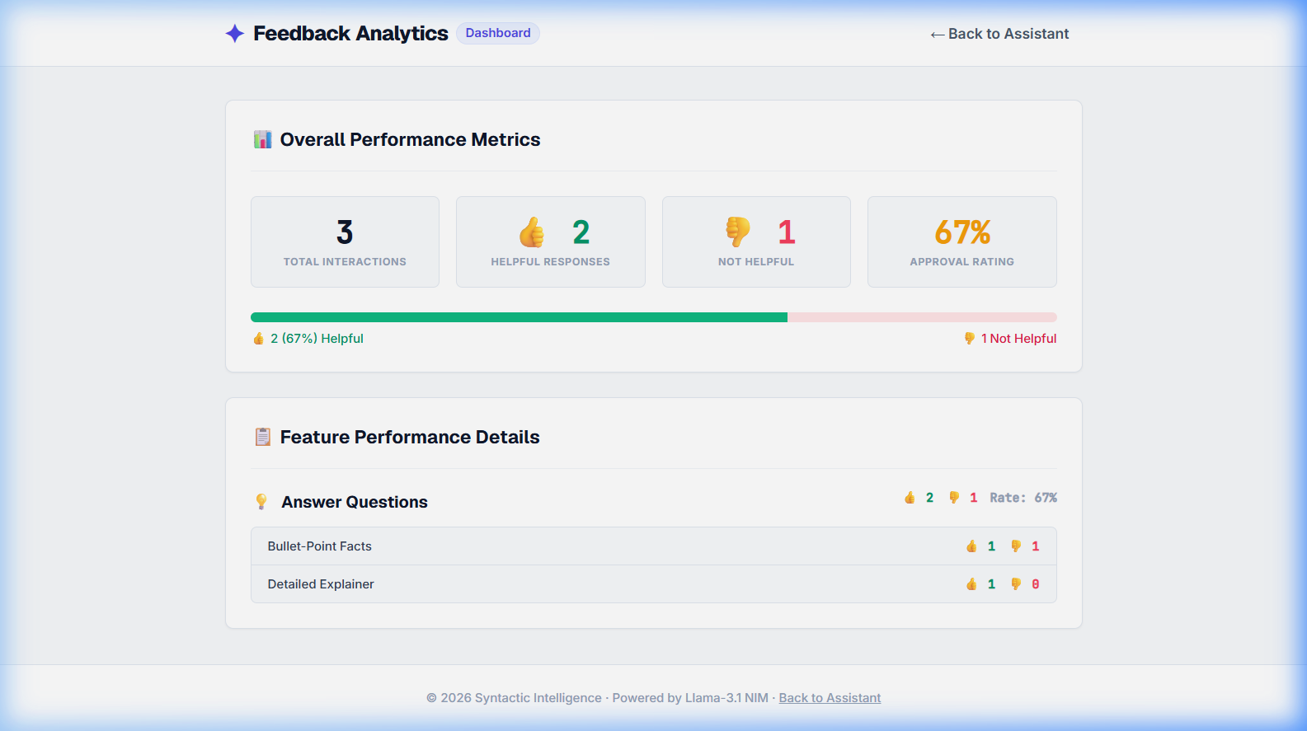
04.B SUMMARY INTERFACE
Feedback Summary & Analytics Dashboard Mockup
Analytics Panel
• Approval Aggregates: Displays total user ratings, helpful count, and satisfaction rates.
• Visual Metrics: A dynamic progress bar indicating satisfied vs dissatisfied ratios.
• Sub-Breakdowns: Tabulates thumbs up/down results for all 9 prompt styles individually.
• Real-time Updates: Refreshes dynamically as user feedback is logged to CSV.

