Slide 1
RiskPulse
An AI/NLP risk engine that turns news and social chatter into tradeable and stress-testable risk signals
Madapati Naga Durga Abhinav Sai
VIT-AP University
S&P Global & Crisil Campus Hackathon 2026

Slide 2
Problem & approach
Markets move on text long before it shows up in prices or ratings
The problem
- Thousands of headlines and posts per hour; analysts can't read them all
- Unstructured text can't feed a model, a limit or a dashboard
- Risk teams find out about the shock after the P&L does
My approach
- One engine, many sources: normalise every feed into a Document
- Score each document on 3 axes: sentiment (-1..1), event type, impact (1-10)
- Publish signals on a bus (JSONL + REST + pub/sub)
- Two consumers prove the signals are usable: a tactical index rebalancer and an event-driven stress tester

Slide 3
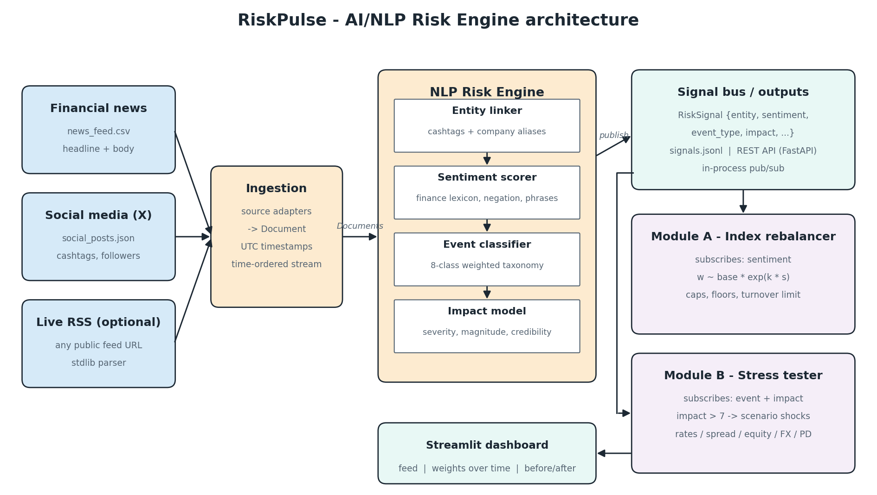
System design
Ingestion -> NLP engine -> signal bus -> downstream modules -> dashboard

Slide 4
Implementation highlights
NLP engine (pure Python, explainable)
- Finance lexicon (~250 terms + phrases): 'crushed it' is positive, 'higher for longer' negative, 'liability' isn't
- Negation window, intensifiers, emoji, cashtag linking
- 8-class event taxonomy with weighted triggers + confidence
- Impact = base severity + tone + magnitude ('7%', '$16bn') + shock words + breadth + source credibility (follower-weighted)
- Pluggable FinBERT backend for sentiment
Downstream modules
- A: w ~ base * exp(k * EWMA sentiment), floors/caps, 10% turnover limit
- B: 20-trade synthetic wholesale book (loans, bonds, swaps, CDS, equity)
- Sensitivity-based revaluation: duration, spread duration, delta, FX, PD x LGD
- Scenario picked by event type, scaled by impact; cooldown de-dupes news + social
Stack: Python, pandas, FastAPI, Streamlit, Plotly, pytest (24 tests)

Slide 5
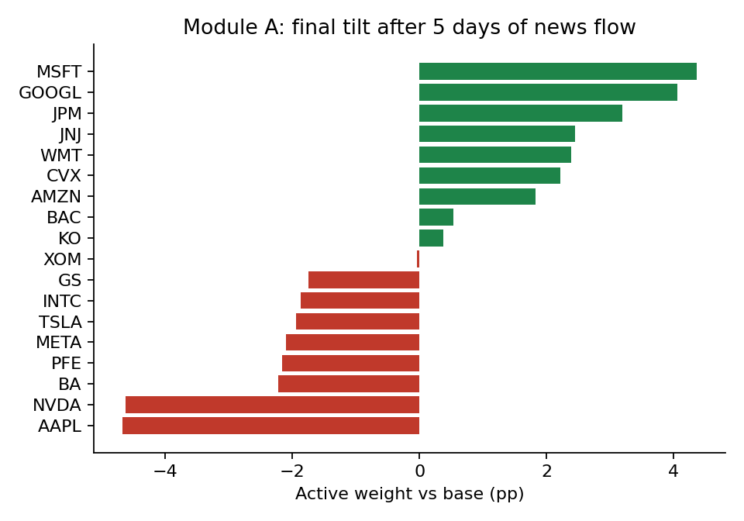
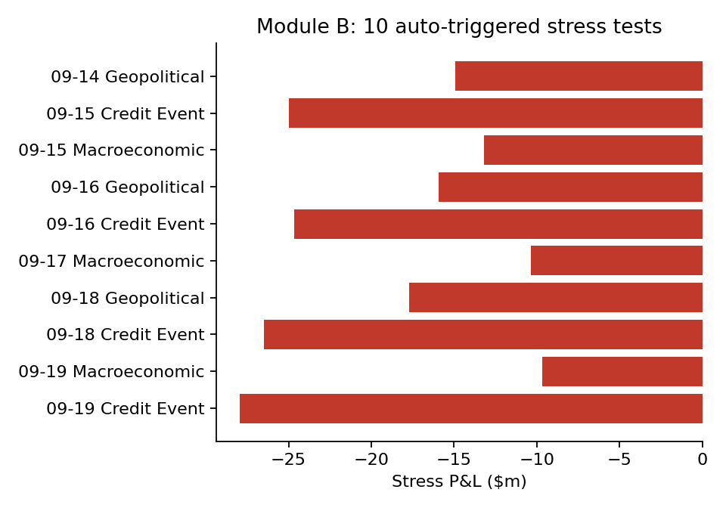
Key results
60 documents -> 68 signals, 19 high-impact, 10 stress tests, 46 rebalances
Worst case: 'Sovereign downgraded as fiscal deficit widens' -> -28.0m (-9.9%) on a $283m book. Index turnover 68% over the window vs 0% for a static index.

Slide 6
Domain impact
Why this matters for a bank or an index provider
- Early warning: a credit event in the news triggers a portfolio revaluation in seconds, not at the next daily risk run
- Explainability: every score comes with the words that drove it - auditable for model risk
- One signal, many consumers: the same feed powers trading tilts, limit monitoring and scenario analysis
- Analyst leverage: a desk watching 18 names and 60 stories sees one ranked feed
- Scales out: swap the CSV adapters for Kafka / vendor APIs without touching the engine

Slide 7
Limitations & next steps
Assumptions / gaps
- Lexicon tuned on a small synthetic sample
- First-order (linear) revaluation; no convexity or optionality
- Scenario library is hand-calibrated, not historical
- Entity linking limited to an alias table
Next steps
- Fine-tune FinBERT on labelled headlines; ensemble with lexicon
- Calibrate impact against realised abnormal returns
- Historical scenario library (2008, 2020, 2022 rates shock)
- Streaming ingestion (Kafka) + alerting
- Backtest rebalancer vs equal-weight benchmark

