Slide 1


Department of CSE
Deep Learning
23AVI3101A
23AVI3101R
Topic:
Introduction to Deep learning (DL)
(History of DL & DL Success Stories)
Session – 1 & 2

Slide 2



AIM OF THE SESSION
To familiarize students with the basic concept of deep learning
INSTRUCTIONAL OBJECTIVES
This session is designed to:
Understand the introduction of Deep Learning.
Know the history.
Learn Success stories
LEARNING OUTCOMES
At the end of this session, you should be able to:
Summarize history of deep learning
Understand the need of deep learning
Identify the deep learning applications in real time

Slide 3
What is Deep Learning (DL)
A machine learning subfield of learning representations of data. Exceptional effective at learning patterns.
Deep learning algorithms attempt to learn (multiple levels of) representation by using a hierarchy of multiple layers
If you provide the system tons of information, it begins to understand it and respond in useful ways.
Machine Learning is an approach or subset of Artificial Intelligence that is based on the idea that machines can be given access to data along with the ability to learn from it.
Deep Learning takes Machine Learning to the next level.

Slide 4
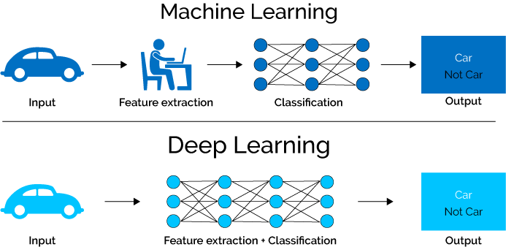
Machine Learning Vs Deep Learning

Slide 5
Machine Learning Vs Deep Learning
Machine Learning | Deep Learning
Works on small amount of Dataset for accuracy. | Works on Large amount of Dataset.
Dependent on Low-end Machine. | Heavily dependent on High-end Machine.
Divides the tasks into sub-tasks, solves them individually and finally combine the results. | Solves problem end to end.
Takes less time to train. | Takes longer time to train.
Testing time may increase. | Less time to test the data

Slide 6
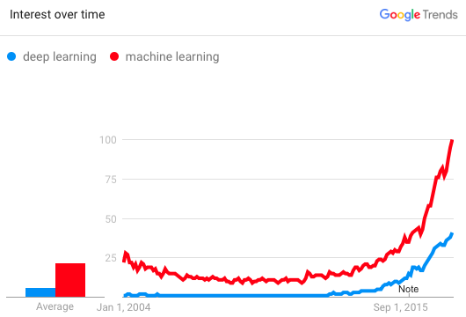
Why is DL useful?
Manually designed features are often over-specified, incomplete and take a long time to design and validate.
Learned Features are easy to adapt, fast to learn.
Deep learning provides a very flexible, (almost?) universal, learnable framework for representing world, visual and linguistic information.
Can learn both unsupervised and supervised.
Effective end-to-end joint system learning.
Utilize large amounts of training data.
In ~2010 DL started outperforming other ML techniques first in speech and vision, then NLP

Slide 7
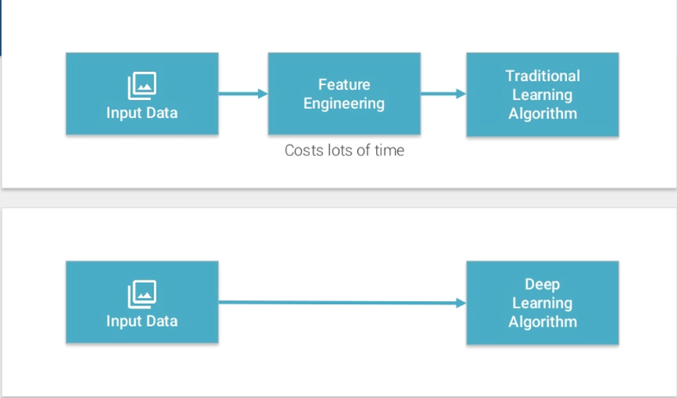
Deep Learning Basics

Slide 8
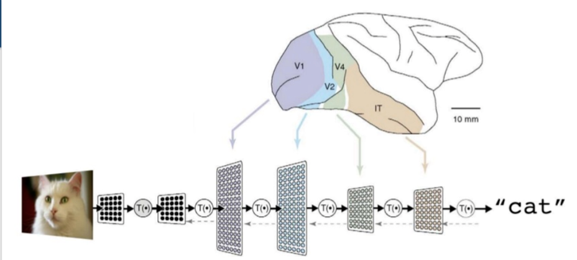
Deep Learning Basics (cont..)
A Deep neural network consists of a hierarchy of layers, where by each layer transforms the input data into more abstract representations (e.g. edge-> nose->face). The output layer combines those features to make predictions.

Slide 9
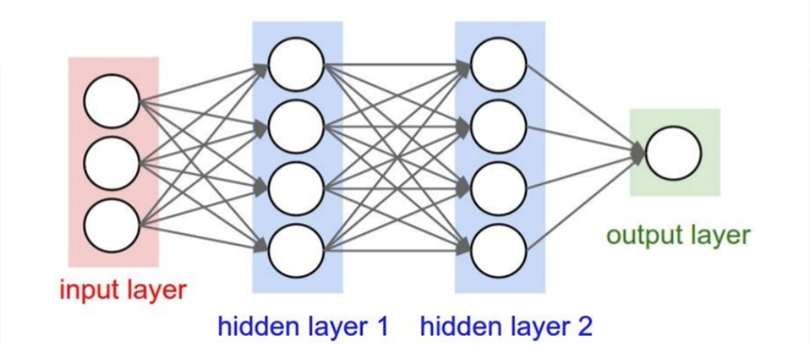
Deep Learning Basics (cont..) ANN
Consists of one input, one output and multiple fully-connected hidden layers in-between. Each layer is represented as a series of neurons and progressively extracts higher and higher-level features of the input until the final layer essentially makes a decision about what the input shows. The more layers the network has, the higher level features it will learn.

Slide 10
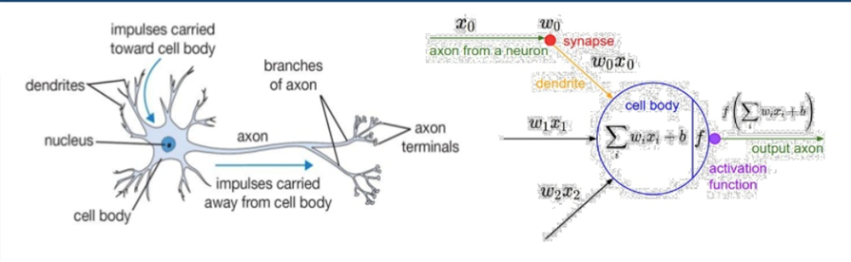
Artificial Neural Network
An Artificial Neuron contains a nonlinear activation function and has several incoming and outgoing weighted connections.
Neurons are trained to filter and detect specific features or patterns (e.g. edge, nose) by receiving weighted input, transforming it with the activation function and passing it to the outgoing connections.

Slide 11
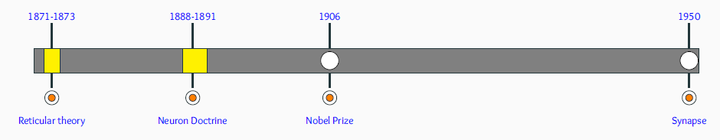
Deep Learning History
Reticular Theory: Joseph von Gerlach proposed that the nervous system is a single continuous network as opposed to a network of many discrete cells!
Staining Technique: Camillo Golgi discovered a chemical reaction that allowed him to examine nervous tissue in much greater detail than ever before He was a proponent of Reticular theory.
Neuron Doctrine: Santiago Ramón y Cajal used Golgi’s technique to study the nervous system and proposed that it is actually made up of discrete individual cells forming a network (as opposed to a single continuous network).

Slide 12
Deep Learning History (cont..)
The Term Neuron: The term neuron was coined by Heinrich Wilhelm Gottfried von Waldeyer-Hartz around 1891. He further consolidated the Neuron Doctrine.
Nobel Prize: Both Golgi (reticular theory) and Cajal (neuron doctrine) were jointly awarded the 1906 Nobel Prize for Physiology or Medicine, that resulted in lasting conflicting ideas and controversies between the two scientists.
The Final Word: In 1950s electron microscopy finally confirmed the neuron doctrine by unambiguously demonstrating that nerve cells were individual cells interconnected through synapses (a network of many individual neurons).

Slide 13
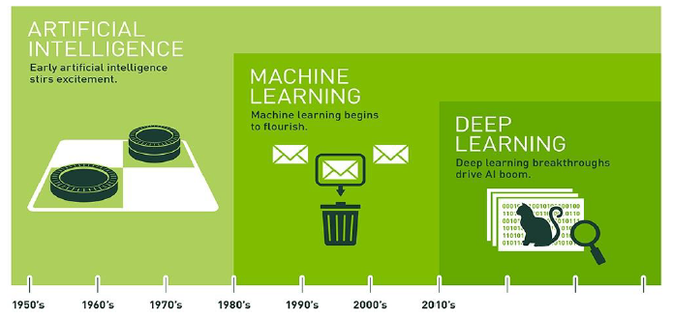
Evolution of Deep Learning

Slide 14
Deep Learning Evolution
1943: An artificial neuron was proposed as a computational model of the “nerve net” in the brain by Warren McCulloch, Walter Pitts
Late 1950s: A neural network application by reducing noise in phone lines was developed by Bernard Widrow, Ted Hoff
Late 1950s: The Perceptron was introduced. It mimicked the neural structure of the brain and showed an ability to learn by Frank Rosenblatt
1969: Proved mathematically that the Perceptron could only perform very basic tasks. It was published in their book, “Perceptrons”. They also discussed the challenges in relation to training multi-layer neural networks. by Marvin Minsky, Seymour Papert
1986: Solved the training challenges of multi-layer neural network using back propagation training algorithm by David E. Rumelhart, Geoffrey E. Hinton, and Ronald J. Williams.

Slide 15
Deep Learning Evolution (Cont..)
1998: Made the Use of neural networks on image recognition tasks. Defined the concept of convolutional neural networks (CNN), in his paper, which mimic the human visual cortex by Yann LeCun.
1998: Popularized the “Hopfield” network which was the first recurrent neural network (RNN) by John Hopfield
1997 – 1998: Introduced long short-term memory (LSTM), greatly improving the efficiency and the practicality of recurrent neural networks (RNN) by Jurgen Schmidhuber and Sepp Hochreiter
2012: Highlighted the power of deep learning by showing significant results in the well-known ImageNet competition by Geoffrey Hinton and two of his students
2012 – 2103: Breakthrough work on large scale image recognition at Google Brain by Jeffrey Dean, Andrew Ng
Refer: https://github.com/ChristosChristofidis/awesome-deep-learning

Slide 16
Deep Learning Evolution (Cont..)
2014: Published his paper on generative adversarial networks (GAN)by Ian Goodfellow
2014: Reinforcement learning: An Introduction by Richard S. Sutton, Andrew G. Barto.
2017: Transformers: Vaswani et al. proposed the Transformer architecture — the basis for large language models (like GPT).
Modern Era (2020s–Present): Explosion of massive models (GPT-3, GPT-4, PaLM, etc.) using transformers. Breakthroughs in multimodal models (text, image, audio, video).

Slide 17
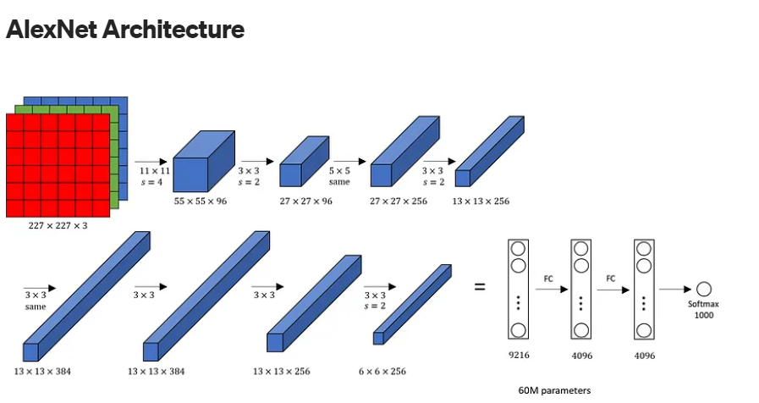
Key Success Stories in Deep Learning Image Recognition: AlexNet 2012:
Developed by Alex Krizhevsky, Ilya Sutskever, and Geoffrey Hinton.
Achievement:
AlexNet won the ImageNet Large Scale Visual Recognition Challenge (ILSVRC) by a significant margin, achieving a top-5 error rate of 15.3%, compared to the second-best entry at 26.2%.
Impact:
The success of AlexNet demonstrated the potential of deep convolutional neural networks (CNNs) for image recognition tasks and sparked renewed interest in deep learning.

Slide 18
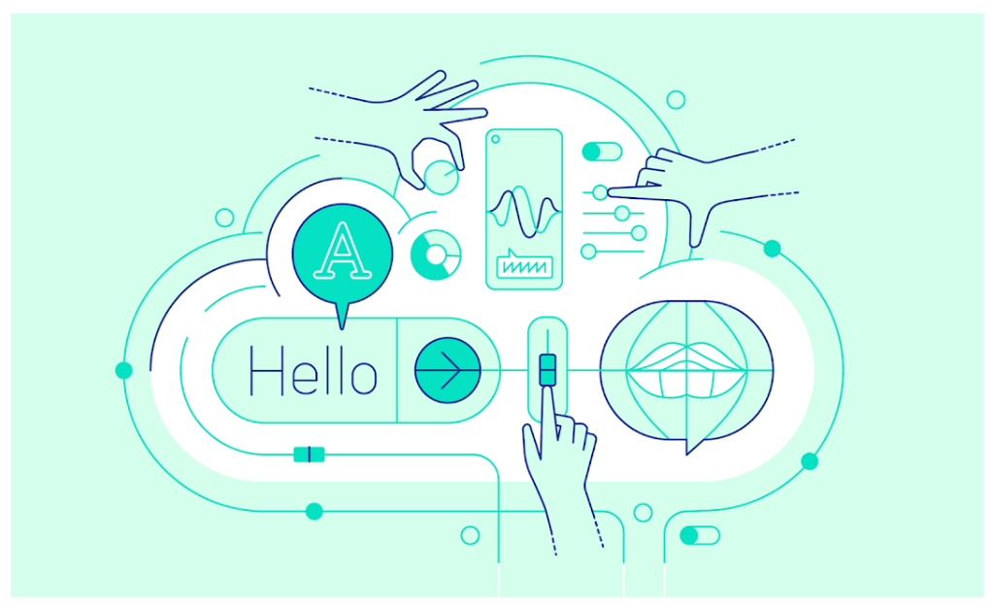
Speech Recognition: Google DeepMind’s WaveNet 2016:
Developed by Google DeepMind.
Achievement:
WaveNet produced more natural-sounding speech synthesis compared to previous methods, using a deep generative model.
Impact:
WaveNet advanced the field of speech synthesis and voice assistants, leading to more realistic and human-like speech outputs in various applications.

Slide 19
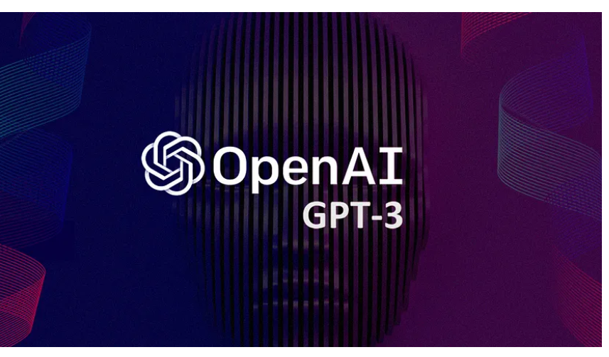
Natural Language Processing: OpenAI’s GPT-3 2020:
Developed by OpenAI.
Achievement:
GPT-3 generated human-like text and performed a wide range of language tasks without task-specific training, using a transformer model with 175 billion parameters.
Impact:
GPT-3 showcased the potential of large-scale transformer models in natural language processing (NLP) applications, including text generation, translation, and summarization.

Slide 20
Game Playing: AlphaGo 2016:
Developed by DeepMind.
Achievement:
AlphaGo defeated world champion Go player Lee Sedol in a five-game match, winning four games to one.
Impact:
The victory of AlphaGo highlighted the capabilities of deep reinforcement learning in mastering complex strategic games, previously considered a significant challenge for AI.

Slide 21
Autonomous Driving: Waymo Ongoing:
Developed by Waymo, a subsidiary of Alphabet Inc.
Achievement:
Waymo has been pioneering self-driving car technology with extensive real-world testing and has logged millions of miles on public roads.
Impact:
Waymo's advancements are paving the way for the future of autonomous transportation, promising safer and more efficient driving experiences.

Slide 22
Medical Imaging: DeepMind’s AlphaFold 2020:
Developed by DeepMind.
Achievement:
AlphaFold solved the protein folding problem, achieving unprecedented accuracy in predicting protein structures, as recognized by the CASP14 competition.
Impact:
AlphaFold's breakthrough revolutionized the field of structural biology and opened new avenues for drug discovery, with potential applications in understanding diseases and developing new treatments.

Slide 23
Self-Assessment Questions
What is deep learning?
(a) A type of machine learning algorithm
(b) A branch of artificial intelligence
(c) A technique for training neural networks
(d) All of the above
What is the purpose of an activation function in a neural network?
(a) It introduces non-linearity to the network
(b) It determines the output of a neuron
(c) It helps in backpropagation
(d) All of the above

Slide 24
TERMINAL QUESTIONS
Define Deep Learning
Explain the need of Deep Learning.
Outline the history of deep learning
List out the differences between DL and ML
Illustrate Real time deep learning applications
Summarize the Evolution of Deep Learning

Slide 25
REFERENCES FOR FURTHER LEARNING OF THE SESSION
Books:
"Deep Learning" by Ian Goodfellow, Yoshua Bengio, and Aaron Courville
"Natural Language Processing with PyTorch: Build Intelligent Language Applications Using Deep Learning" by Delip Rao and Brian McMahan
"Transformers for Natural Language Processing: Build and Train State-of-the-Art Natural Language Processing Models Using Transformer's Architecture" by Denis Rothman
Web references:
https://jalammar.github.io/illustrated-transformer/
https://arxiv.org/abs/1706.03762

Slide 26
THANK YOU
Team – Deep Learning

