Slide 1

Group - 7
Programming for Data Science

Slide 2
DIABETIC PATIENT READMISSION

Slide 3
Presented by GROUP 7 Abhinav Saluja Bhavika Faldu Chinmay Parkar Manish Shukla

Slide 4
Objective
To predict the hospital re-admission probability of a DIABETIC patient by using appropriate Data Science techniques.
GROUP - 7

Slide 5
WHY THIS DATA?
People Affected by Diabetes :
WORLD: 425m, USA: 26m (8.3% of the population)
Expenditure on Diabetes:
WORLD: $727 billion, USA: $327 billion
People will be affected by Diabetes : 629 million
Penalties paid by US Hospitals due to readmission of patients: $528 million
Readmission Rates of diabetes patients are readmitted with 30-days of discharge : 20.3%
GROUP - 7

Slide 6
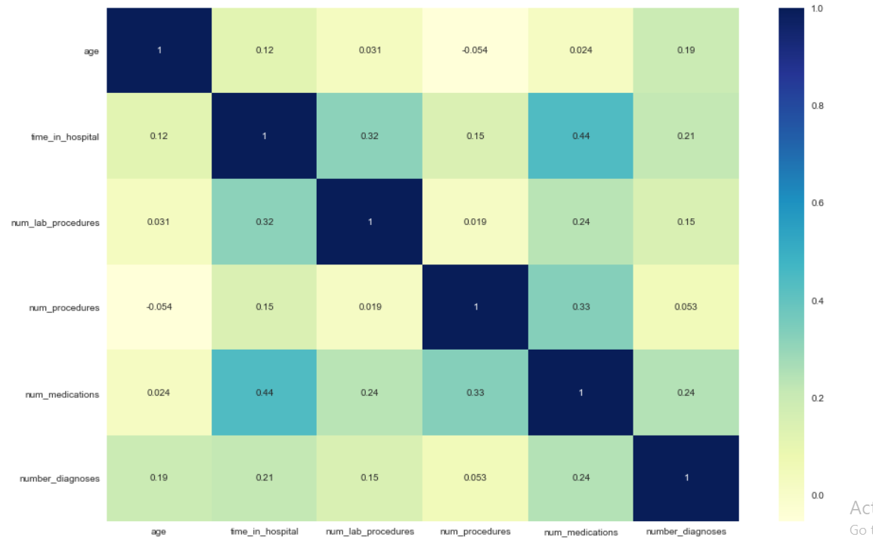
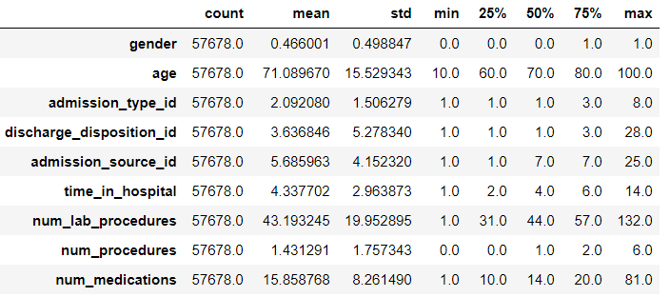
KNOW THE DATA
HEAT- MAP
DIABETIC PATIENT ENCOUNTER
130 HOSPITALS ACROSS USA
RECORDED BETWEEN 1999-2008
50 FEATURES, INCLUDING 23 MEDICINES
GENDER : 53% FEMALE AND 46% MALE
AGE : MOST FREQUENT (70-80) YEARS
NO STRONG CORRELATION
AGE HAS NO CORRELATION SIGNIFICANCE
WITH TIME IN HOSPITAL & LAB PROCEDURES
6

Slide 7
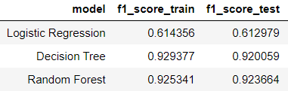
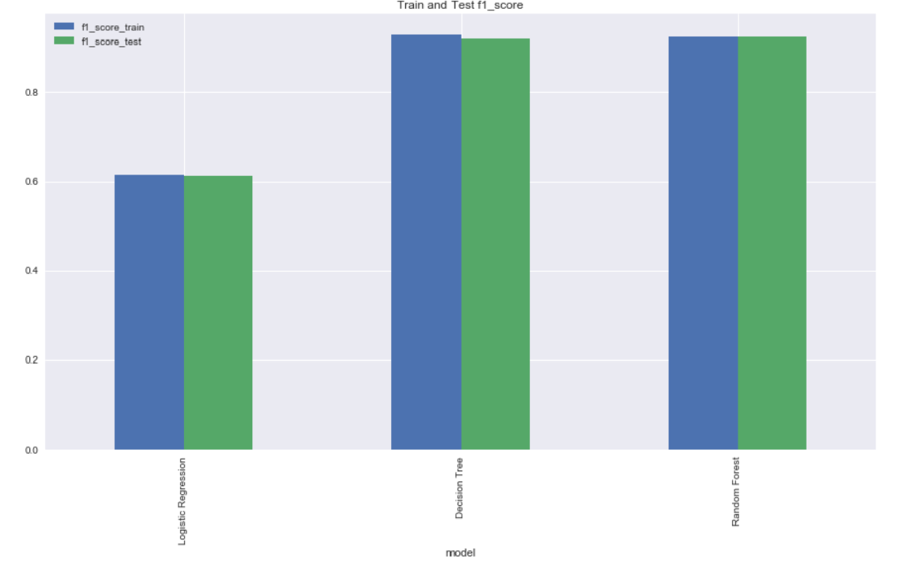
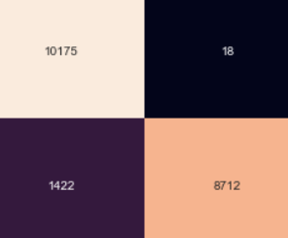
PROJECT OUTLINE
FEATURE CREATION
Number of medication change
Number of medicine prescribed
Service utilization
STEPS WE TOOK TO SOLVE THE PROBLEM AND MAKE AN AWESOME MODEL
FEATURE ENGG.
Feature Encoding
Collapsing Multiple Encounters
Standardization & Log Transform
Oversampling by SMOTE
MODELLING
Logistic Regression
Decision Tree
Random Forest
6

Slide 8
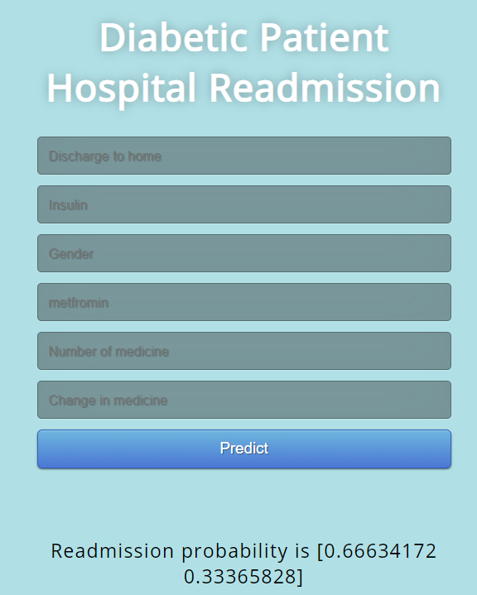
PRODUCT INTERFACE
GROUP - 7
LINEAR DIGRESSORS

Slide 9
PRODUCT DEMO
PREDICTING
DIABETIC PATIENT READMISSION
GROUP - 7
LINEAR DIGRESSORS

Slide 10

INSIGHTS FOR READMISSION
01
15 YEARS AGE
23% ODDS OF RE-ADM.
MALE HAS MORE ODDS COMPARED TO FEMALE
05 02
PROMINENT FACTOR
DISCHARGE TO HOME
CAUCASIAN ARE HIGHLY-LIKELY
04
03
USE OF INSULIN & METAFROMIN
INCREASES CHANCE

Slide 11
IMPROVEMENTS
01
USING MORE FEATURES IN MODEL
EMPLOYING OTHER MACHINE LEARNING METHODS
05 02
ADDING MORE STAT IMP FIELDS
ON INTERFACE
UTILIZING UNDER-SAMPLING TECHNIQUE
04
03
ATTAINING CURRENT DATA
11

Slide 12
QUESTIONS ?
GROUP-7

Slide 13
THANK YOU
GROUP-7

